Slide 1
GISC Casablanca status
Hassan Haddouch
Task Team GISC
TT-GISC2017
13-17 November 2017, Geneva

Slide 2
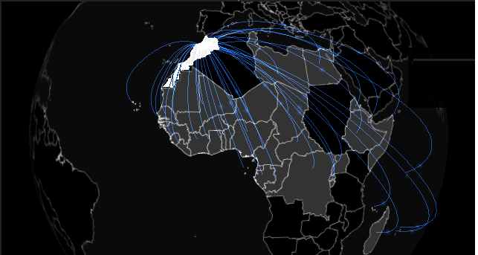
Area of responsability
Guinea
Guinea Bissau
Liberia
Libya
Madagascar
Mali
Mauritania
Mauritius
Niger
Nigeria
Rwanda
Sao Tome and Principe
Senegal
Seychelles
Sierra Leone
Somalia
Togo
Uganda
Benin
Burkina Faso
Burundi
Cabo Verde
Cameroon
Central African Republic
Chad
Comoros
Congo
Côte d'Ivoire
Democratic Republic of the Congo
Djibouti
Egypt
Equatorial Guinea
Eritrea
Ethiopia
Gabon
Gambia
Ghana
TT-GISC2017 pp2

Slide 3
Area of responsability connectivity
TT-GISC2017 pp3

Slide 4
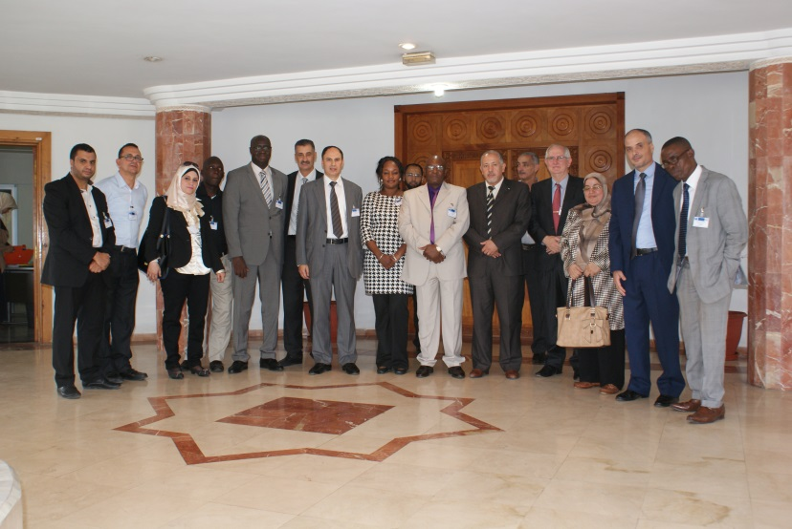
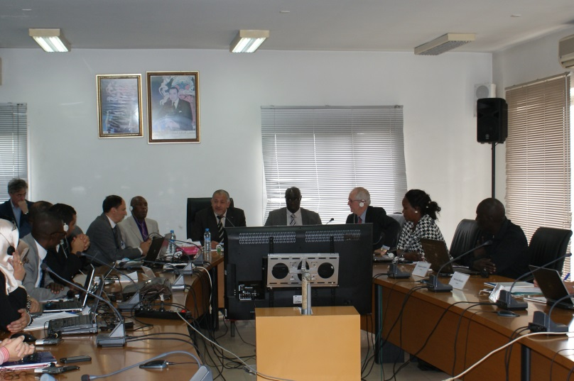
Capacity building
WIS/WIGOS Workshop held in Casablanca in November 2013
Regional GISC training workshop was held in Casablanca from 26 to 30 October 2015,
TT-GISC2017 pp4

Slide 5
GISC Backup
GISC Toulouse
  In progress: planed for December 2017
  GISC 2 GISC : RMDCN and internet backup
TT-GISC2017 pp5

Slide 6
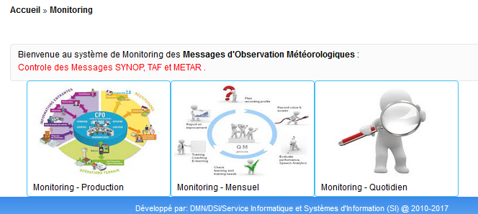
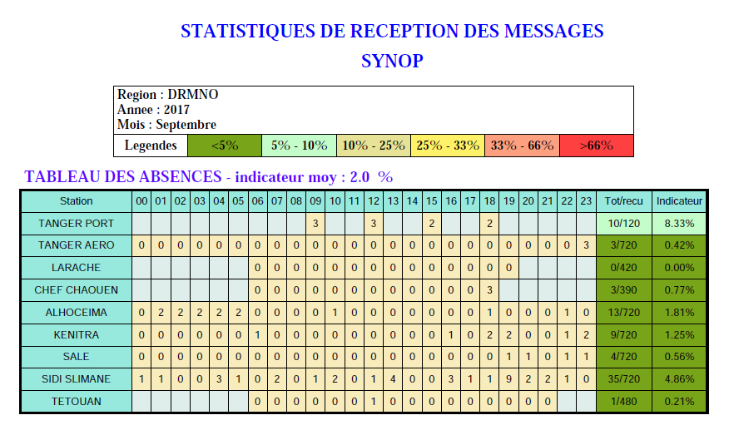
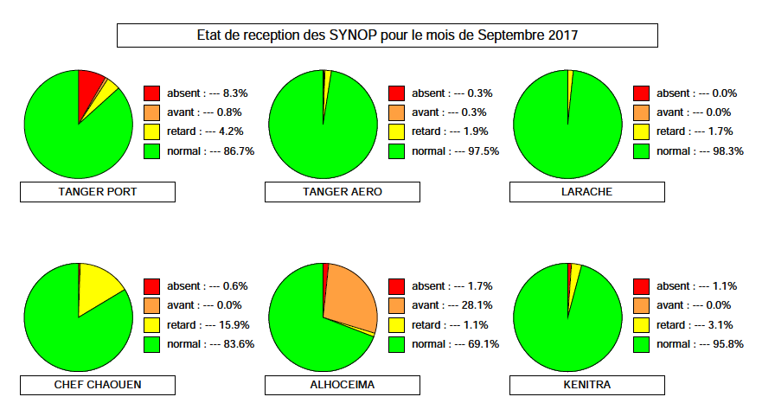
Monitoring Activity & volume
Daily and monthly monitoring system for production and data reception at national level to be extended to AoR
TT-GISC2017 pp6

Slide 7
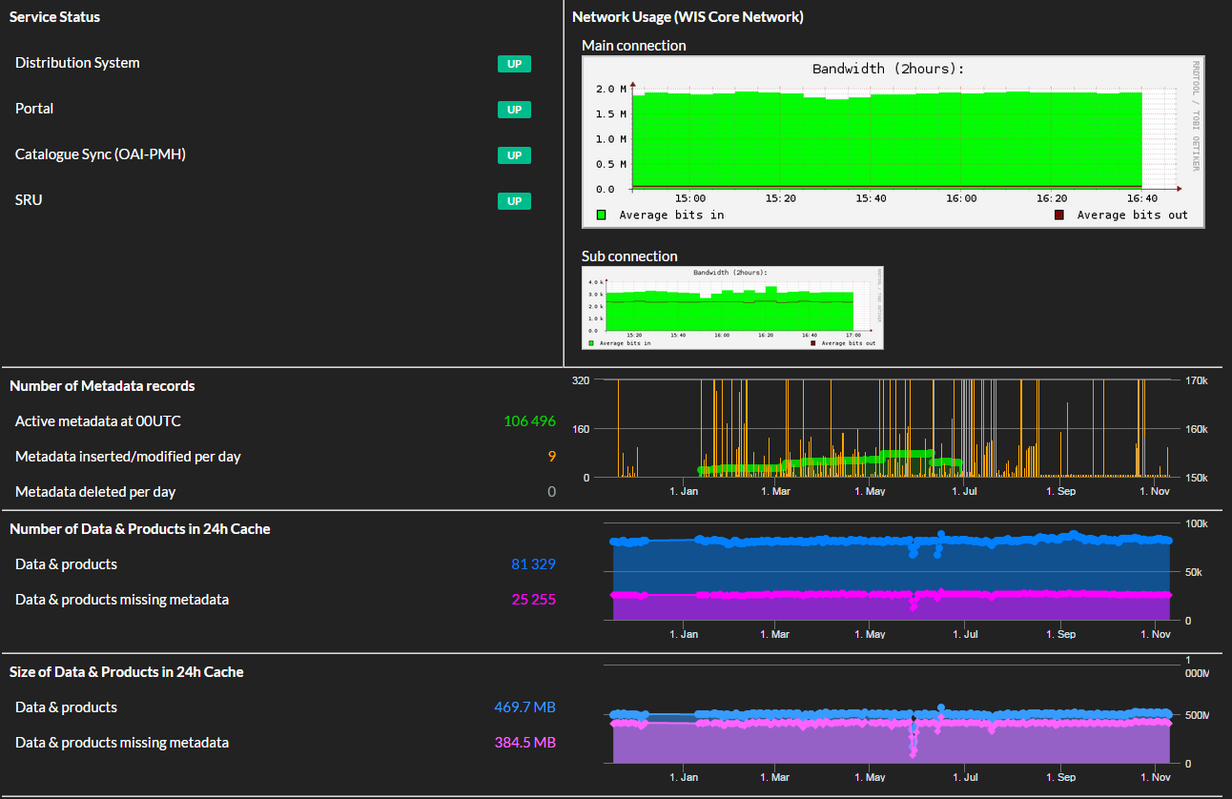
Monitoring Activity & volume
58 users registered in GISC Casablanca
Daily Size of the cache = 245 Mbs
TT-GISC2017 pp7

Slide 8
Changes in GISC
TT-GISC2017 pp8
New DCPCs:
  DCPC Prévision Numérique : OpenWIS solution was established for DCPC NWP Casablanca and metadata generation is in progress
  DCPC Marine meteorological services for West African Countries is also planned for 2018
A letter to be sent to PRs of AoR is under signature to promote the use of the Excel2wis metadata tool to generate NC and DCPC metadata.

Slide 9

Thank you
Merci

