Slide 1
GISC Brasília
José Mauro
Agenda item 4.1.3
Task Team GISC
TT-GISC2017
13-17 November 2017, Geneva

Slide 2
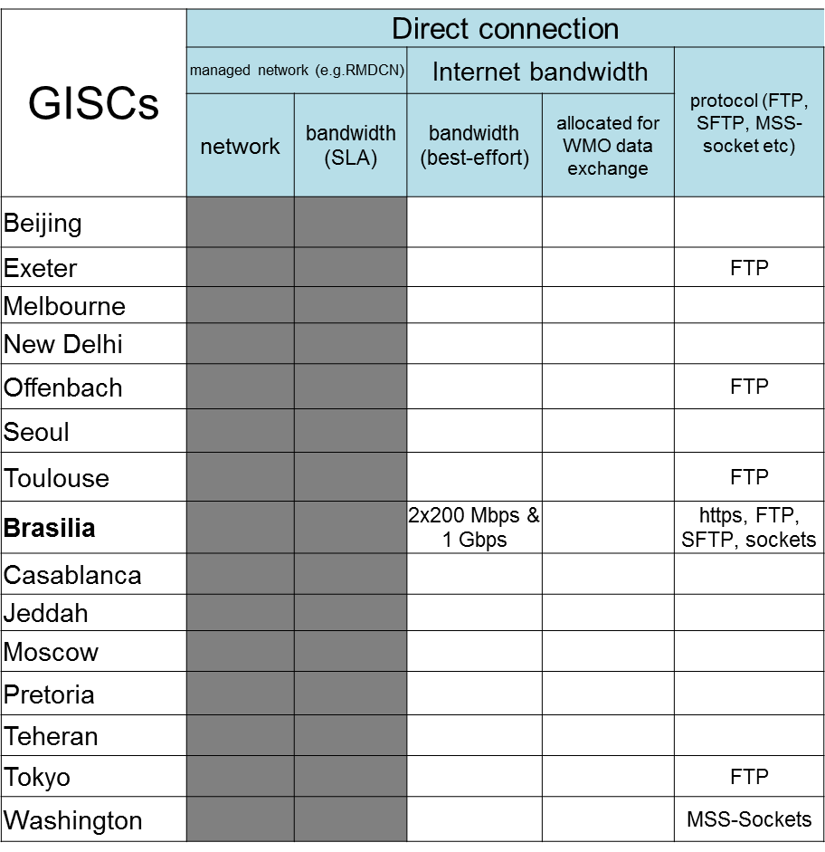
GISC-GISC Connectivity

Slide 3
Internet capability in Region III
 | 2017
 | Commercial | Internet 2
 | Mbps | Mbps
Argentina | 250 + 250 | 500
Bolivia | 4 +4 + 15
Brazil | 200 + 200 | 1000
Chile | 100
Colombia | 128 + 64
Ecuador | 30
French Guiana | -
Guyana | 5 + 5 + 5
Paraguay | 80 + 40
Peru | 70
Suriname | 8
Uruguay | 3
Venezuela | 4 + 2

Slide 4
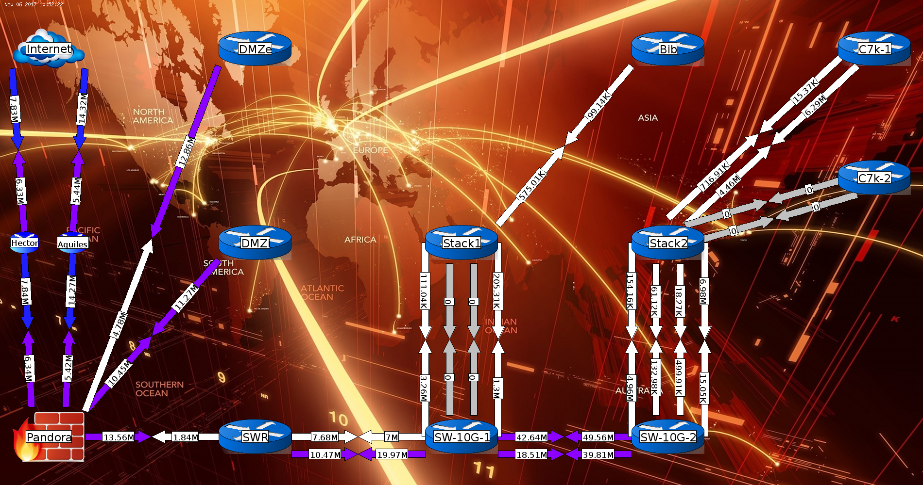
Daily traffic
GISC Brasilia

Slide 5
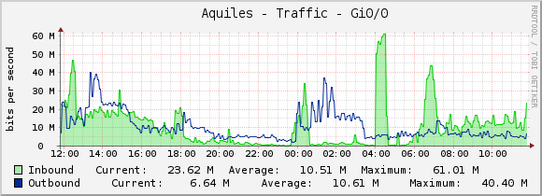
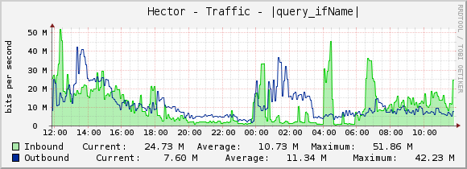
Daily traffic

Slide 6
Area of Responsability: WMO RA-III (South America)
Connections:
  Washington, Buenos Aires, Offenbach, Exeter, Tokyo, Toulouse
  Other centers inside Brasil and Region III
Daily traffic (October 2015):
  Input 376,636 bulletins - 5.3 GBytes per day
  Output 2,096,221 bulletins - 27.5 GBytes per day
Daily traffic (March 2016):
  Input 601,789 bulletins - 8.8 GBytes per day
  Output 2,756,201 bulletins - 35.6 GBytes per day
Daily traffic (November 2017):
  Input 829,291 bulletins - 11.2 GBytes per day
  Output 2,951,913 bulletins - 38.9 GBytes per day

Slide 7
Progress
Back up: GISC Washington and Pretoria is under investigation (What should we back up?)
Local network infrastructure renewed.
A New monitoring system is under consideration.
A SIEM system installed. (AlienVault)
GISC Brasilia started IPv6 testes

Slide 8
Progress
Hardware updated
Software update
Operational System replacement
Increase server virtualization
New authentication system under implementation

Slide 9
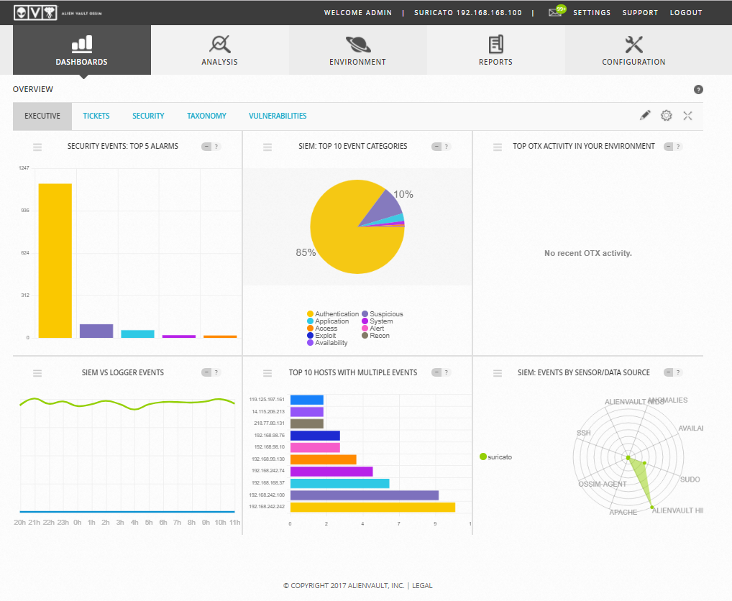

Slide 10
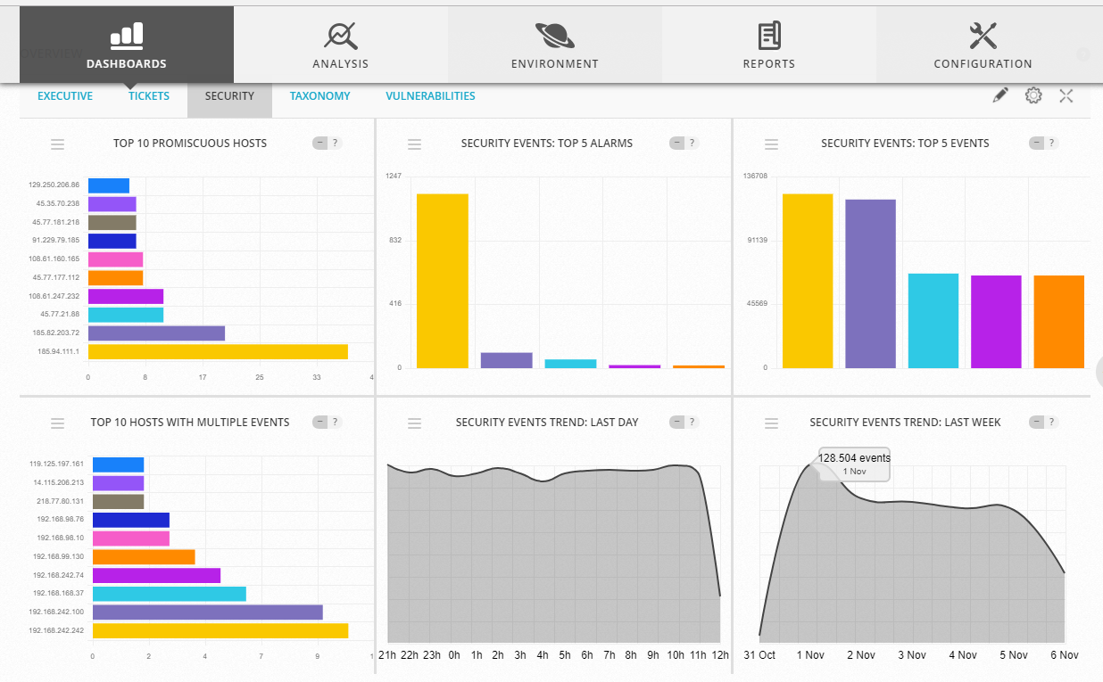

Slide 11
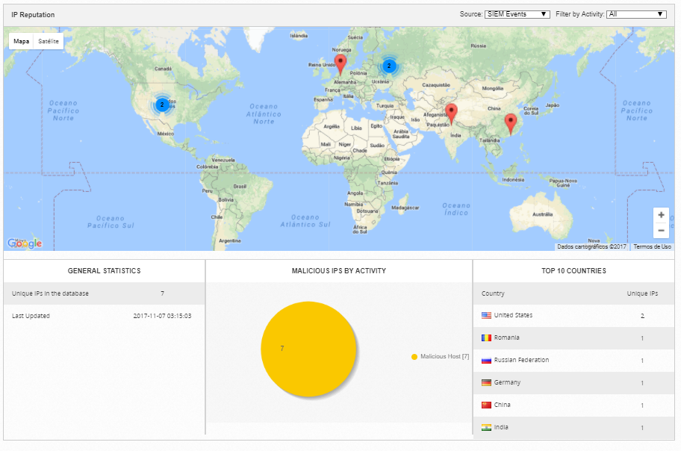

Slide 12
Training
Santiago - Chile
Assuncion - Paraguay
Bogotá - Colombia
Montevideo - Uruguay
Quito - Ecuador
Lima - Peru

Slide 13
Issues
Lack of staff
Budget reduction over the past years.
BUFR migration
The use of WIGOS Identifier for existing stations

Slide 14
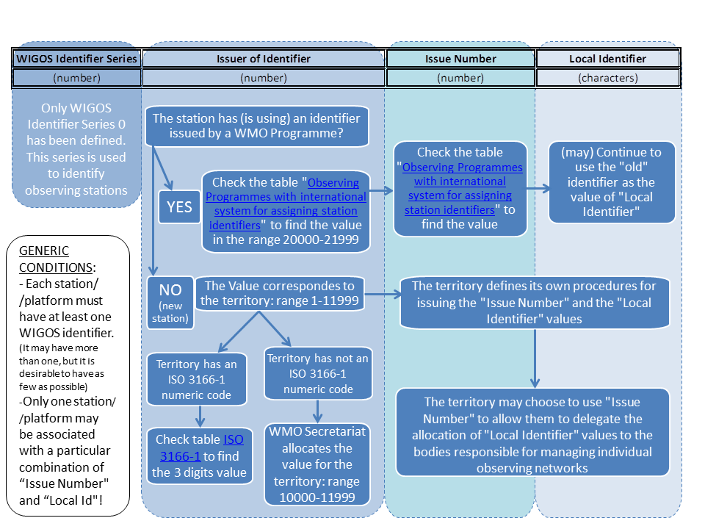
WIGOS IDENTIFIER

Slide 15

Thank you
Merci
Obrigado

