Slide 1
Status of GISC Tokyo
Shigeharu NISHIKAWA
Agenda item 4.1.14
Task Team GISC
TT-GISC2017
13-17 November 2017, Geneva

Slide 2
Contents
Area of Responsibility
  AMDCN connectivity
Training – Capacity building activity
Operational issues in last period
GISC Back up and activities
Monitoring Activity & volume
  Traffic size and volumes, uptime etc, user registration
Changes in GISC, including new features since last meeting
Progress on action items
Outlook (planned changes/improvements)
Summary (Text for report)

Slide 3
Area of Responsibility
AMDCN connectivity
64K
Khabarovsk
GISC Tokyo (RTH Tokyo)
2M
Doha
100M
10M x 2
2M
RMDCN MPLS
Network
(Interoute)
MPLS
Network
(NTT-COM)
Internet
DAR Users
50M
Manila
Washington
4M
New Delhi
64K
NMHS users of MTSAT Imagery and High-resolution GSM
Melbourne
2M
20M
EUMETSAT
Hong Kong*
1M
Beijing
16M
20M
Exeter
128K
Bangkok
Brasilia
Toulouse
Offenbach
Vientiane
50M
50M
Seoul
Phonom Penh
4M
Nay Pyi Taw
Hanoi

Slide 4
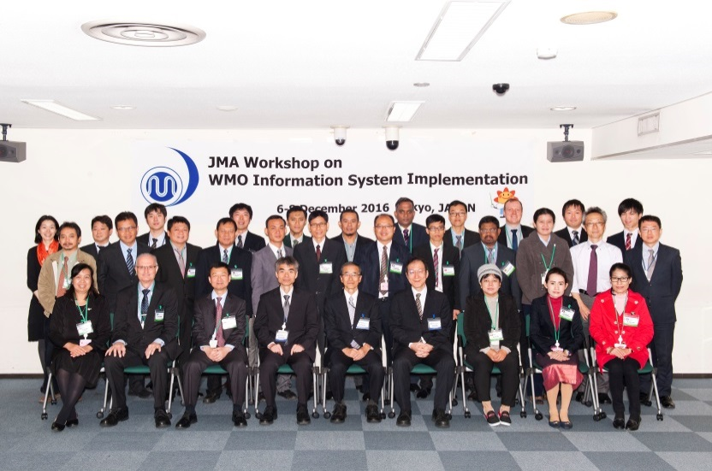
Training – Capacity building activity
“WIS Workshop in Tokyo”
  1st : March 2010
  2nd : October 2012
  3rd : November 2014
  4th : December 2016
    Eighteen participants mainly from AoR of GISC Tokyo and two lecturer from GISC Melbourne.
    AMDCN Connectivity, SE-Asia Radar data activity, WIS monitoring and so.

Slide 5
Training – Capacity building activity
Onsite technical meeting at centres in AoR of GISC Tokyo
  Cambodia: 2012, 2015
  Lao PDR: 2012, 2015, 2018*
  Myanmar: 2014 , 2017/3
  Philippines: 2012, 2014
  Thailand: 2012, 2013, 2015, 2017/11
  Viet Nam: 2012, 2014, 2018*
These activities was very popular with participants and colleague at each centers.

Slide 6
Operational issues in last period
Arrangement for re-establishing circuit with Washington
  Operation start date will be 2018/3

Slide 7
GISC Back up and activities
Backup Partner
  GISC Beijing
  GISC Melbourne
  GISC Offenbach

Slide 8
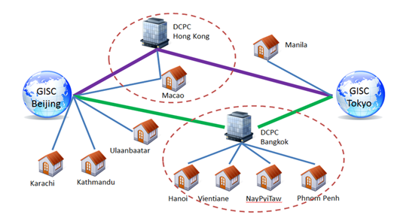
GISC Back up and activities
GISC Beijing
  GISC Backup between Beijing and Tokyo is in operational by using GTS and Internet DAR service.

Slide 9
GISC Back up and activities
GISC Melbourne
  Signed letters on GISC backup agreement were officially exchanged in March 2012.
  Tokyo has two options for AoR of Melbourne;
  Option 1: Existing GTS based backup
  Option 2: Internet based backup
  Both options are already running in backup with Beijing and Offenbach.

Slide 10
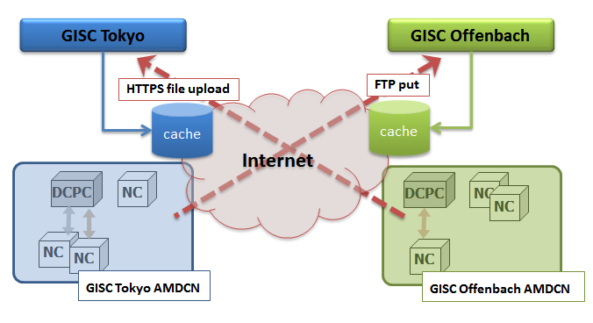
GISC Back up and activities
GISC Offenbach
  GISC Backup between Offenbach and Tokyo is in operational by using Internet.
    To Offenbach: using FTP put
    To Tokyo : using HTTPS file upload

Slide 11
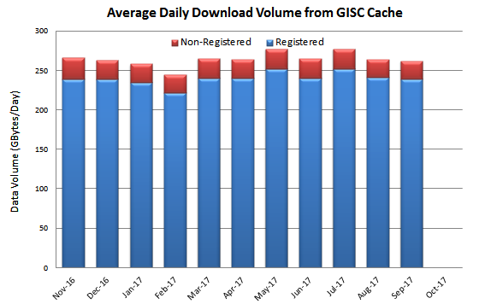
Monitoring Activity & volume
Traffic size and volumes (GISC Cache)
  Monthly Traffic 7,855GB (Sep. 2017)
  Daily Traffic 261GB (Sep. 2017)

Slide 12
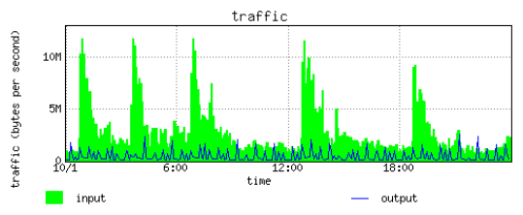
Monitoring Activity & volume
Traffic pattern (GISC Cache)
HR-GSM

Slide 13
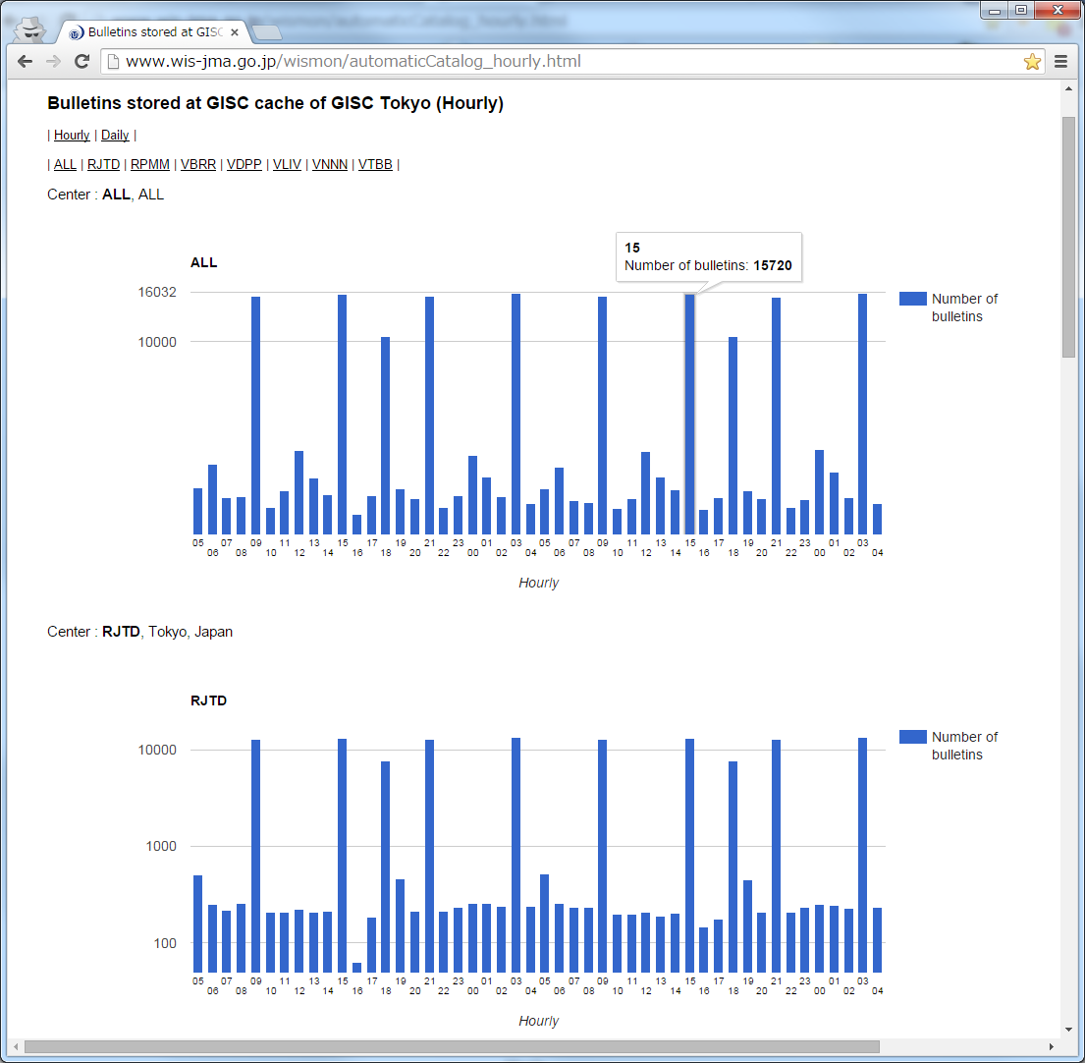
Monitoring Activity & volume
Bulletins stored at GISC Tokyo’s cache
(Hourly & Daily)

Slide 14
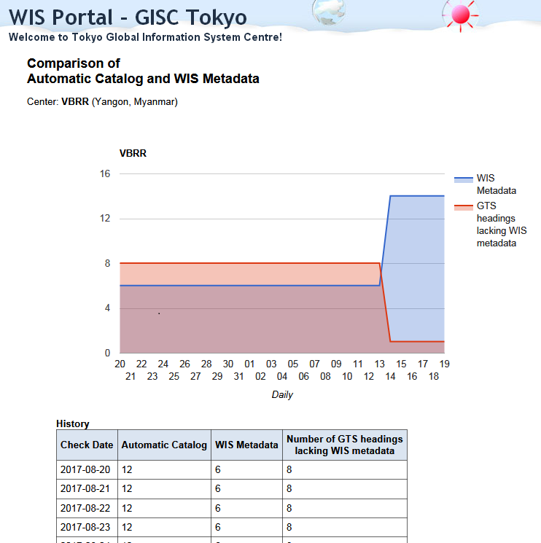
Monitoring Activity & volume
Comparison of
received GTS bulletins and metadata

Slide 15
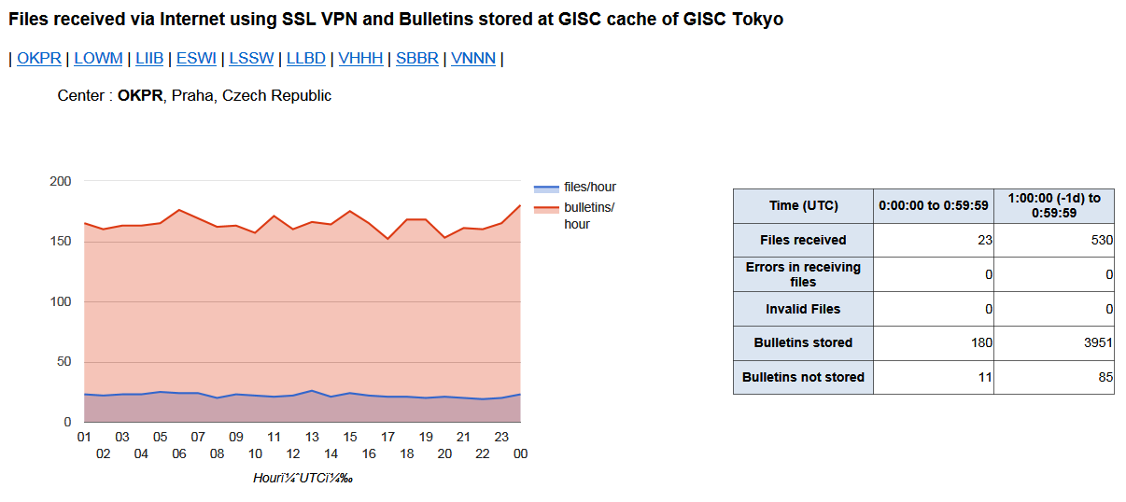
Monitoring Activity & volume
Files received via Internet using SSL VPN and Bulletins stored at GISC cache of GISC Tokyo
  Monitor for GISC Backup

Slide 16
Monitoring Activity & volume
Uptime etc

Slide 17
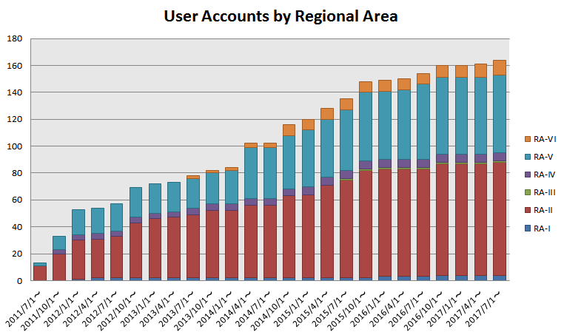
Monitoring Activity & volume
User registration
  Nearly 160 accounts are provided.
    Except account for GISC cooperation and test account.

Slide 18
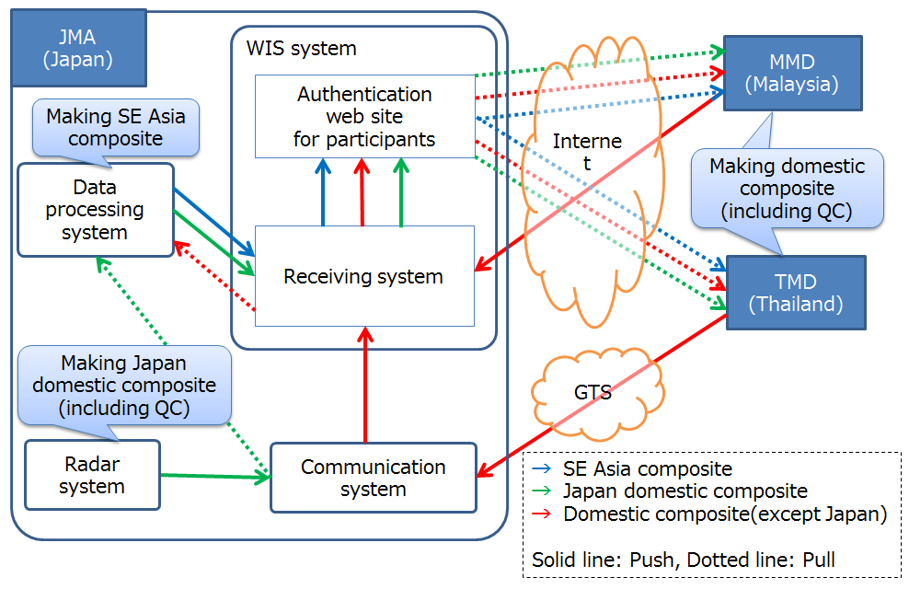
Changes in GISC, including new features since last meeting
SE-Asia radar data composite

Slide 19
Progress on action items
WMO WIS Monitoring
Common Dashboard (WCD)
http://www.wis-jma.go.jp/wcd/v1/top.html
  Develop
  Introduce / Explain on side event of CBS16
  Successfully completed.

Slide 20
Outlook
(planned changes/improvements)
Replacement of JMA’s WIS server
  Mainly using for WIS Part B.
  HTTP -> HTTPS
  Disaster Recovery Site (Osaka)
  Operation start will be 2018/3
For further information, JMA will notify with email to cbs-wisc-tt-gisc@wmo.int

Slide 21
Any other issues of interest

Slide 22
Summary (Text for report)
Mr. Shigeharu NISHIKAWA, JMA reported the current status of GISC Tokyo and the progress of the GISC Backup with GISC Offenbach, Beijing and Melbourne.
He explained that JMA held 4th “WIS Workshop in Tokyo” with inviting eighteen participants from mainly AoR of GISC Tokyo and two lecturer from GISC Melbourne. JMA visited Myanmar and Thailand for Onsite technical meeting at center. He mentioned that these activities was very popular with participants and colleague at each centers.
He also explained replacement of JMA’s WIS server mainly using for WIS Part B. JMA have a plan to change protocol for WIS server from HTTP to HTTPS. And also, DRS at Osaka will be planed. JMA will notify with email (to: cbs-wisc-tt-gisc@wmo.int) for further information.

Slide 23

Thank you
Merci

