Slide 1
Status Reprot GISC SEOUL
Sungsoo DO
TT-GISC2017 4-1-11
Task Team GISC
TT-GISC2017
13-17 November 2017, Geneva

Slide 2
Area of Responsibility
  AMDCN Connectivity
  - In the AoR of GISC Seoul, 4 DCPCs and 1 NC
※ (1) DCPC WAMIS: connecting to each AgroMeteorological Services on web portal
On going to implement WAMIS system by CAgM
(2) DCPC Tashkent: has been started to discuss connectivity and data exchange.
(3) NC Seoul: Using the same infrastructure of GISC Seoul
Name | Bandwidth | Type | Protocol
DCPC NMSC | 10Gbps | dedicated | FTP
DCPC LC/LRF MME | 10Gbps | dedicated | FTP
DCPC WAMIS | - | - | -
DCPC Tashkent | - | - | -
NC Seoul | - | - | -

Slide 3
Area of Responsibility
  DCs WIS Compliance (1)
Interface T. S. | NMSC | LC/LRF MME | WAMIS | NC Seoul
Uploading of metadata for data and products | √ | √ | √ | √
Uploading of data and products | √ | √ | - | √
Centralization of globally distributed data | N/A | NA/ | N/A | N/A
Maintenance of user identification and role information | √ | √ | √ | √
Consolidated view of distributed identification and role information | N/A | N/A | N/A | N/A
Authentication of a user | √ | √ | √ | √
Authorizatin of a user role | √ | √ | √ | √
DAR metadata(WIS Discovery Metadata) Catalogue search and retrieval | √ | √ | √ | √
Consolidated view of distributed DAR Metadata(WIS Discovery Metadata) Catalogue | N/A | N/A | N/A | N/A

Slide 4
Area of Responsibility
  DCs WIS Compliance (2)
Interface T. S. | NMSC | LC/LRF MME | WAMIS | NC Seoul
Downloading files via dedicated networks | √ | √ | - | √
Downloading files via non-dedicated networks | √ | √ | √ | √
Downloading files via other methods | - | - | - | -
Maintenance of dissemination metadata | √ | √ | √ | √
Consolidated view of distributed dissemination metadata catalogues | N/A | N/A | N/A | N/A
Reporting on quality of service | √ | √ | - | √

Slide 5
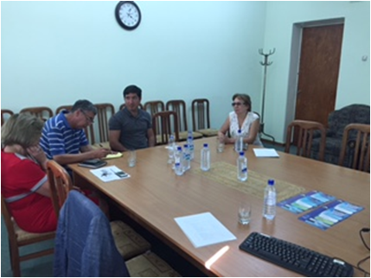
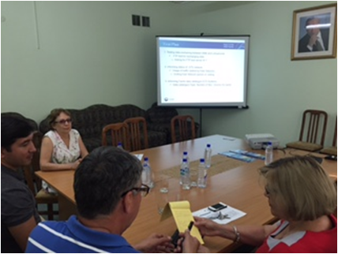
Training
  Capacity Building Activity (1)
  Practical Meeting & Workshop of WIS in Tashkent
  - Location & Date: Uzhydromet, 26 – 28 July
  - Participants: KMA(2), Uzhydromet(4)
  - Agenda: WIS implementation(focusing on how to implement DCPC),
  R&R of between GISC Seoul and DCPC Tashkent
  Implementing AMDCN connectivity

Slide 6
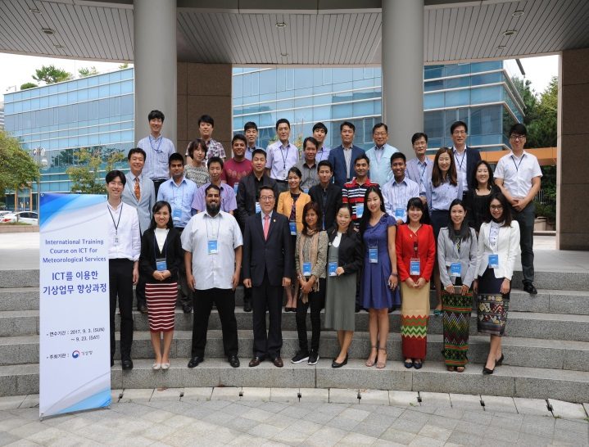
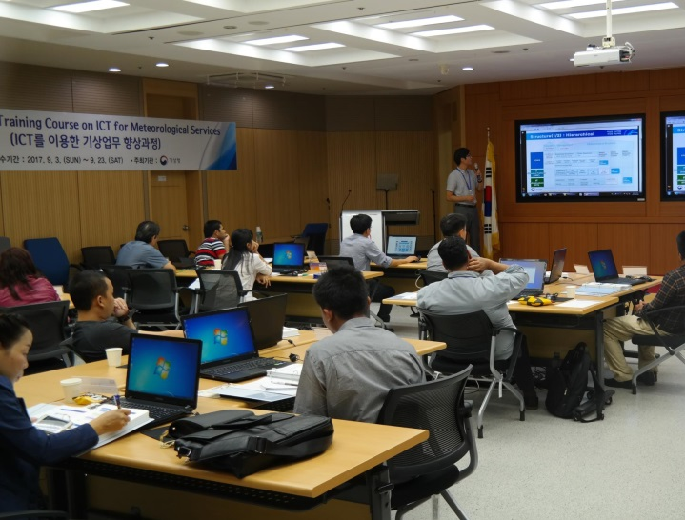
Training
  Capacity Building Activity (2)
  Training Courses on ICT for Meteorological Services
  - Location & Date: RTC-Korea, Seoul, 6 and 13 September(2days)
  - Trainees: WMO members, 7 countries(21)
  - WIS Concept and Structure, WIS funcioanality, WIS metadata,
  WIS Operation guidance, TDCF migration

Slide 7
GISC Backup and Activity
  GISC Seoul Backup and activity
  Not operational step on GISC backup activities
  - Letter of arrangement with GISC Melbourne
  - Negotiating with GISC New Dehli in bilateral meeting between KMA
  and IMD

Slide 8
Monitoring Activity & Volume
  Status of cache exchange
  1:1 Cache exchange (via RMDCN)
  - exchanging cache directly to 4 GISCs
  - Offenbach, Toulouse, Exeter, Moscow, (Tokyo; retreiving via internet
  portal)
  Cache in cloud exchange (via internet)
  - Joining ‘cache in cloud project’, exchanging cache with 12 GISCs
 | 1:1 Cache |  | Cache in cloud
 | num. of files | volume(MB) | num. of files | volume(MB)
Dissemination | 205 | 14 | 270 | 15
Retrieval | 139,142 | 1,000 | 381,734 | 5,000

Slide 9
  Changes in GISC
  KMA upgraded GISC Seoul software, the latest version OpenWIS 3.14.8 in november 2017
  GISC Seoul Operation
  User registration: 182 users for data service
  RMDCN connectivity: 4Mbps (plan to upgrade to 6Mbps in this year)
  Internet connectivity: 1Gbps (best effort)
  Operated in dualized systems and romote DR

Slide 10





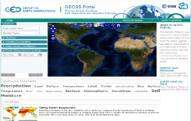

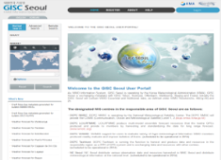

Any other Issues(1)
  WIS and GCI interoperability ativities
  GISC Seoul providing for WIS community with DAR service of GEOSS metadata, harvested from GEO-DAB based on ISO19139 via GISC Seoul OAI-PMH since 2013
  Telcon meeting with CNR & GEO (4th Sep, 2017)
  - for harvesing changed GEOSS metadata(34 sets, 930k records)
  - for GEO-DAB OAI server exclusively for GISC Seoul
  GEOSS SRU server pointer
  - http://gisc.kma.go.kr/openwis-user-portal/srv/en/main.home/portal.sru?
PANGAEA
NASA
Millions of Resources
SeaDataNet
…
WIS
…
GEO Portal
GEO DAB
GISC Seoul
GEOSS
Metadata Harvesting
(OAI-PMH )
GISC Seoul Portal
GEOSS
Metadata Service
WIS + GEOSS
Metadata

Slide 11
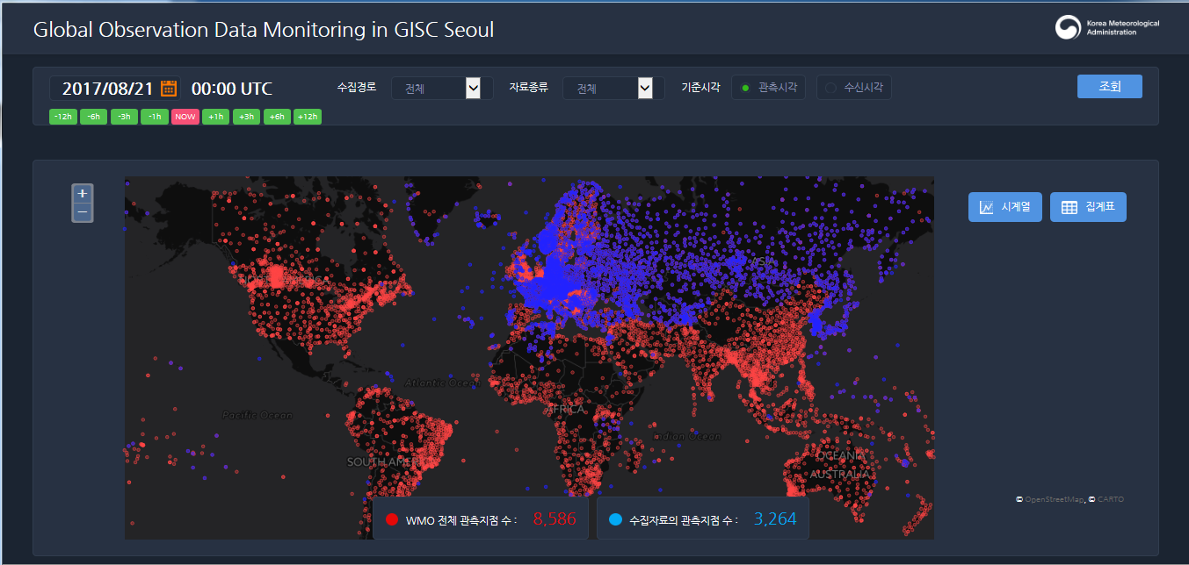
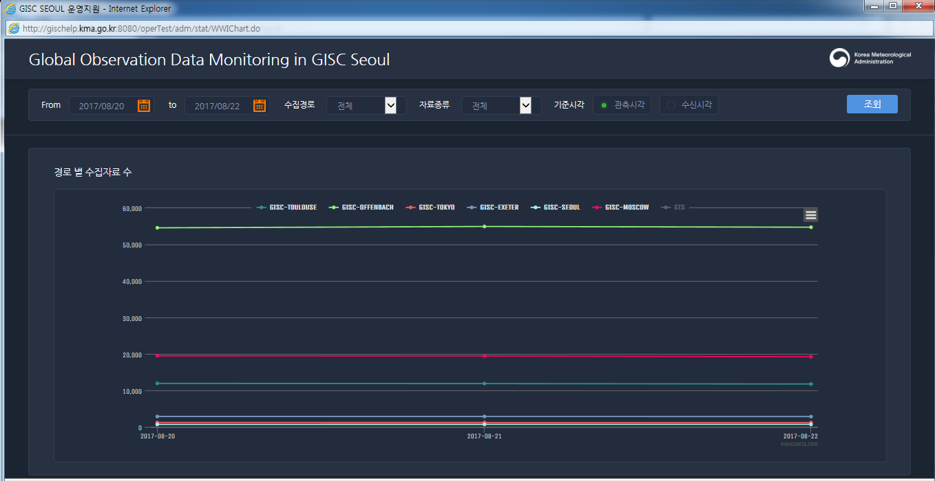
Any other Issues(2)
  Implementing ‘GISC Seoul Data Monitoring’
  Providing in real-time statistical information of ;
  - data retrieval and possible data service in GISC Seoul(synop, temp, buoy, ship)
  - analysis of cache not defined by WIS metadata

Slide 12
Summary
  GISC Seoul is directly exchanging cache with 4 GISCs and offering other GISCs for one to one cache exchange in compliace with ‘centralization of globally distributed data’ as prior phase of cache in cloud to be operational
  GISC Seoul is still progressing GISC backup procedure and discussing with GISCs not securing backup partner
  For the WIS capacity building for the members, GISC Seoul has established anual WIS training course jointed with ICT training course for WMO members in RTC-Korea
  In result from WIS and GCI interoperability activities, GISC Seoul is providing GEOSS SRU server for other GISCs to harvest WIS compliant discovery metadata from GEOSS

Slide 13

Thank you
Merci

