Slide 1
GISC Toulouse status
Benjamin Saclier
Agenda item number
Task Team GISC
TT-GISC2017
13-17 November 2017, Geneva

Slide 2
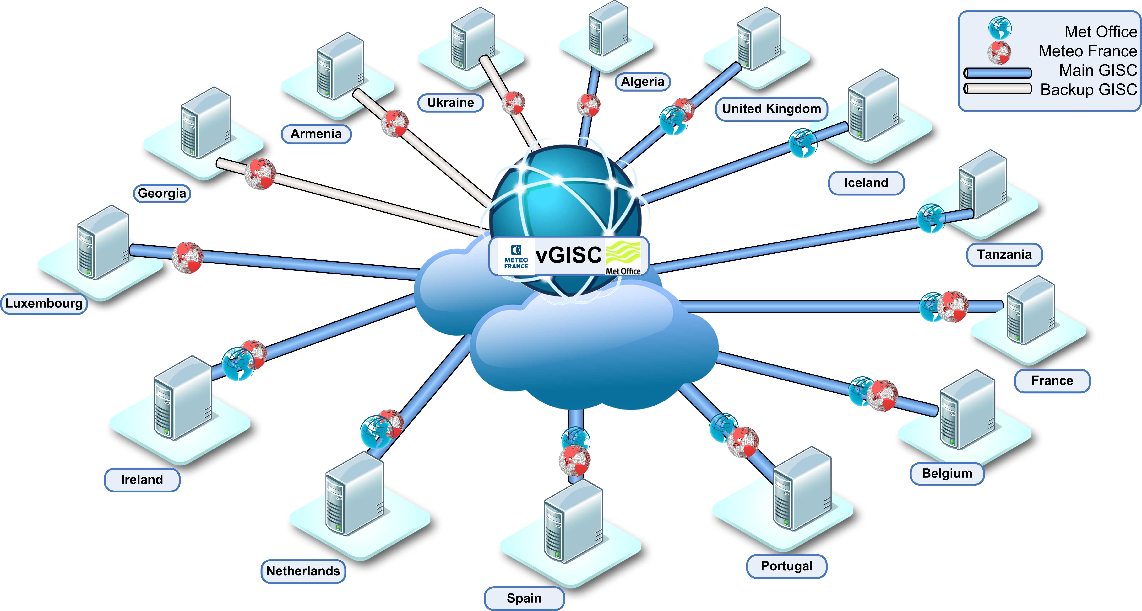
Area of responsability

Slide 3
Area of responsability connectivity
TT-GISC2017 pp3

Slide 4

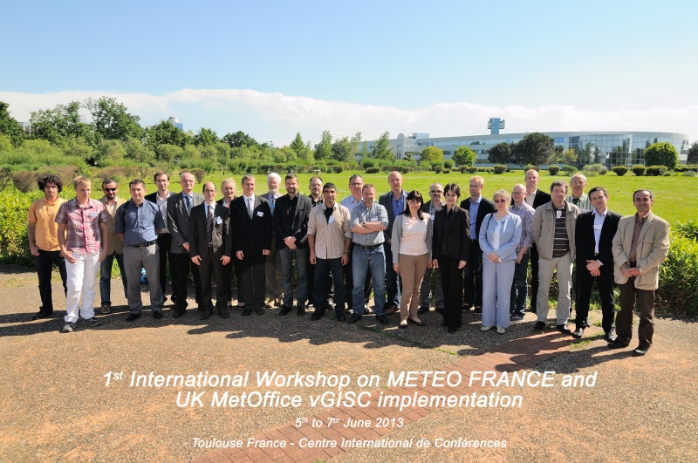
Capacity building
WIS Workshop hold in Toulouse:
  1st : June 2013
  2nd : June 2017
Participation to ASECNA (Dakar) seminar November 2015
Cooperation with DMN (GISC Casablanca)
  April 2015 : Support to DMN for GISC Audit
  July 2017 : Immersion of DMN WIS administrators in Meteo France
Hosted the Openwis association annual meeting March 2017
TT-GISC2017 pp4

Slide 5
GISC Backup
GISC Exeter
  Regular face to face meetings with Met Office
  GISC 2 GISC : RMDCN and internet backup
  Ireland, Netherlands backup through RMDCN, mode A-P tx, mode A-A rx
GISC Moscow
  Regular exchange with Roshydromet
  GISC 2 GISC : RMDCN
  Armenia, Georgia an Ukraine backup through internet, mode A-A for tx and rx
GISC Casablanca
  In progress
  GISC 2 GISC : RMDCN
  Congo, Niger, Senegal through internet and satellite, Tunisia through internet
TT-GISC2017 pp5

Slide 6
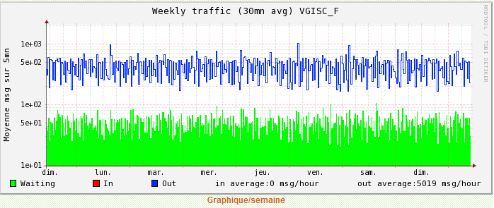
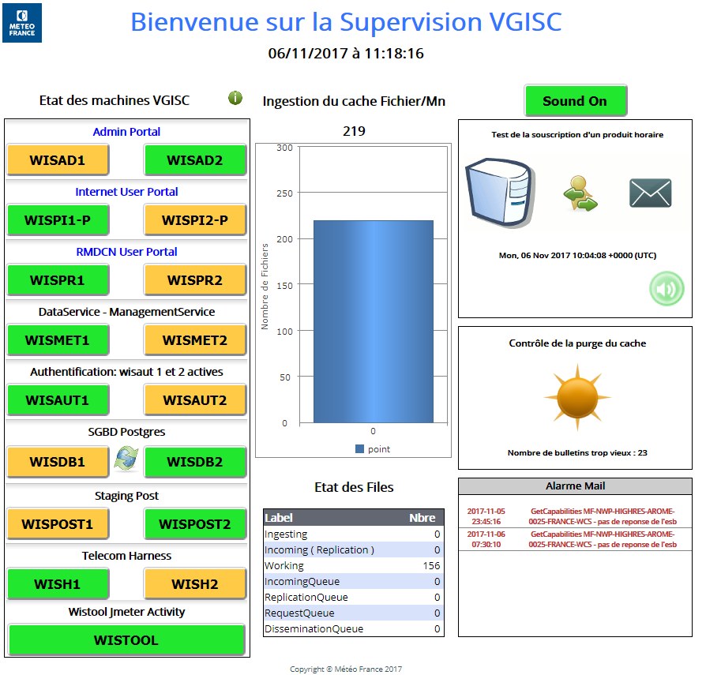
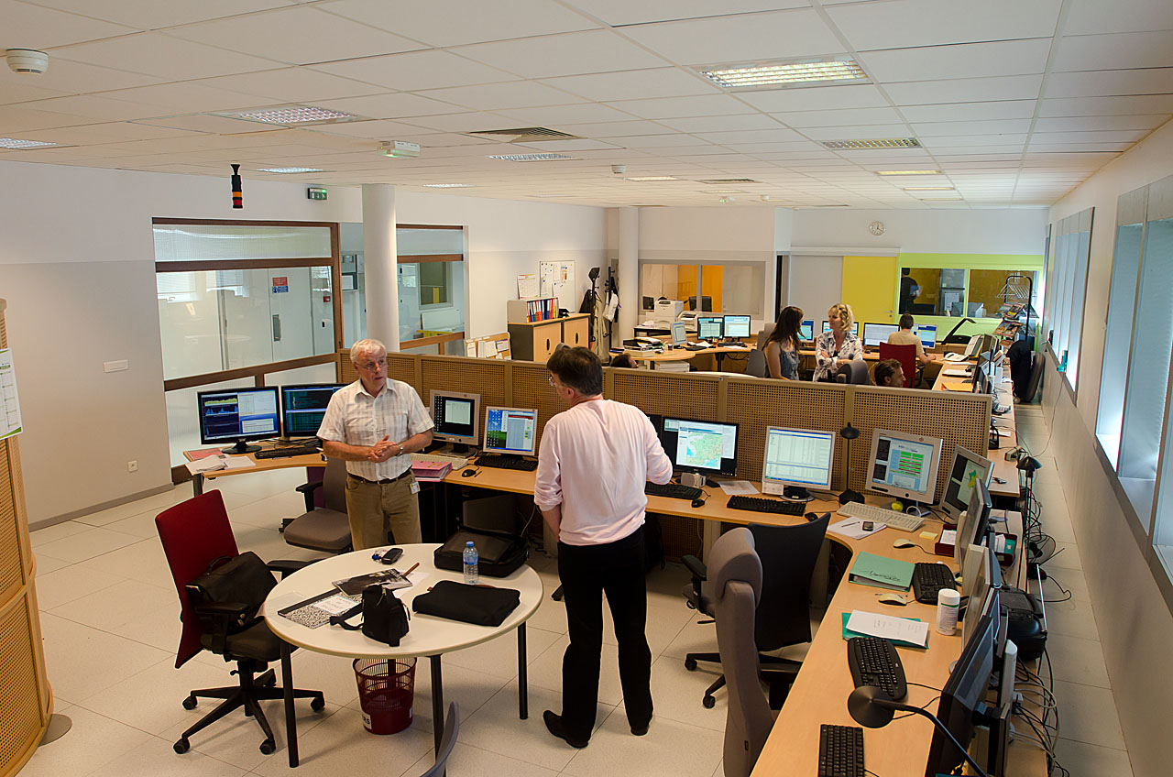
Monitoring Activity & volume
vGISC offering 24x7 monitoring and helpdesk support
TT-GISC2017 pp6

Slide 7
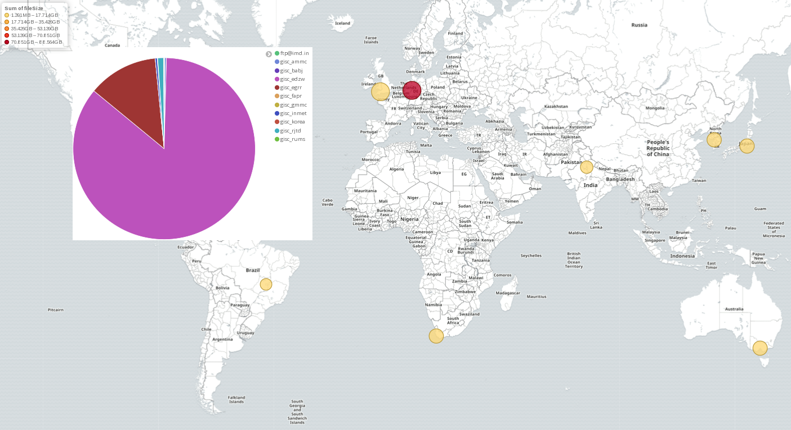
Volume exchange
GISC 24 h cache : 7 Gb
GISC Toulouse area : 300 Mo
TT-GISC2017 pp7

Slide 8
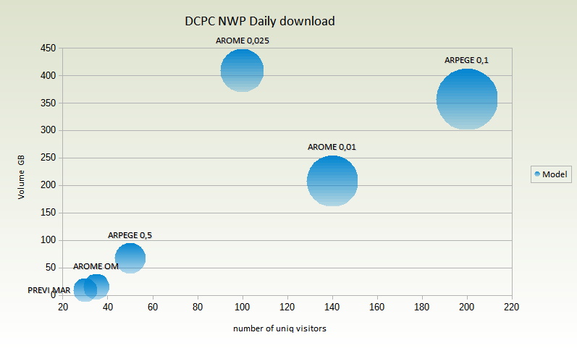
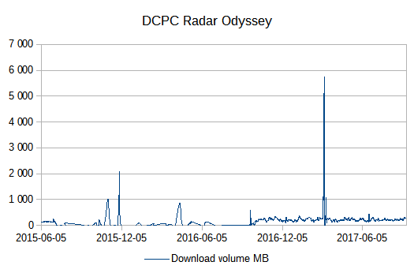
Audience
~1200 users register (including DCPCs)
Less than 300 search queries by day on GISC
Main activity on:
  DCPC NWP (+45% on last 6 month), 260 regular users .
  Inspire webservices
> 70 webservices online, 2 millions hits by day for a download volume of 2 TB
TT-GISC2017 pp8

Slide 9
Changes in GISC
TT-GISC2017 pp9
News DCPC:
  DCPC Copernicus : Regional air quality products
  DCPC EER environmental emergency response
  DCPC Volcanic Ash Advisory Centers
  DCPC Long Range Forecast
News weather models on DCPC NWP
OpenWIS code repositories on GitHub are now PUBLIC
Excel2wis metadata tool publish on github

Slide 10
2018 Outlook
In the frame of Openwis association, participation to the WIS 2.0 « Proof Of Concept »
Upgrade of GISC Toulouse: new architecture, update OS and Openwis
« Dockerize » Openwis software
DCPC Cyclone data centre
DCPC API discovery store
Development of news webservices
TT-GISC2017 pp10

Slide 11
Draft text for report
Mr Benjamin Saclier reported the current status of GISC Toulouse
Main activity is on DCPC sites and specially DCPC NWP
Large success on webservices
Started operation of news DCPCs : Regional air quality, EER, VAAC and LRF.
OpenWIS and excel2wis software are now available from github
Meteo France will continue to develop API for DCPC
TT-GISC2017 pp11

Slide 12

Thank you
Merci

