Slide 1
WIS Monitoring & WCD/CMA
CMA/Wang Peng
Task Team GISC
TT-GISC2017
13-17 November 2017, Geneva

Slide 2
Implementation timeline (phase 1)
Monitoring JSON format ver. 0.1
Dec. 2014
BoM, CMA, DWD, JMA
Monitoring JSON ver. 1.0
Apr.~May. 2015
TT-GISC
Demo on Cg-17
2015
Publishing JSON
Jan. 2015
CMA, DWD, JMA
Dashboard prototypes ver. 0.1
Feb. 2015
CMA, JMA, INMET

Slide 3
Implementation timeline (phase 2)
Monitoring JSON format ver. 1.1
Jun. 2016
BoM, JMA, CMA, …
CBS-16
2016
Publishing JSON ver. 1.1
BoM, CMA, DWD, JMA, KMA, MétéoFrance, MétéoMaroc, Roshydromet
Dashboard prototypes for JSON ver. 1.1
CMA, JMA

Slide 4
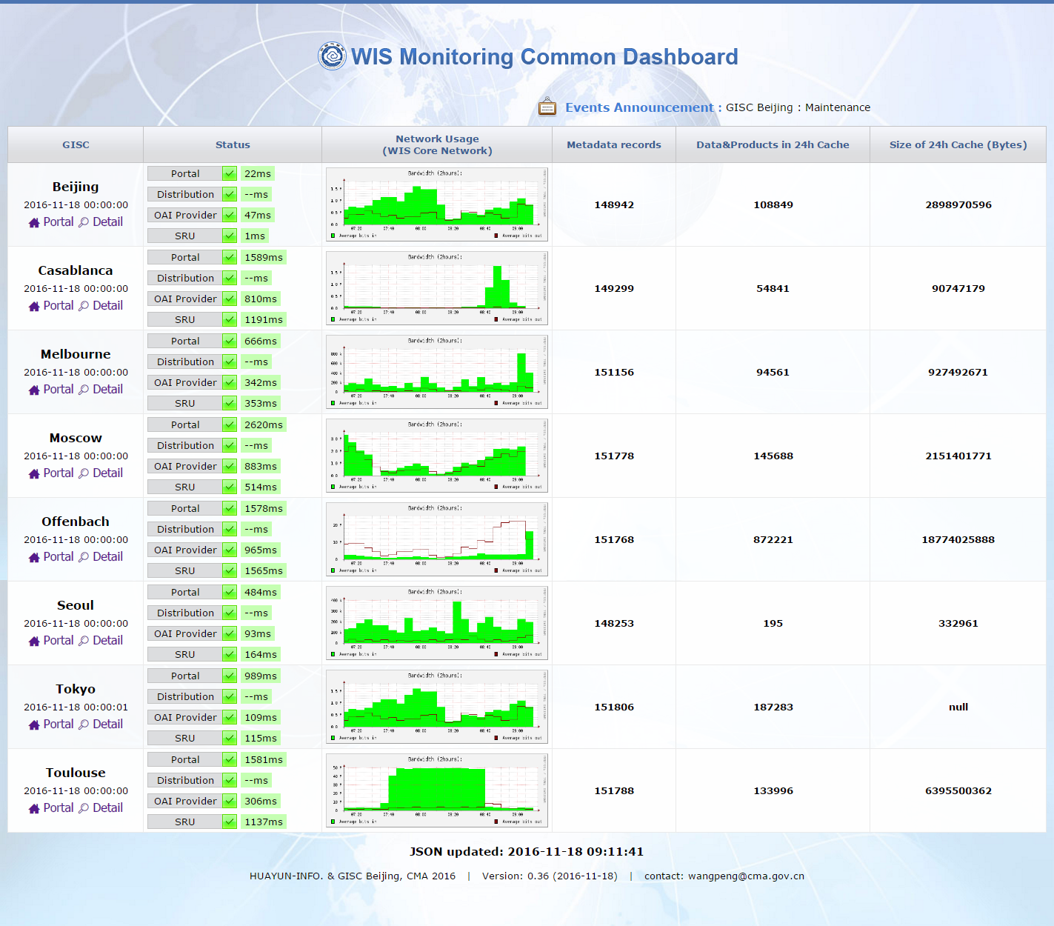
WIS Common Dashboard by CMA
http://mon.wis.cma.cn/WCD

Slide 5
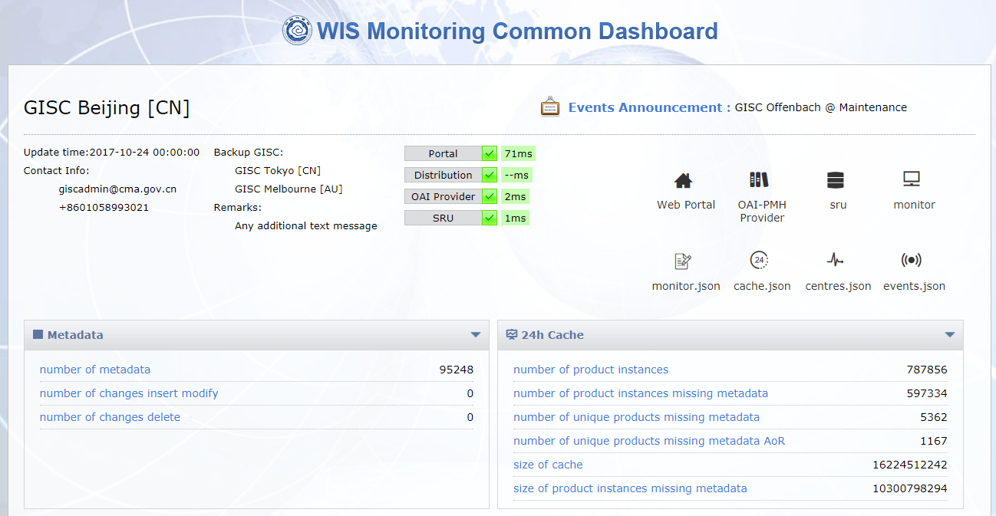
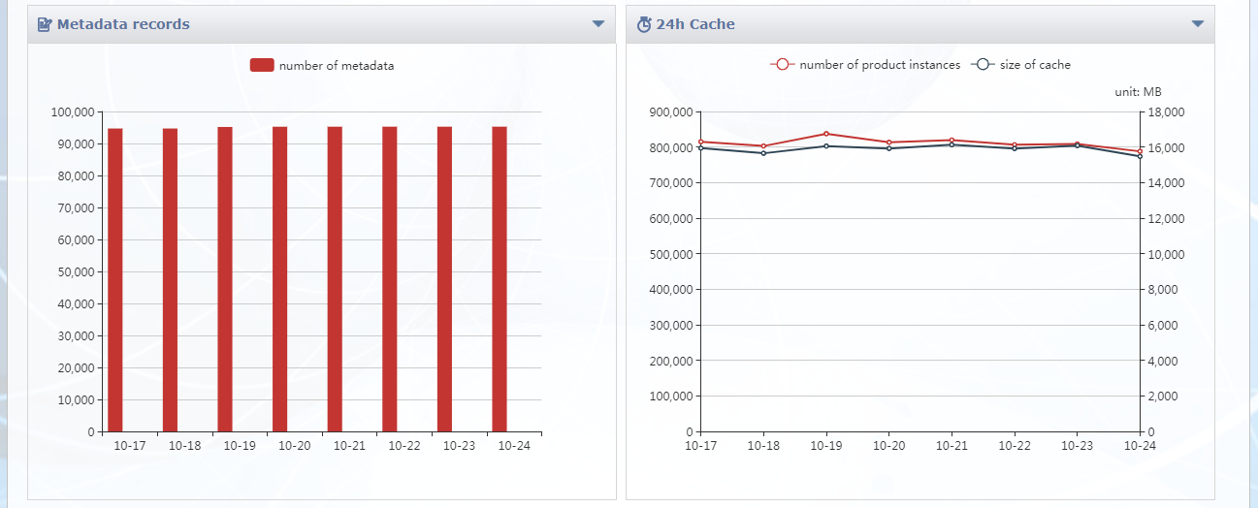

Slide 6
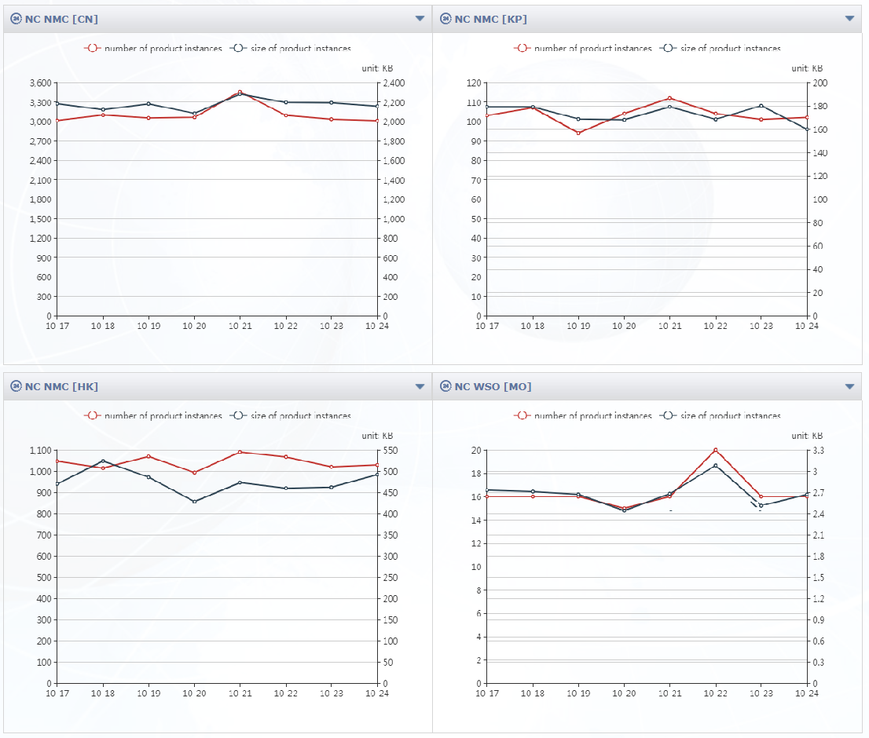

Slide 7
WIS Common Dashboard by CMA
Decision 5.5(1)/2 (CBS-16) WIS SYSTEM MONITORING:
“THE COMMISSION FOR BASIC SYSTEMS,
Recognizing:
(1) That ICT-ISS has successfully developed and demonstrated pseudo operational prototype WIS Monitoring Common Dashboard (WCD) at GISC Beijing and Tokyo”
CMA plan to continue improving the WCD and operationalize it

Slide 8

Thank you
Merci

