Slide 1
GISC Beijing Status Report
Wang Peng
Agenda item 4.1
Task Team GISC
TT-GISC2017
13-17 November 2017, Geneva

Slide 2
Area of Responsibilities
NCs (7):
China
Mongolia
Nepal
Pakistan
Hong Kong, China
Macao, China
Democratic People’s Republic of Korea.
DCPCs (6):
WWIS ( Hong Kong, China )
5 CMA’s internal DCPCs
International roles of CMA in WIS:
NC China
GISC Beijing
RTH Beijing (DCPC)
RCC Beijing (DCPC)
RSMC Beijing – Geographical (DCPC)
RSMC Beijing – Activity – ATM (DCPC)
National Satellite Meteorological Center (DCPC)

Slide 3
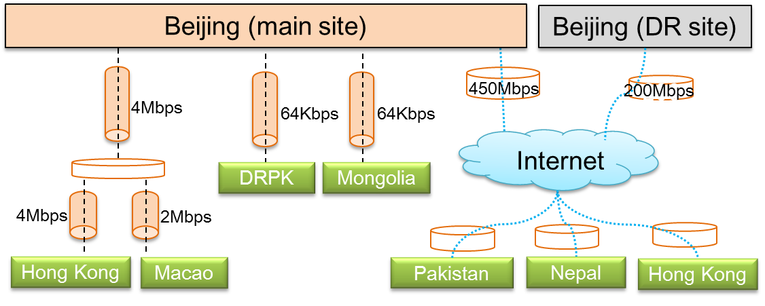
AMDCN Connectivity
Dedicated lines(4):
NC Hong Kong, China,
NC Macao, China
NC Pyongyang.
NC UlaanBaatar
Internet connections (3):
DCPC WWIS ( Hong Kong, China )
NC Karachi
NC Kathmandu

Slide 4
DCs WIS Compliance
DCs in AoR are all compliant with WIS requirements and specifications
WWIS ( Hong Kong, China )
RTH Beijing (DCPC)
RCC Beijing (DCPC)
RSMC Beijing – Geographical (DCPC)
RSMC Beijing – Activity – ATM (DCPC)
National Satellite Meteorological Center (DCPC)

Slide 5
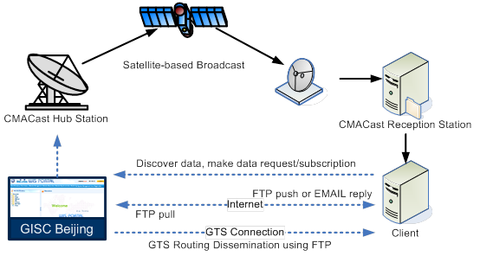
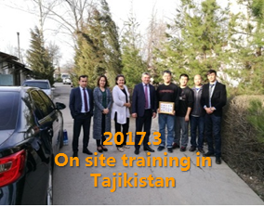
Training – Capacity building activity
Since December 12, 2016,
2 on-site trainings on CMACast system maintenance to WIS users.
2017.3, Tajikistan
2017. 10, Philippines
Communication with NC in AoR of GISC Beijing on WIS implementation
22th Mar 2017, with Hong Kong in Beijing.

Slide 6
Operational issues in last period
GISC Beijing portal operates with no issues.

Slide 7
GISC Backup and activities
GISC Beijing and GISC Tokyo together drafted
bilateral GISC backup specifications
and disaster failover procedures

Slide 8
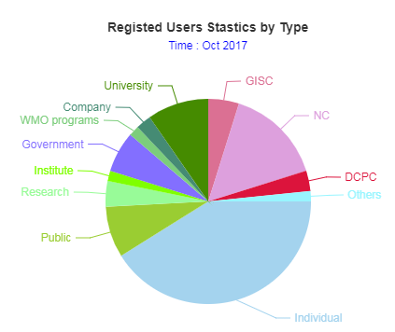
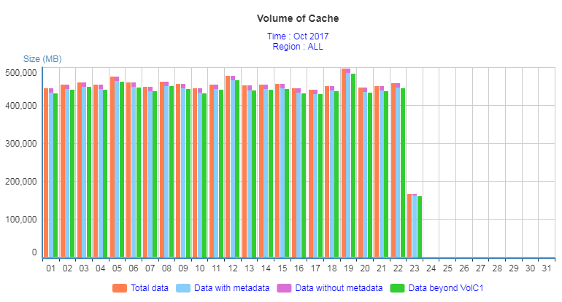
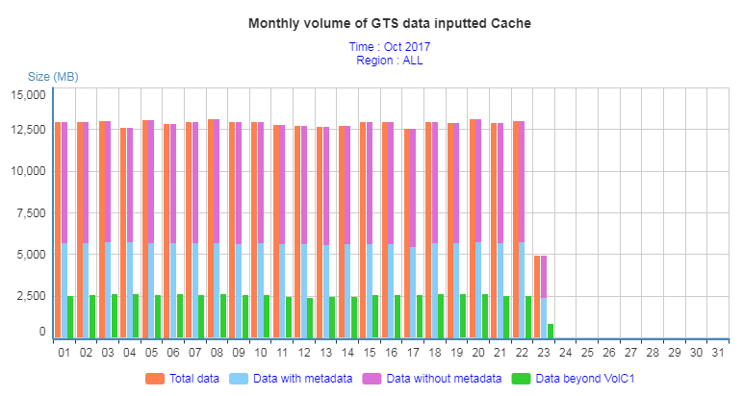
Monitoring Activity & Volume
By the end of October 2017, there are 114 users from 39 WMO Members registered in GISC Beijing.
The daily data volume of distribution via CMACast and Internet is over 740GB.
11/13/2017
8

Slide 9
Changes and Progress in GISC
5th, Sept. WIS portal version 2 Beta online to public
~20th, July TIGGE DAR metadata are marked “deleted”

Slide 10
Future Plan: supports to WIS 2.0
GISC Beijing v2 supports
Pushing data to “cloud cache” in real-time
AMQP / RabbitMQ message communication
  CMA domestic telecommunication system is using AMQP/RabbitMQ for real-time operational data transmission

Slide 11
Future Plan
GISC Beijing v2 is
Working on integration of IQWMA (monitoring)
Troubleshooting bugs and issues
Consolidating the beta version
Improving the WCD

Slide 12
Summary
Mr. Wang Peng reported the current status of GISC Beijing and the progress of GISC Beijing WIS portal version 2. In 5th September 2017, its version 2 beta released to public as scheduled.
In 2017, GISC Beijing and GISC Tokyo together drafted bilateral GISC backup specifications and disaster failover procedures.

Slide 13

Thank you
Merci

