Slide 1
GISC Brasília
José Mauro
Agenda item 6.2
Expert Team on WIS Centres
ET-WISC2017
13-17 November 2017, Geneva

Slide 2
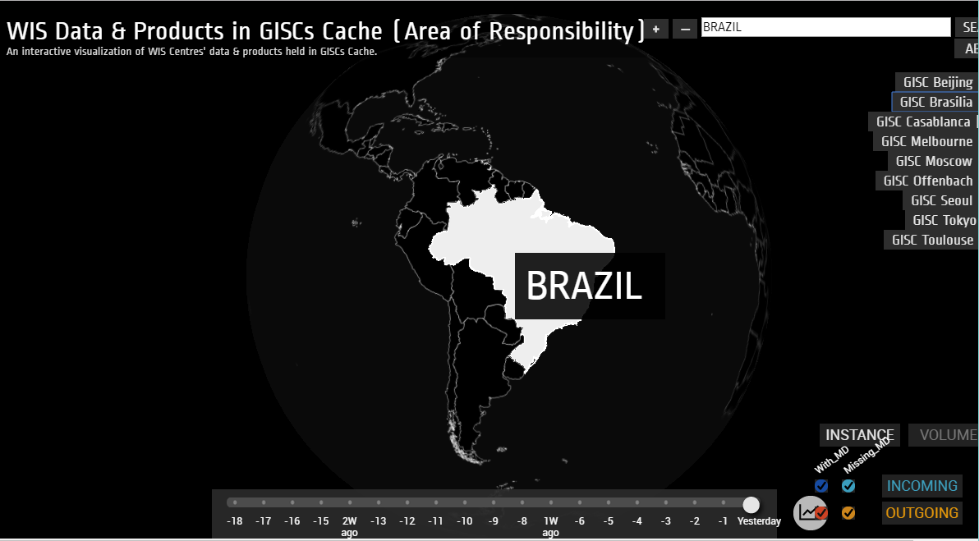
WIS Monitoring

Slide 3
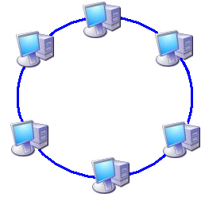
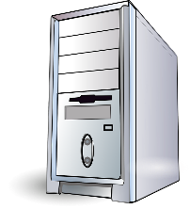
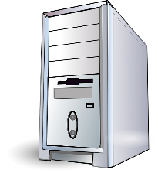
Monitoring and data colection
One local computer runs a self controlled “atacck” against its own GISC server. The results are stored, classified and rated according to the risks found.
All assets are rated based on a 5 stars classification according to the relevance of the vulnerability found.
The risk table is them published to other GISC centers.
The classification results can be restricted using some authentication procedure.

Slide 4
Monitoring and data colection

Slide 5

Risk, Vulnerability and Availability map
R V A
R V A
R V A
R V A
R V A

Slide 6
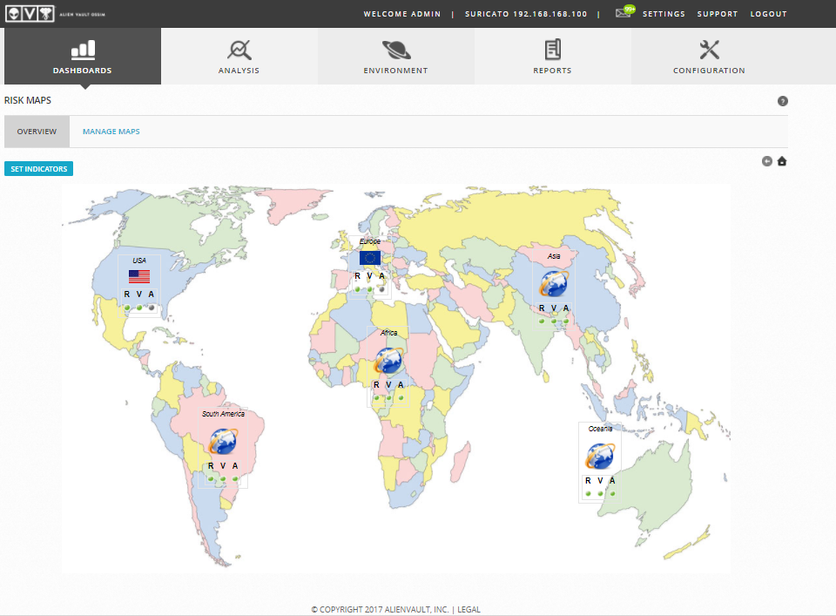
Risk, Vulnerability and Availability map

Slide 7
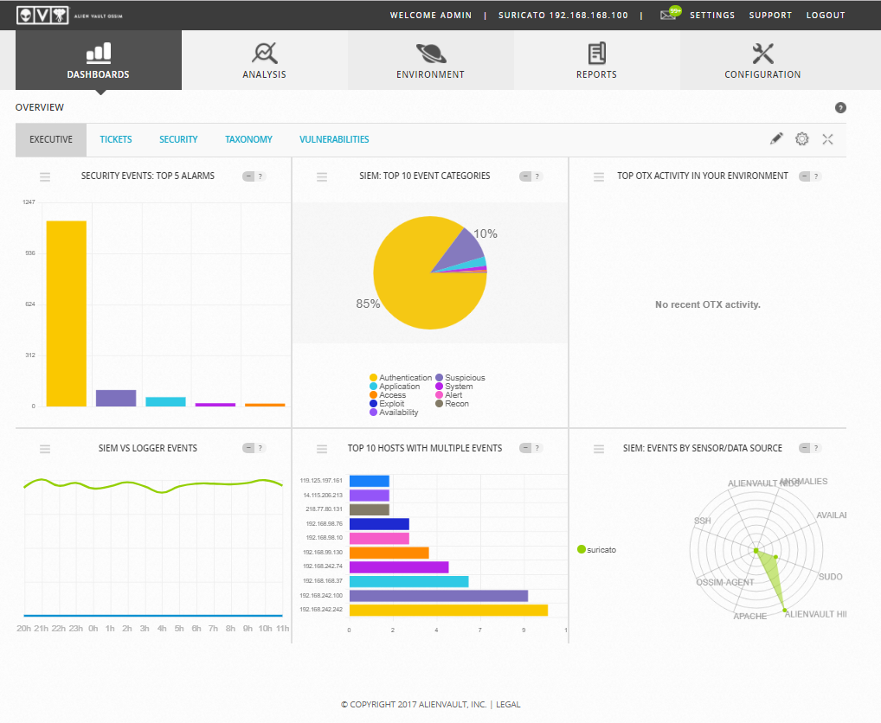
AlienVault Dashboard

Slide 8
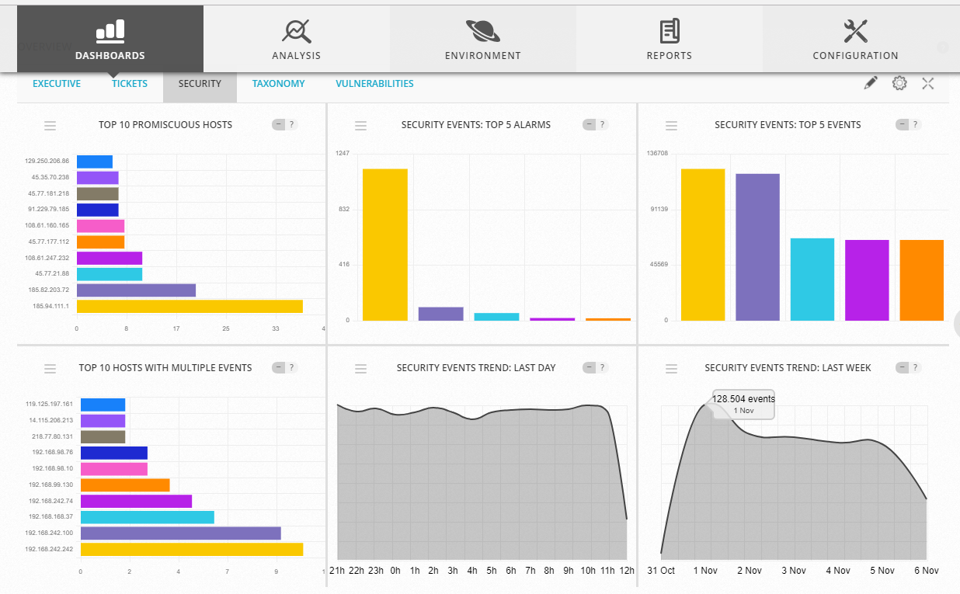
AlienVault Dashboard

Slide 9
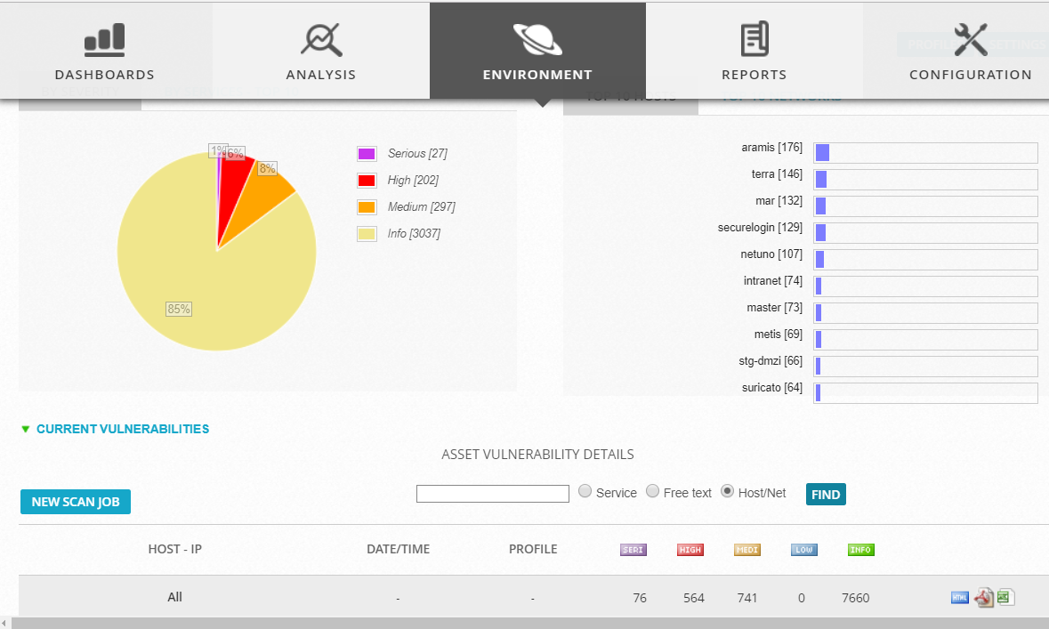
AlienVault Dashboard

Slide 10
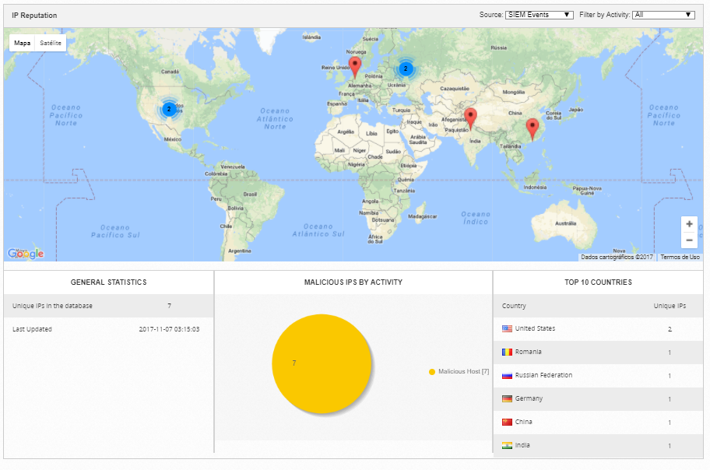
AlienVault Dashboard

Slide 11
Issues
Does it works?
What should be monitored?
What are the rules?
What can or should be reported?
What can not or should not be reported?
How to present or exchange the results?

Slide 12

Thank you
Merci
Obrigado

