Slide 1
Cache in the cloud
- Measurement of traffic volume -
Shuichi Ikeda
Agenda item 3.1.9
Task Team on Evolution of WIS
TT-eWIS2017
21-23 November 2017, Geneva

Slide 2
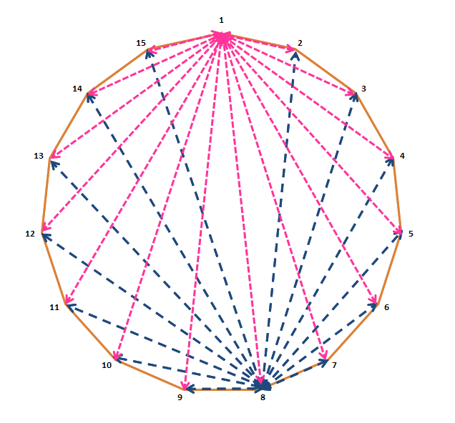
Cache in the cloud project
RMDCN
（WIS Core Network)
Data center (Cloud)
INTERNET
Current
Full mesh Sync among 15 GISCs
One possible solution
Centralization using cloud technology
* A solution using a cloud based approach was presented at TT-GISC and ET-CTS in 2014.
* Then it was agreed to run a pilot to access whether this option was viable or not in 2015.

Slide 3
Cache in the cloud project
GISC1
GISC2
GISC3
GISC4
GISC5
GISC6
GISC7
cloud1.teganet.eu
FTP/SFTP client
Internet
100Mbps
Best Effort
Cloud SV
(Interoute)
GISC Tokyo
GISC8
GISC9
GISC10
GISC11
GISC12
GISC13
GISC14

Slide 4
Requirement of cache in the cloud
  Centralization of global distributed data
    Performance
      Centralization global data is to be transmitted end to end within two minutes (if priority data is included)
    Data flow
      Inputs: Global information
      Outputs: Cached global information
    Note
      Global information is required to be all GISCs within 15 minutes
Requirement : See Tech-Spec 3 of Manual on the WIS

Slide 5

Target architecture (initial stage)
Condition:
SLA: | Best Effort
Storage: | 200 GB
Number of users: | 15 users (GISCs)
CDN Service: | May be needed to meet 20 Mb/s or more
Throughput: | 20 Mb/s (not contractual) between a GISC and the cloud e.g. to get 4 GB (e.g. NWP) within 30 minutes, minimum actual speed must be 20Mb/s or more (see below)
If actual speed of each connection is 20Mb/s, the deliver time (end-to-end) will be 120 minutes
20Mb/s
4GB/30 min
20Mb/s
4GB/30 min
20Mb/s
4GB/30 min
20Mb/s
4GB/30 min
DCPC-A
NWP
GISC-A
GISC-B
DCPC-B
NC-B
Cache
End-to-end : 120 minutes

Slide 6
TEST case of GISC Tokyo
Our test server is
  Uploading JMA’s data (Observation, NWP Products, etc.) and GISC Tokyo’s Area of responsibility’s data as WMO FTP file format by using FTP (LFTP tool).
  Downloading data one by one from Cloud server (cloud1.teganet.eu) by using SFTP (LFTP tool) and removing data after downloaded it from directory of GISC Tokyo on the cloud.
FTP PUT
SFTP GET
Cloud
GISC Tokyo

Slide 7
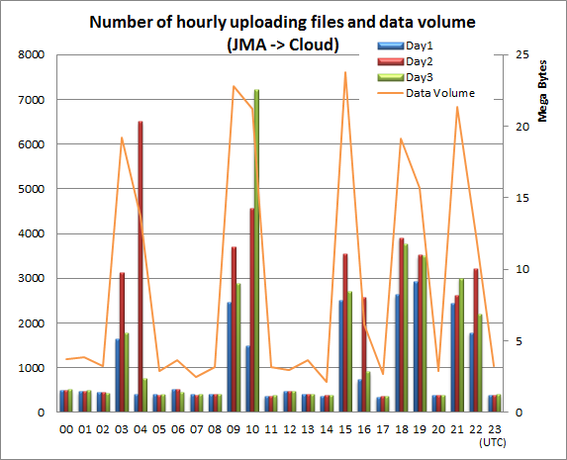
Uploading data from Tokyo to Cloud
Average uploading daily data
  Number of Bulletin: 43,115
  Number of File data: 69 (Satellite)
  Daily data volume: 219 Mbytes
Bulletin
WMO FTP format
FTP PUT
Cloud
Tokyo

Slide 8
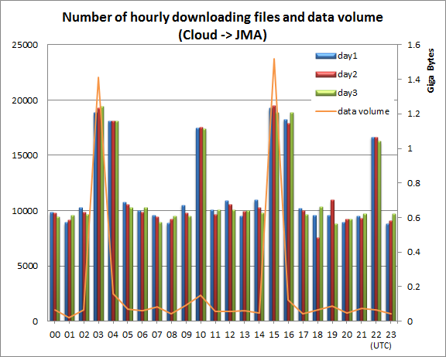
Downloading data from cloud to Tokyo
Average downloading daily data
  Number of Bulletin: 285,443
  Number of File data: 50 (Satellite)
  Daily data volume: 4.5 GBytes
Bulletin
File format
SFTP GET
Cloud
Tokyo

Slide 9
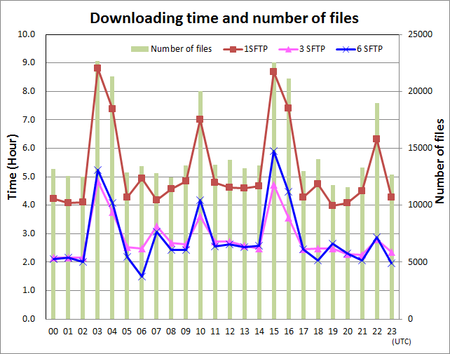
Comparing time for parallel download
Test case:
In case of 1 SFTP session
Cloud
Tokyo
In case of 3 SFTP sessions
Cloud
Tokyo
In case of 6 SFTP sessions
Downloading time is total time to download for an hour's data.
Cloud
Tokyo

Slide 10
Total downloading time per hour
Test case |  | Number of data in an hour | Data Volume in an hour | Total Download Time | Download speeds
SFTP 1 session | Ave. | 15020 | 213 MB | 5 h 13 min | 1.25 sec/1 file
 | MIN | 11665 | 70 MB | 4 h 0 min | 1.22 sec/1 file
 | MAX | 22941 | 1646 MB | 8 h 48 min | 1.38 sec/1 file
SFTP 3 sessions | Ave. | 15029 | 187 MB | 2 h 0 min | 0.68 sec/1 file
 | MIN | 11386 | 89 MB | 2 h 9 min | 0.67 sec/1 file
 | MAX | 22477 | 1642 MB | 4 h 48 min | 0.77 sec/1 file
SFTP 6 sessions | Ave. | 14976 | 181 MB | 2 h 36 min | 0.62 sec/1 file
 | MIN | 10538 | 65 MB | 1 h 30 min | 0.47 sec/1 file
 | MAX | 22963 | 1646 MB | 5 h 54 min | 0.92 sec/1 file
Downloading time is total time to download for an hour's data.

Slide 11
Consideration (1)
About parallel sessions
  SFTP 3 sessions are effectively
  SFTP 1 session is not effectively
If we can reduce number of files, downloading time will be reducing.
  To use WMO FTP procedure (accumulating message)
  To pack data (e.g. ZIP, bz7)

Slide 12

Consideration (2)
There is a “Round-Trip-Time issue” in the TCP/IP’s world
  In theory, throughput of the "Round Trip Time (RTT) 222ms” is 2.31 Mbps.
  In this situation, we might not get a good performance of high speed even though the number of files reduced.
  And I’ve tried calculating expected downloading time in case of RTT 222ms when we can handle WMO FTP procedures.
Cloud
Tokyo
RTT: 222ms

Slide 13
Summary
Exchanging data using cloud will be useful
  It’s easy to access data, no full mesh sync
  Concerns
    Many files on cache in the cloud
    Throughput (TCP/IP round trip time issue)
In preparation for WIS 2.0
  How to achieve requirement of WIS 2.0 strategy, seamless access to meteorological information using cloud.
  How to handle large volume data.

Slide 14

Thank you
Merci

