Slide 1
Interoperability WMO Information System and GEOSS
Stefano Nativi
Thorsten Büßelberg
Deutscher Wetterdienst
21th November 2017

Slide 2
Agenda
Motivation Metadata
Interoperability WMO Information System – GEOSS
Metadata Quality

Slide 3

Supermarket without metadata
Source: WMO Core Metadata Profile v1-2 Guidance Documentation v0.1
Notes:
3
3

Slide 4
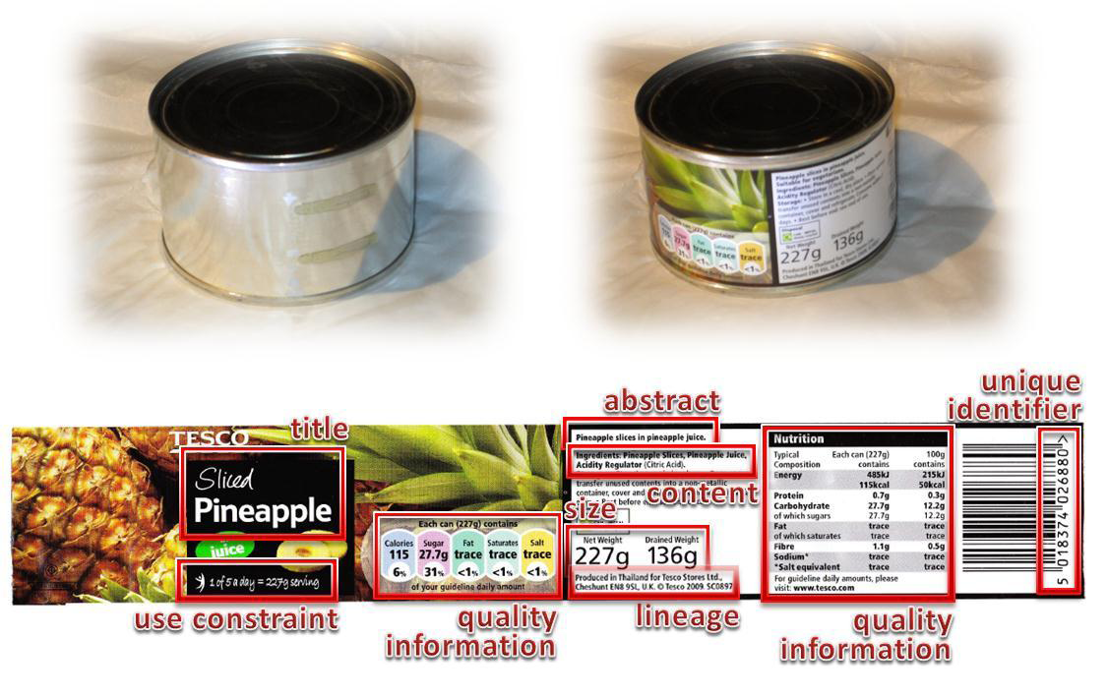
Supermarket with metadata
Source: WMO Core Metadata Profile v1-2 Guidance Documentation v0.1
Notes:
4
4

Slide 5
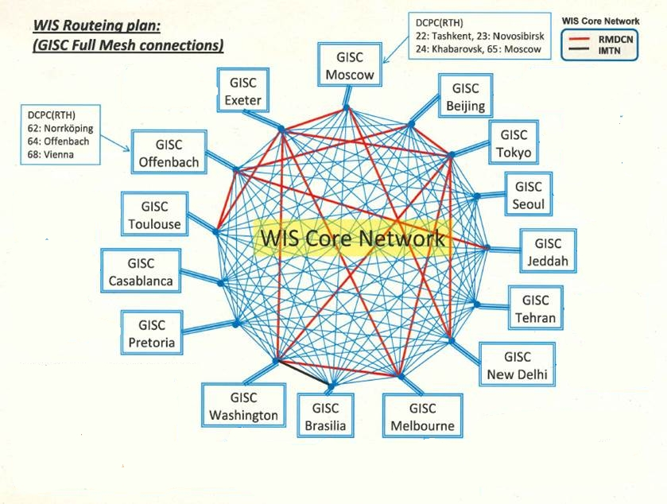
WMO Information System
GISC
Global Information Service Center
DCPC
Data Collection/Production Center
NC
National Meteorological and
Hydrological Center

Slide 6
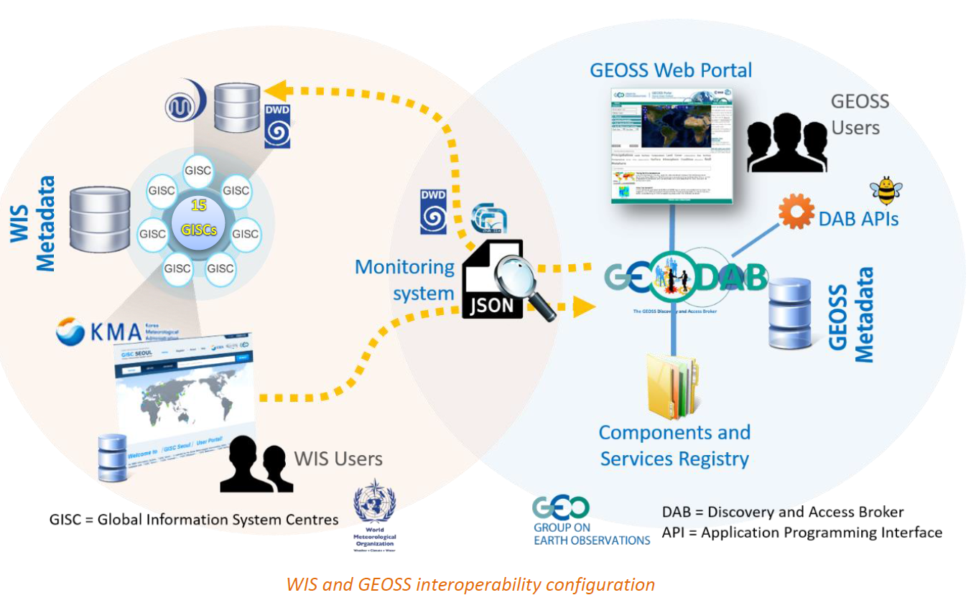
Interoperability WIS und GEOSS
Notes:
JSON Monitor: https://gisc-test.dwd.de/monitor/data/centres.json

Slide 7






Metadata synchronization
CSW
Subset Germany
OAI and FTP
DKRZ
AWI (PANGAEA)
DLR
EUMETSAT
National Meteorological
Centres,
e.g. Austria,
Croatia, …
WIS core network
connected to GISC Offenbach as internal DWD centre:
  GCC, Global Collection Centre
  GPCC, Global Precipitation Climate Centre
  GRUAN, GCOS Reference Upper-Air Network
  NKDZ, Nationales Klimadatenzentrum
  RCC-CM, Regional Climate Centre on Climate Monitoring for Europe
connected to GISC Offenbach as external DCPC
  DKRZ
  DLR
  AWI Bremerhaven (Pangaea)
  EUMETSAT

Slide 8
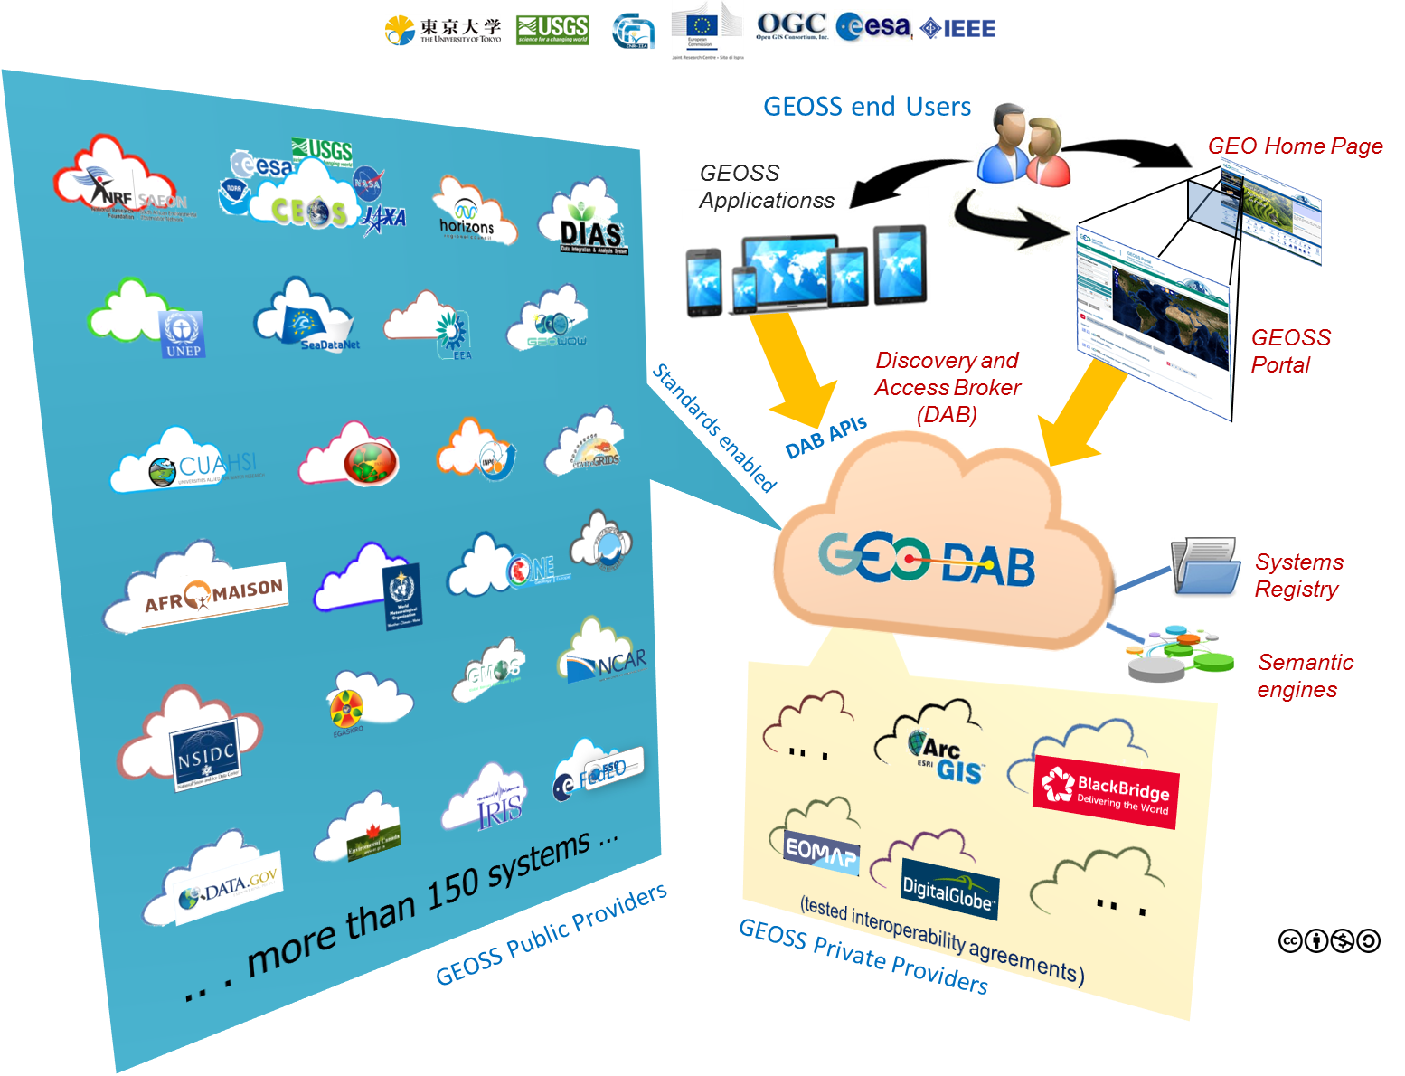
Source: Stefano Nativi

Slide 9
System Accessing GEO DAB | Number of Queries (2016)
WMO Information System | Very High | > 1 M
Cloud Infrastructures (including GWP) | High | > 100 K < 1 M
China GEOSS | Medium | > 10 K < 100 K
US GEO | Medium | > 10 K < 100 K
EC-funded projects | Medium | > 10 K < 100 K
ESRI ArcGIS Online | Medium | > 10 K < 100 K
Other | Medium | > 10 K < 100 K
CEOS Water Portal | Low | > 1 K < 10 K
UNEP GRID | Low | > 1 K < 10 K
Source: Stefano Nativi

Slide 10
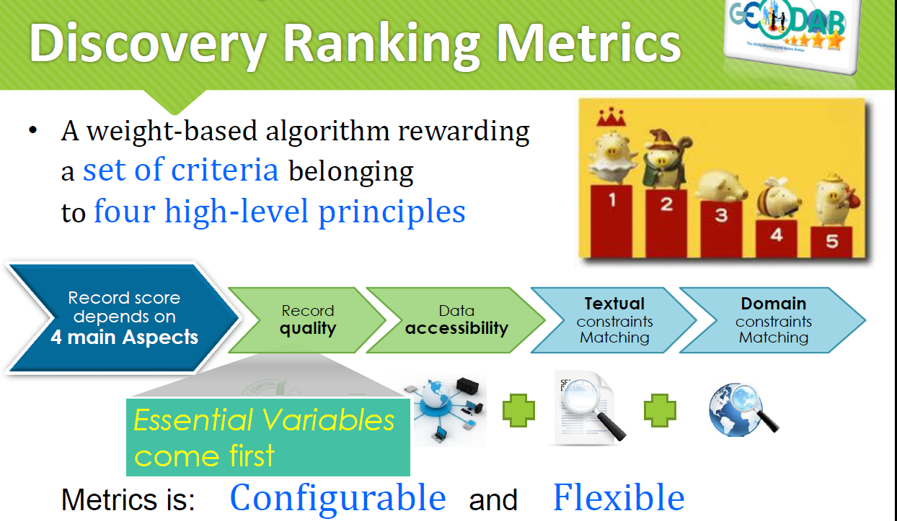
GeoPortal –ranking search results
Source: Stefano Nativi

Slide 11
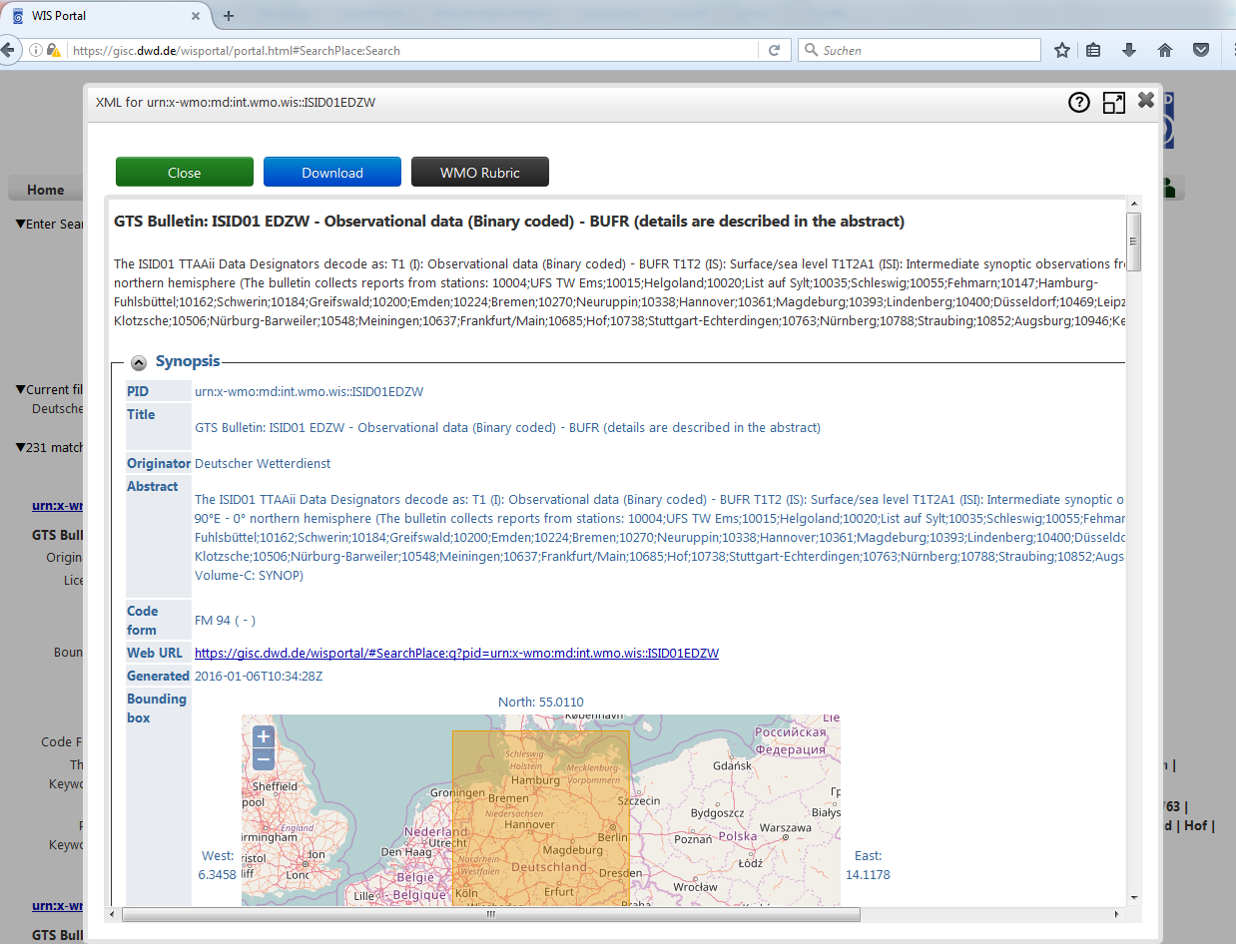
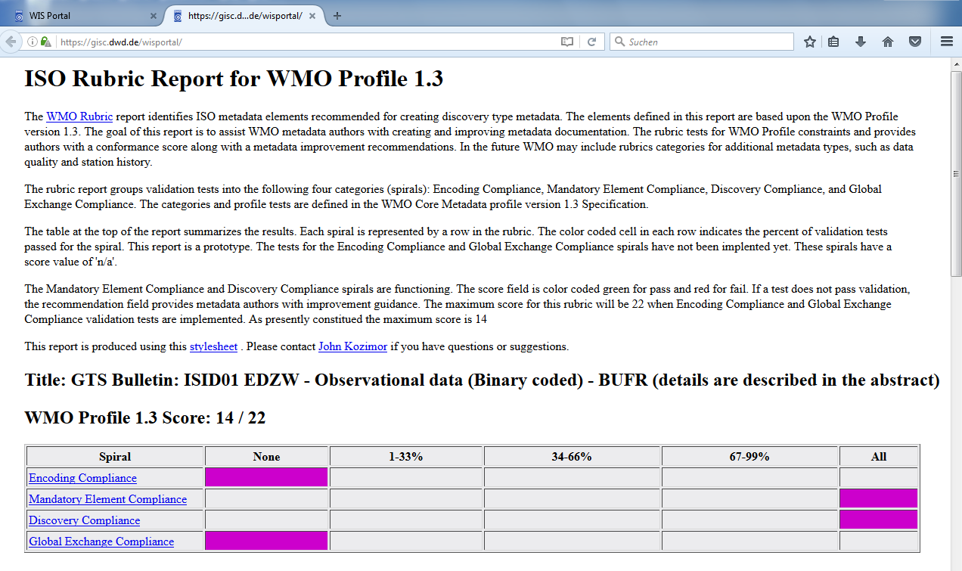
Metadata Quality in WMO Information System
NOAA provides a “WMO Rubric Report” (xslt transformation) http://www.ngdc.noaa.gov/metadata/published/xsl/wmoRubricReport.xsl
Useful tool to monitor metadata quality, build into Web-Frontend GISC Offenbach gisc.dwd.de

Slide 12
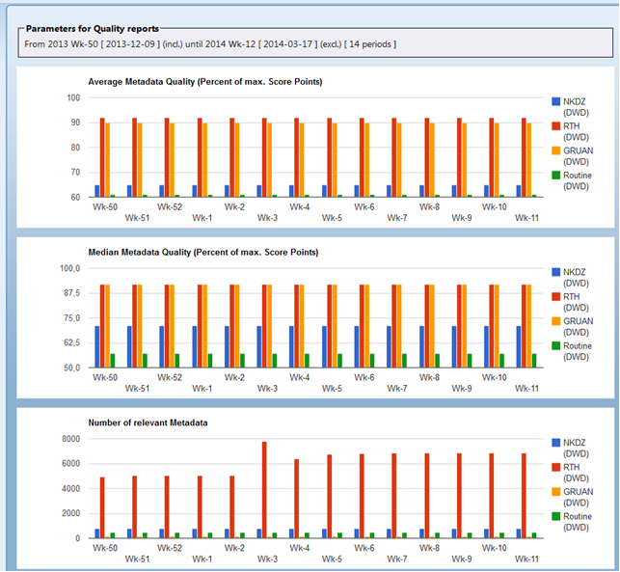
Metadata Quality in WMO Information System
Example 2014

Slide 13

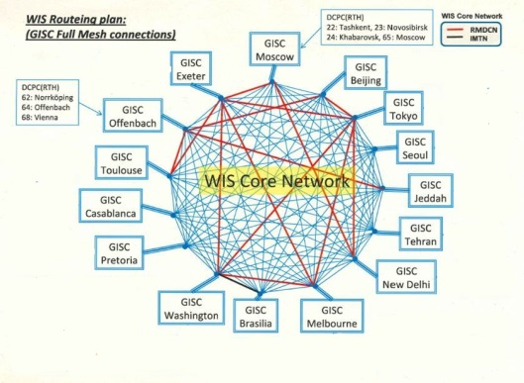
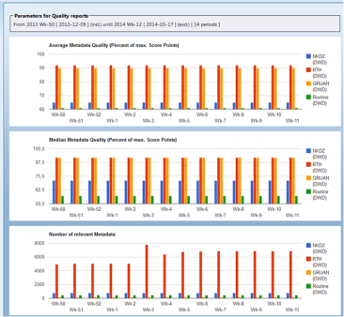
Summary
Metadata quality is essential
for user experience in catalogue systems
Interoperability
WMO Information System – GEOSS
Useful approach to measure
metadata quality is
„WMO Rubric“ (from NOAA)

Slide 14
Thank you !

