Slide 1
Meteorological Service of Canada
WMO WIS TT-eWIS 2017 meeting
Alexandre Leroux, M.Sc., ing
National Focal Point on WIS matters
November 21-23 2017

Slide 2
Content
The Meteorological Service of Canada (MSC) environment
Metadata and WMO WIS at the MSC
  DCPC CSW and DAR
MSC public data dissemination
  MSC Datamart
  MSC GeoMet

Slide 3
The MSC environment

Slide 4
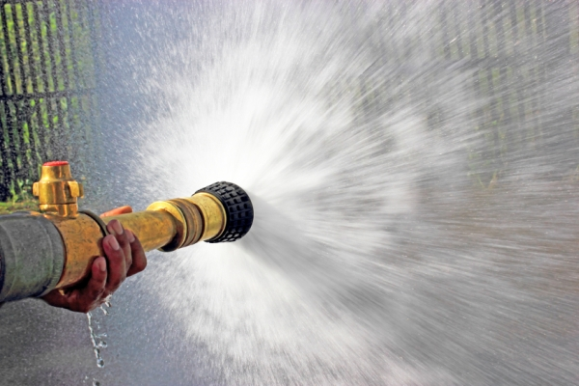
The MSC Environment
Data
24 / 7
Real-time
Voluminous
Temporal
Continuous
Business Lines
Monitoring
Prediction
Services
Geographic scope
Global
Clients / Partners
  WMO
  Other weather services
  Intra / inter departmental (DND, NavCan)
  Commercial weather services
  General public
Notes:
Image source: https://wutqfm.com/fire-herkimer-leaves-homeless/

Slide 5
MSC Data Volumes / Bandwidth
Every day
  Input: over 10 billion observations
  Output: over 10 Terabytes of data
Archive
  over 12 Petabytes of data
Public Data Access
  Geospatial Web Services (GeoMet)
    Over 90,000 daily users
    Over 1,8M maps served daily
    Over 1,400 weather layers available on GeoMet-Beta
  MSC Datamart
    About 500 GB of fresh data available daily
    Over 500,000 daily users
    Over 15M hits daily
Notes:
Image source: https://wutqfm.com/fire-herkimer-leaves-homeless/

Slide 6
Data Products and Services
Current / Real-Time Data (forecast model outputs, real-time observations, warnings)
  Machine access through MSC Datamart at http://dd.weather.gc.ca
    Information is file-based
  Geospatial Web Services
    MSC GeoMet
  Websites:
    WeatherOffice at http://weather.gc.ca
    WaterOffice at http://wateroffice.ec.gc.ca
Public Archive Data
  Historical Climate Data at http://climate.weather.gc.ca/
WMO Data Centres
  World Ozone and Ultraviolet Radiation Data Centre (WOUDC)
Notes:
Canadian Open Data Catalogue
http://open.canada.ca/data/en/dataset?sort=metadata_modified+desc&organization=ec&q=hazards
hazard data examples:
spills
conservation
protection
Wildlife
tornado database (1980 – 2009)

Slide 7
Metadata and WMO WIS at MSC

Slide 8
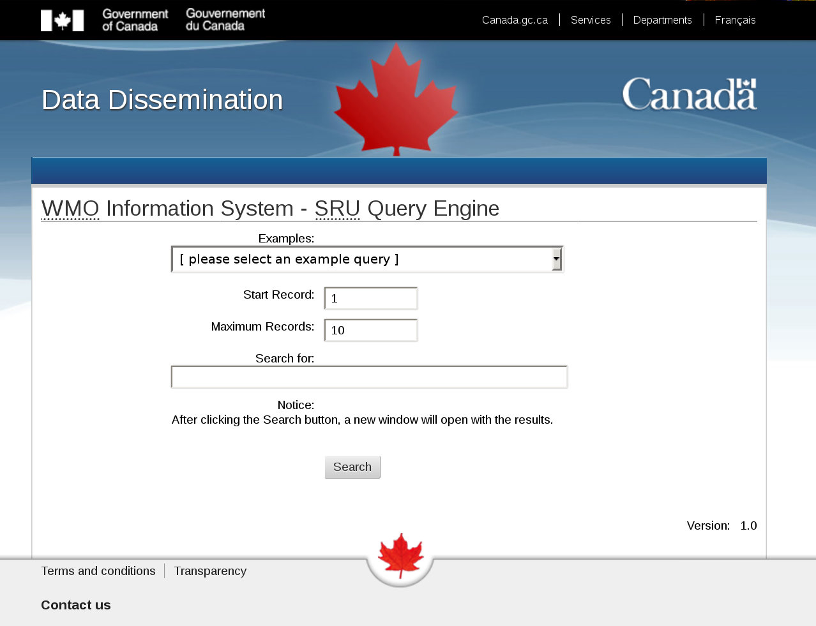
MSC WMO WIS DAR
MSC WMO WIS Discovery Access and Retrieval (DAR)
http://dd.weather.gc.ca/dar/
Notes:
- GeoMet was used to feed WxO during the 2010 Winter Olympics

Slide 9
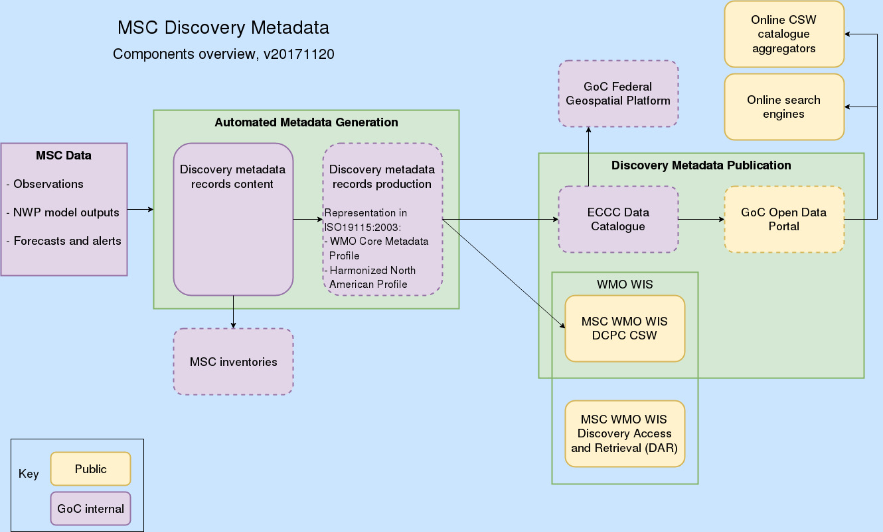
MSC Discovery Metadata Overview

Slide 10
MSC public data dissemination

Slide 11
Open Data Server: MSC Datamart
http://dd.meteo.gc.ca
Free and Open access for specialized users
  Open data: freely available to everyone to use and republish as they wish, on the main condition of attribution of the original data to Environment and Climate Change Canada
  Open formats: published specifications that can be used by anyone
  Target audience has some weather and/or IT knowledge
  Designed for direct, automated (batch) downloading of data via HTTP protocol, supports AMQP « just-in-time pull » notifications and data retrievals
  Offer is complementary to EC’s weather.gc.ca website
  Service is anonymous, supported on best-effort basis
Data also available via web services on MSC GeoMet

Slide 12
MSC GeoMet in a Nutshell
Provides public access to
MSC data via international
web services standards / interoperable APIs

Slide 13
MSC GeoMet Value Proposition / Benefits
Data dissemination service
  Open Geospatial Consortium (OGC) standards: WMS, WFS, WCS, SLD
  Operational 24/7 since 2009
Not a website
Enabling
Supports domain specific requirements
  Real-time, operational, mission critical, data volume (500GB of new public data daily)
Benefits to users
  Data is accessed on-the-fly, always the latest available
  Data is available in multiple formats, either raw data (clip/zip/ship) or for visualization (with custom styling)
  Users can integrate data directly into their tools: desktop software, mobile devices / mobile apps, web pages, etc
  Only the requested data is transmitted for the user-specified spatial / temporal extent

Slide 14
Merci / Thank you!
For more information:
Alexandre Leroux (alexandre.leroux@canada.ca)

