Slide 1
The Progress of
Cloud Platform for Big data and
AI algorithm in CMA
Luo Bing
National Meteorological Information Center

Slide 2
CONTENTS
Building CMA Cloud platform for big data
Using Public Cloud Extend our ways for service
Testing of AI prediction Method

Slide 3
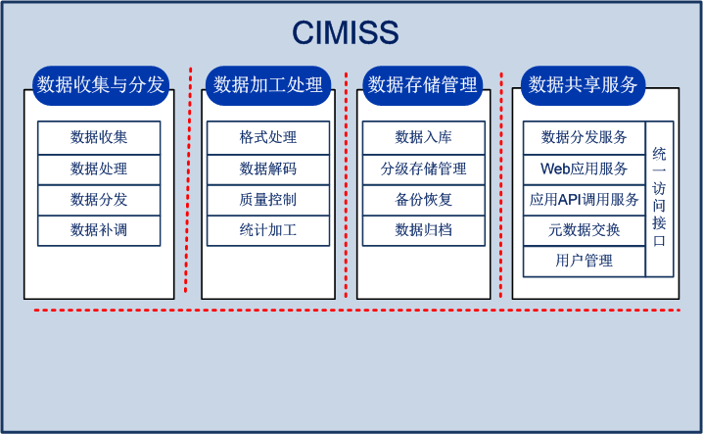




CIMISS - China Integrated Meteorological Information Service System
CIMISS
National DB
CIMISS
GTS
Operational Sys
(MICAPS、CIPAS……)
Internet
Message Switching System
Users
(……)
departmental special network
Beijing
CMANet
Data synchronized
Data Access
Data Dissemination
CIMISS
Provincial DB
Message Switching System
CIMISS
departmental special network
Operational Sys
(MICAPS、CIPAS……)
Users
(……)
CIMISS基础平台
Province
CMANet
Observations
Operational Sys
(MICAPS、CIPAS……)
Operational Sys
(MICAPS、CIPAS……)
Surface
Upper Air
Radar
……
Users
(……)
Users
(……)
County
Prefecture
Notes:
flattened organization
same infrastructure and functions for national level and provincial level,
the database in province directly support prefecture and county operational system

Slide 4
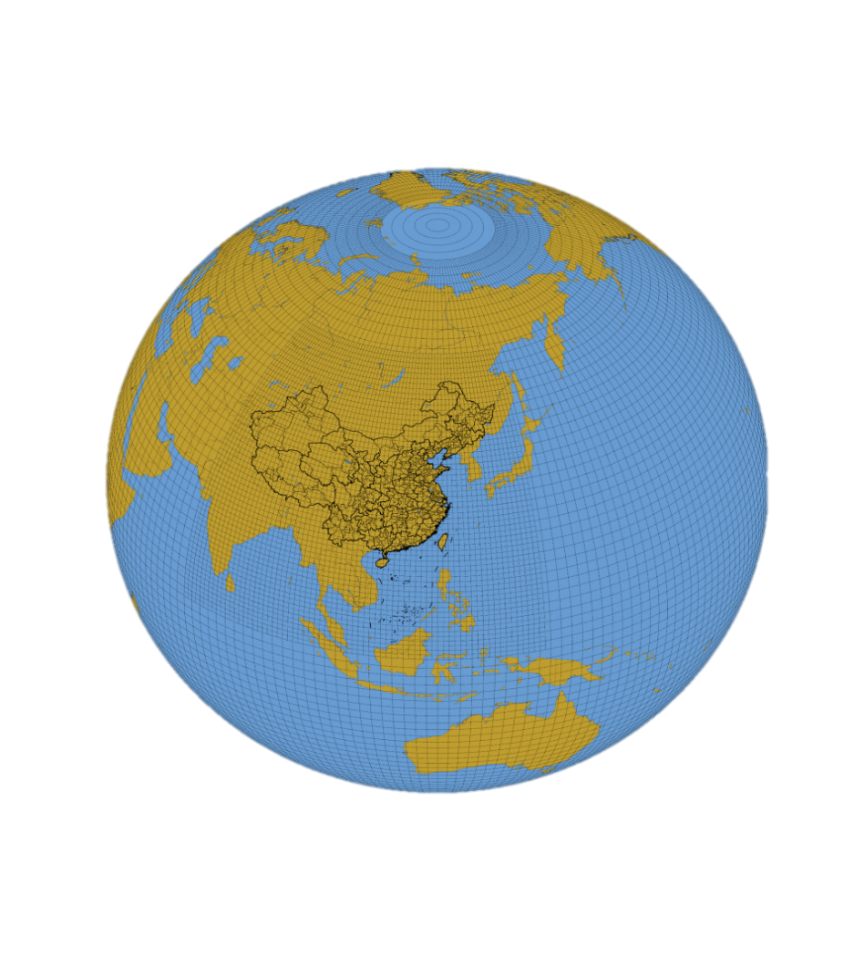
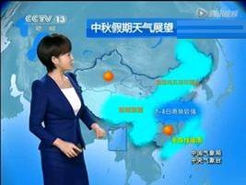
Weather forecast from station forecast to grid forecast
The transition from site forecast to grid forecast: More service is needed
Time resolution : hour -> minutes
Space resolution : 50 km - > 1-5 km
From temperature and precipitation prediction to disaster impact prediction
Needs delivery of on-demand weather service.
5Km
5Km
10Km
Notes:
站点预报向格点预报的转变: 服务需求牵引.
时间滚动 小时 -> 分钟
地域细分 50公里 -> 1-5公里
内容变化 温度降水 -> 综合灾害预估

Slide 5
CMA Cloud platform for big data
Providing Cloud Computing Service
Supporting “ Cloud + Client” deployment model
Data integrity: collection, management and service of all data resources of meteorological department(observations, products, government / Multimedia / publications / equipment information / monitoring logs, industry and social data... More than 100P in 2020)
Cloud Computing: computing services for processing, mining and analyzing all kinds of data products ( except the NWP model now)
Public services: providing big data analysis, optimization of applications, and decision-making
Promote new ECO system: establish "cloud + client“ computing for application development (direct support applications)
Notes:
数据，计算

Slide 6
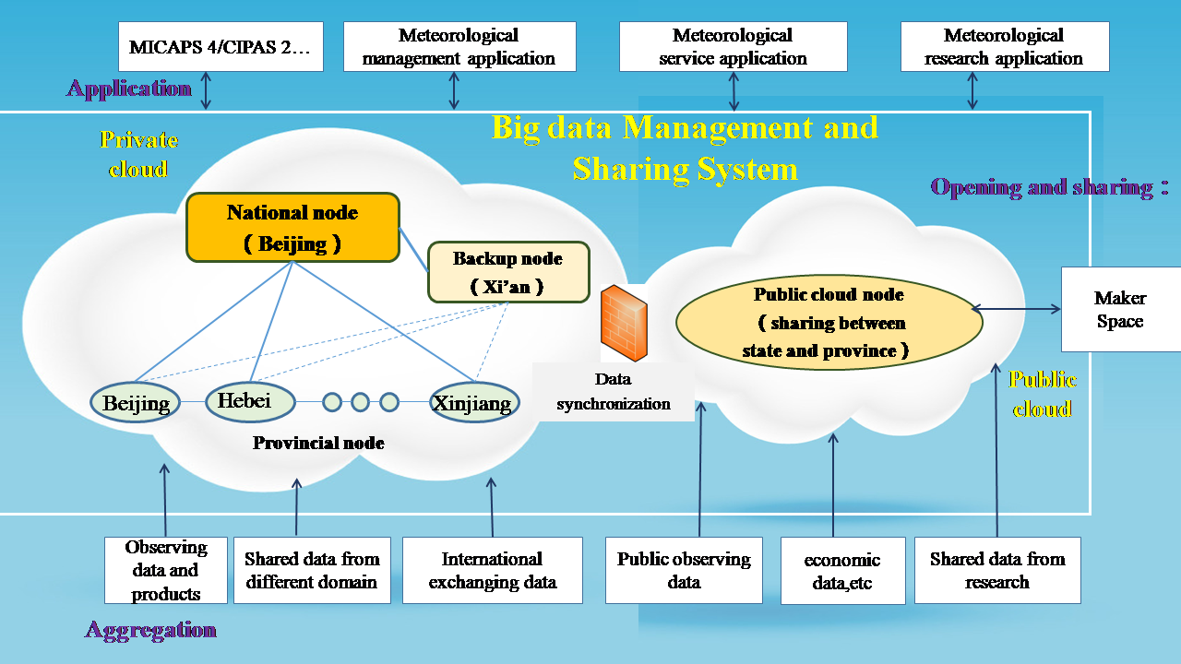
Hybrid Cloud Database in CMA
Hybrid Cloud structure
Real-time information & historical data service center , also provide Cloud computing integrated services
National Center , backup center , 31 provincial nodes and public cloud

Slide 7
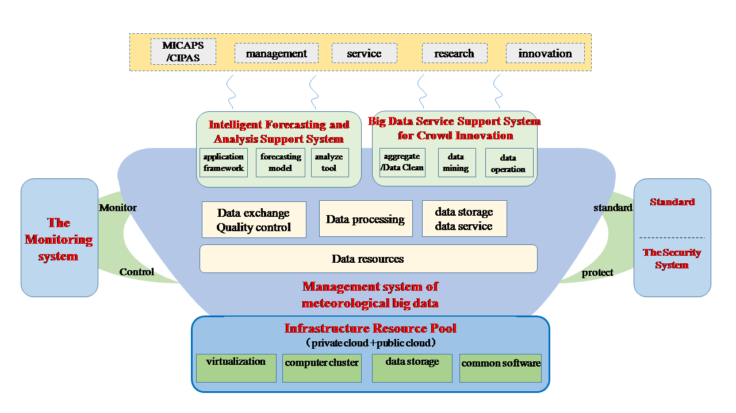
System Structure

Slide 8
The Data Management , unified common interface
Different distributed storage technology and meteorological data unified common interface
are used to support applications and data sharing
Query the observation
data from station
Statistical data
analysis
Real-time interaction
analysis
Data service for
the long sequence file
Meteorological Data Unified Service Interface System of CMA （MUSIC）
Basic database for observation data
from meteorological station
Analytical database for observation data
from meteorological station
Database for real-time interaction
Observation data：surface data Upper-air data, ocean , and so on
Statistical data：surface statistical data, Upper-air statistical data, and so on
radar data, satellite data, surface data,
and so on
Technology：The distributed
relational database
Storage time：long term
Technology：The distributed
analytical database
Storage time：long term
Technology：The distributed
table system
Storage time：7days-30days
Database for files and products (real-time)
Database for files and products (history)
radar data, satellite data, NWP data , meteorological products, and so on
radar data, satellite data, NWP data , meteorological products, and so on
Technology：The distributed file
system (high-end )
Storage time：the last 3 years
Technology：The distributed file
system (low-end )
Storage time：3 years ago

Slide 9
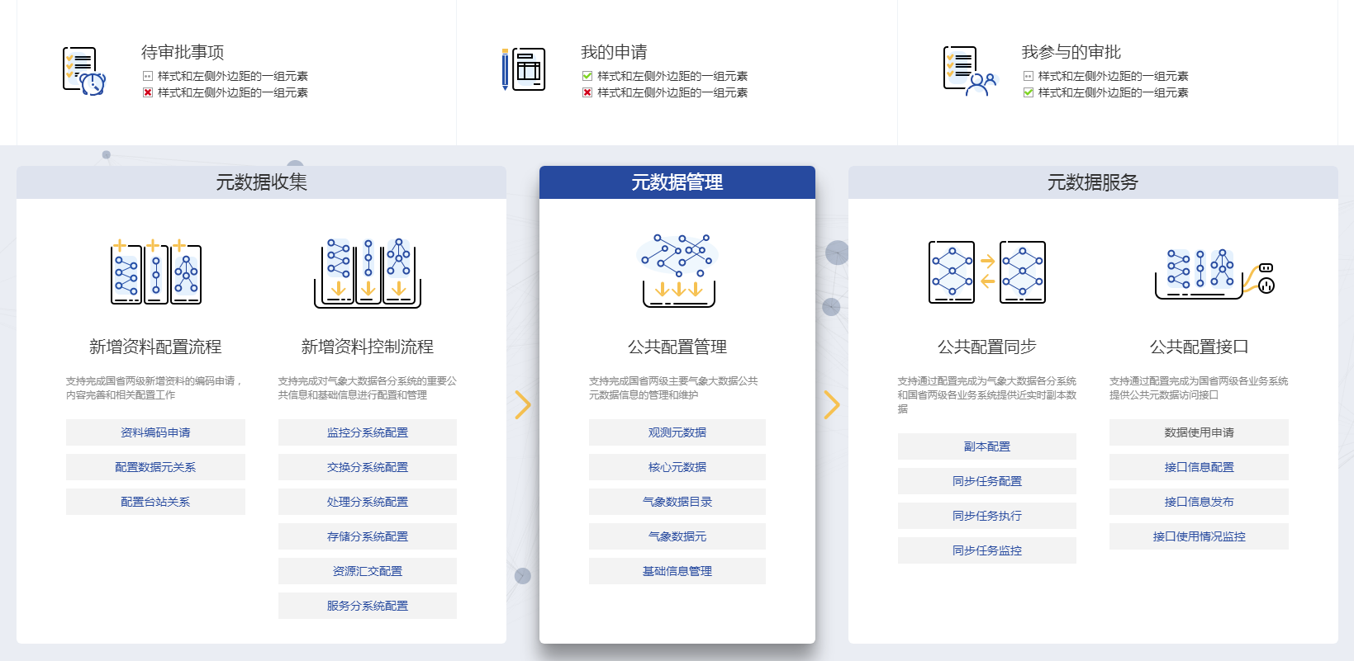
Unify Metadata management & service
Unified Metadata management and synchronization of CMA including state-province, and observation , station information ;
data directory and data element …
Metadata Service covers whole Cloud Platform

Slide 10
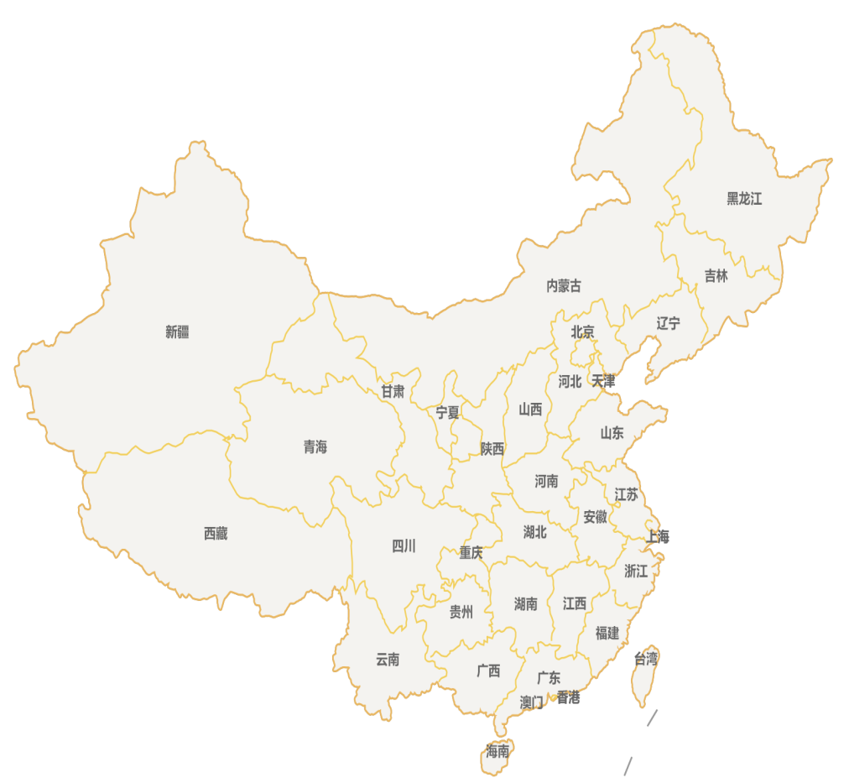
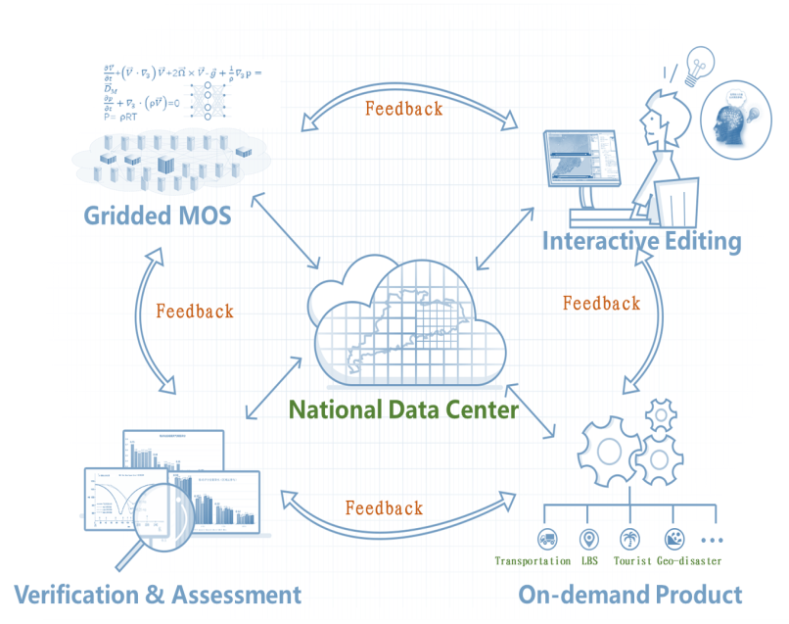
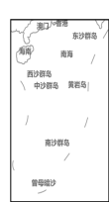
CMA Forecast : One Mesh across the Nation since 2016
5KM Resolution
Data Centric Operation
Common Interface：Cloud based API interface
Government Departments
Collaboration
For One Grid
Disaster Manager
Private Sectors
Province
Beijing
Province
Hebei
Province
Tianjin
。。。。
Province
Jiangsu
Province
Hubei
Province
GD

Slide 11
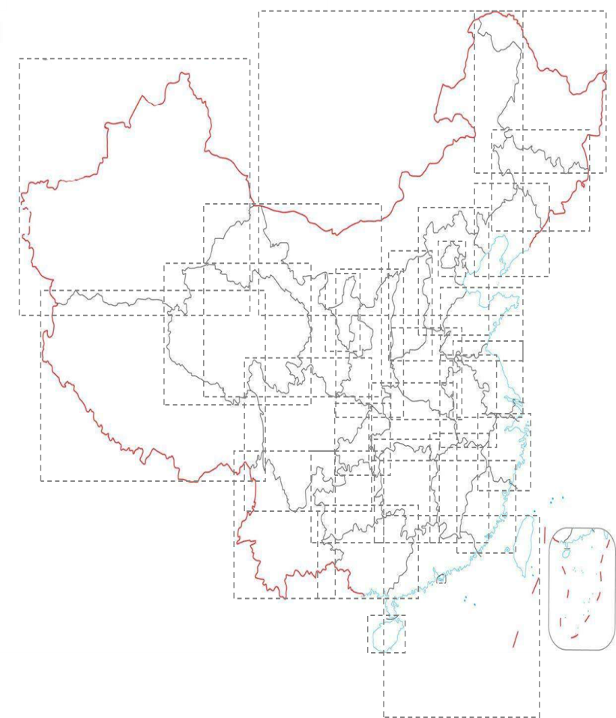
Multi-scale Models & 5KM Gridded Guidance
available both Private and Public Cloud
GRAPES-MESO/RAFS-10KM
NMC-5KM
Public Cloud
for Fast and Widely sharing
BJ-9KM
Could be an option
for other countries and WIS
SH-9KM
GZ-3KM
SH-9KM

Slide 12
Plan : CMA Cloud platform for big data
Within 2017-2019 , Build One meteorological big data cloud platform , Merging the Applications.
2016-2017: to Start the cloud platform design and construction in national center, initially provide big data resources services (small sized hardware ; Metadata service , data storage & sharing , a few applications adjustment, data collection outside CMA ) .
2018: to Complete cloud platform in the national center and some provinces, support the development of observation, weather, climate, service, scientific research applications.
2019: to Complete the platform construction of all provinces, focusing on opening up the national and provincial, public cloud and proprietary cloud data collaboration services.

Slide 13
CONTENTS
Building CMA Cloud platform for big data
Using Public Cloud Extend our ways for service
Testing of AI prediction Method

Slide 14
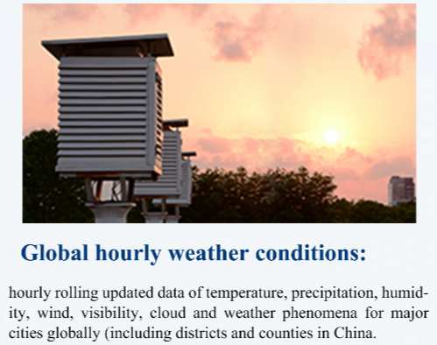
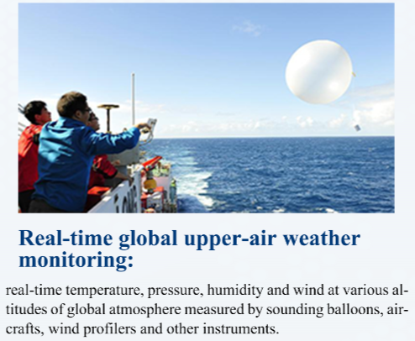
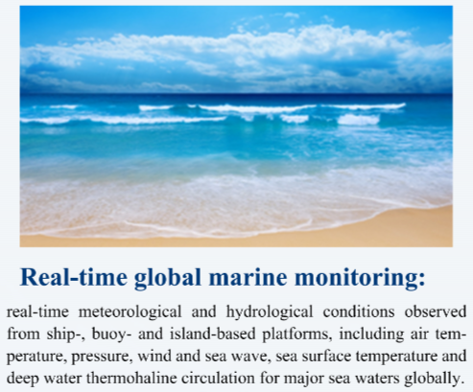


Our Data
Service Mode

Slide 15
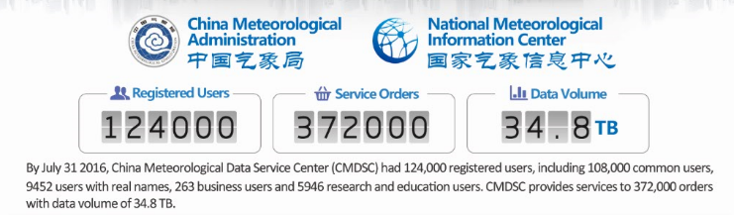
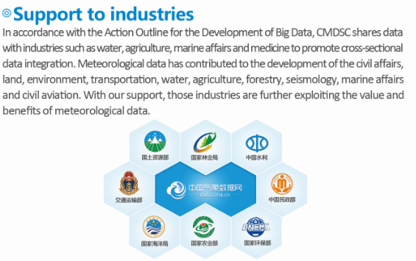
Service Satisfaction

Slide 16
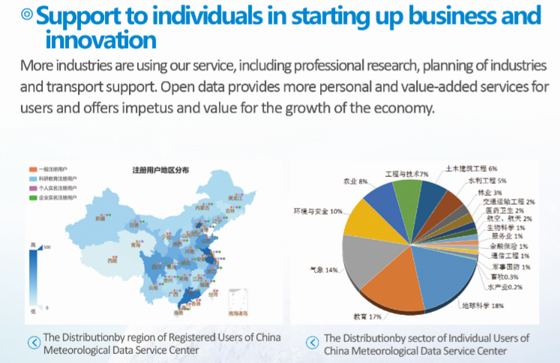
Service Satisfaction

Slide 17
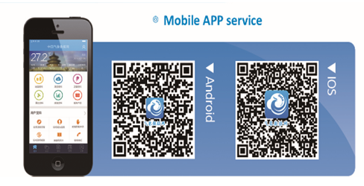
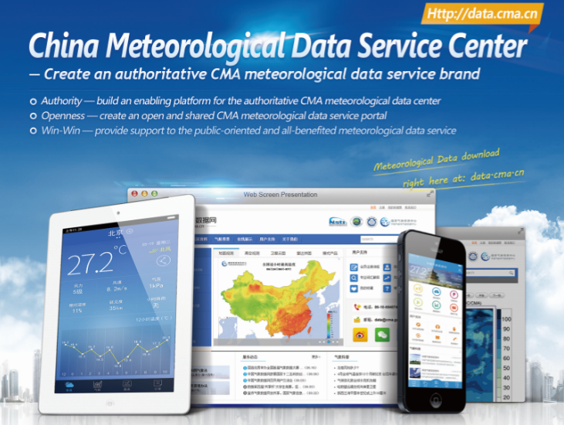





Technical Platform

Slide 18
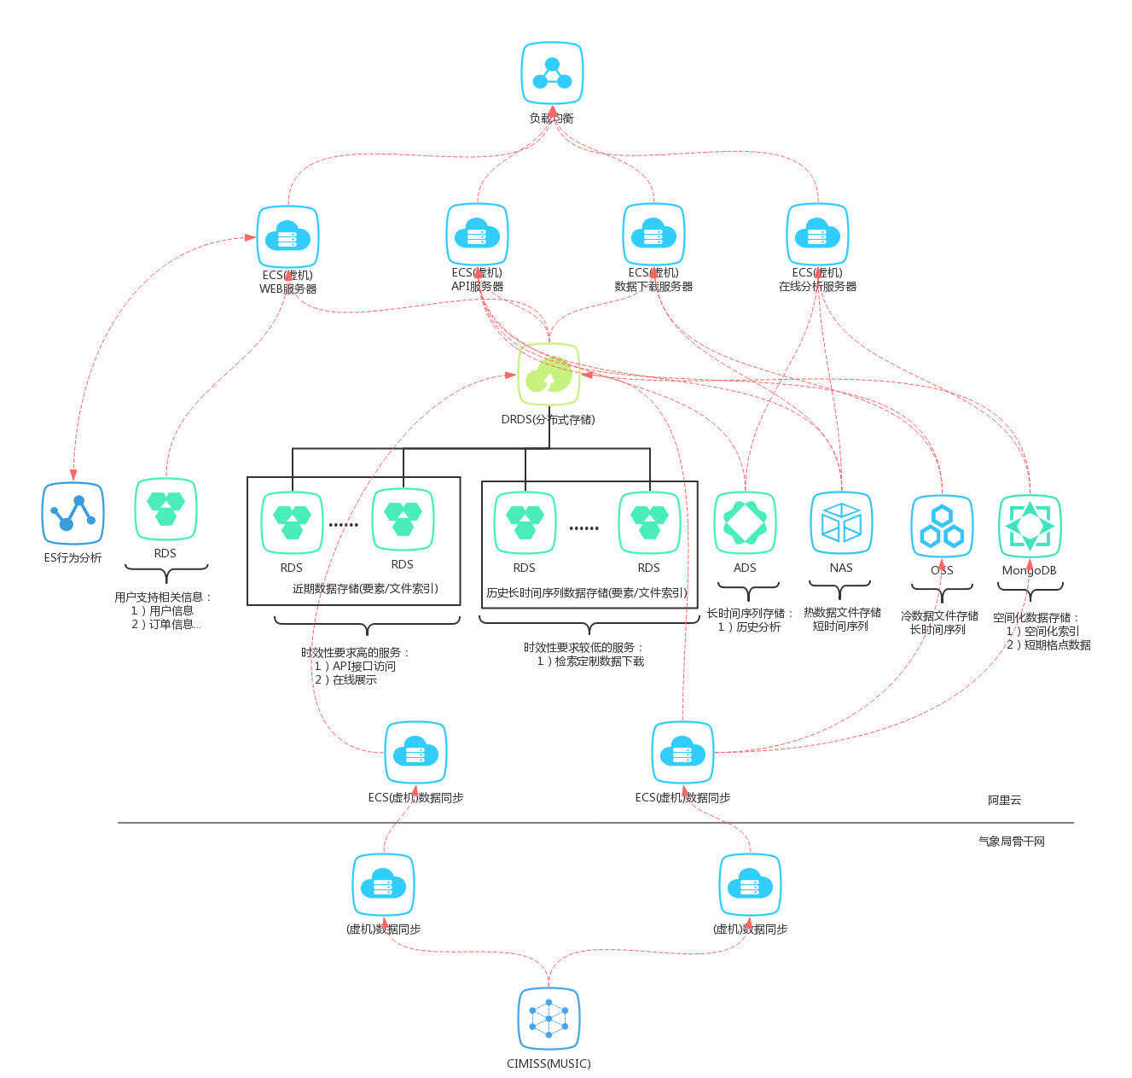
Service Type | Service Name | Products
Storage | Relational Database System(MySQL) | Cloud Database(RDS)
 | Analytical Database | Relational Distributed Database(DRDS)
 | Analytical Distributed Database | Analytical Database System(ADS)
 | MongoDB | MongoDB
 | Distributed Object-Based Storage System | Open Storage Service(OSS)
 | Distributed NAS | NAS
 | ElasticSearch | ---
Service | Cloud Hosting | Cloud Elastic Compute Service
 | Memcache | Open Storage Service
 | Load Balance | Server Load Balancer
Service determines storage mode
Improve service effectiveness
We build storage framework through the timeliness，time sequence，and relevance of Data service

Slide 19
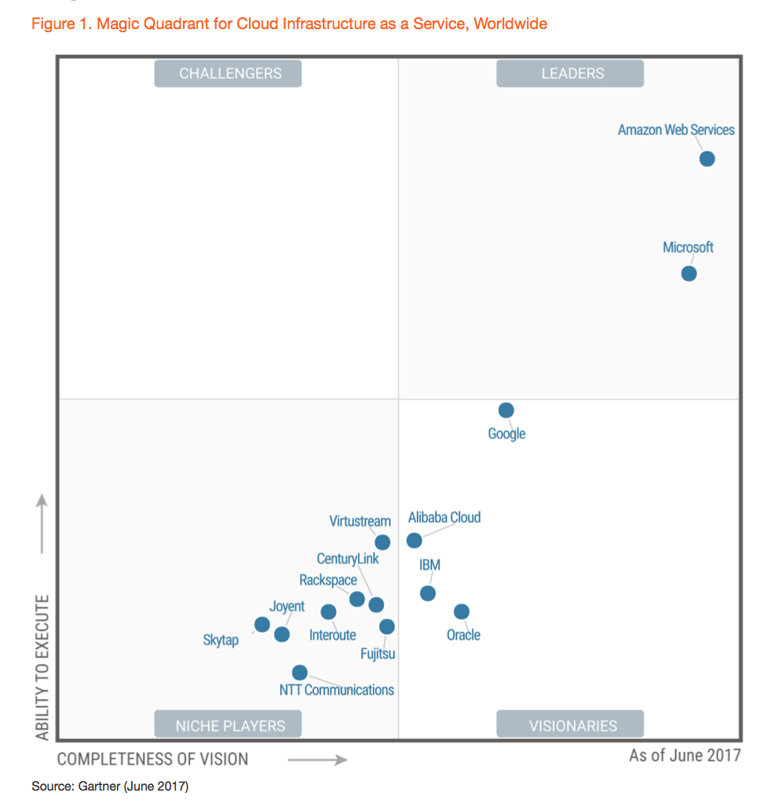


Alibaba Cloud in Gartner MQ for IaaS 2017
26
Data Centres
Around the World
40.7%
China Market Share
26
Data Centres
Around the World

Slide 20

Next Step
Based on the Meteorological informatization, Data and products, deeply integrate with industry and social Data,
Intelligent Meteorological Data service
Data resource
Tech application
Service innovation
Big Data storage and analysis mining
storage and computation integration
Data service mode innovation
Data on the cloud+ application software
Data developing mode innovation
Integration analysis of industry Data

Slide 21
CONTENTS
Building CMA Cloud platform for big data
Using Public Cloud Extend our ways for service
Testing of AI prediction Method

Slide 22
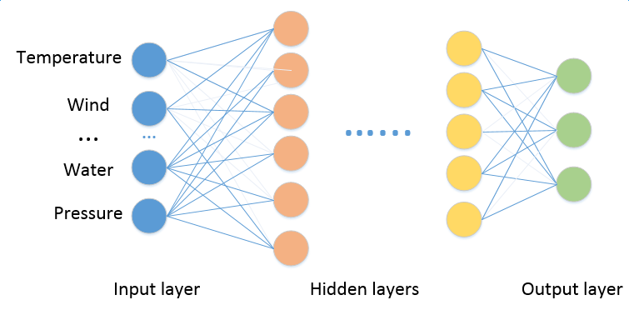
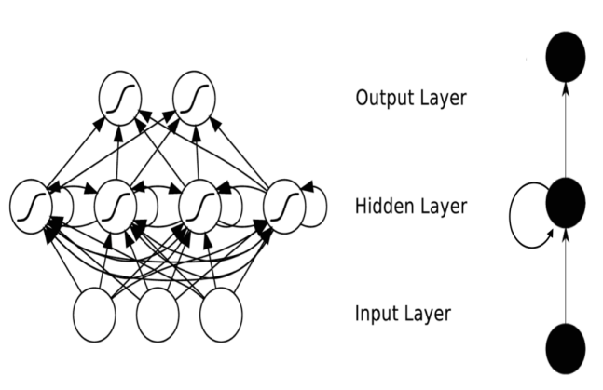
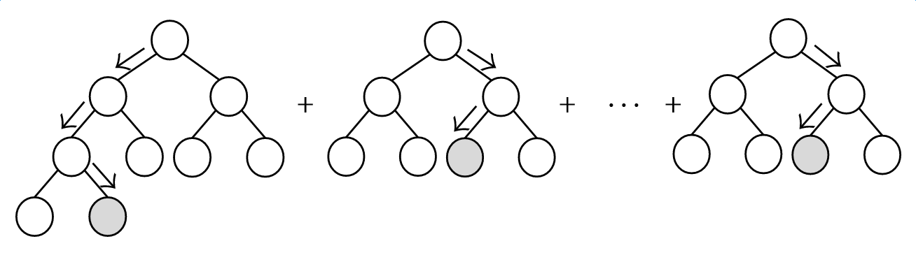
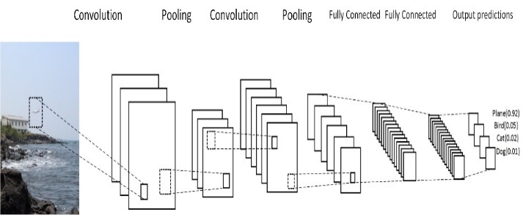
尝试多种非线性机器学习方法建模
DNN(Deep Neural Networks)
RNN(Recurrent Neural Networks)
Nonlinear
( ensemble decision trees)
CNN(Convolutional Neural Network)
GBDT(Gradient boosting decision tree)

Slide 23
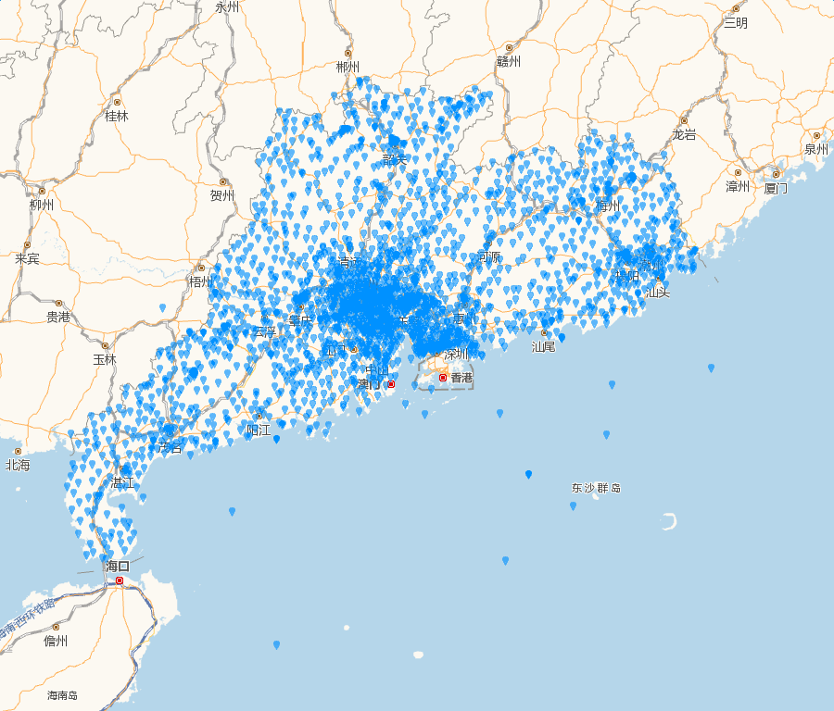





Large amount of observation and NWP data is ingested into the algorithm
Data：
1、2000+Oberservations(2013-2015)
2、Radar echoes, QPE、QPF数据
3、NWP prediction data
More than half billion records.
Target：
3 hours rainfall forecast
Learning ：2013-2014
Testing：2015

Slide 24
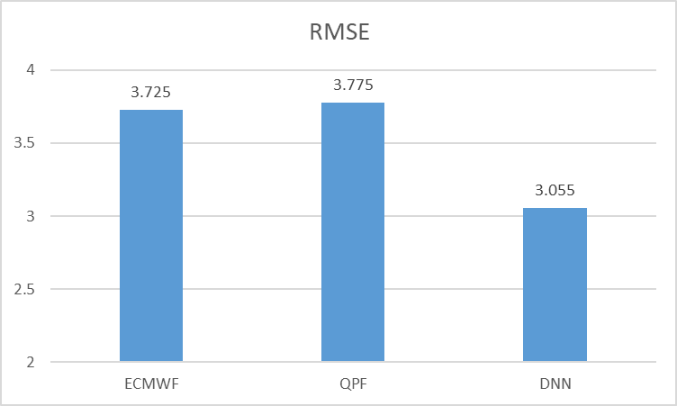
Remarks：The modeling data were taken from 2013-2014 .
The test data were collected from 2015 for the cumulative precipitation forecast test in the next 3 hours.
The root mean square error of the deep learning method is the smallest,
but detailed classification tests should be done for applications,
Because ECMWF is the global model, and only 2 reporting time every day,
so We need to focus on comparing the effect of QPF and deep learning .

Slide 25
CSI test
POD test
FAR test
 | QPF | DNN
0-0.1 | 0.871 | 0.139
0.1-2 | 0.125 | 0.077
2-10 | 0.185 | 0.202
>=10 | 0.182 | 0.154
>=0.1 | 0.431 | 0.156
>=20 | 0.07 | 0.002
晴雨 | 0.883 | 0.257
 | QPF | DNN
0-0.1
0.1-2 | 0.168 | 0.703
2-10 | 0.332 | 0.534
>=10 | 0.334 | 0.185
>=0.1 | 0.532 | 0.958
>=20 | 0.116 | 0.002
 | QPF | DNN
0-0.1
0.1-2 | 0.672 | 0.921
2-10 | 0.704 | 0.755
>=10 | 0.715 | 0.521
>=0.1 | 0.306 | 0.843
>=20 | 0.851 | 0.389
 | QPF | DNN
RMSE | 4.019 | 3.193
Conclusion:
1. The mean root mean square error of DNN is the smallest in the whole year.
2. For grading precipitation test, DNN and QPF have their own advantages:
For weaker precipitation, the CSI score of DNN is better, and POD is higher (that is, more likely to predict rain);
For strong precipitation (3H rainfall over 10 or 20mm), QPF is still better than DNN.

Slide 26
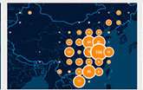
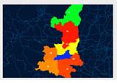
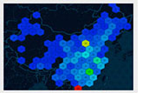
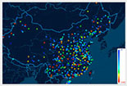
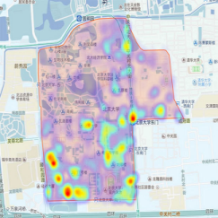
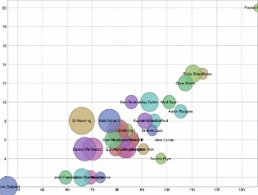
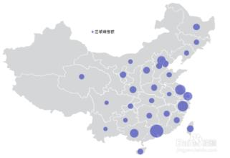


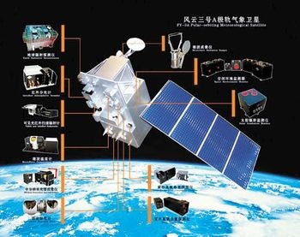
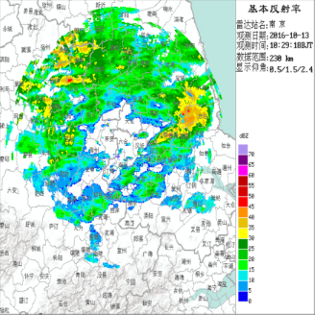
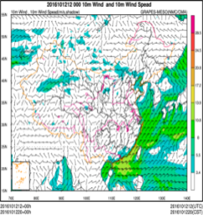
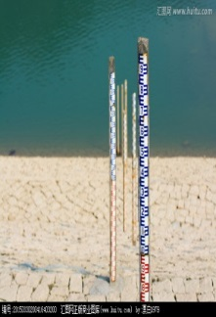

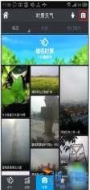

On our way :Intelligent Forecasting System
Forecasting products automated generation and visualization
Big data technology, machine learning method, deep learning method and the weather prediction method combines the virtue of subjective and objective are used to make the weather forecasting and early warning more intelligent.
Association
Regression
Cluster
Similar
case
Anomaly detection
Deep learning
Weather analyze
Physical quantities diagnose
Forecast verification
Extreme weather
Explain and
application
Forecast ensemble
hydrology data,
environmental
data ,and so on
Ground
observation
Satellite
observation
Radar
observation
Numerical weather
prediction
Observation
by public

Slide 27
Thank you for your attention

