Slide 1
Environmental Research Division's Data Access Program (ERDDAP) – An example of data and metadata brokering infrastructure
Tobias Spears

Slide 2
What is ERDDAP
Data server and metadata catalogue
Acts as a mediator between many data formats/services and new connectors continue to be developed
Can be operated standalone or federated (brokered) relationships with other systems
Supports multiple interrogation and access pathways
Is open source and you can host/extend your own ERDDAP instance(s)
Is one example of the types of data and metadata cataloguing and access technologies in use within the marine community

Slide 3
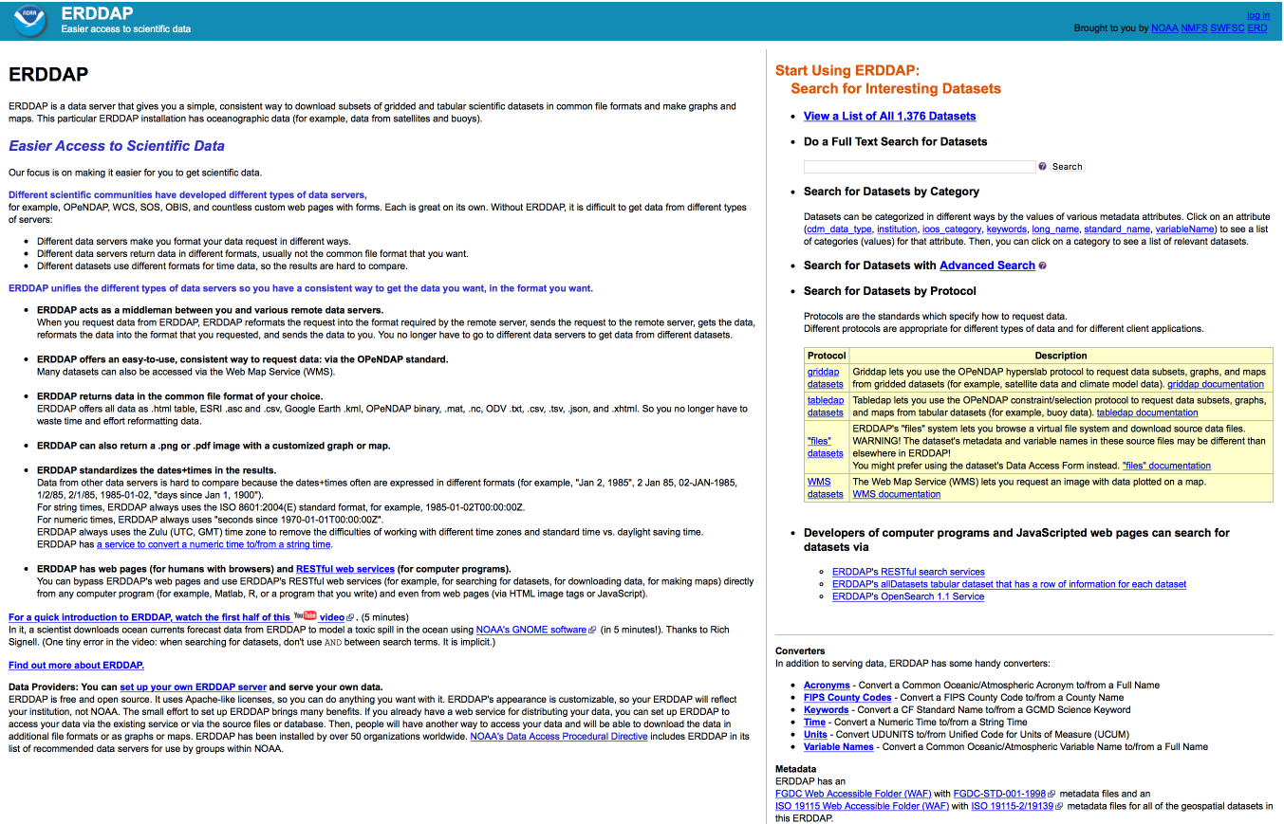
Deceptively plain
Minimalist UI – easy to skin
Direct access to key capabilities – easy to wrap in another user experience or implement interoperability connections
Extensible – connect to new data sources/services

Slide 4
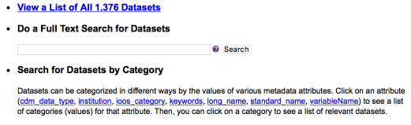

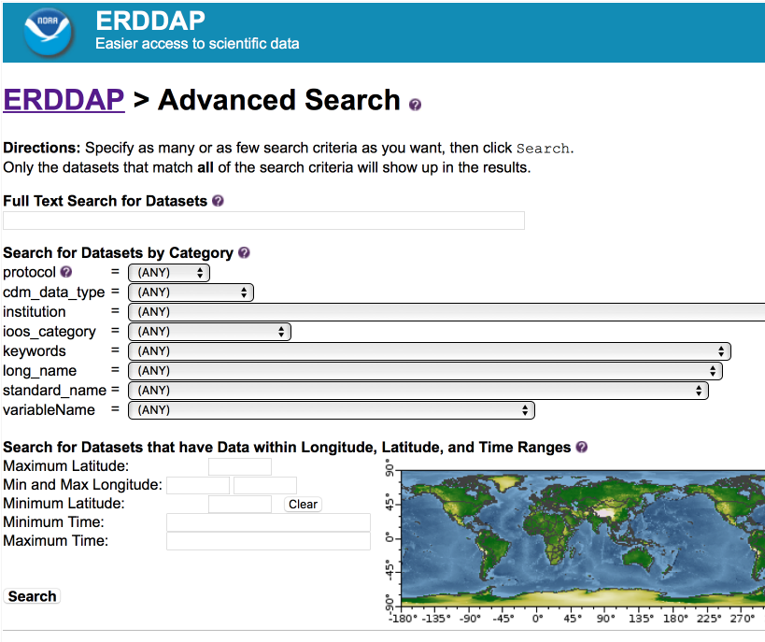
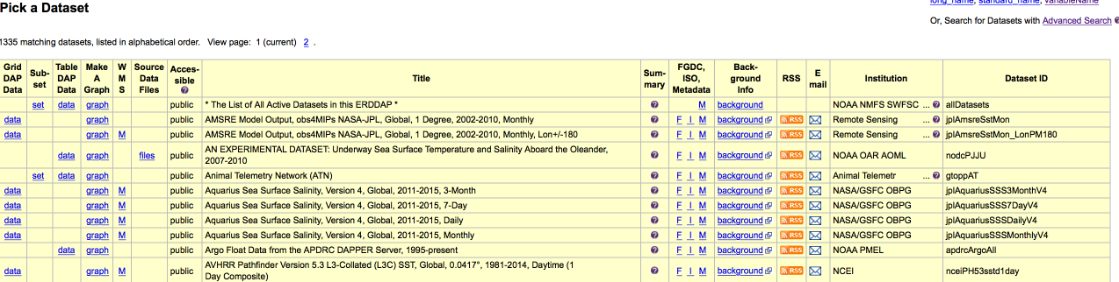
Search facilities
Interactive and non-interactive facilities
Simple, advanced, and service/API
Faceting and controlled vocabularies supported
Human and machine readable results
RSS and e-mail subscription to dataset updates is supported

Slide 5
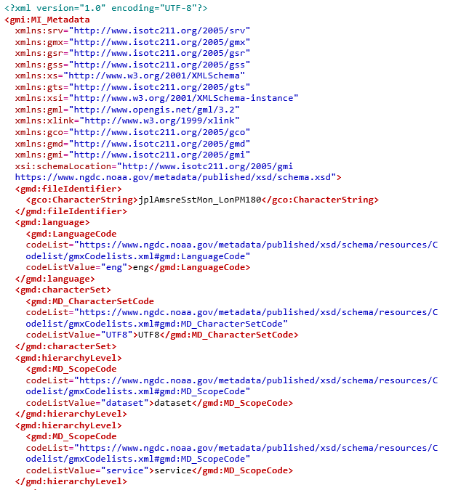
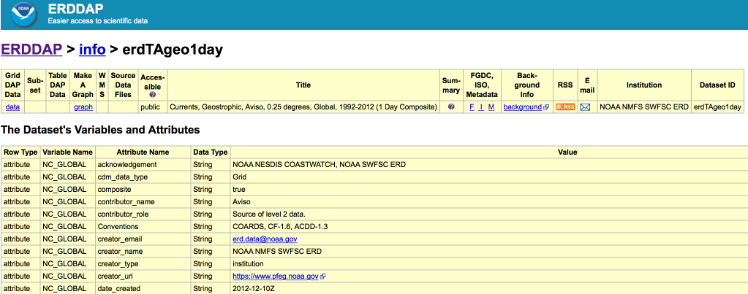
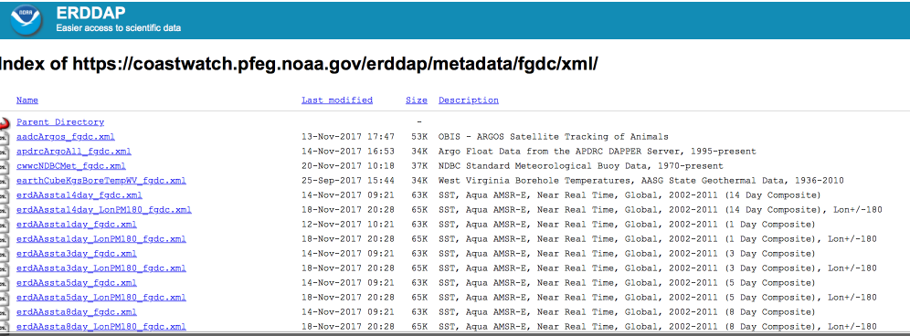
Metadata
Simple and advanced interface, service/API
Human and machine readable output
FGDC and ISO 19115 metadata
WAF support

Slide 6
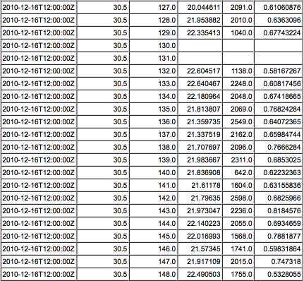
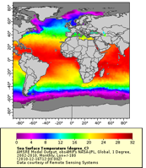
Data
Interactive and non-interactive facilities
Direct access to full dataset, subsetting in some cases
Human and machine readable data
Value-added products
Support for embedding and linking from other systems/applications
{
"table": {
"columnNames": ["griddap", "Subset", "tabledap", "Make A Graph", "wms", "files", "Accessible", "Title", "Summary", "FGDC", "ISO 19115", "Info", "Background Info", "RSS", "Email", "Institution", "Dataset ID"],
"columnTypes": ["String", "String", "String", "String", "String", "String", "String", "String", "String", "String", "String", "String", "String", "String", "String", "String", "String"],
"rows": [
["", "https://coastwatch.pfeg.noaa.gov/erddap/tabledap/erdGtsppBest.subset", "https://coastwatch.pfeg.noaa.gov/erddap/tabledap/erdGtsppBest", "https://coastwatch.pfeg.noaa.gov/erddap/tabledap/erdGtsppBest.graph", "", "https://coastwatch.pfeg.noaa.gov/erddap/files/erdGtsppBest/", "public", "Global Temperature and Salinity Profile Programme (GTSPP) Data, 1985-present", "The Global Temperature-Salinity Profile Programme (GTSPP) develops and maintains a global ocean temperature and salinity resource with data that are both up-to-date and of the highest quality. It is a joint World Meteorological Organization (WMO) and

Slide 7
Conclusions
ERDDAP is one example of the types of portal/middle-ware solution being used in the marine community
Rather than focusing on the technology, it is more important to focus on agreed upon interface and content standard, and to ensure the individual implementations meet agreed upon service levels.

Slide 8
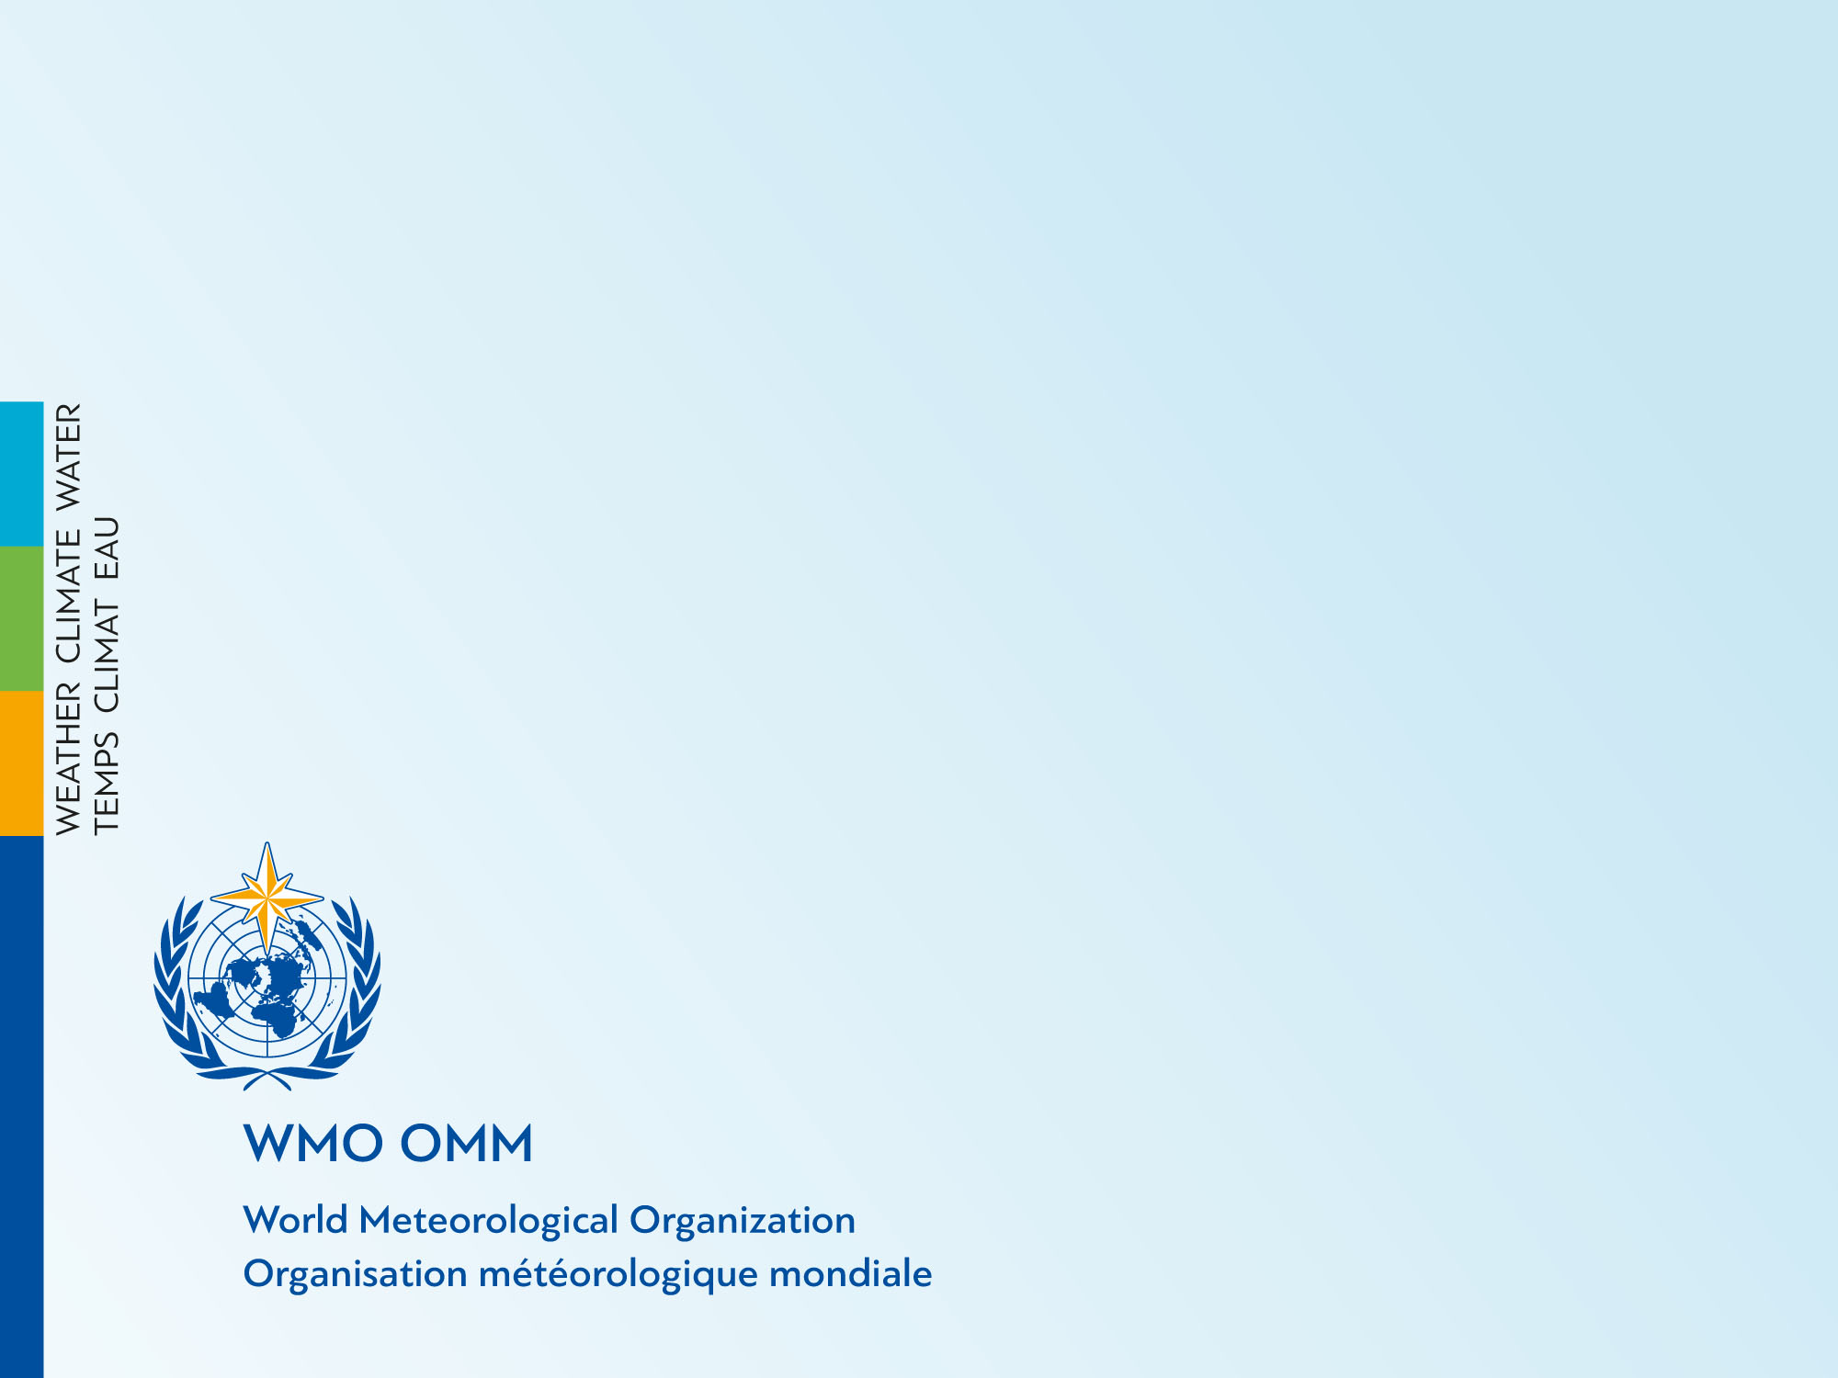
Thank you
Merci

