Slide 1
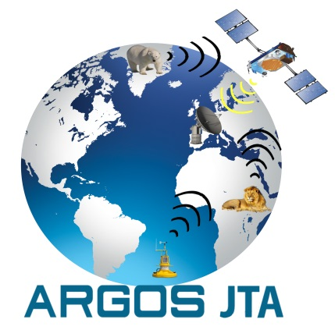
Satcom E2 Meeting
WMO, Geneva,
March 26th, 2018
Agenda Item 5.0
Overview of Argos JTA
Eric Locklear
ARGOS JTA Chairman

Slide 2

Why is the ARGOS JTA Here?
Brief History Of JTA
Starting with the 1974 CNES/NOAA MOU, rates were negotiated and the 1st Tariff Agreement Adopted on 14 December 1979.
In 1981, at a WMO EC meeting, the U.S. recommended that an international agreement be established for all interested users to encourage participation and growth in the system.
Thus the ARGOS JTA was born with 9 countries at the inaugural meeting: Argentina Australia Canada Netherlands
  Denmark France Germany Norway USA
Beginning in 1985, and continuing today, the JTA is served by secretariats of the World Meteorological Organization (WMO) & the Intergovernmental Oceanographic Commission (IOC).
In 2017, have approximately 27 Nations participating in the JTA

Slide 3
Vision & Mission of the JTA
VISION
To provide a fair and affordable mechanism to monitor the environment.
MISSION
To ensure the sustainability of Argos, a global data collection and localization satellite system dedicated to studying and protecting the environment.
What does the JTA do?
Transparently negotiate the Argos tariffs for data collection, location, and processing for the environmental observation community; and influence the technological evolution of the Argos system to meet User needs
How does the JTA do it?
Provides a collaborative global forum between nations, user groups, and CLS within the WMO & IOC framework; and through a participative governance structure in accordance with the JTA Terms of Reference.

Slide 4


What is the current structure of the program?
World Meteorological Organization (WMO)
(SatComm Forum)
Intergovernmental Oceanographic Commission (IOC)
Collecte Localisation Satellites (CLS)
FINANCIAL
(ARGOS JTA)
USERS
OPERATIONS
(OPSCOM)
NOAA-CNES-EUMETSAT-ISRO
Floats
Fixed Stations
Wildlife
Buoys

Slide 5
Recent Changes
Recent Changes Include:
JTA Meetings now 1X every 4 years following the lead of the Satcom Forum Terms-Of-Reference. Used to meet annually following the WMO/IOC Data Buoy Cooperation Panel (DBCP).
January of 2018, implemented a major overhaul of the tariff structure for all users with the purpose to make it simple, attractive, and budget predictable with the goal of leading and encouraging the future of Argos and the development of its applications.
3. Added an action for the JTA Chair to provide a summary report on any official meetings to the Satcom Forum Chair.

Slide 6
Questions?

