Slide 1
Aviso
Notification system for ECMWF real-time NWP products and dissemination
T. Quintino, C. Iacopino, J. Hawkes, B. Raoult
Pub/sub Workshop @ Météo France, Toulouse

Slide 2

Aviso
Aviso is a software developed at ECMWF with the aim of:
Notifying NWP data availability
Meant for automated systems in support of Cloud based workflows
Support When <this> … Do <that> … via Event-Listener architecture
Support ECMWF metadata semantics in its requests

Slide 3


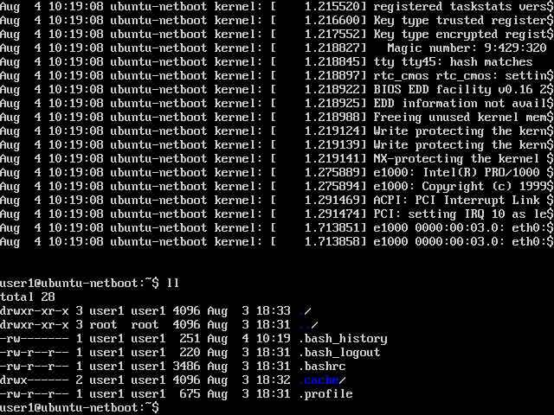

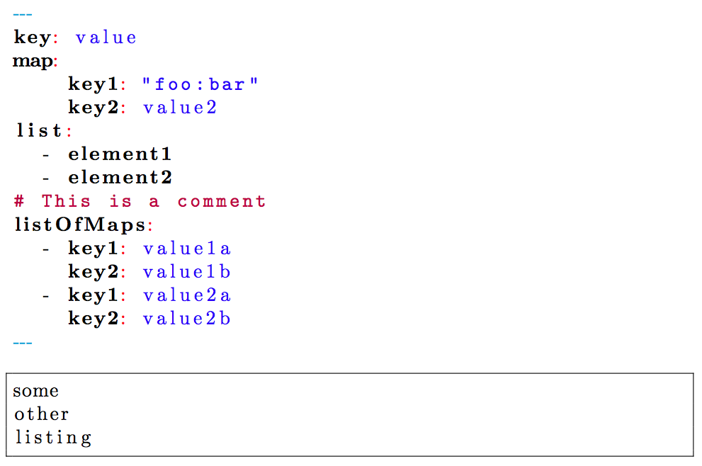

Aviso Architecture
Scalable, distributed and reliable notification system for heterogenous applications
User interfaces: CLI and Python API
Client-Server protocols REST and gRPC
Server: Google etcd key-value store
Client: standalone Python application
Workflow
Aviso Server
Aviso Client
<k><V>
Etcd
Etcd
User subscribes for changes to a set of keys and defines command to be trigged once a notification is retrieved.
Aviso starts polling the key-value store for changes.
A notification provider sends a key-value change.
The subscriber is notified with the new key-value pair.
Event triggers user’s defined command as a new process.
key?
<notification>
Notification Subscriber
Etcd
<k><V>
Listener configuration
Notification Provider

Slide 4
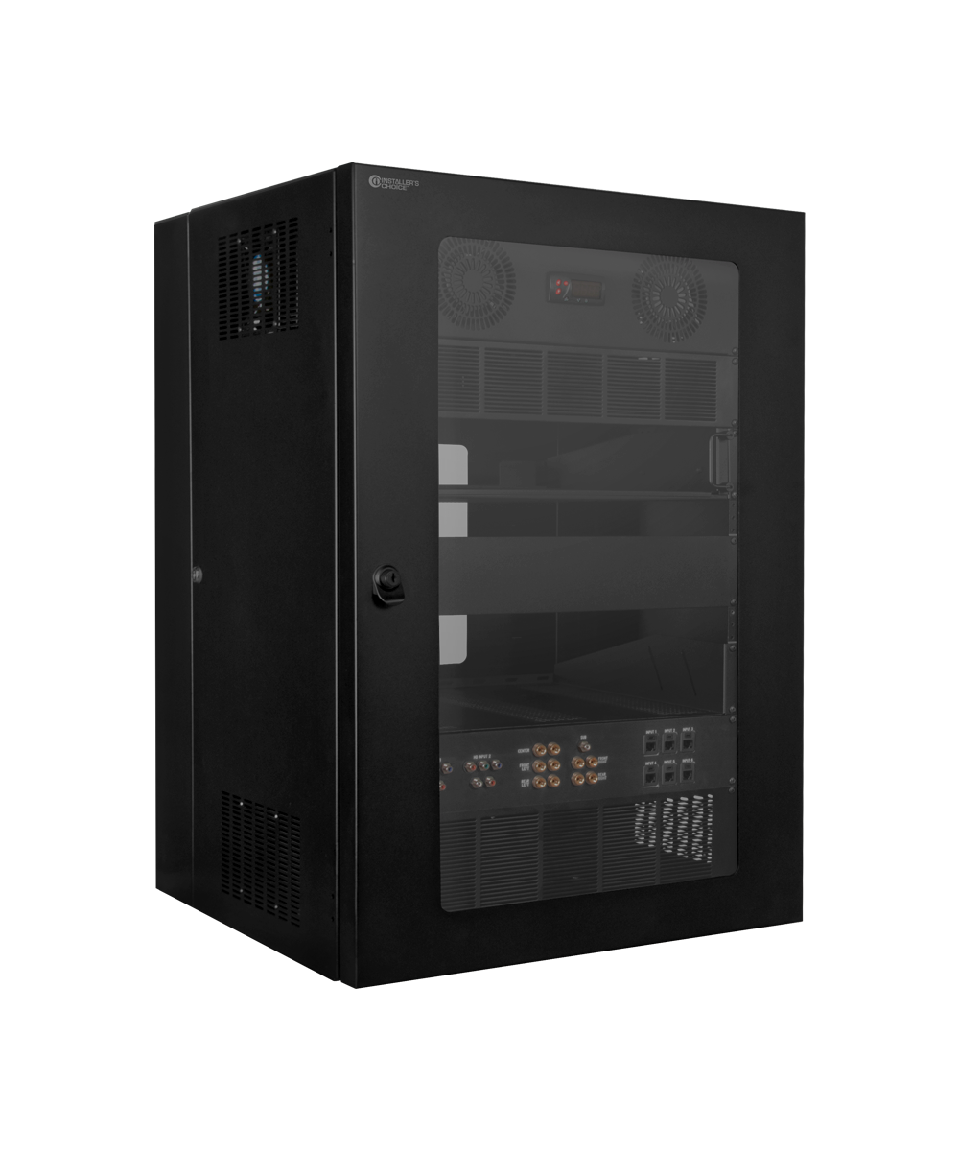

ECMWF Dataflow today
notification
notification
NWP Model
IFS
Object Storage
FDB
Post Processing
PGEN
Dissemination
ECPDS

Slide 5
Aviso for new forecast data on FDB
European Weather Cloud
User subscribes for when new forecast step is available.
Aviso Client starts polling Aviso Server for changes.
IFS produces the new forecast step.
New forecast step is sent to FDB.
Forecast step notification is sent to Aviso Server.
Aviso Client is notified of the new forecast step.
Aviso triggers Mars Client to fetch the new forecast.
Aviso Client
Mars Client
Aviso server
Etcd
Etcd
Etcd
FDB
IFS

Slide 6
Aviso for product dissemination via ECPDS
European Weather Cloud
User subscribes for when new products are available.
Aviso Client starts polling Aviso Server for changes.
New product is sent from PGEN to ECPDS for dissemination.
ECPDS sends the product to a S3 store.
ECPS sends the notification to Aviso Server.
Aviso Client is notified of the new product.
Aviso runs a user scripts to fetch the new product.
Aviso Client
Aviso Server
Etcd
Etcd
S3
Etcd
Post Processing
PGEN
Dissemination
ECPDS

Slide 7
Aviso installation
On a EWC VM:
Setup the Python3 environment
On the Ubuntu image, install Git
Install Aviso
  $ sudo pip3 install -e git+ssh://git@git.ecmwf.int/lex/aviso.git@master#egg=aviso

Slide 8
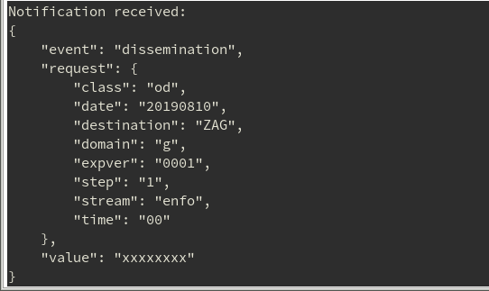
Quick Start
To launch Aviso:
Create a configuration file in $HOME/.aviso/config.yaml :
Launch Aviso:
  $ aviso listen
listeners:
- event: dissemination
request:
destination: ZAG
stream: enfo
step: [1,2,3]
triggers:
- type: echo
Event Listener configuration
notification

Slide 9
Configuration
Aviso can be executed as:
Shell application:
  $ aviso listen
Aviso configuration file in $HOME/.aviso/config.yaml
System service:
  Create a system service unit in /etc/systemd/system/aviso.service:
  Reload systemd
    $ sudo systemctl daemon-reload
  Start the service
    $ sudo systemctl start aviso.service
Aviso configuration file in the system directory, /etc/aviso/config.yaml with system logging path.
[Unit]
Description=Aviso
[Service]
ExecStart=/usr/local/bin/aviso listen
[Install]
WantedBy=multi-user.target

Slide 10
Listener configuration
Note, listeners can also be defined as independent files, in the latter case:
  $ aviso listen your_listener.yaml
listeners:
- event: dissemination
request:
destination: FOO
stream: enfo
step: [1,2,3]
triggers:
  - type: command
  command: examples/script.sh --date ${request.date} -s ${request.stream}
  environment:
  STEP: ${request.step}
  TIME: "The time is ${request.time}"
Request defines a selection that filters the event
Trigger defines the post notification command to be executed

Slide 11
Listener configuration (continued)
Multiple listeners can be defined simultaneously. Multiple triggers can be defined per listener.
listeners:
- event: dissemination
request:
destination: FOO
stream: enfo
step: [1,2,3]
triggers:
  - type: command
  command: examples/script-enfo.sh --date ${request.date} -s ${request.stream}
  environment:
  STEP: ${request.step}
  TIME: "The time is ${request.time}“
- event: dissemination
request:
destination: FOO
stream: oper
time: [0, 12]
step: [1,2,3]
triggers:
  - type: echo

Slide 12
Testing your configuration
Add the following setting to the configuration file $HOME/.aviso/config.yaml
This allows to connect to a local test notification server, part of Aviso.
Launch Aviso:
  $ aviso listen
Send notifications. From another terminal run the notifiy command. Here an example:
  $ aviso notify event=dissemination,class=od,date=20190810,destination=FOO, domain=g,expver=1,step=1,stream=enfo,time=0,value=xxxxxxxx
notification_engine:
type: test

Slide 13
Catch-up feature
The user can retrieve past notifications of several days past.
This can also be used to test the listener configuration with real notifications.
Launch Aviso:
  $ aviso listen --from 2020-01-20T00:00:00.0Z --to 2020-01-21T00:00:00.0Z
It will replay all the notifications sent from 20 January to 21 January.
Note, lauching Aviso with no options:
  $ aviso listen
listens from the last notification received.
If there was none, it will ONLY listen to new notifications.

Slide 14
Using Aviso as a Python API
Aviso can be used as a Python API. Below an example:
from pyaviso import ListenerManager
# define function to be called
def do_something(notification):
# do something with the notification
...
# define the trigger
trigger = {"type": "function", "function": do_something}
# create a event listener request that uses that trigger
request = {"destination": “FOO", "stream": "enfo", "time": 0}
listener = {"event": "dissemination", "request": request, "triggers": [trigger]}
listeners = {"listeners": [listener]}
# run it
aviso = ListenerManager()
aviso.listen(listeners=listeners)
# wait ...
1
2
3
4
5

Slide 15
Compatibility with CloudEvents - http://cloudevents.io
Aviso Notification
Aviso Notification in CloudEvents Json format
{
"event": "dissemination",
"request": {
"class": "od",
"date": "20191112",
"destination": "ZAG",
"domain": "g",
"expver": "0001",
"step": "001",
"stream": "enfo",
"time": "18"
},
"value": https://xxx.ecmwf.int/xxx/xxx.xx
}
{
"specversion" : "1.0",
"type" : "com.example.someevent",
"source" : "/mycontext",
"id" : "C234-1234-1234",
"time" : "2020-01-05T17:31:00Z",
"datacontenttype" : "application/json",
"data" : {
  "event": "dissemination",
  "request": {
  "class": "od",
  "date": "20191112",
  "destination": "ZAG",
  "domain": "g",
  "expver": "0001",
  "step": "001",
  "stream": "enfo",
  "time": "18"
  },
  "value": https://xxx.ecmwf.int/xxx/xxx.xx
  }
}
Under Investigation

Slide 16


THANK YOU !
QUESTIONS ?
This work has been supported by LEXIS project and partly funded by European Union’s Horizon 2020 Research and Innovation programme under Grant Agreement 824115

