Slide 1
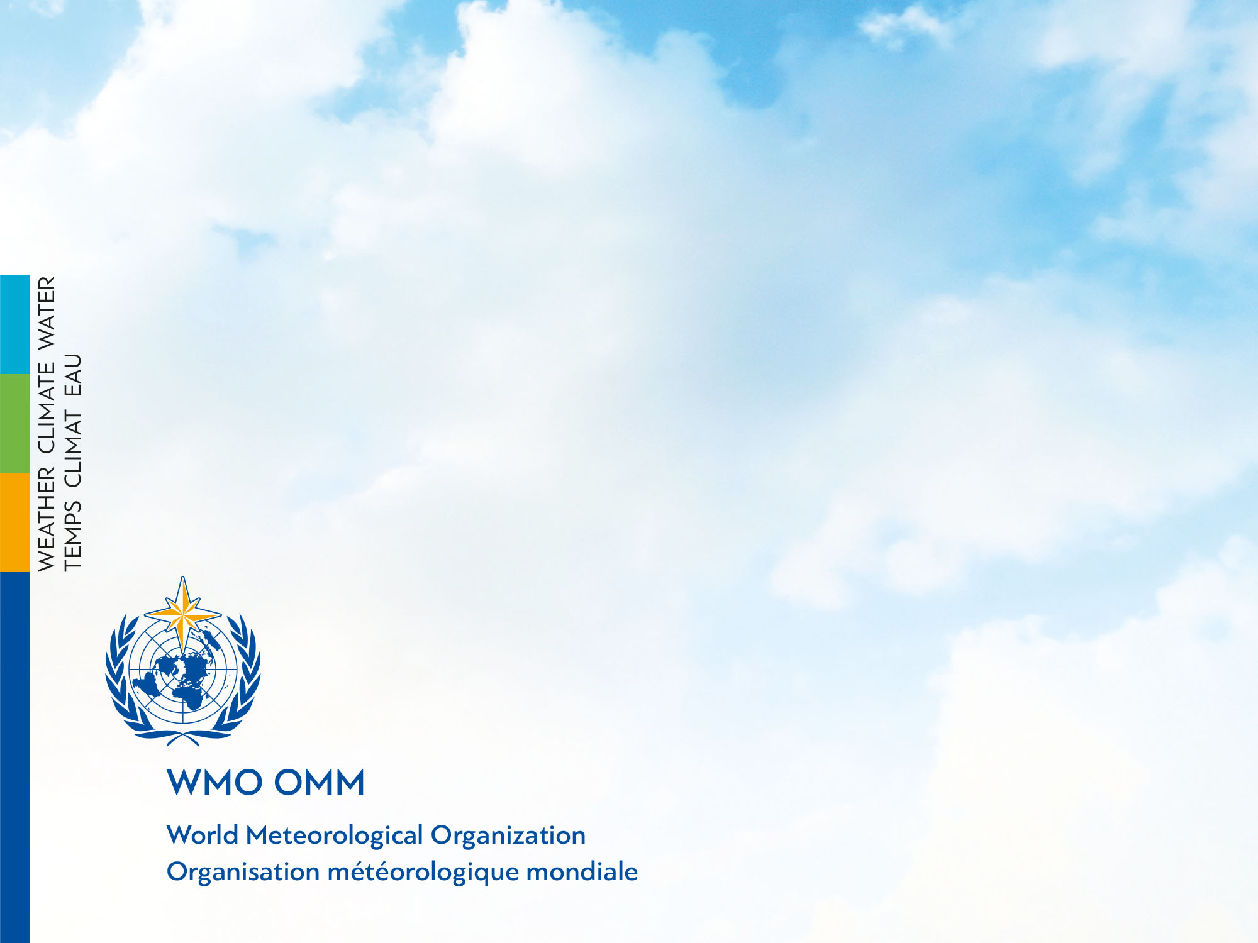
WMLGW - WATERML2 GROUNDWATER
Silvano Pecora
Vice-President of CHy
Inter-Program Expert Team on Data Representation Development
Zagreb, Croatia
18-20 February 2019

Slide 2
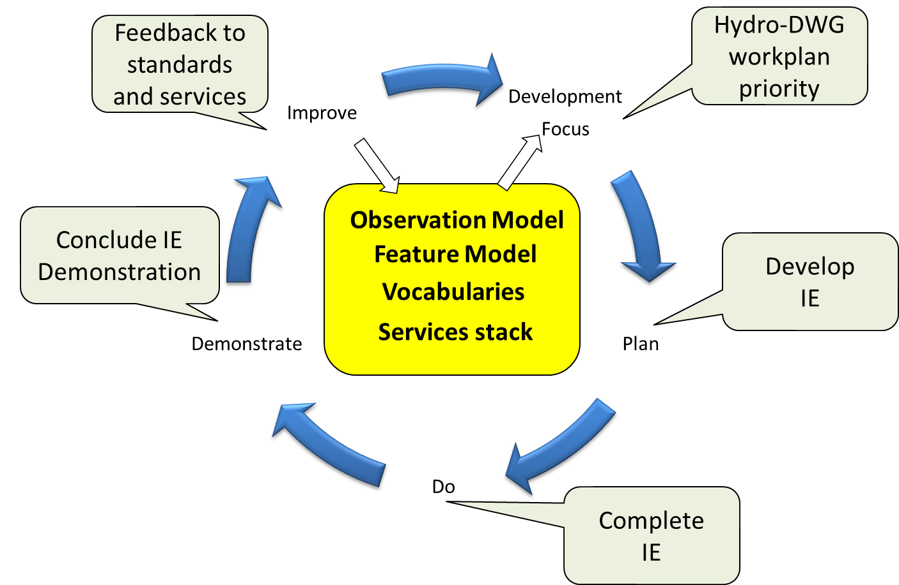
International Standardization for Water Data
OGC-WMO Hydrology Domain Working Group
  standards for water data: WaterML 2.0 suite
  organizing Interoperability Experiments (IEs) focused on different sub-domains of water
Chairs:
  Tony Boston (Australia)
  Silvano Pecora (Italy)
  David Blodgett (USA)
Iterative Development
http://external.opengis.org/twiki_public/bin/view/HydrologyDWG/WebHome

Slide 3
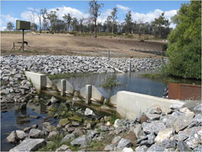
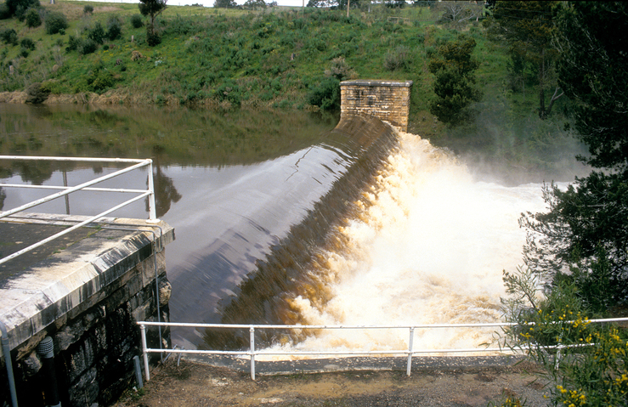
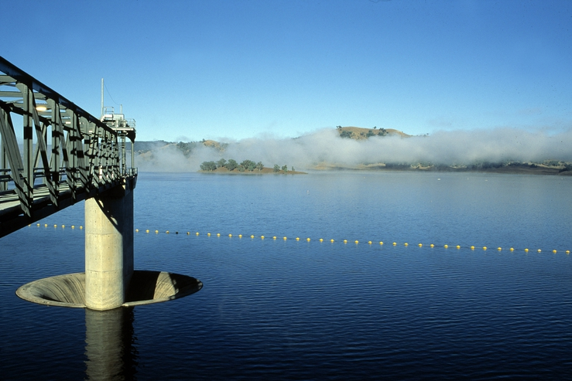
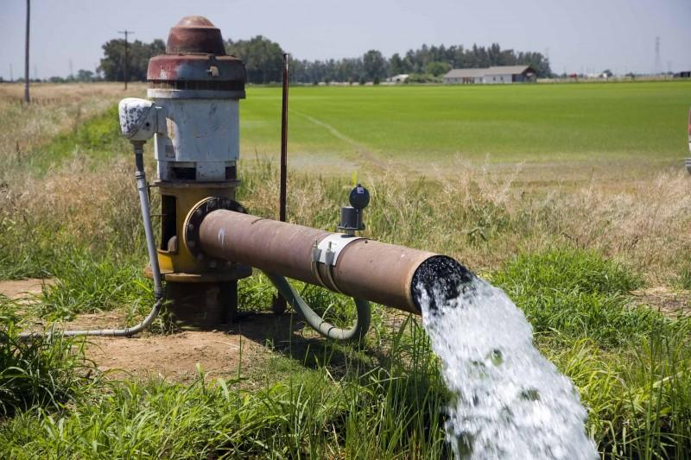
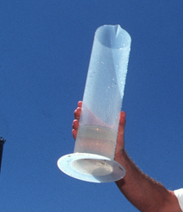
WaterML2.0 standards
Part 1 - Timeseries
Part 2 – Ratings, Gaugings and Sections
Part 3 – Surface water features
Part 4 – Groundwater
Part 5 –
Water quality (best practice)

Slide 4
ADOPTIONS by OGC and WMO
OGC adopted WaterML2 Part1 – Timeseries in February 2014, WaterML2 Part2 - Ratings, Gaugings and Sections in February 2016, the conceptual model WaterML2 Part3 - Surface Hydrology Features in January 2018, WaterML2 Part 4 - GroundWaterML2 in March 2017
WMO Executive Council 69th session meeting in May 2017 formally adopted WaterML2 Part 1 & 2 standards (p.133-134)
decides “To amend the Manual on Codes, Volume I.3 to introduce WaterML2 Parts 1 and 2 as data representations that are suitable for the exchange of hydrological information, as specified in Annex 1 of the Annex to Recommendation 12 (CBS-16)”
Notes:
EC-69: https://library.wmo.int/opac/doc_num.php?explnum_id=3645
CHy-15: https://library.wmo.int/doc_num.php?explnum_id=3404

Slide 5
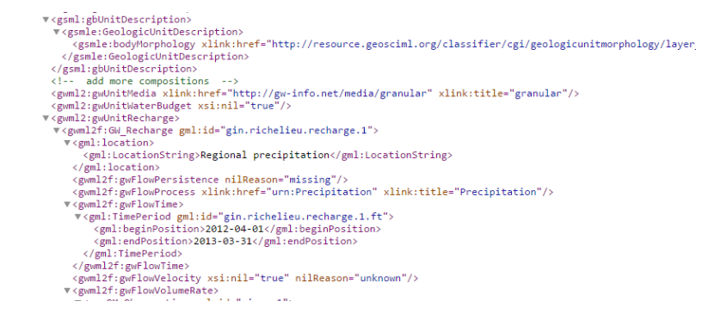
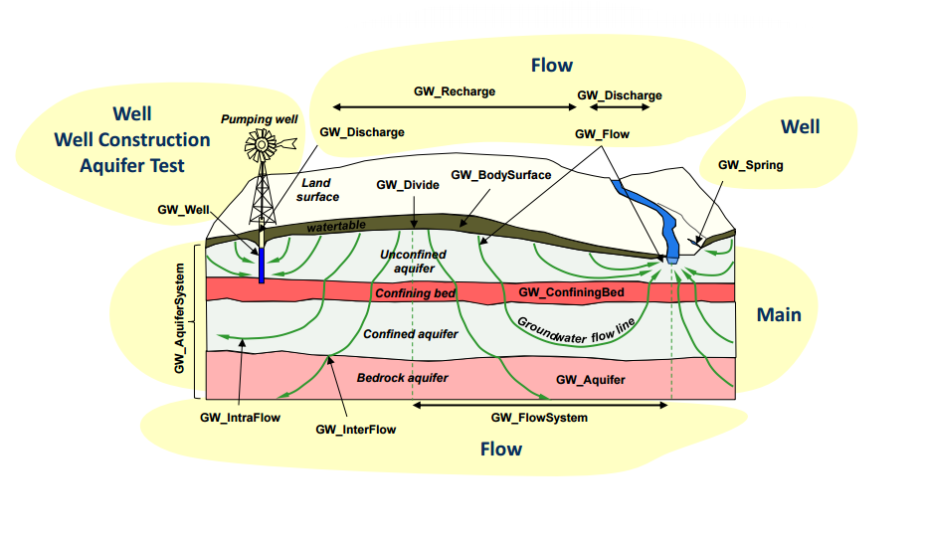
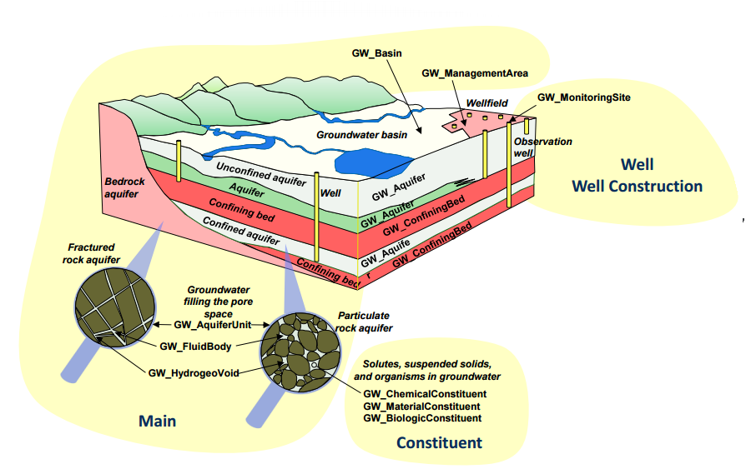
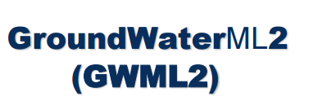
WaterML2 Part4
OGC Standard today -> WMO Standard soon

Slide 6
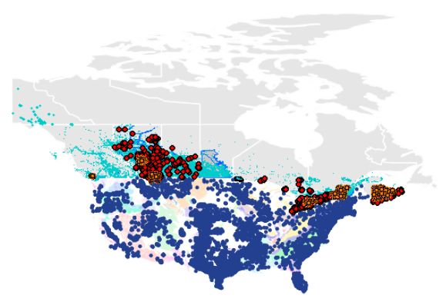
Context
Big Science and Big Data
Increasing gw data volume and online availability
Increasing scientific and societal need for integrated gw data
Rise of water data networks and software tools
No appropriate int’l data standards!
CAN & US groundwater data networks

Slide 7
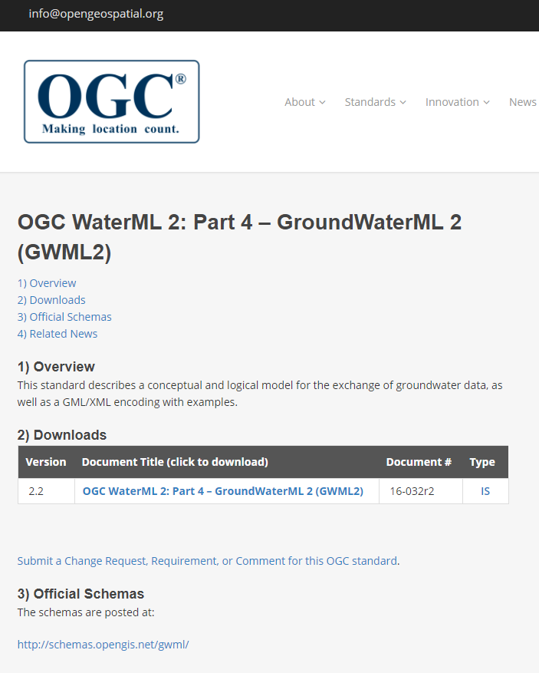
Standards Development
GroundwaterML2 (GWML2)
Open Geospatial Consortium
Geospatial standards of all kinds
Hydro Domain Working Group
WaterML2 hydro data standards
Groundwater Standards Working Group
GWML2
reuses GeoSciML, O&M, …
Hydrogeological & data experts
CAN, USA, FR, DE, AT, NZ, AU
2012-1017
final approval: March 2017

Slide 8
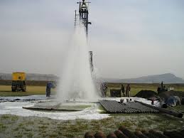
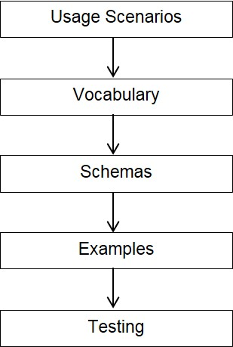



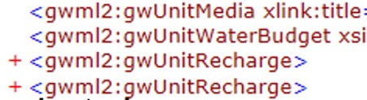
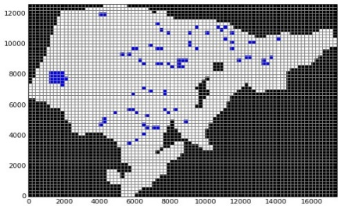
Methods
GWML2 development
well drilling
environmental
policy
flow modeling
https://water.usgs.gov/ogw/aquiferbasics/

Slide 9
Conceptual Model: GW & SW
Fluid Container Pattern: Containers, Voids, Fluids
fluid flow
container object
container matter
void
fluid body
groundwater
surface water
fluid matter

Slide 10
Conceptual Info Model: GW
GW Container Pattern: Units, Voids, Fluids
Hole-y Trinity

Slide 11
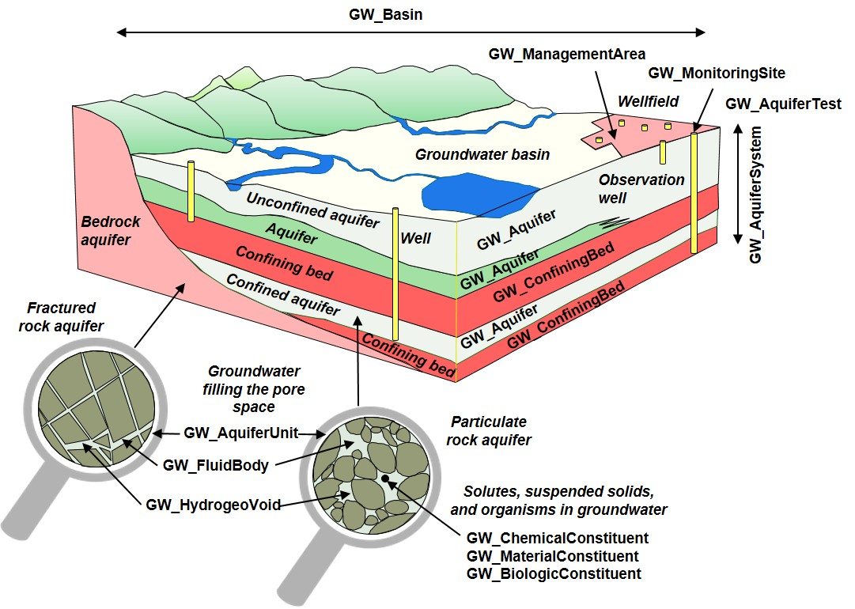
GWML2: contents
Hydrogeological Units, Voids, Fluid bodies

Slide 12
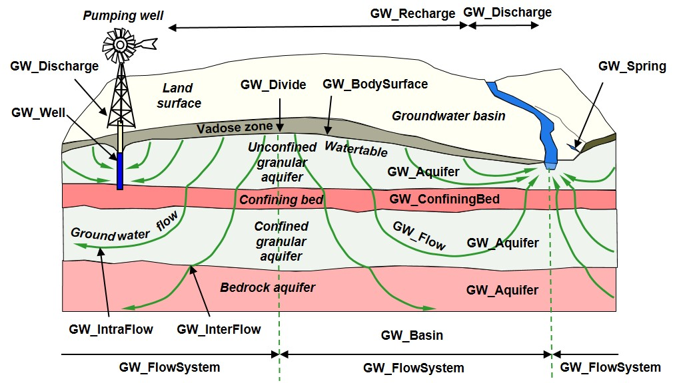
GWML2: contents
Fluid Flow, Water wells, Springs

Slide 13
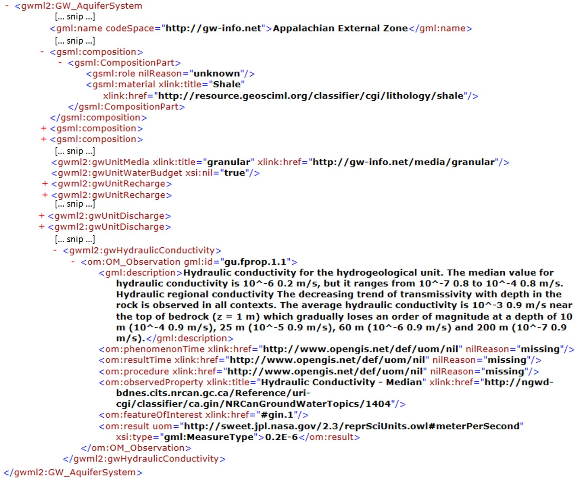
GWML2: GML-XML encoding
Aquifer System: Lithology, Hydraulic Conductivity

Slide 14
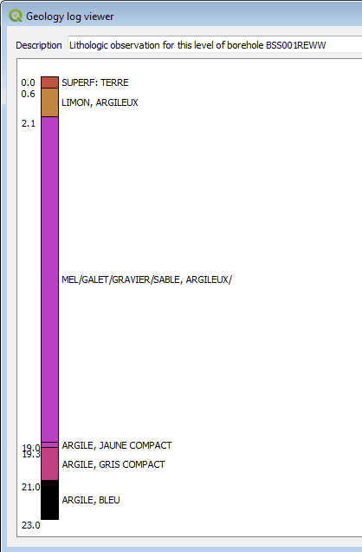
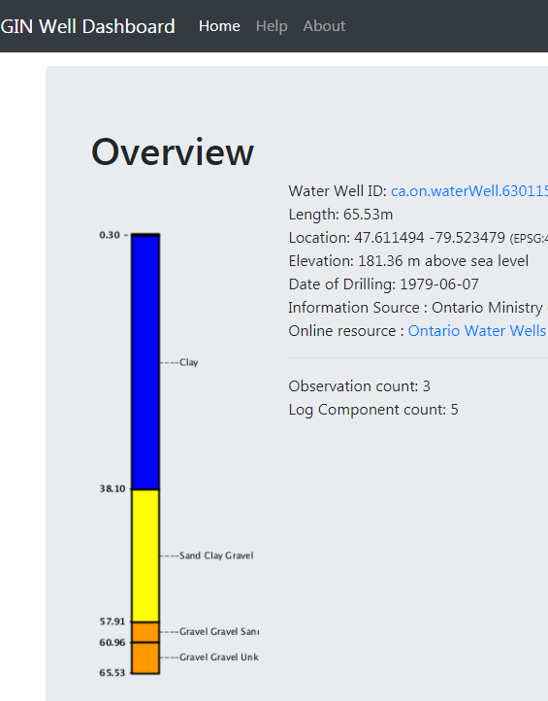

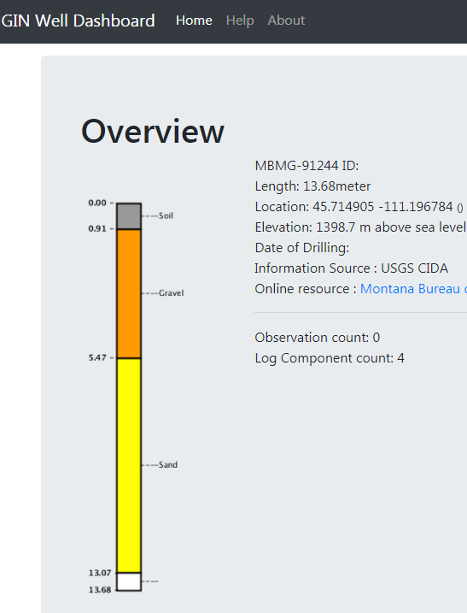
Implementation
Commercial Scenario: Wells, Units, Levels,…
Logs
GW Info Network (CAN)
QGIS
National GW Monitoring Network (USA)

Slide 15
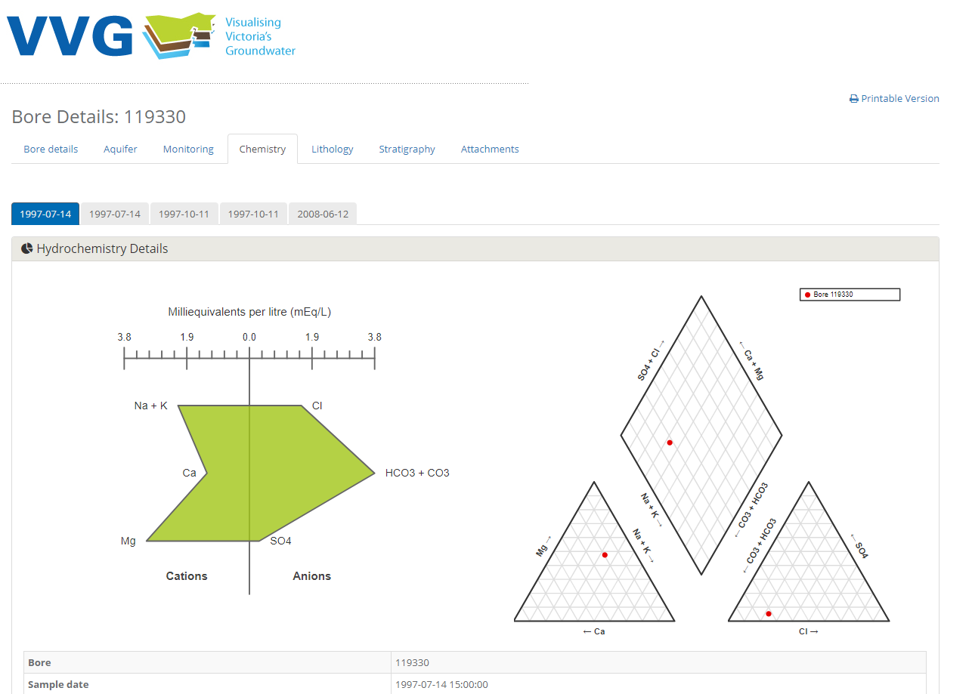
Implementation
Environmental Scenario: Monitoring, Flow,…
groundwater chemistry

Slide 16
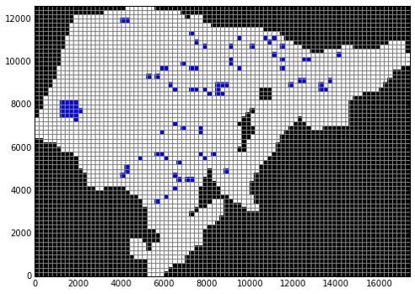
Implementation
Scientific Scenario: Units, Wells, Measurements,…
MODFLOW model from GWML2 inputs (Horowhenua, NZ)

Slide 17
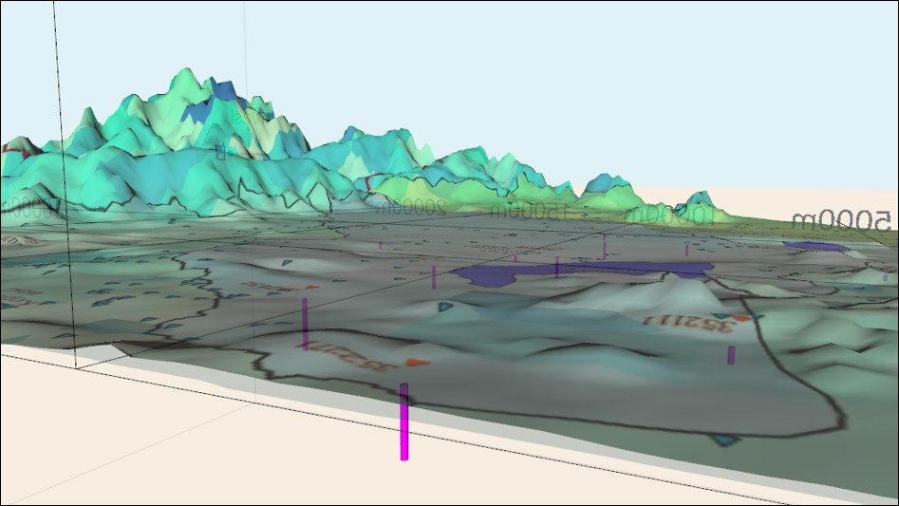
Implementation
Policy Scenario: Management Areas, Units,…
3D visualization of GWML2 data for Horowhenua Management Area (NZ)

Slide 18
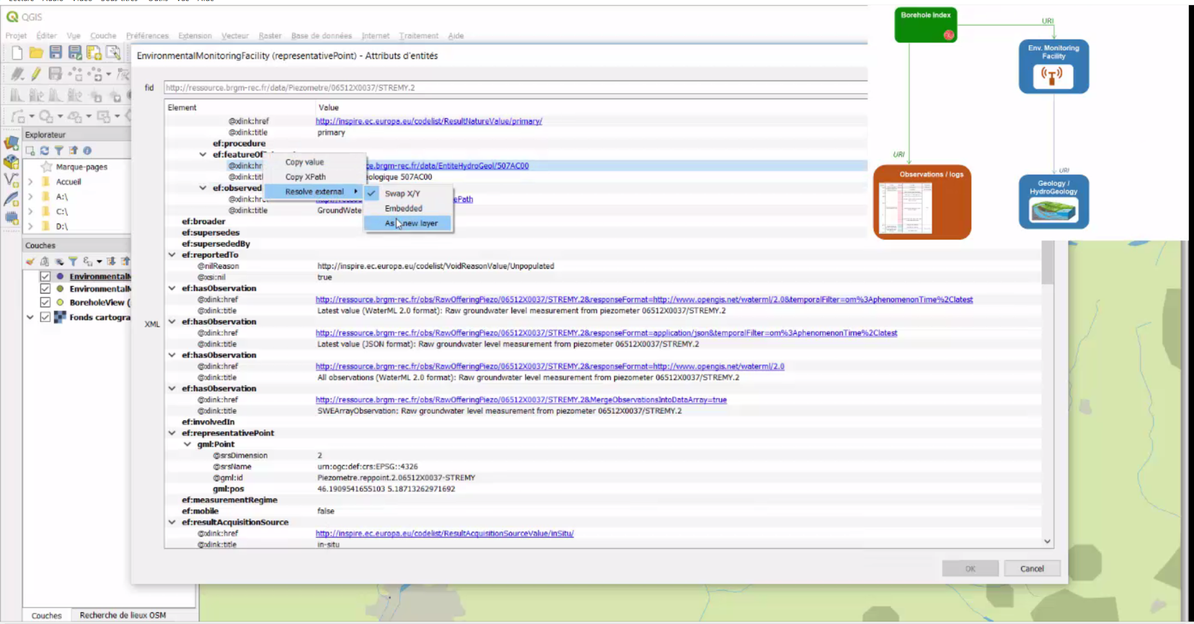
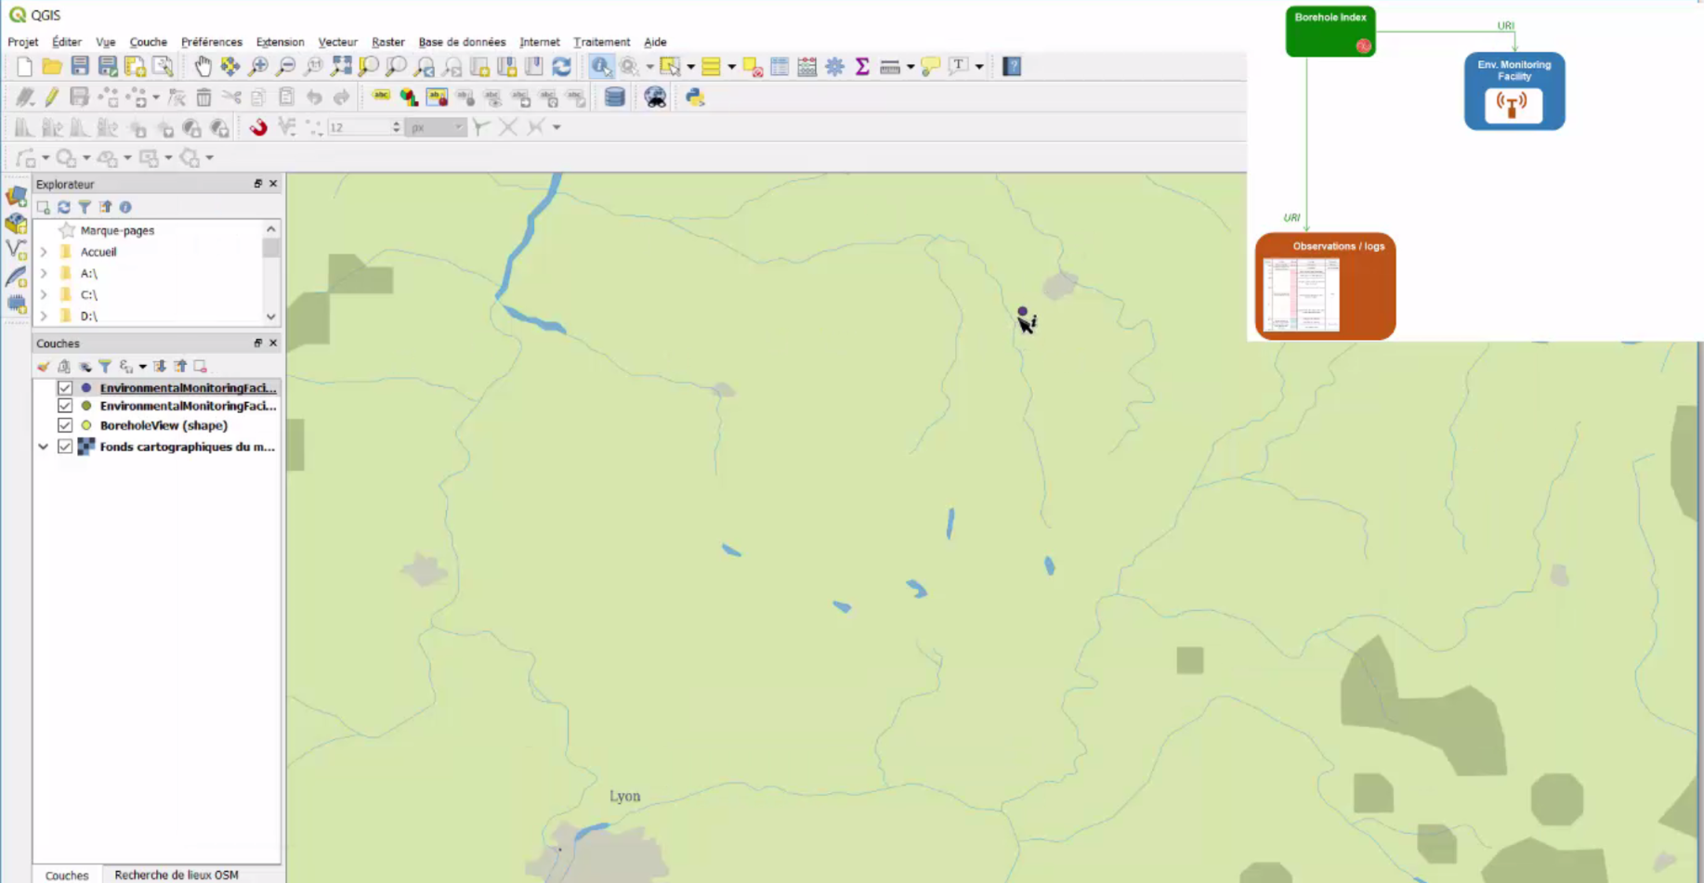
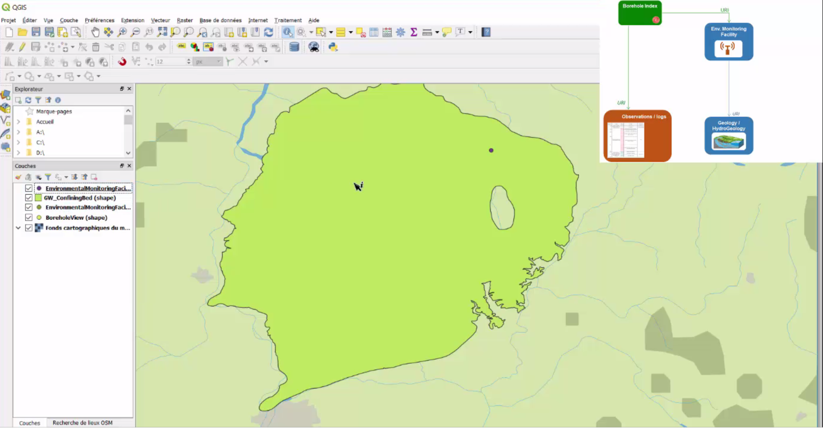
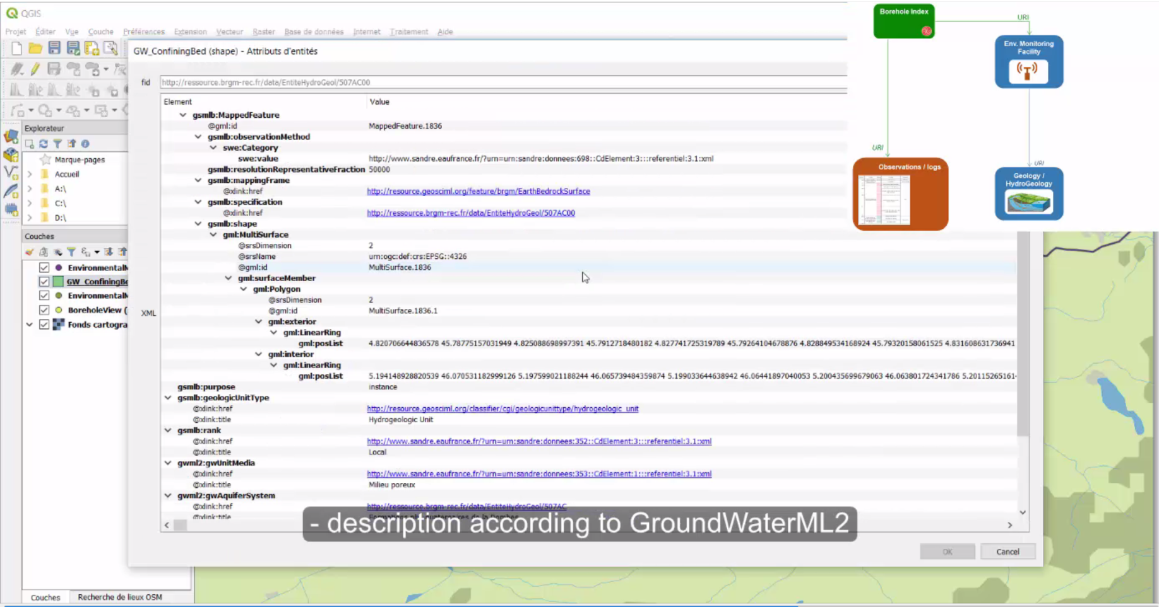
Implementation
Technical scenario: GWML2 data used in QGIS
Screenshot QGIS GMLAS toolbox interaction with French Groundwater Information Network: linking stations to aquifers description flows

Slide 19
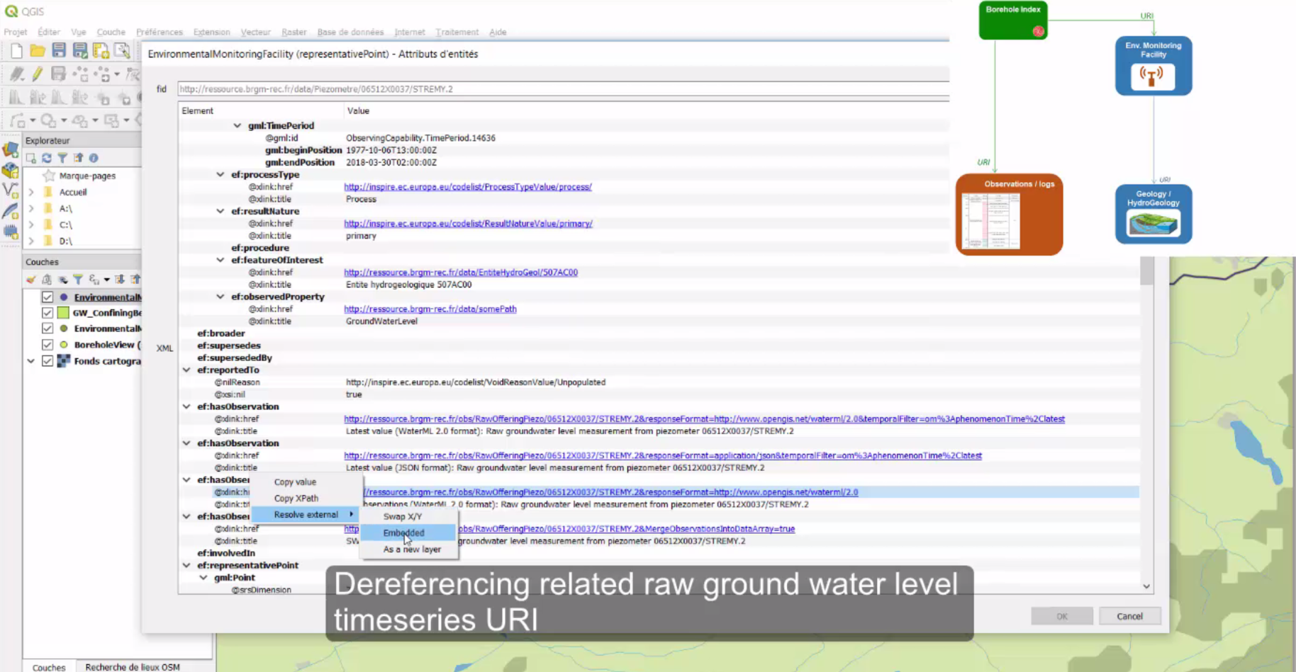
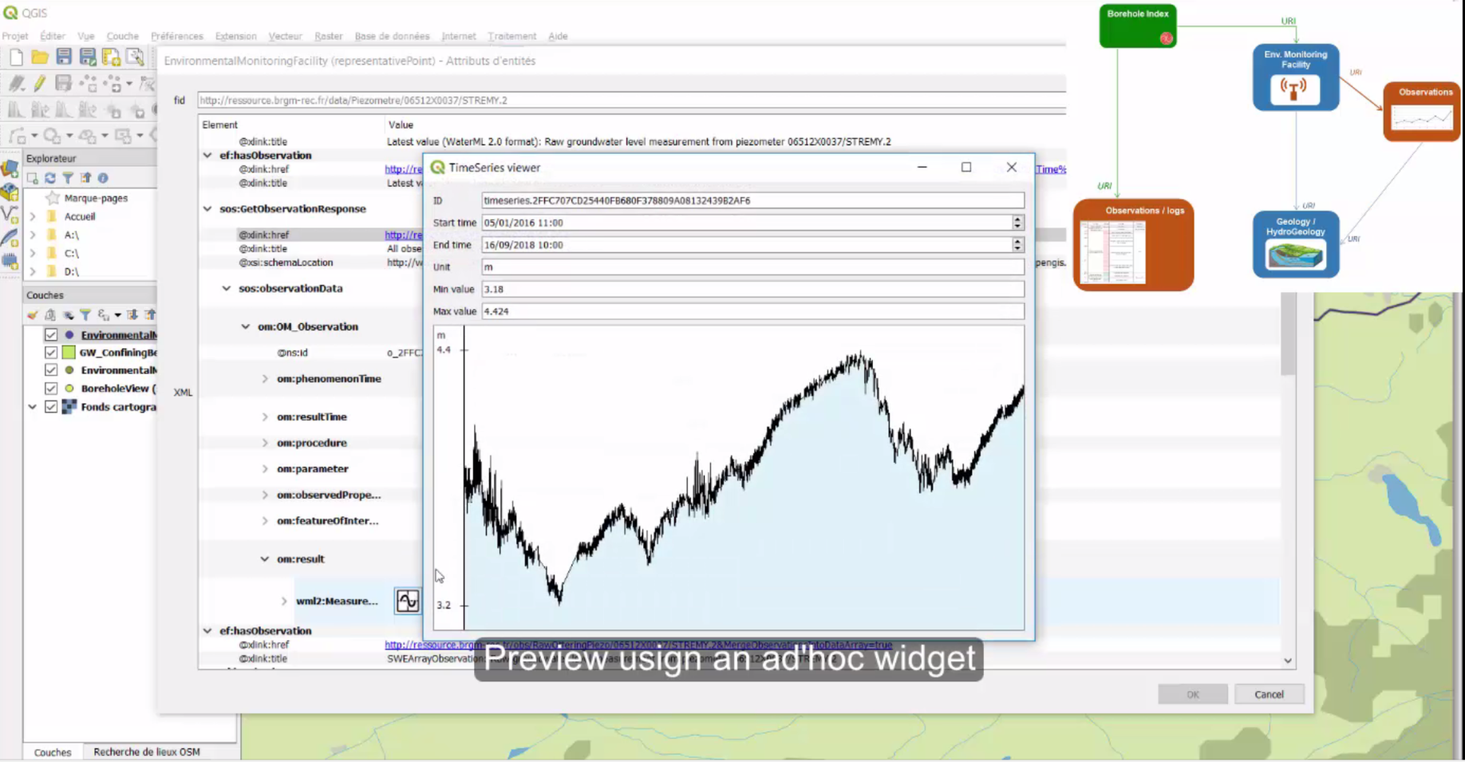
Implementation
Technical scenario: GWML2 data used in QGIS
Screenshot QGIS GMLAS toolbox interaction with French Groundwater Information Network : linking stations to groundwater level observations services

Slide 20
Implementation
Technical scenario: GWML2 data used in QGIS
Full video available from GitHub
https://github.com/BRGM/gml_application_schema_toolbox/tree/master/presentations/2018_INSPIRE_conference
Download via the QGIS plugin repository
https://plugins.qgis.org/plugins/gml_application_schema_toolbox/
Feedback / contribute on GitHub
https://github.com/BRGM/gml_application_schema_toolbox

Slide 21
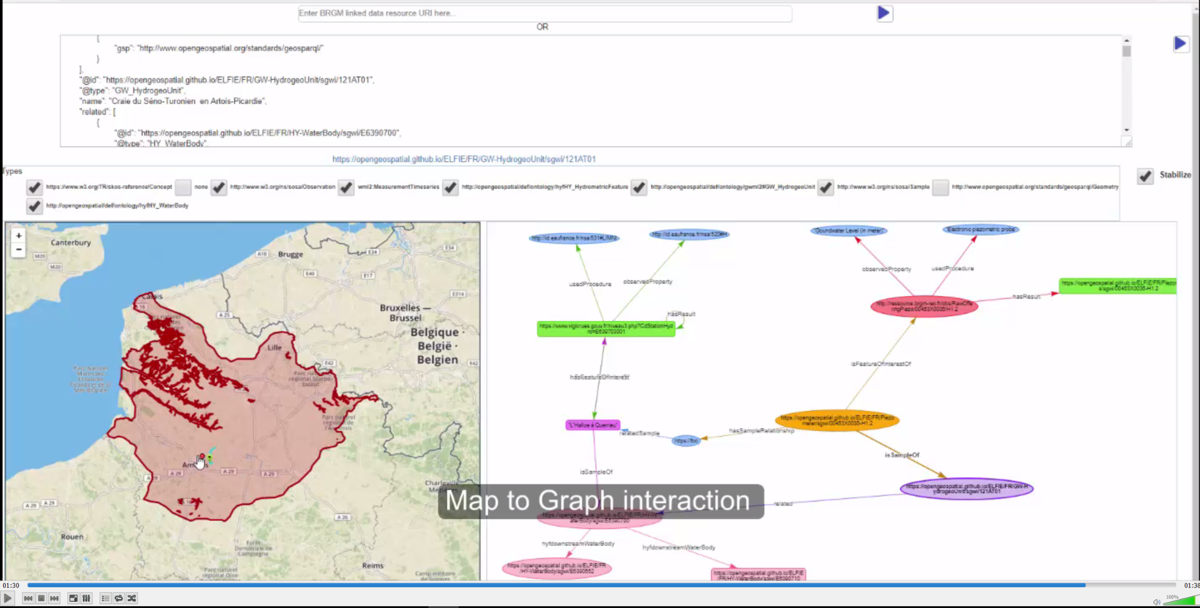
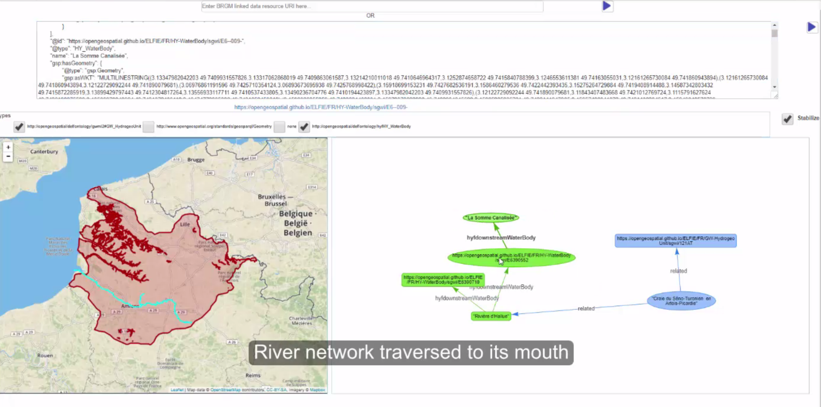
Implementation
Linked data scenario – surface/ground water interaction
GWML2 data exposed in LinkedData and consumed in a JSON-LD aware viewer (BRGM : BLiV)

Slide 22
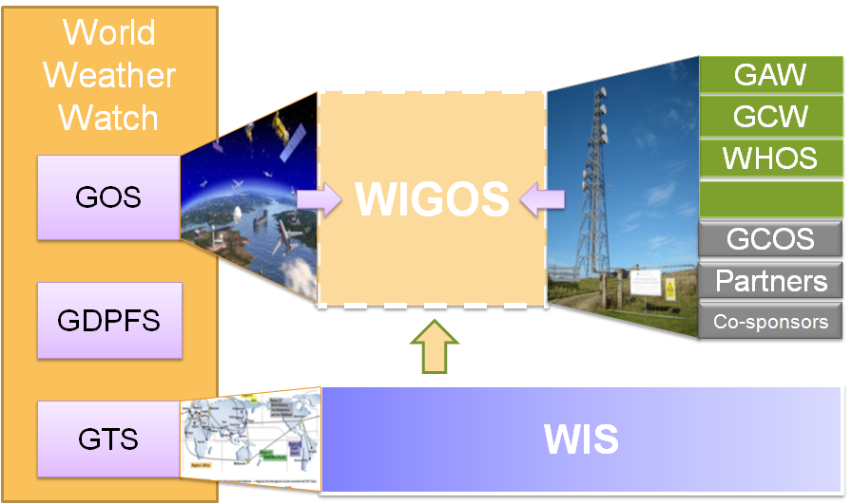
WMO INTEGRATED GLOBAL OBSERVING SYSTEM (WIGOS) and
WMO HYDROLOGICAL OBSERVING SYSTEM (WHOS)
In June 2015 the President of CHy informed Cg-17 of CHy proposal to develop WHOS as the CHy contribution to WIGOS
  Congress welcomed the effort and urged the president of CHy to continue guiding WHOS to full implementation
  Congress urged the promotion of WHOS among NHSs and the hydrological community

Slide 23
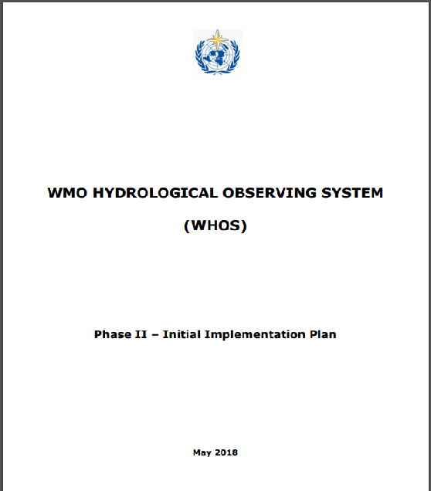
EC-70 DOCUMENT on THE INITIAL IMPLEMENTATION
http://www.wmo.int/pages/prog/hwrp/chy/whos/documents/WHOS_Phase-II_Initial_Implementation_Plan.pdf

Slide 24
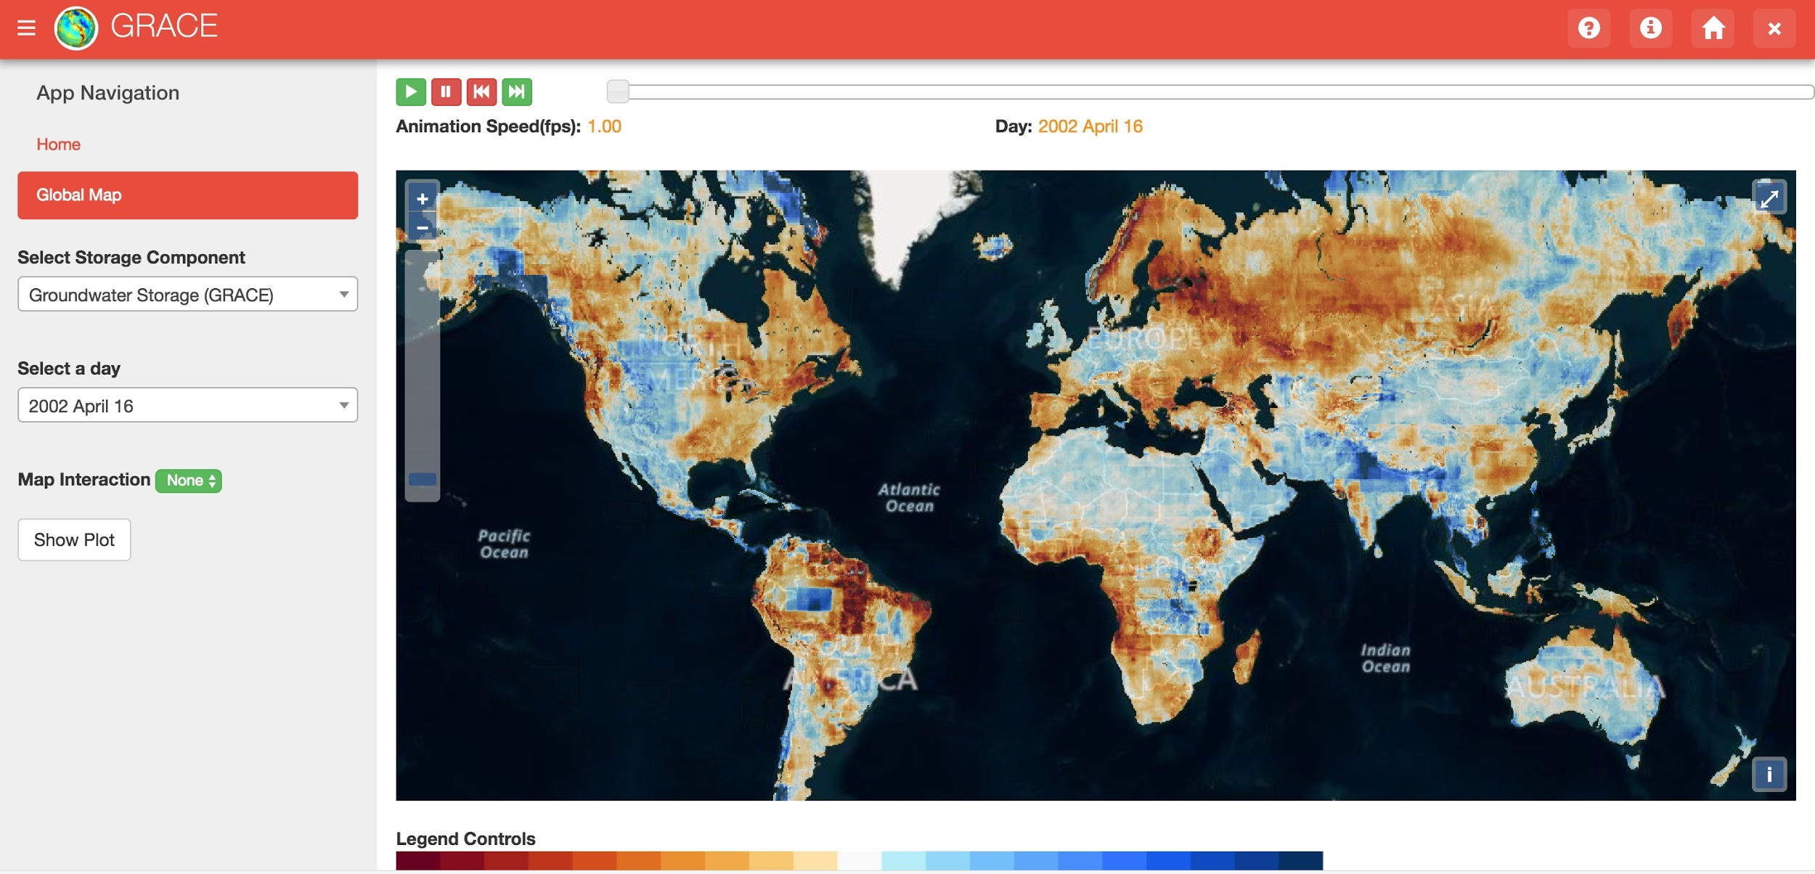
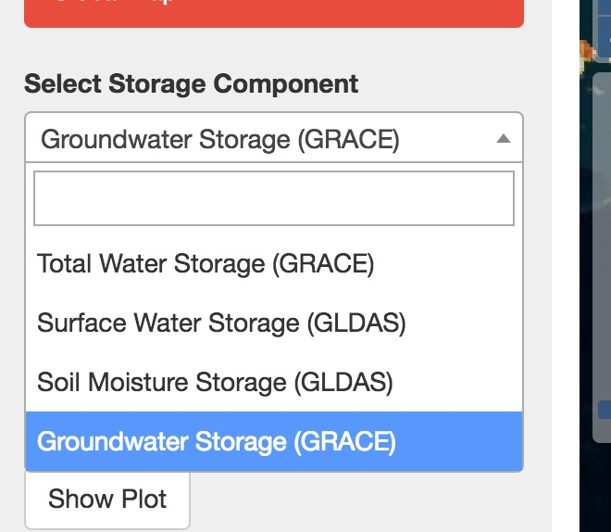
Tethys GRACE App
- GRACE Data
- GLDAS Data
- Calculated Groundwater Data
Notes:
All 4 layers (Total, Surface Water, Soil Moisture, and Groundwater storage) will be available with all of the current functionality of GRACE application
Generate a time series for a user defined point(map interaction)
Regional analysis based on user uploaded shapefile
Animation to view changes over time

Slide 25
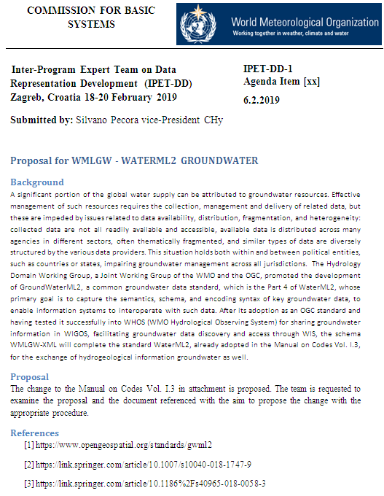

Slide 26
These are the fine people that make
WaterML2-GroundWater what it is today
Boyan Brodaric (GSC)
Dave Blodgett (USGS)
Eric Boisvert (GSC)
Francois Letourneau (GSC)
Jessica Lucido (USGS)
Sylvain Grellet (BRGM)
Laurence Chery (BRGM)
Bernhard Wagner (BGS)
Alex Kmoch (GMS/U Salz)
Peter Dahlhaus (FedUni)
Andrew MacLeod (FedUni)
Bruce Simons (CSIRO/BOM)
Thank you!

Slide 27
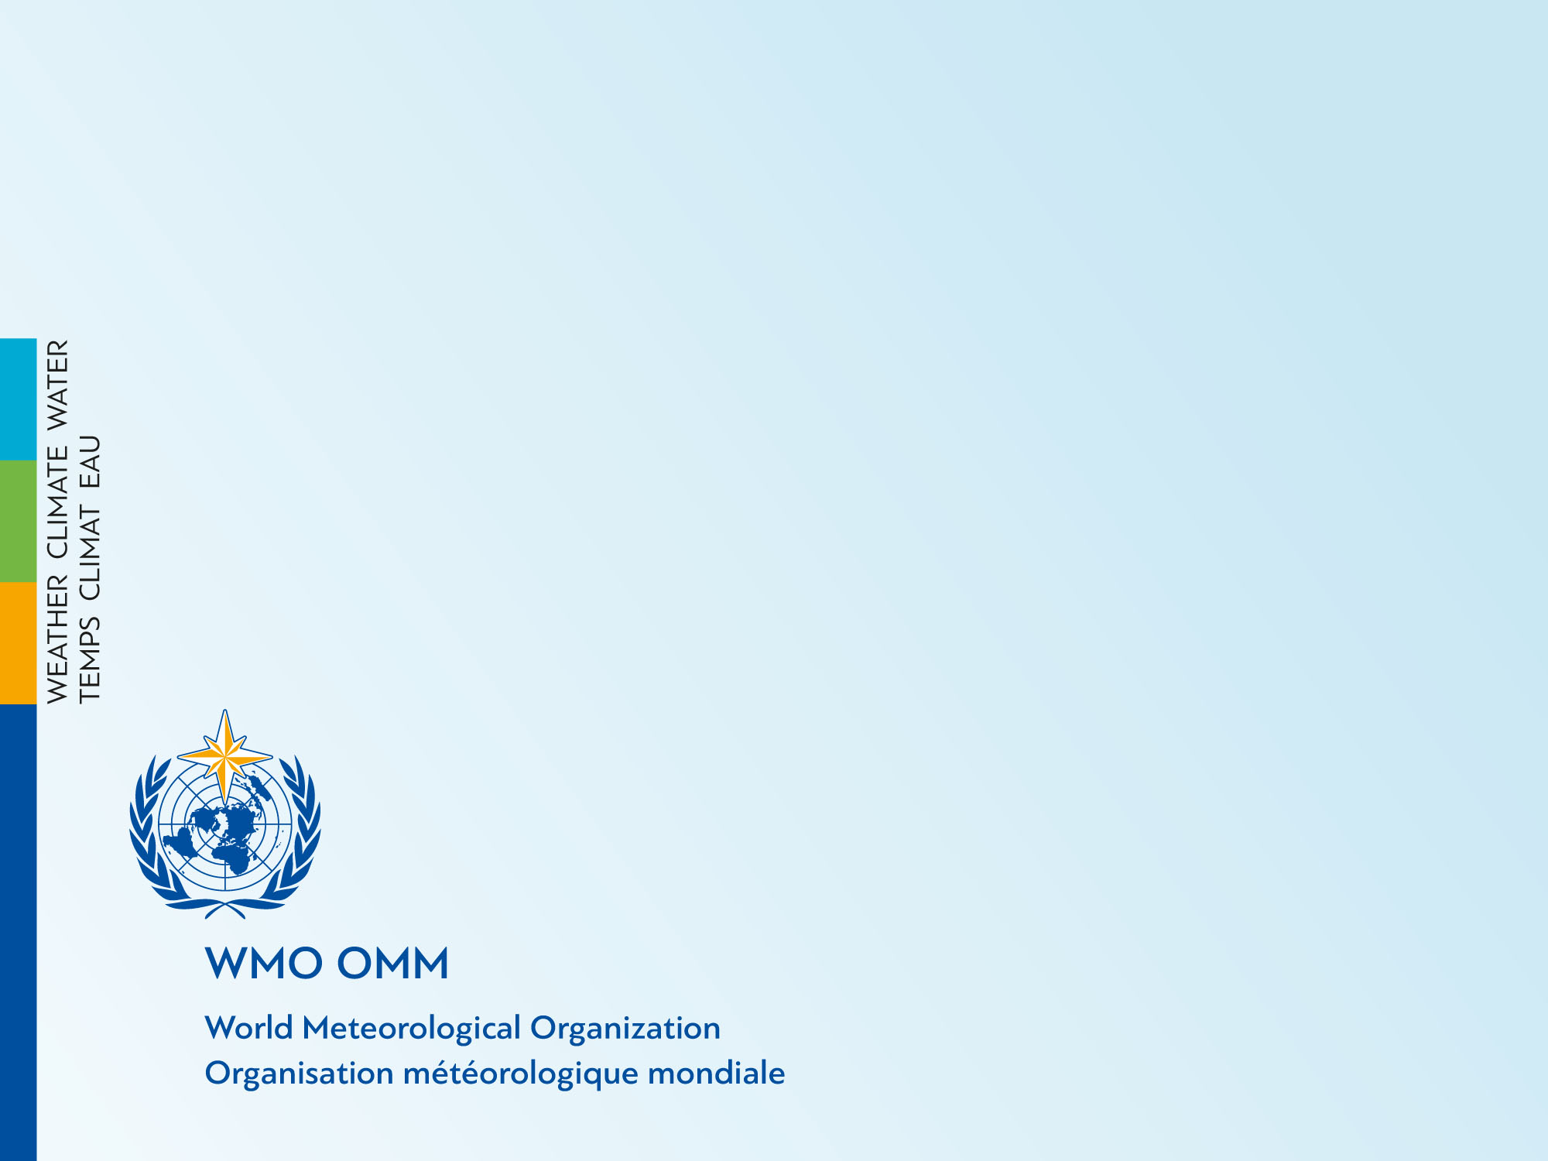
Thank you
Merci

