Slide 1

Assessing the Robustness of ISO with the NOAA Metadata Rubric
Anna Milan
NOAA National Centers for Environmental Information
2017-05-23
National Oceanic and Atmospheric Administration | NOAA Satellite and Information Service

Slide 2

It all started when…
NOAA required, per the NOAA Data Documentation Procedural Directive, to document their datasets, models, observations and other earth science resources with the ISO Standards.
Around 2011!

Slide 3
However...
There are many different ways to implement the standards and very little content is required to create a valid metadata record.
How do I know what else is important to include?

Slide 4
Therefore...
In addition to ISO compliance, the Completeness Rubric provides an extra level of assessment to help metadata authors provide more thorough descriptions.
I want to get at least 90% score!

Slide 5


History
The rules for Completeness Rubric V2 were determined by the NOAA Metadata Working Group and evolved from the first NOAA Rubric developed by Ted Habermann.
Me three!
Hey, I know Ted!
Me too!

Slide 6
Standards Supported by Rubric V2
ISO 19115:2003 Geographic information -- Metadata
ISO 19115-2:2009 Geographic information -- Metadata -- Part 2: Extensions for imagery and gridded data
ISO 19139 Geographic information -- Metadata -- XML schema implementation
Just say: “The ISO 19*** Suite of Metadata Standards”

Slide 7
About Completeness Rubric V2
There are 10 Categories. Each Category looks for the
existence of certain elements. It doesn’t know if the content is meaningful, but it does check a couple
codelist values to determine the required categories and some of the required elements.
The rubric supports different types of resources.

Slide 8
Always Required Categories
Category | Definition
Identification | Needed for basic discovery of the resource.
Coverage | The extent of the resource, such as temporal range of content, geographic bounds of content and general place names.
History | How the resource was collected or processed. Acquisition subcategory is recommended for raw observations. Lineage subcategory is recommended for processed resources.
Connections | Checks that all URLs have a Function Code and either a Name or a Description.
Metadata | Information about the metadata record.
This slide needs more room...

Slide 9
Mostly Required Categories
Category | Definition
Access | How to obtain the data, including formats, access points, distribution contacts and disclaimer statements. Not required when Resource Hierarchy Level='fieldSession' or Status = 'planned'.
Content | Identifies the parameters, variables or features of the resource and can be documented with at least one of the two subcategories: Attributes or Features. Not Required when Resource Hierarchy Level = 'fieldSession'.
Quality | Reports on how complete or accurate a resource is. Not required when Resource Hierarchy Level = 'fieldSession'.
Rubric doesn’t require planned data to have data download URLs.

Slide 10
Highly Recommended Categories
Category | Definition
Associated Resources | Citations to related papers, sister resources, projects or programs.
Attribution | Information to cite the resource and provide proper credit, such as creator names, publisher names and a Digital Object Identifier (DOI).
Sometimes, we just don’t have this level of detail...
This info seems really important! How come it is not required?

Slide 11
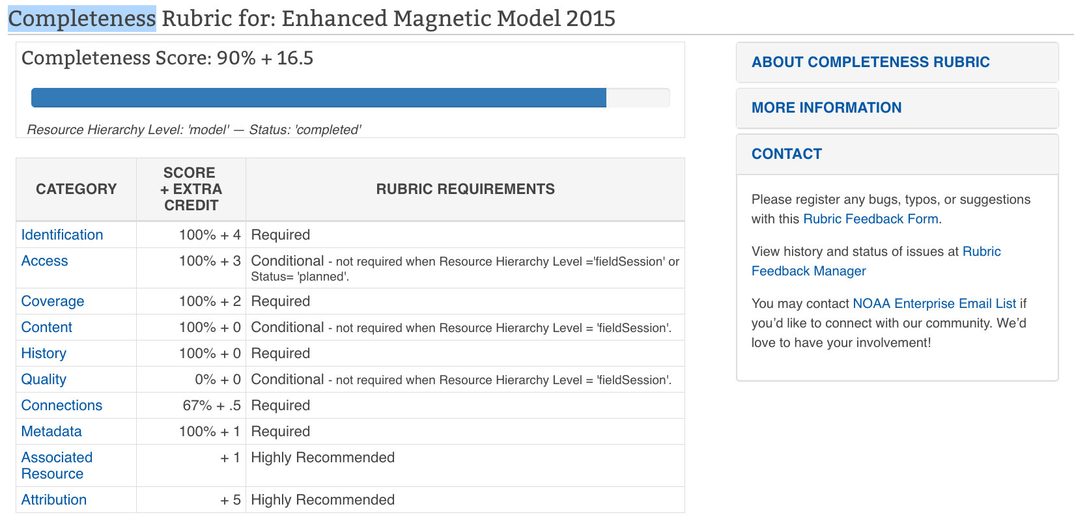
Understanding the Rubric Report
About
Total Score + Extra Credit Points
Hierarchy and Status Codelists
Category Scores + Extra Credit Points
Report Bugs or Request New Features
There’s more below the fold

Slide 12
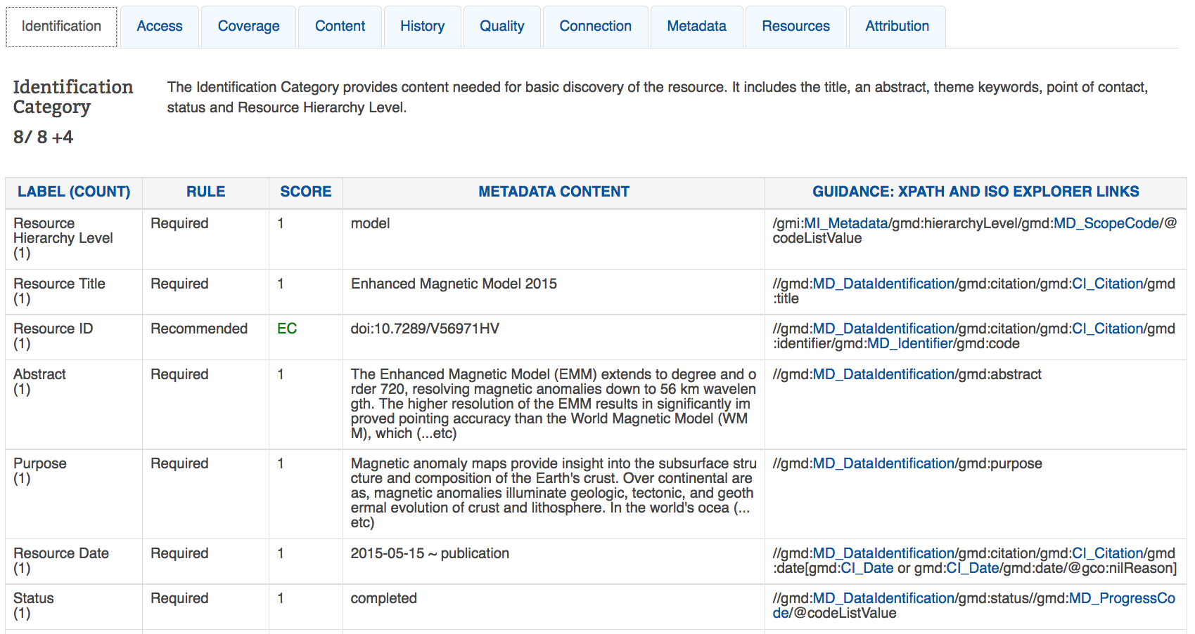
Understanding the Rubric Report
Category Tabs
Category Score + Extra Credit
Label
Rule
Score
Content
Guidance

Slide 13
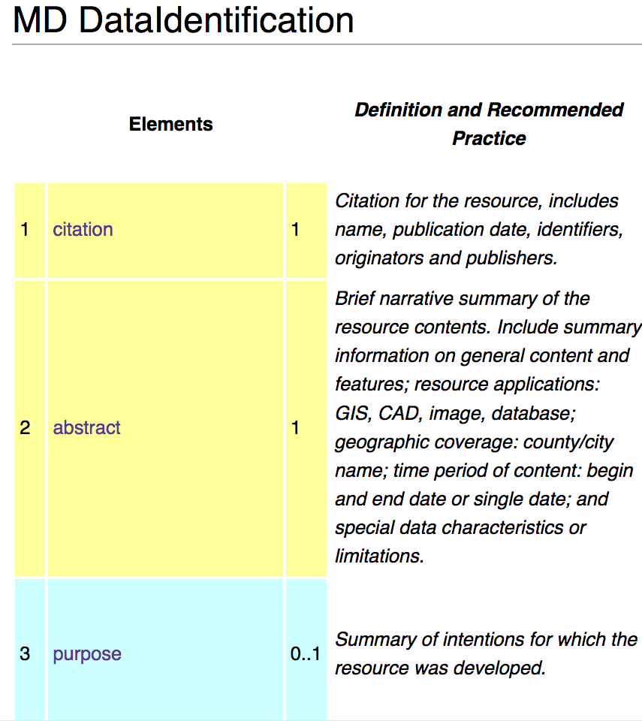
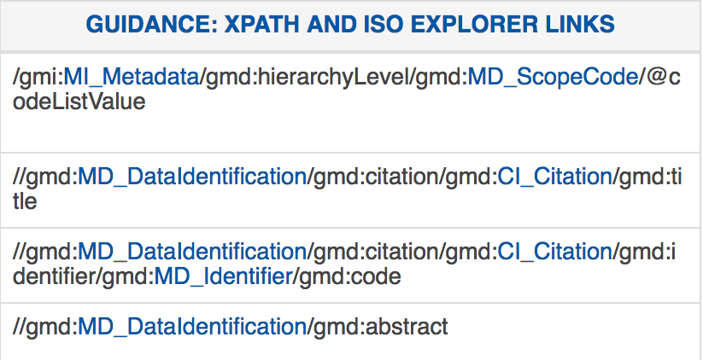
Rubric Guidance Tips
Links to ISO Explorer wiki pages
Copy Xpath and find location in XML record

Slide 14
Use the Rubric
While developing templates
While developing a solution that will produce high quality metadata
While editing individual records
Right before publishing records for discovery
To understand the completeness of
metadata over time
But HOW?

Slide 15
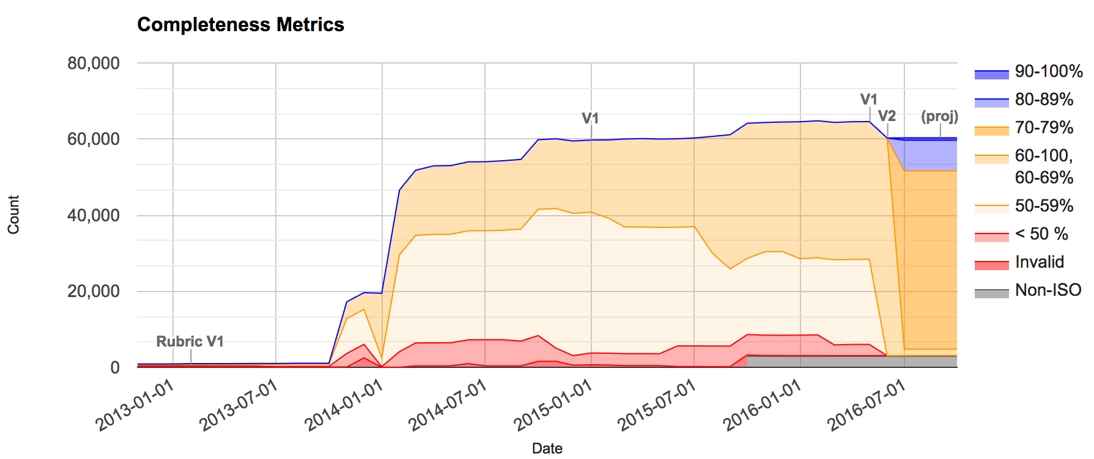
NOAA Completeness Metrics Over Time

Slide 16
How to Apply the Rubric
Via the Docucomp Record Services
Run XSL transformation in an XML editor
Register a collection of metadata with EMMA* for bulk assessments
This isn’t helping.
HOW how?

Slide 17
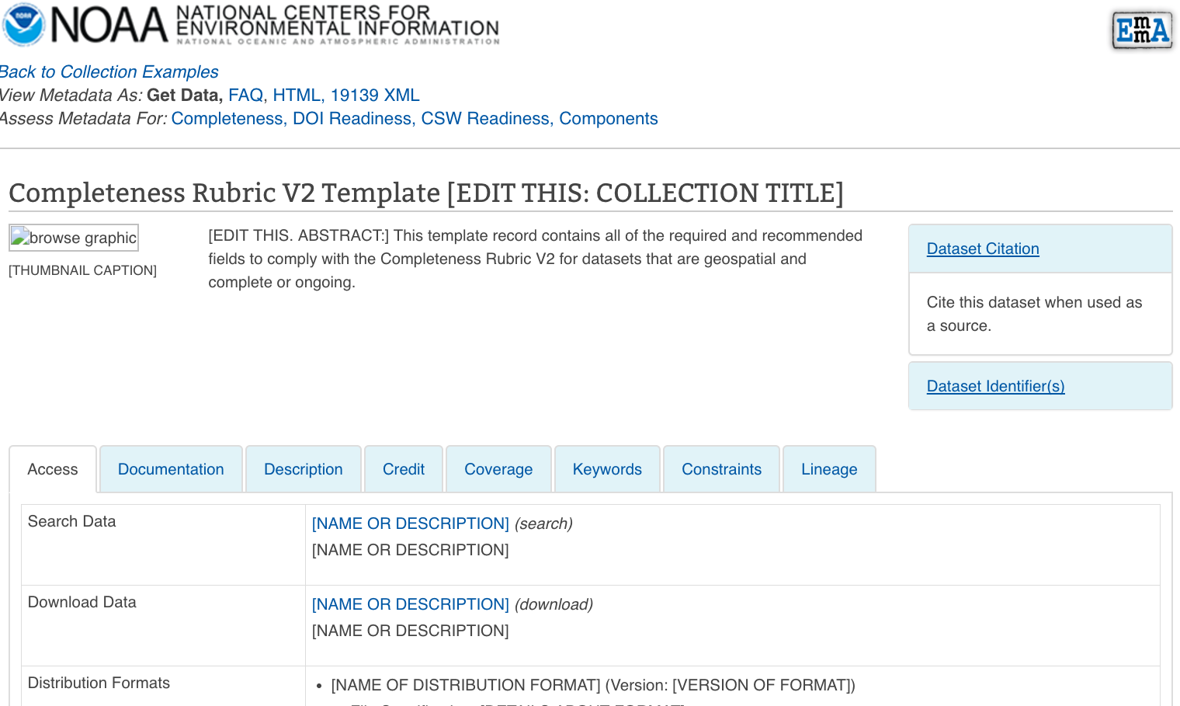
When Starting from Scratch….
Use the Rubric V2 Template in the Examples WAF and bring into your favorite XML Editing environment.
I like Oxygen XML EDitor
Link to XML Record

Slide 18
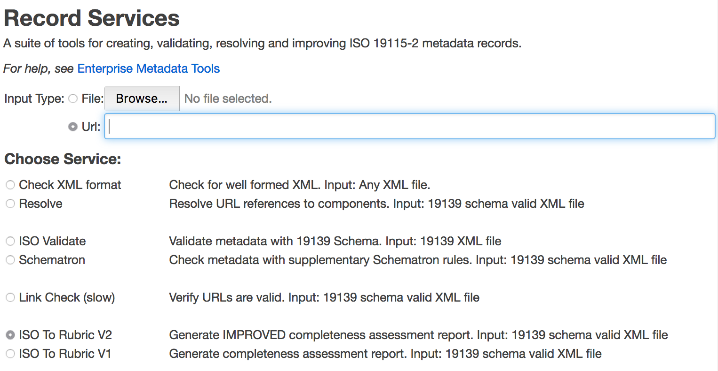
Docucomp Record Services
Input XML Metadata Record
Ah HAH!
Select ISO to Rubric V2
Hit Submit Button

Slide 19
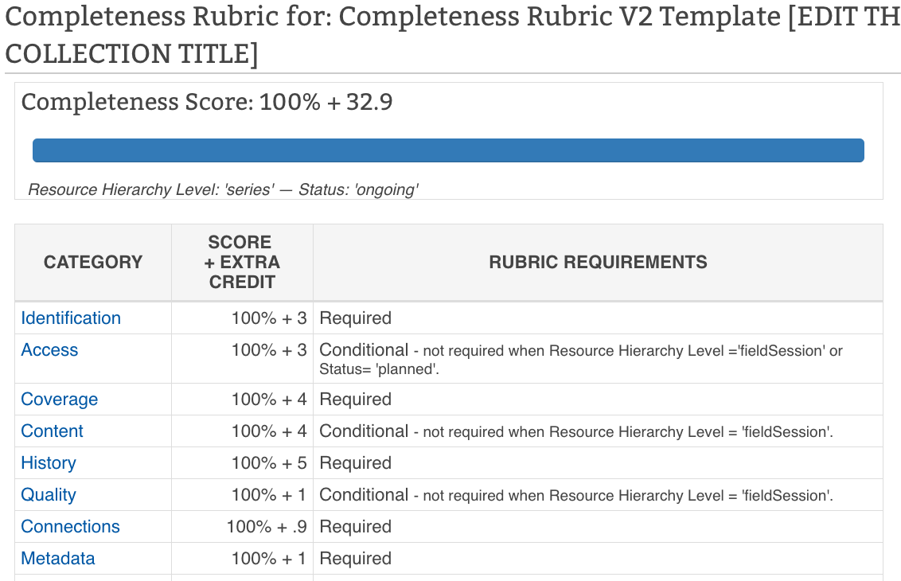
Evaluate the Results, Edit, Repeat
100%! I’m done, right?

Slide 20
Thanks!
No
Bye!
enterprise.metadata@noaa.gov

Slide 21
References
ISO Explorer on the NOAA Environmental Data Management Wiki
  https://geo-ide.noaa.gov/wiki/index.php?title=Category:ISO_Explorer
Docucomp
  https://www.ngdc.noaa.gov/docucomp
Examples WAF
  https://www.ngdc.noaa.gov/metadata/published/Examples/iso
Enterprise Metadata Management Architecture (EMMA)
  https://www.ngdc.noaa.gov/metadata/emma
See you again soon?

