Slide 1
TT-WIS-MD 2019

Slide 2
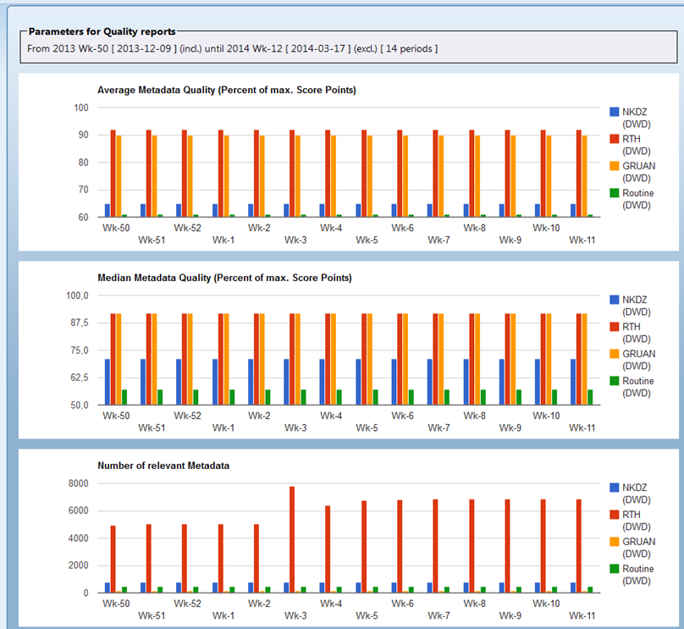
WMO rubric – XSLT for metadata quality monitoring
NOAA provided a XSL Transformation, the “WMO Rubric Report” available at github [1]. During the implementation phase of WIS, GISC Offenbach has built a tool based on the WMO Rubric to get scores for the metadata quality.

Slide 3
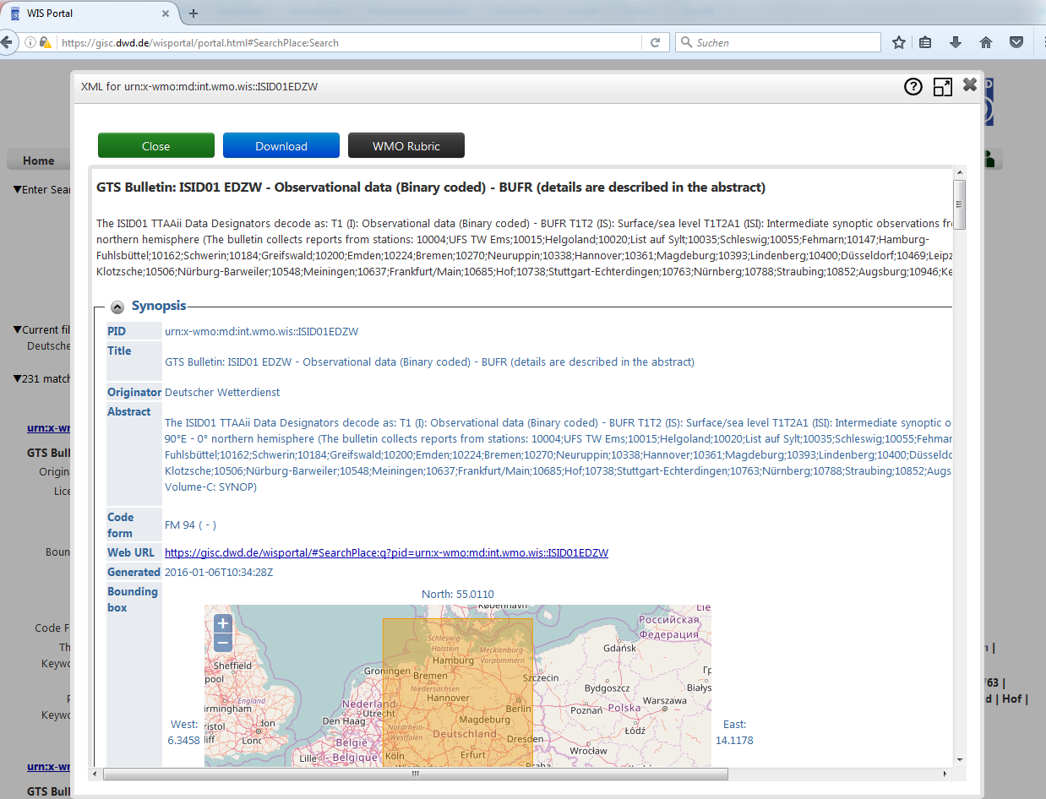
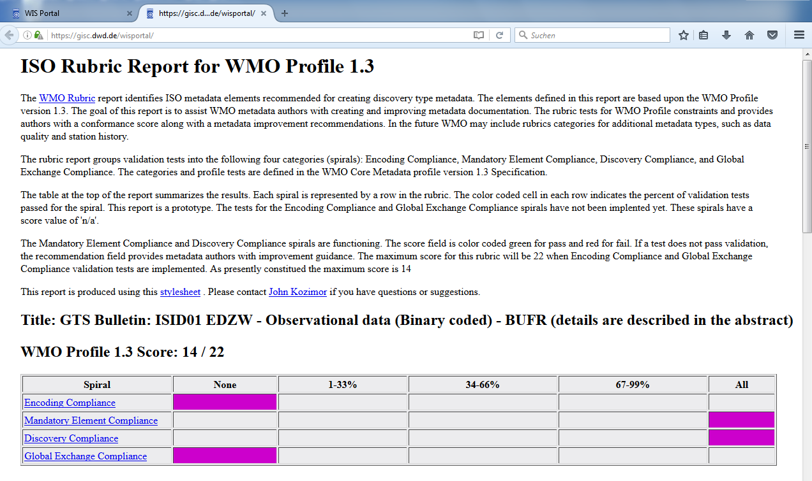
WMO rubric
GISC Offenbach implemented the WMO rubric in the frontend of gisc.dwd.de

Slide 4
WMO rubric
A further development of the WMO Rubric as XSLT did not take place in the last years.
The “WMO Core Metadata Profile Test Suite” [2] written in python offers a different approach than the XSLT.

Slide 5
References
[1] https://github.com/wmo-im/wmcp
[2] https://github.com/wmo-im/wmo-cmp-ts
[3] https://wiswiki.wmo.int/tiki-index.php?page=IPET-MDRD-1
[4] https://gisc.dwd.de/

Slide 6
Collection of REQ from TT-GISC for WIS Metadata
There are two ways to represent WMO data policy:
  to use gmx:Anchor
  free text:CharacterString
  TT GISC requests to consider this example and to avoid in the next version of WMO Core Profile multiple encoding styles for crucial information to minimize the implementation work for the GISCs
Find a list of mandatory elements and use them as metric in the Performance Indicator.
For example the DataDistributionScope (GlobalExchange, RegionalExchange, OriginatingCenter) is crucial to the WIS Core Cache
Find a list of elements that need to have a constrained vocabulary. Discuss elements that influence GISC Operation with TT-GISC. Use of the codes registry.

Slide 7
Collection of REQ from TT-GISC for WIS Metadata
WMO Core Profile 1.3 is derived from the ISO 19139 XML representation of ISO 19115 "Geographic Information — Metadata"
Support should be added for ISO 19119 - "Geographic information — Services" to support Web Services such as Web Feature Service (WFS)/ Web Coverage Service (WCS) / Web Map Service (WMS) and others. Example xml files are attached
ET-CTS proposed a topic structure for messages in the AMQP/MQTT WIS2.0 Pilot project to be discussed:
WIS/<DATE>/<Country Code>/<Organization name>/<Data Type>/
with
Field Format Standard
DATE YYYMMDD ISO8601
Country Code two letters (responsibility of PR to authorize ) ISO3166-2
Organisation Name Less than 10 letters covering CCCC
Data Type Less than 10 letters in English Easy to understand for human readable

Slide 8
Collection of REQ from TT-GISC for WIS Metadata
It should be possible to define Metadata describing Pub/Sub access to data for example by allowing
  Broker: URL of Message Broker
  Protocol: MQTT|AMQP
  Topic: Description of the data available under the named Topic
Details should be discussed with ET-CTS and TT-eWIS

Slide 9
WIS 2.0
Discontinuation of GTS
Removal of Volume C1 + NOXX
Pub/Sub Messaging
Geo web services

Slide 10
WIS 2.0
Pub / Sub = Publish / Subscribe
  A Publisher publishes topics
  Interested parties can subscribe to topics
  Messages on a topic are forwarded to interested parties
  Amazon@dwd becomes Twitter@dwd
AMQP v0.9, AMQP v1.0, MQTT

Slide 11
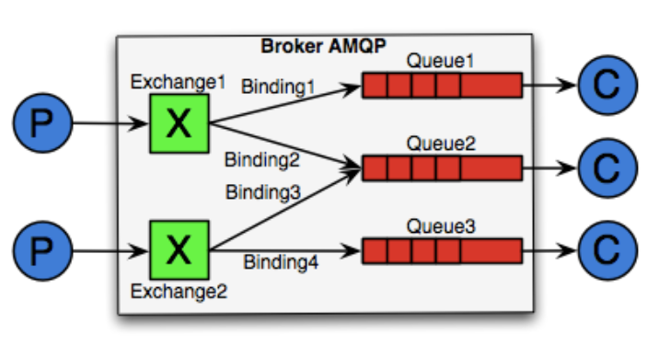
WIS 2.0
Source: https://blog.zenika.com/2010/12/19/introduction-a-rabbitmq-amqp/
An AMQP Broker provides Exchanges
Messages are not sent directly but to an Exchange
Messages are transmitted from Exchange to the correct queues and can be retrieved there.
a subscription is made against a queue
With a subscription, a queue and a connection of the queue to an Exchange are created.
No binding => No routing => No Message

Slide 12
WIS 2.0
Nachrichten können sein
  Informationen zu Störungen
  Informationen über Bereitstellung neuer Daten => Abruf über Geowebdienste
  Daten => Bulletins, insbesondere Warnungen

Slide 13
Old vs. New
TTAAii / Volume C1 | Metadata
NOXX | RSS-Feed
Routing / Active Push | Pub/Sub Messaging + Geowebservices
Manual configuration | Self-Service

