Slide 1

CF/netCDF for Radar:
Adoption of CfRadial 2.0 as a WMO standard representation of radial weather radar data
Daniel Michelson
Tom Kralidis
Environment and Climate Change Canada
On behalf of IPET-OWR
IPET-DD-1
19-20 September 2019
Exeter, United Kingdom

Slide 2
Inter-Programme Expert Team on Operational Weather Radars IPET-OWR
Daniel Michelson | Chair | ECCC | Canada
Hiroshi Yamauchi | Vice-Chair | JMA | Japan
Tom Kane | Vice-Chair | BoM | Australia
Paul Joe |  | Secretariat | WMO
Dean Lockett |  | Secretariat | WMO
Wai Kong |  | HKO | Hong Kong China
Mark Curtis |  | BoM | Australia
José Mauro de Rezende |  | INMET | Brazil
Pei Chong |  | CMA | China
Elena Saltikoff |  | FMI | Finland
Bernard Urban |  | MF | France
Andreas Becker |  | DWD | Germany
Theo Mammen |  | DWD | Germany
Akihito Umehara |  | JMA | Japan
Jeong-Hee Kim |  | KMA | Republic of Korea
SungHwa Jung |  | KMA | Republic of Korea
Yuri Borisovich Pavlyukov |  | Roshydromet | Russian Federation
Marco Boscacci |  | MCH | Switzerland
Marco Gabella |  | MCH | Switzerland
Ercan Büyükbaş |  | TMS | Turkey
Blake McGuire |  | NOAA | USA
Michael Dixon |  | NCAR | USA
Vlado Stojanovic |  | ECCC | Canada

Slide 3
CBS
No. 544
No. 1160
ET-SBO
TT-WRDE
IPET-OWR
ET-ORST
IOC-RQQI
OWR-BPG
ISO 19926-1
No. 8
CIMO

Slide 4
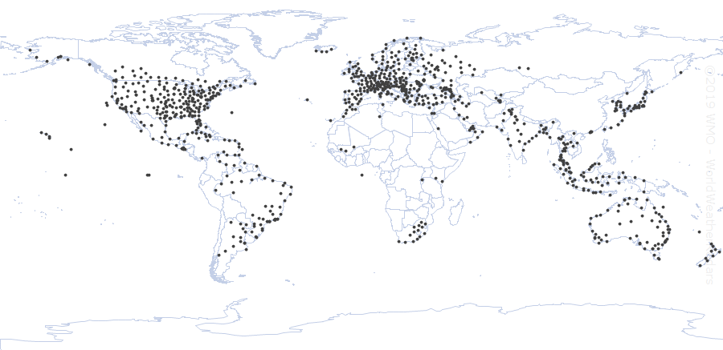

WMO weather radar database – WRD
949 active radars on 19 February 2019
WRD hosted by Turkish Meteorological Service

Slide 5
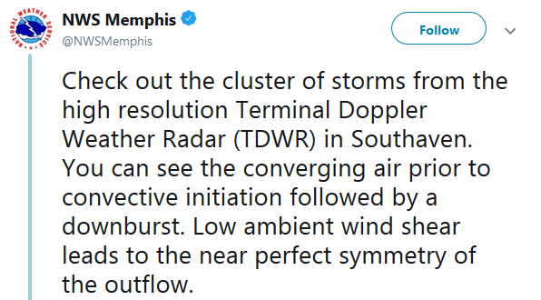
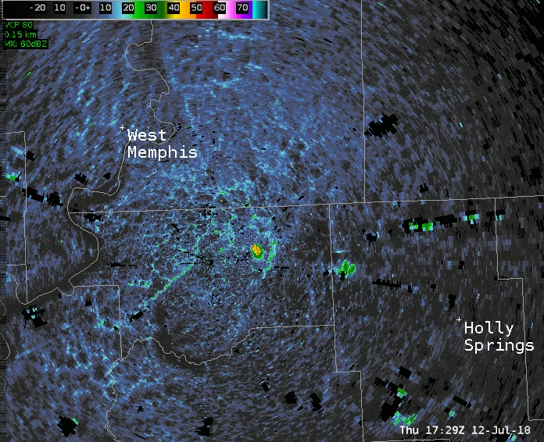
Weather radar capabilities

Slide 6
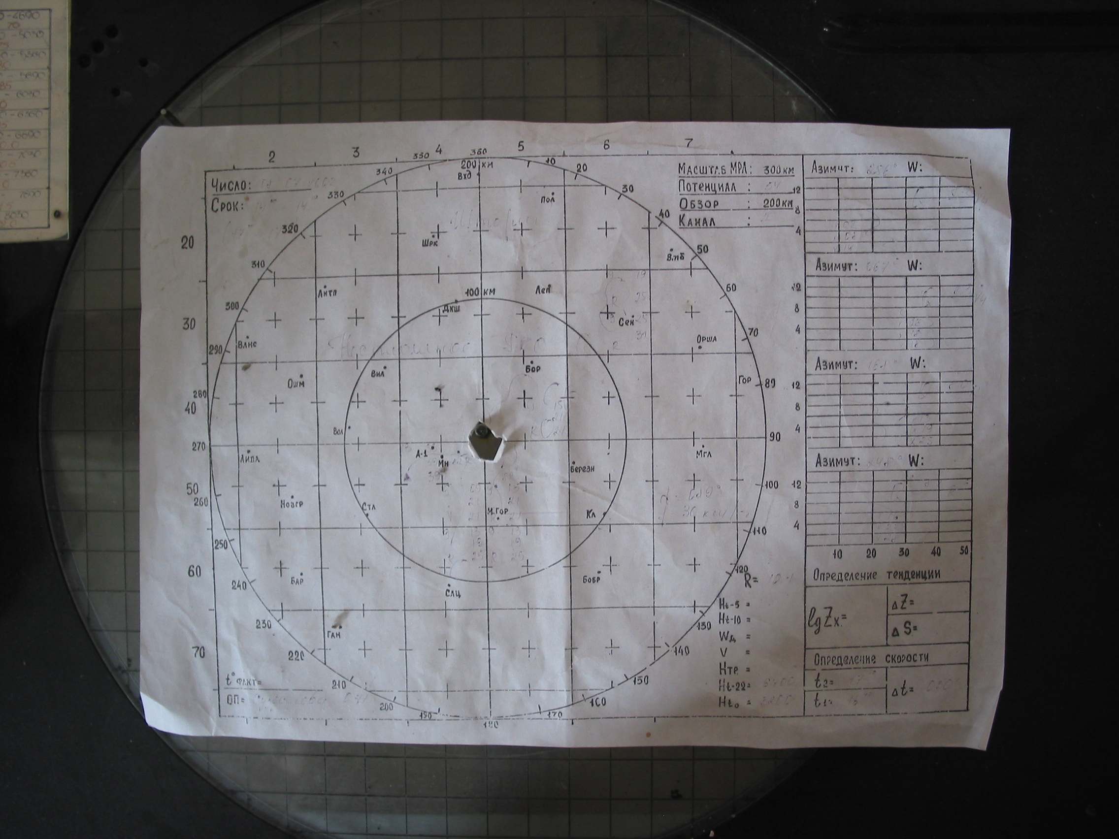
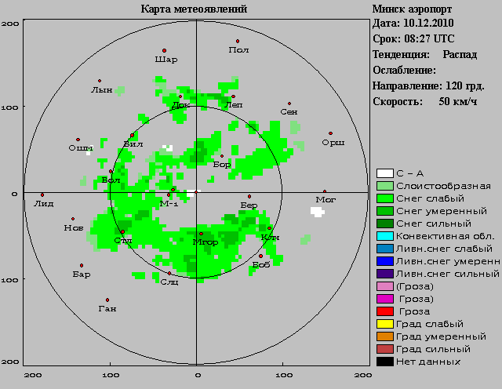
Radar-based weather message

Slide 7
Purposes of data representation
Transmission to facilitate data transfer from site to central facility
Production contains all data and metadata
required to derive higher-order
outputs from input data
Exchange data or product sharing but not necessarily further processing
Archive data representation from many
different (observing) systems for storage
WMO
context

Slide 8
IPET-OWR’s weather radar (and lidar) radial data representation deliverables
Sweep 3
Sweep 2
Information model
Data model
File format specification
WMO Member guidance
Sweep 1
VOL1
0.5°
130°
...
32.0°
Volume
Sweep
Ray
Range Bin
Dataset
0.5km
180km
DBZH
VRADH
DBZH
VRADH
129°
...
...
Object model hierarchy

Slide 9
Example: horizontal beam width
Information model: Identifier*=3.2, Type=real, Unit=degrees, Accuracy=0.01
Data model: Type=float, Encoding=float64, Definition=64-bit floating point value in IEEE 754-2008 binary64 format
File format specification: radar_parameters sub-group, variable name = radar_beam_width_h
WMO Member guidance: required for exchange
*Table reference in format: table.entry

Slide 10
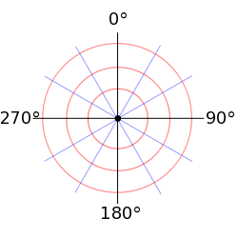

Basic weather radar observation in radial/spherical coordinates
Radar site
Longitude, Latitude, Height
Geodetic datum name
WIGOS site identifier
Per sweep
Elevation angle
Number of azimuth gates
Number of range bins/azimuth
Azimuthal offset from North
Azimuth angle
North
Range from radar
Bin length
Per ray
Time of acquisition

Slide 11
Radar quantities or “moments”
For each quantity
Dataset identifier
Quantity name
Quantity units
Special value: missing data
Special value: no signal
Scaling gain
Scaling offset
e.g.
Quantities per sweep
Total power (H/V)
Radar reflectivity factor (H/V)
Radial wind velocity (H/V)
Spectral width (H/V)
Signal quality index (H/V)
Differential reflectivity
Correlation coefficient HV
Differential phase
Specific differential phase
Radar echo classification
Doppler
Dual-
polarization
0 data 255
-32 dBZ 95
Excludes data quality characterization/indices

Slide 12
More (optional/desirable) metadata
Calibration metadata (47 attributes)
Ray characteristics, (12 attributes) e.g.
  Precise read-out angles
  Transmit power
  Noise estimate
  Sample size (number of pulses)
  Pulse repetition time(s)
Thresholds applied to quantities

Slide 13
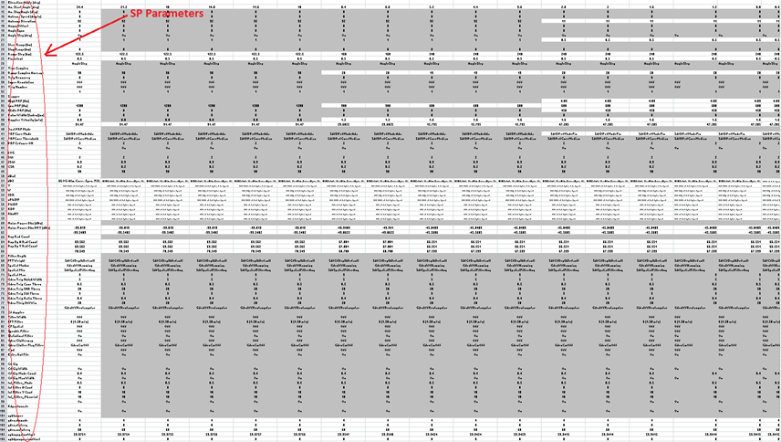

Slide 14
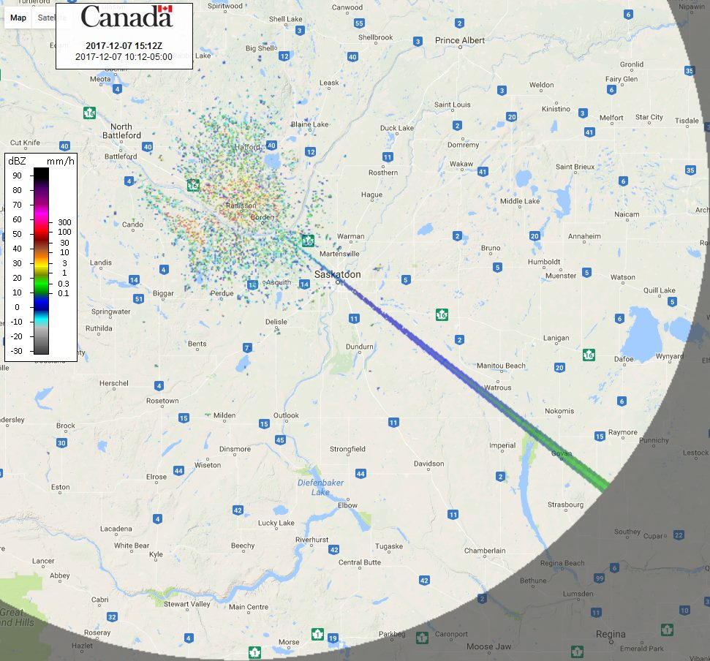
When metadata matters : quality assurance
Weather radar as a radio telescope: solar signatures from operational data
Methods evolved in Europe (NL, FI)
2018 WMO Vaisala Award winners
Allows determination of:
Antenna pointing accuracy
Calibration level stability
Differential reflectivity bias/offset
With exchanged data!

Slide 15
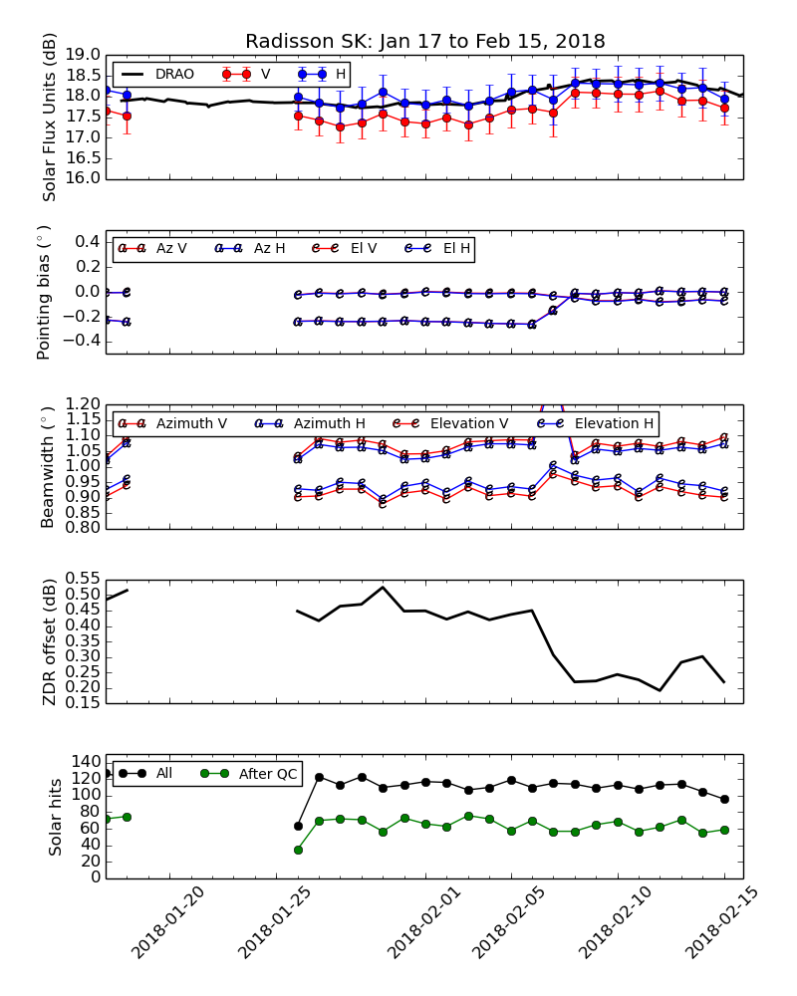
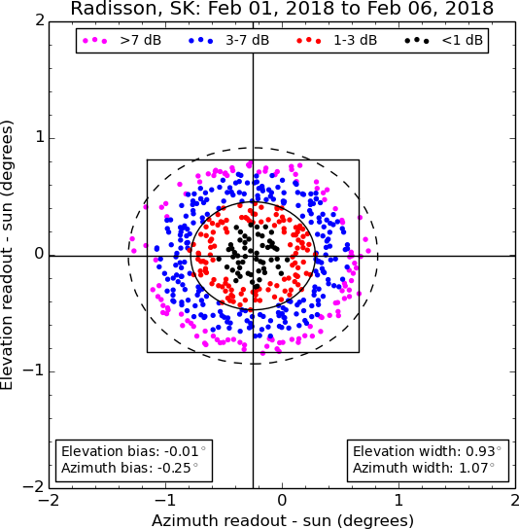
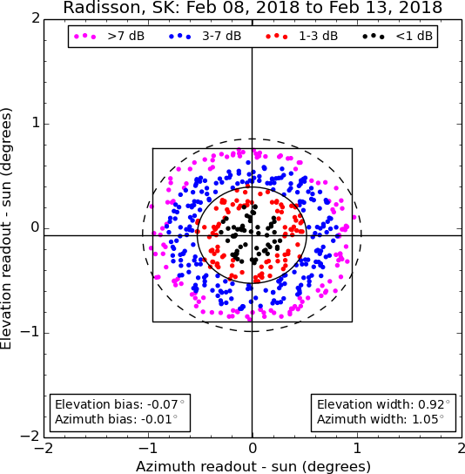
When metadata matters:
Solar monitoring
Power distributions

Slide 16
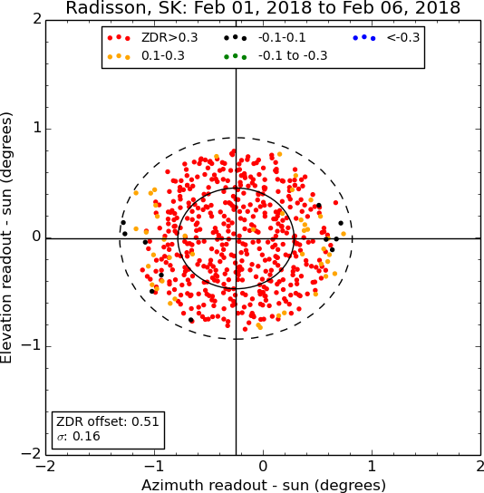
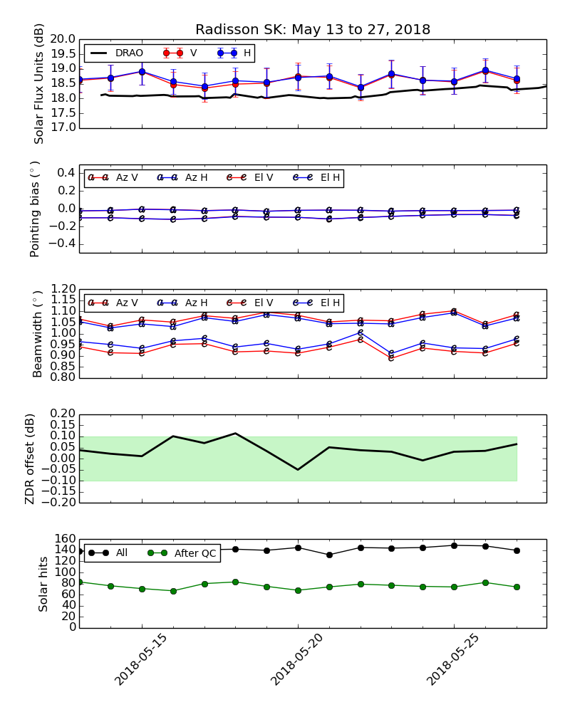
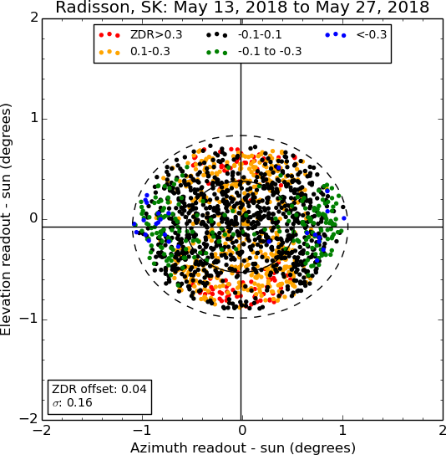
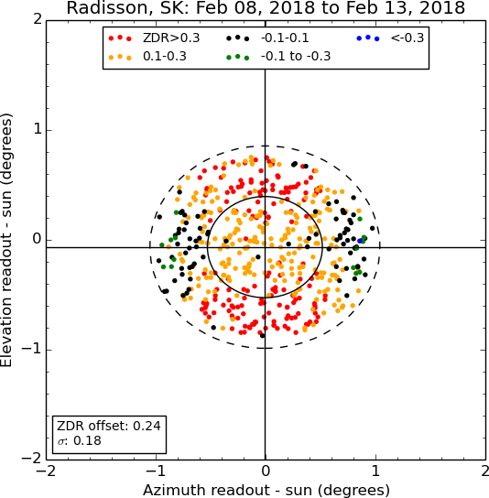
Solar Z_{DR}
offset
monitoring

Slide 17
Data exchange
HDF5
- Groups, hierarchies, compression
NORDRAD
BALTRAD
COST 717 OPERA
ODIM_H5 2.1 2.2 2.3, 3.0?
Data quality
2001 2003 2008 2011 2013 2014 2016-
now
CF Conventions 1.4, 2.0
CfRadial 1.3 Groups
Hierarchies
Data quality
Compression
netCDF
v 4
Research

Slide 18
Data exchange
Engagement with ICT-ISS: IPET-CM, IPET-DD
on achieving
official approved status of Guidance to Members
for No. 306?
HDF5
ODIM_H5 2.2
Structure
CfRadial 2.0
CF
Single
Global
Standard
CfRadial 1.4
netCDF
github.com/wmo-ipet-owr
Research

Slide 19
Operational Weather Radar Best Practices Guide
Complement to
CIMO Guide
Manual on WIGOS
Guide to Weather Radar Network Design
Guide to Weather Radar Technology
Guide to Weather Radar Procurement
Guide to Weather Radar Siting, Configuration, and Scan Strategies
Guide to Weather Radar Calibration, Monitoring, and Maintenance
Guide to Weather Radar Data Processing
Guide to Weather Radar Data Representation and International Exchange
Operational Weather Radar Glossary of Terminology
Aligned with ISO 19926-1 weather radar standard (under development)

Slide 20
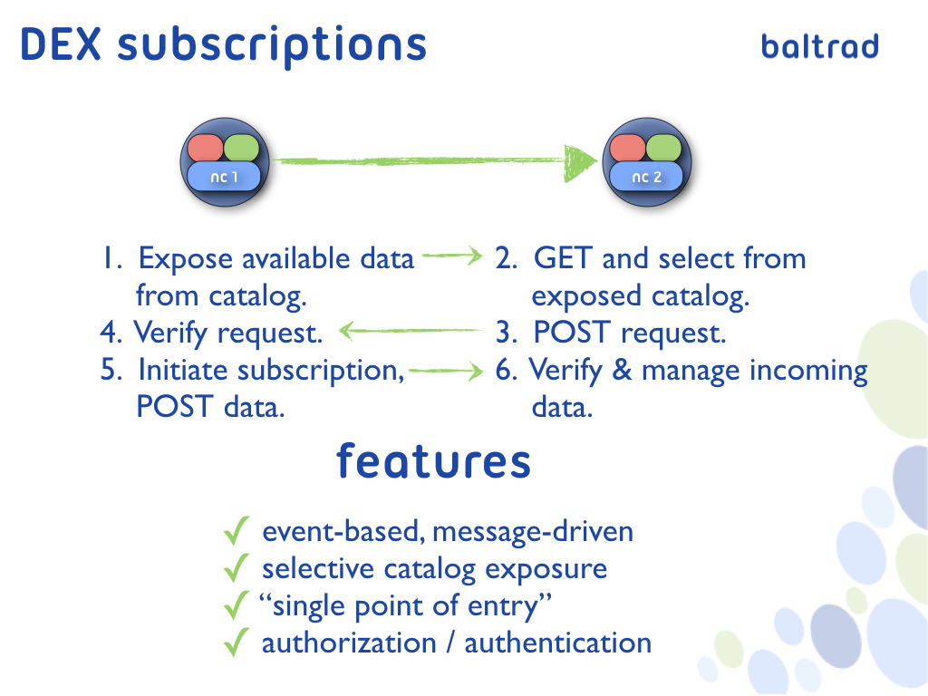

Slide 21
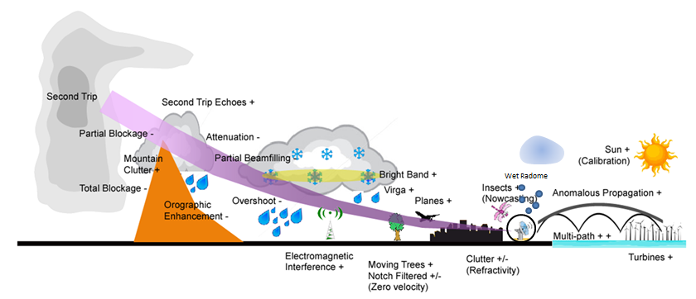
Site and data quality

Slide 22
Data Management Value Proposition
Standards and Interoperability
  Doesn’t happen by accident
    Cliff Kottman, OGC
No data are esoteric
Extending the reach of our data
Lowering the barrier to implementation
Attract expertise from wider net of candidates
  academia
Metadata to support data exchange AND processing
Better metadata -> better data

Slide 23
General discussion points about netCDF and CF Conventions for/in/with WMO
Accelerate evolution of CF
WMO does not need to own or govern CF, but it would need to own and govern Member use of CF, e.g. “profiles”
Strengthen WMO “fit for purpose” relevance
Exploratory joint team or workshop could show the way

Slide 24

Thank you

