Slide 1
NetCDF/CF @ ECMWF
usage, governance and perspectives
Sebastien Villaume
ECMWF
Sebastien.Villaume@ecmwf.int

Slide 2
Usage of NetCDF @ ECMWF
Netcdf is not widely used at ECMWF and is not the preferred meteorological data format (GRIB, BUFR/ODB). The Mars Archive contains ~ 300PB of data in GRIB/BUFR
NetCDF mostly for incoming/outgoing data
  Incoming data is usually converted to a WMO data format (GRIB or BUFR)
  Data is converted to NetCDF in the last step before sending it out to users/customers
We tried to modify our long term archive to handle NetCDF but the limitations of the data format are difficult to overcome: hard to split/merge, no possibility to do partial read…

Slide 3
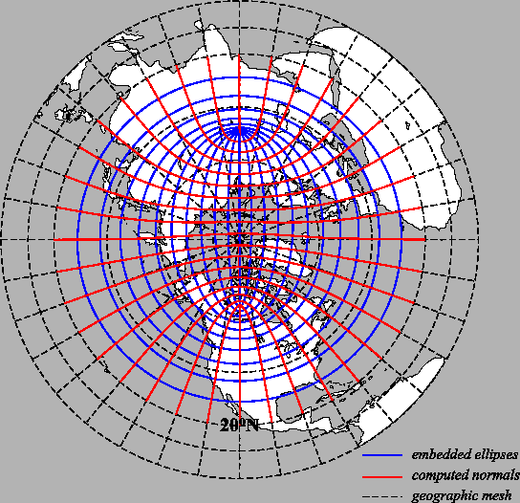
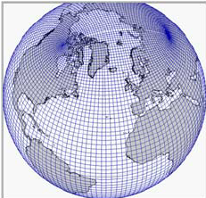
The only exception: Ocean data
The only exception is the ocean model (NEMO) and the main reason for not using GRIB is the nature of the ocean grid: a tripolar grid with 2 north poles located in Russia and North America.
  The tripolar is not better represented in NetCDF, i.e. 2 irregular 2D arrays for lat and lon.
  When stored in our long term archive, the preferred way is to interpolate the tripolar grid into a regular Lat/Lon grib.

Slide 4
Usage of NetCDF for Copernicus (covered by P.-A. presentation)
ECMWF is running 2 Copernicus services and host some datasets for a third one:
  C3S (Copernicus Climate Change Service)
  CAMS (Copernicus Atmosphere Monitoring Service)
  CEMS (Copernicus Emergency Management Service)
We receive data from many providers and it is mostly in NetCDF
  We have developed a profile at ECMWF, derived from CF to try to standardized the incoming data from providers.
Copernicus users are generally “public” users with mostly basic technical background: they want NetCDF because the level of technical knowledge required is low.

Slide 5
The ECMWF NetCDF “profile”
Adopt the general principles of CF
Enforce elements that are often optional in CF
Restrict some unwanted features
Recommend one alternative when there are several ways to encode the metadata
Designed to facilitate metadata indexing and aggregation
Filenames do not carry an information necessary to understand the content
As generic as possible to be applicable to any dataset.

Slide 6
Spatiotemporal Coordinates
The units attribute should not be used to identify coordinates
standard_name and axis attributes are mandatory and are the primary way to identify coordinates
For vertical coordinates, the positive attribute is also mandatory.
An explicit dimension is recommended (but not mandatory) if the vertical coordinate is a scalar.
A coordinate and its associated dimension do not need to have matching names ( lat(lat), time(time), etc.)
Each data variable must have a coordinate attribute that lists all its coordinates, including the ones that could be derived from inspecting the “dimensions” of the data variable
Several sets of spatiotemporal coordinates can co-exist in an NetCDF file and may or may not be shared by several data variables.

Slide 7
Time: Only 1 Time axis but several time coordinates
In CF convention and CF community, axes and coordinates tend to be overlapping concepts creating some confusion, particularly for the Time coordinates.
We define 2 absolute time coordinates and 1 time interval … all on the same single time axis!
The time coordinates require the standard_name, units and calendar attributes.
The time interval variable only requires standard_name and units.
The axis attribute is associated to the time coordinate with standard_name "time".
Forecast reference time
Lead Time
Time
00Z
12Z
00Z

Slide 8
Time in NWP
+3
+6
+9
+12
+18
+24
00Z
06Z
12Z
18Z
Time

Slide 9
Time: getting one Forecast
+3
+6
+9
+12
+18
+24
00Z
06Z
12Z
18Z
Time

Slide 10
Time: getting the best possible estimate (merged forecast)
+3
+6
+9
+12
+18
+24
00Z
06Z
12Z
18Z
Time

Slide 11
Time: comparing forecast with various reference time but same valid time
+3
+6
+9
+12
+18
+24
00Z
06Z
12Z
18Z
Time

Slide 12
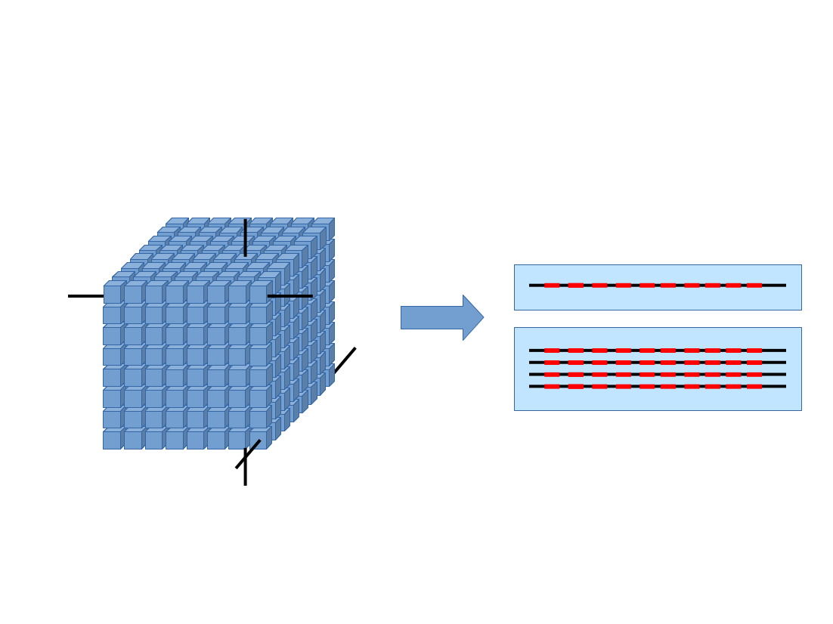
More generally, we want to concatenate and slice on demand

Slide 13
Data variables
The coordinates attribute should be present even when all the coordinates are explicit dimension.
The cell_methods is mandatory when the data variable is post-processed (by the model itself or by subsequent tools).
But the cell_method string can quickly become unoractical for complex post-processing
  Example: probability of at least 20mn total precipitation in the last 24hours
  probability of surface temperature to be at least more than 1.5 standard deviation from climatological values
  Extreme Forecast Indexes (EFI)

Slide 14
Need for other type of coordinates or concepts
We also defines other types of coordinates to represent ordered list or unordered collections
Few examples are:
  Ensemble member
  Reforecast model date or version
  Model origin

Slide 15
Where to go from here at ECMWF: what we need…
Improve how the various time concepts are encoded: it is not straightforward to determine in CF if the content of a file is an analysis, a forecast, a reforecast, a collection of one of the previous types mentioned, or something else.
Improve the consistency in the standard_name table: some standard names are really long and sometimes they contain post processing information or sign convention !
Replace the cell_methods attribute by either a set of attributes or by an external dummy variable with attributes
  one long string to fit it all is not working for complex or multiple post processing

Slide 16
Where to go from here?

Slide 17
Tons of profile “based on CF” (CMIP, ECMWF, CF Radial, etc.)
CF Convention
NetCDF
Storage backend (HDF)

Slide 18
CF Convention
NetCDF
Storage backend (HDF)

Slide 19
CF controlled vocabularies
CF structure/standard (attributes, Cf data model, etc.)
NetCDF
Storage backend (HDF)

Slide 20
One possible way of working together….
CF vocabularies
WMO vocabularies
CF structure/standard (attributes, Cf data model, etc.)
NetCDF
Storage backend (HDF)

Slide 21
What happens if
WMO needs (really badly) a new “structure” or “feature” requiring amending the underlying level?
  If it follows the CF philosophy and extend CF without violating the CF model -> we are good
  But what if is not the case?

Slide 22
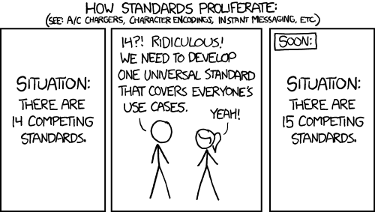
Concluding remarks
ECMWF NetCDF profile is not another attempt to create a new universal convention
It could be used as a starting point to building the WMO profile at least for the NWP part.
Some work still to be done to bring all the basic concepts we need for the NWP community

