Slide 1
netCDF CF conventions
for WMO data exchange
Use of CF and netCDF at CMA
GAO Feng
National Meteorological Information Center, CMA
gaof@cma.gov.cn
Sep. 20th ,2019

Slide 2
Outline
Using of netCDF in CMA
CMA data element specification
Summary and recommendations

Slide 3
The use of NC in CMA
（1）Some observation data and products of CMA have been stored in NC format
Wind Profiler Radar data and products (WPR) of China
CMA Ocean Data Analysis System Global Sea Surface Temperature （V1.0）
CMA Land Data Assimilation Products (CLDAS-V2.0，RT,NRT)
East Asia High Resolution Land Driving Field and Soil Moisture Products in East Asia (HRCLDAS )
FY-4A Satellite Level 1 Data
FY-4A Satellite Level 2 Data
FY-3D Satellite Level 1 Data
FY-3C Satellite Level 1 Data
FY-3C Satellite Level 2 Data
…

Slide 4
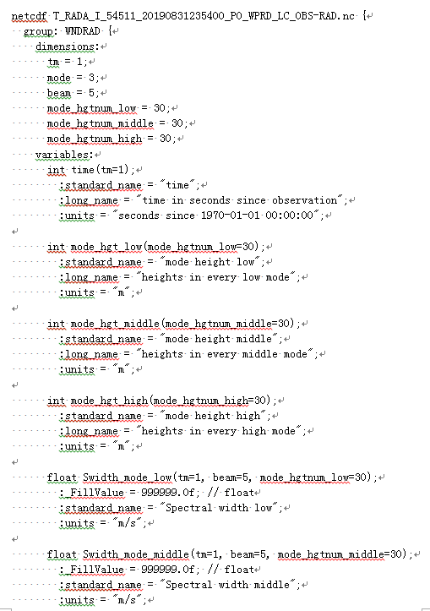
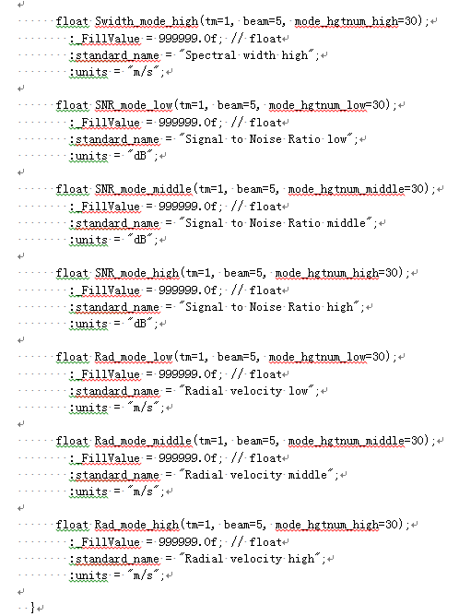
The use of NC in CMA
Wind Profiler Radar data and products (WPR) of China in netCDF format:

Slide 5
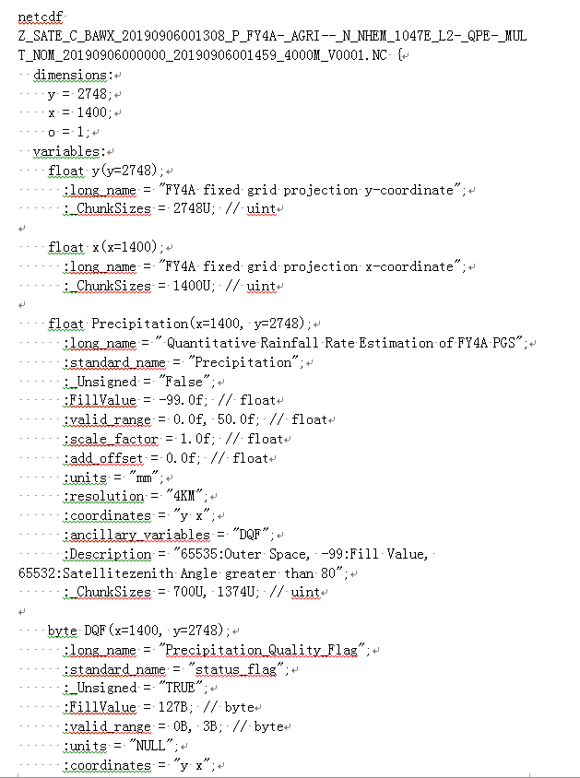
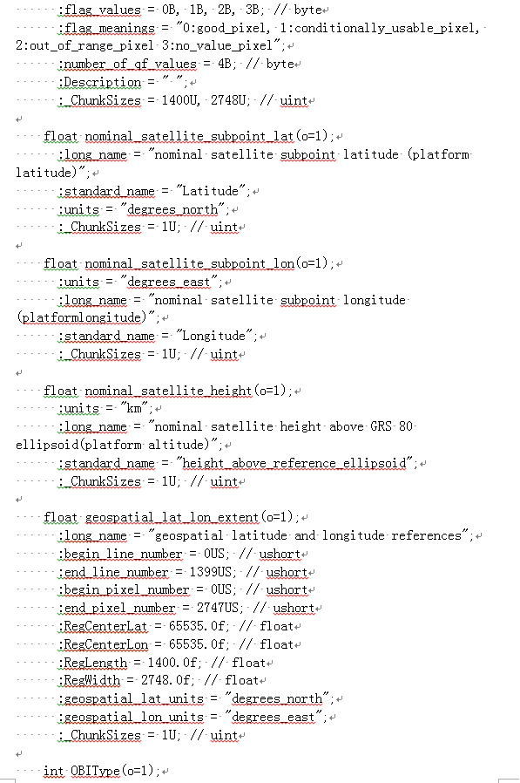
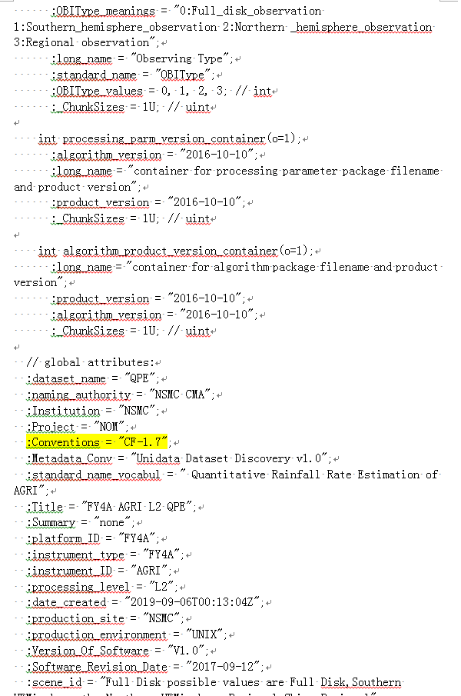
The use of NC in CMA
FY-4A Satellite 2 level data (Refer to CF-1.7)

Slide 6
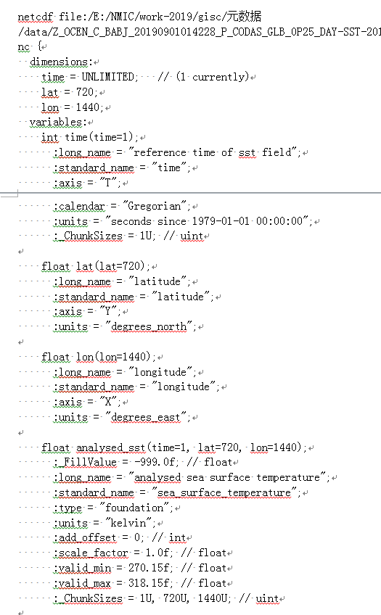
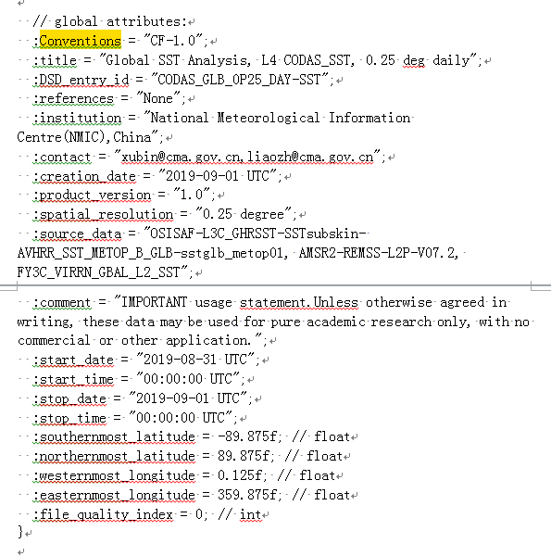
The use of NC in CMA
CMA Ocean Data Analysis System Global Sea Surface
Temperature （V1.0）(Refer to CF-1.0)

Slide 7
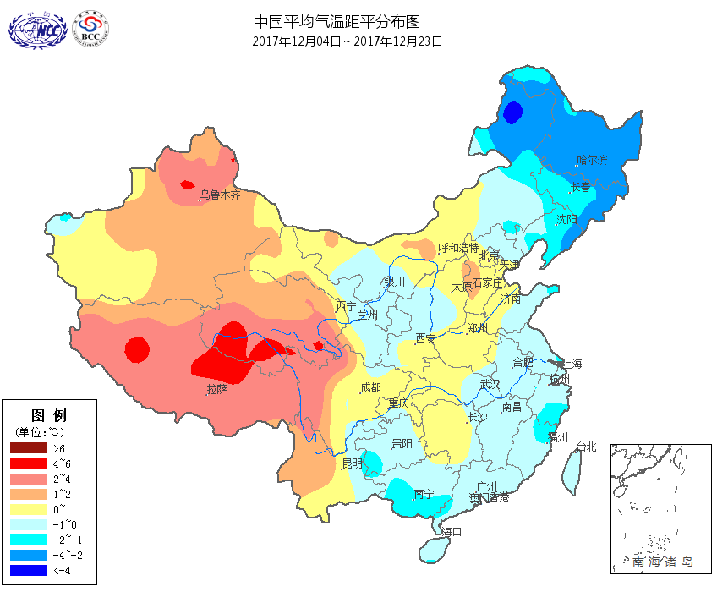
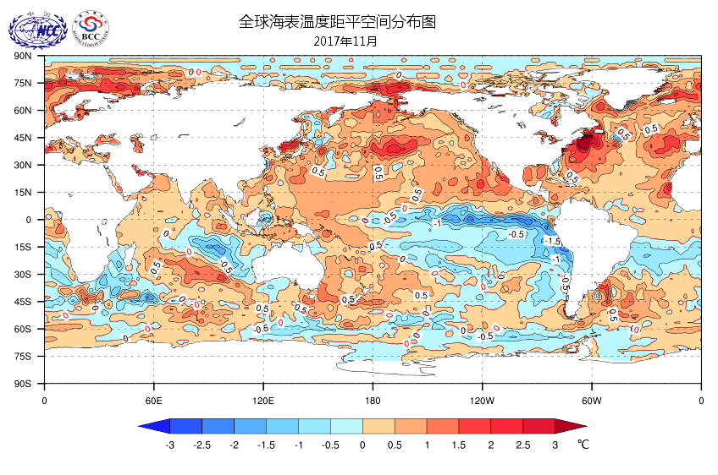
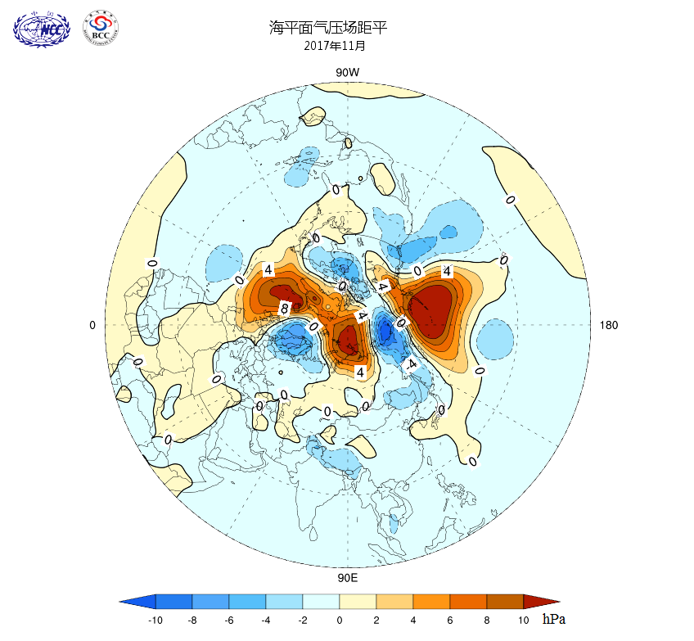
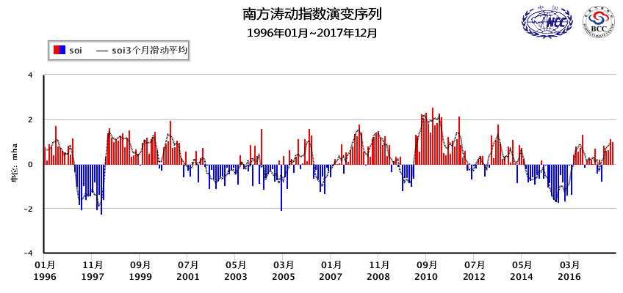
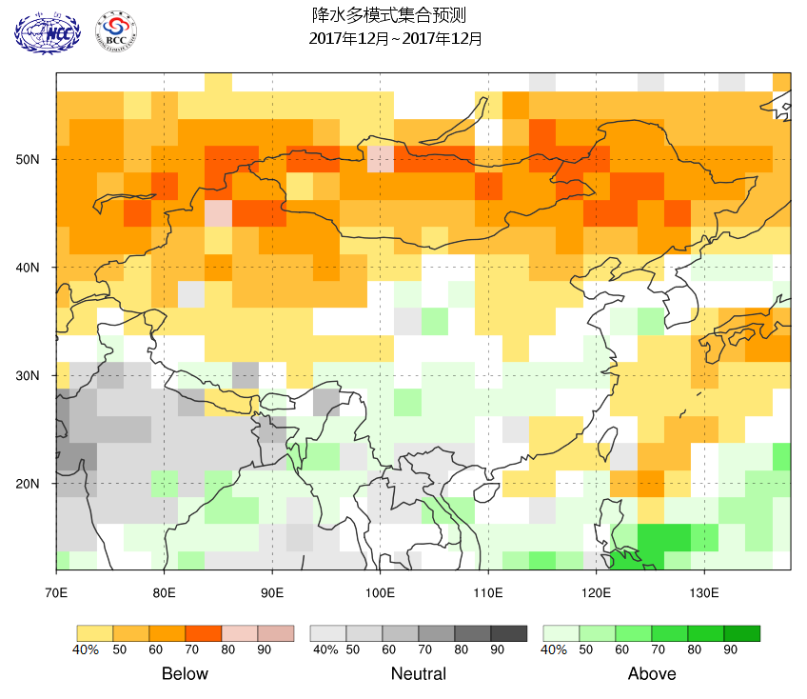
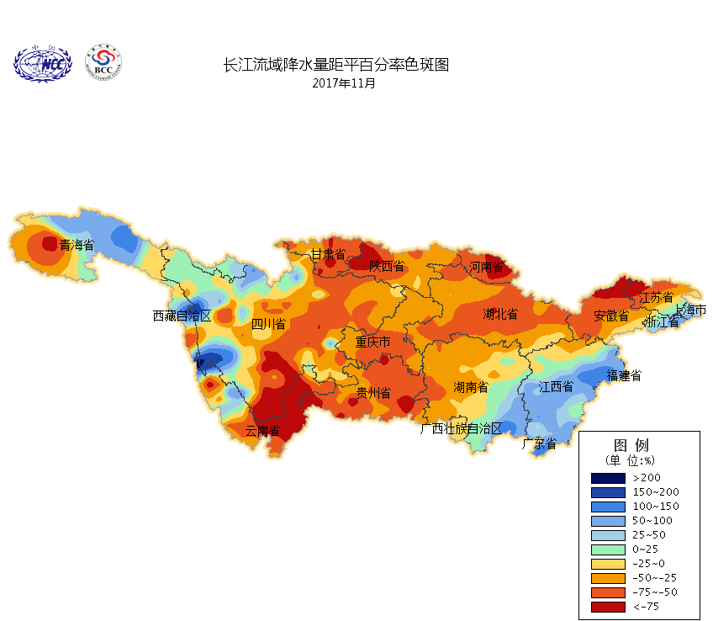
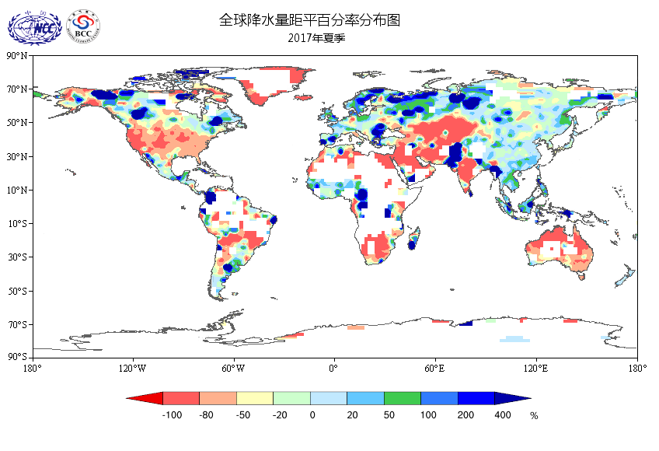
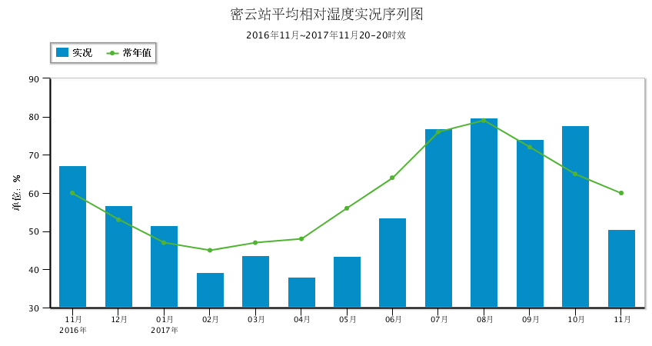
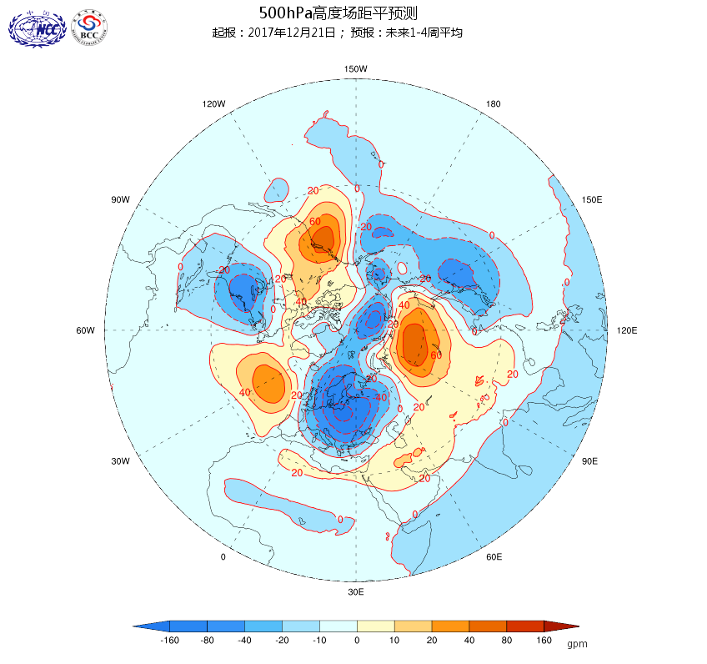
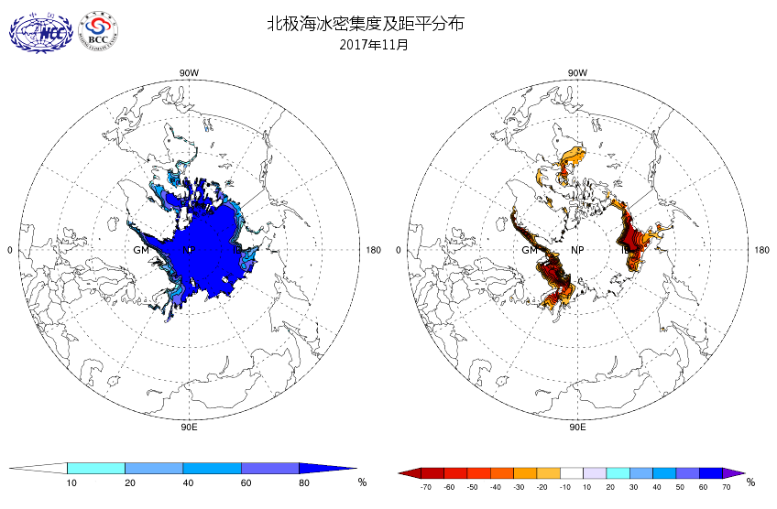
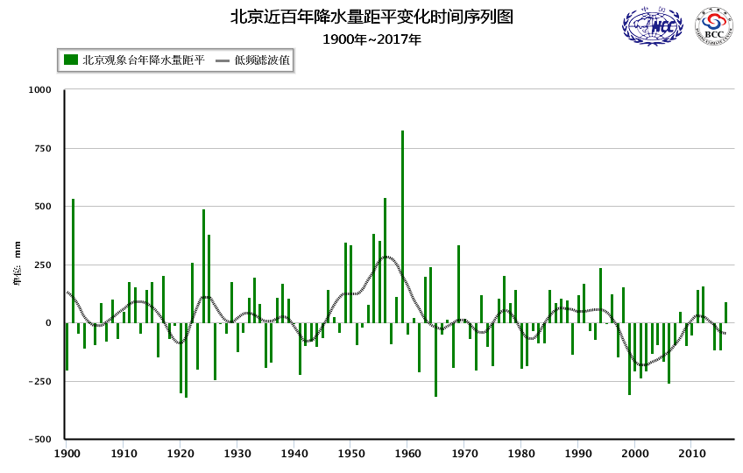
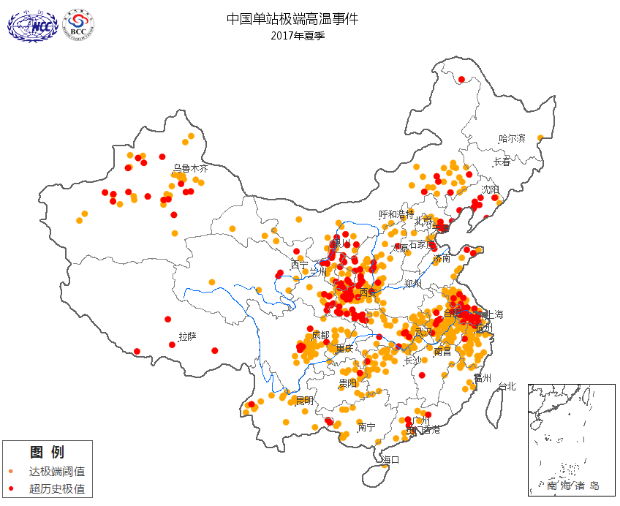
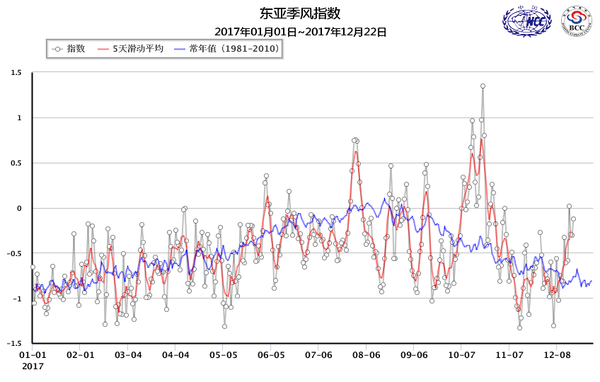
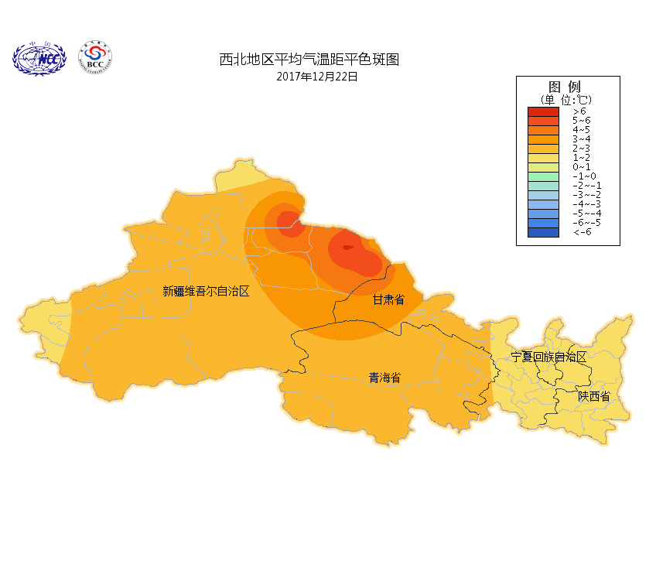
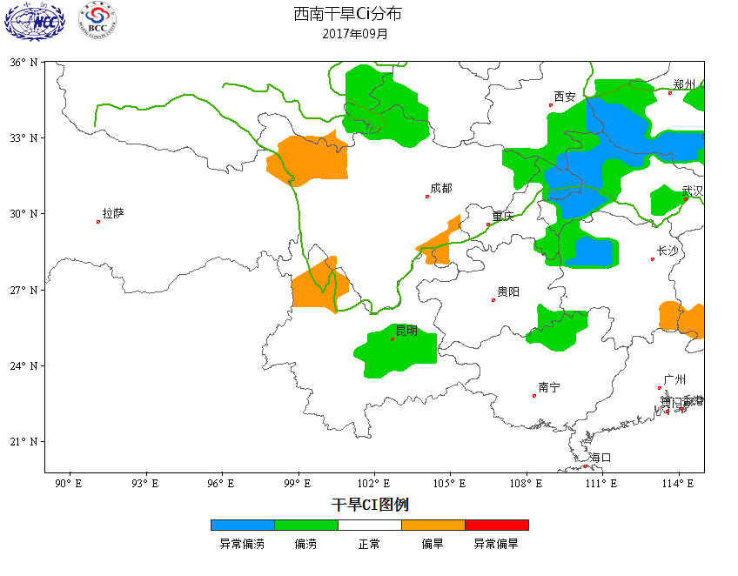
The use of NC in CMA
（2）NetCDF is widely used in the climate operations
Based on the NetCDF file library, BCC has constructed the CIPAS(Climate Intelligent Prediction and Analysis System).
CIPAS
To support the climate operational work and climate service
To enable all operational staff to access climate products with most convenient way

Slide 8
The use of NC in CMA
In the CIPAS ,the data from different sources are converted into unified NC files.
  DATA CONVERSION ENGINE: Unify data from various sources into NC format.
  achieve the data conversion. The engine includes three components:
  DATA DISTINGUISH: identify data sources, get the corresponding processing rules(self-defined).
  FILE PROCESSING: decompression, file naming…
  DATA PROCESSING: multi-source data integration, time scale regularity, basic statistical …
Data Conversion Engine
Grib
ASCII
File catalogue
DATA
DISTINGUISH
DATA
PROCESSING
TXT
NetCDF
File libary
File naming
RDBMS
attribute
FILES
PROCESSING
others
signature value
  Five unifications have been achieved after transformation
dimension

Slide 9
The use of NC in CMA
File Format used in BCC Climate Model system
All the climate model input data sources of CMA are stored in NC format, and the output products are also in NC format at present.
Model Name | Initial Field | Model Output | Forecast Application | For other Center
DERF 2.0 | netCDF | netCDF | netCDF | /
Seasonal Forecast | netCDF | netCDF | netCDF | /
S2S | netCDF | netCDF | netCDF | Grib2
CMIP6 | netCDF | netCDF | netCDF | netCDF

Slide 10
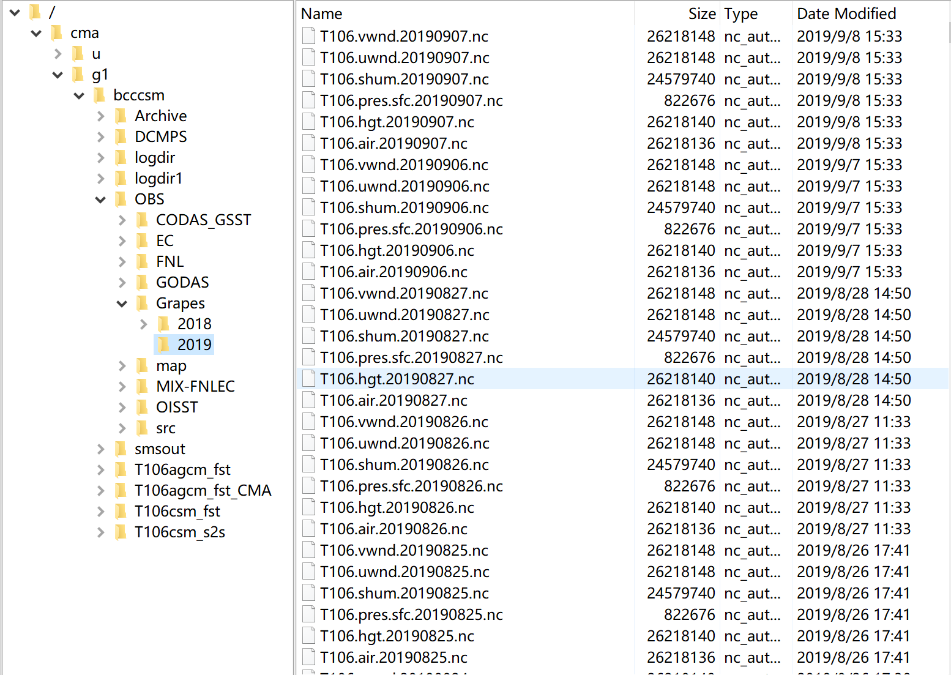
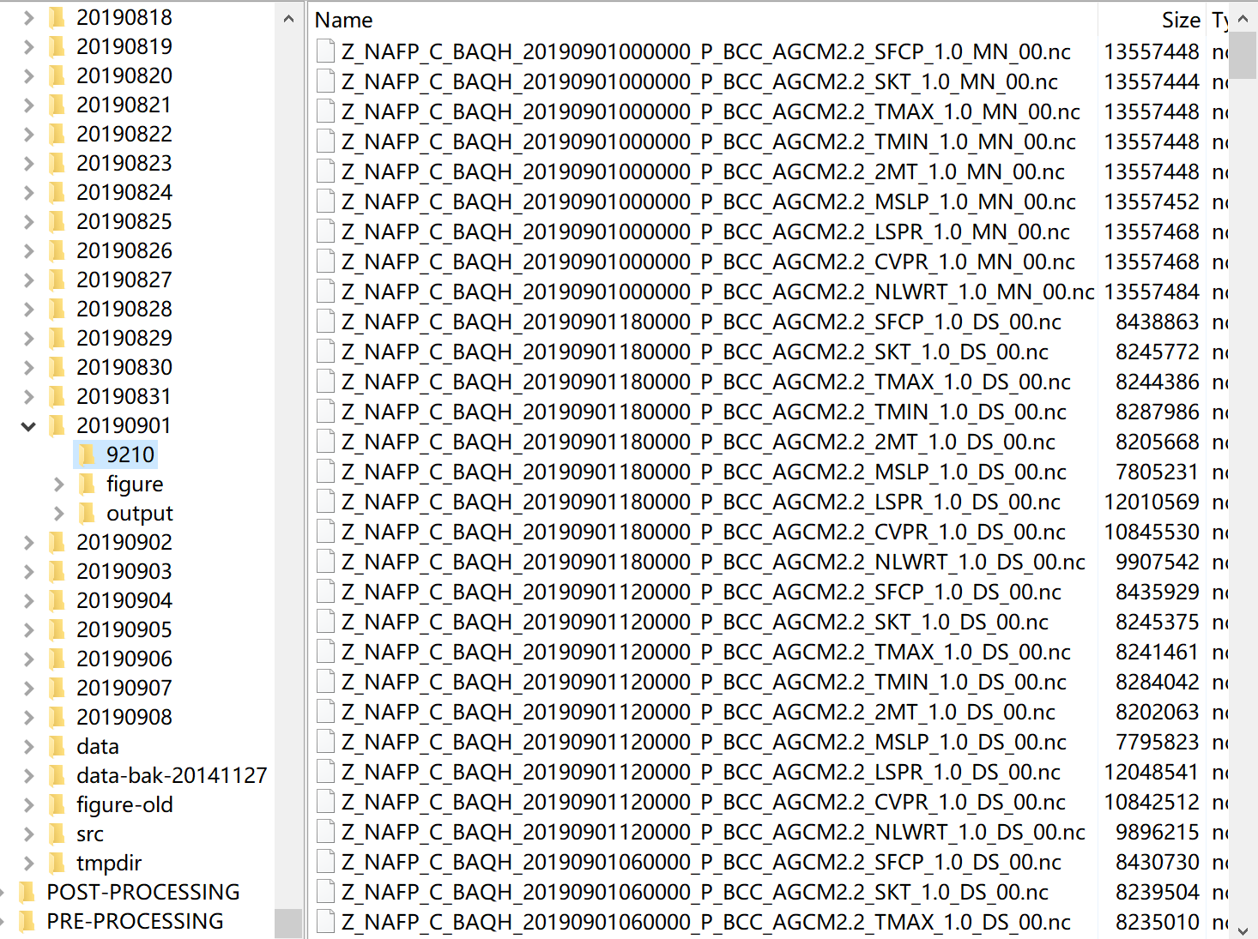

The use of NC in CMA
File Format used in BCC Climate Model System
DERF 2.0 model initial field dataset(input)
DERF 2.0 model prediction(output)
Grapes dataset

Slide 11
Data element specification in CMA
CMA is also developing a rule, similar like CF-Data elements for meteorology, including 1 general and 25 different elements of the data source standard fascicle.
It will be applied to CMA data collection, transmission, analysis, processing, storage, release, and application to solve the inconsistency of the same data elements in each weather and climate operations.

Slide 12
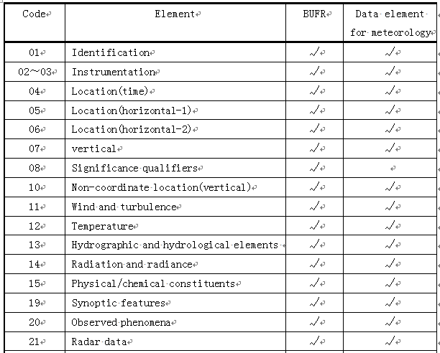
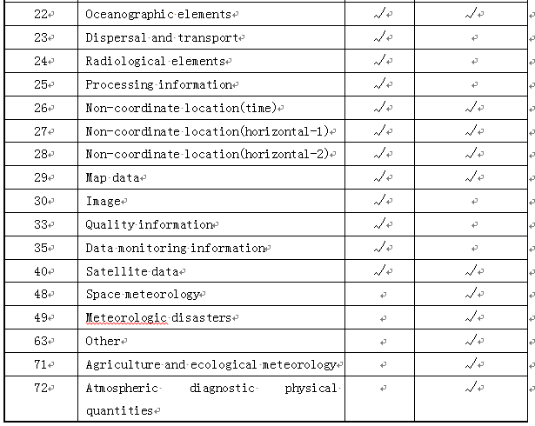
Data element specification in CMA
（1）Classification of Data elements for meteorology
The classification of data elements for meteorology refers to BUFR descriptor classification
At the same time, it is extended, like space weather, disasters, agriculture and ecological weather, atmospheric diagnostic physical quantities, etc.

Slide 13
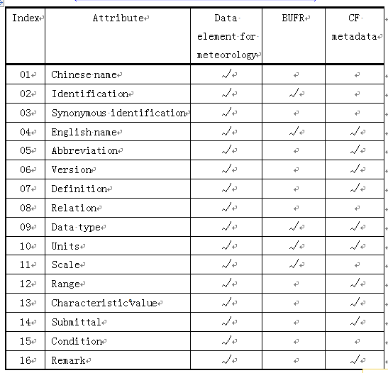
Data element specification in CMA
（2） Attributes of data elements for meteorology
There are 16 common elements (see the table below)
Which cover 5 BUFR descriptors and 10 CF metadata.

Slide 14
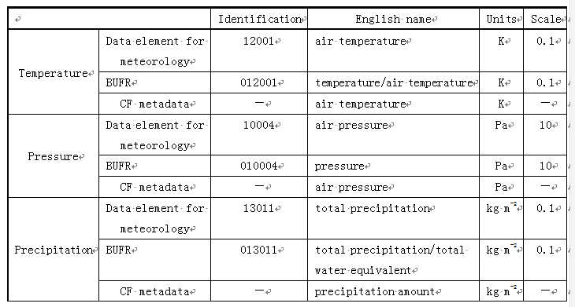
Data element specification in CMA
（2） Attributes of data elements for meteorology
The difference for the definition of attributes among BUFR, CF and the specification

Slide 15
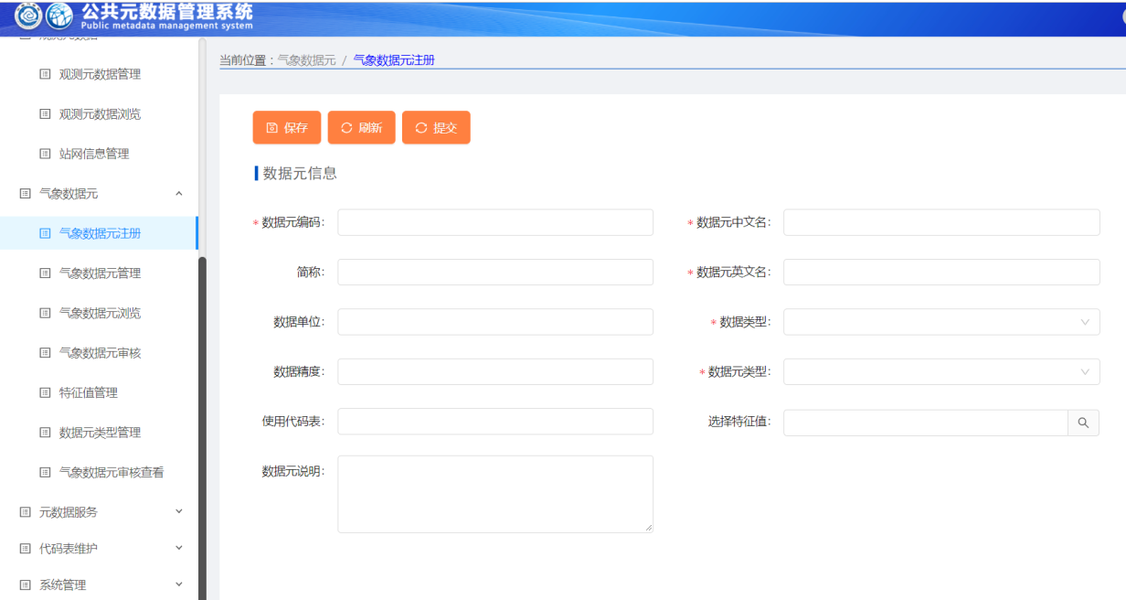
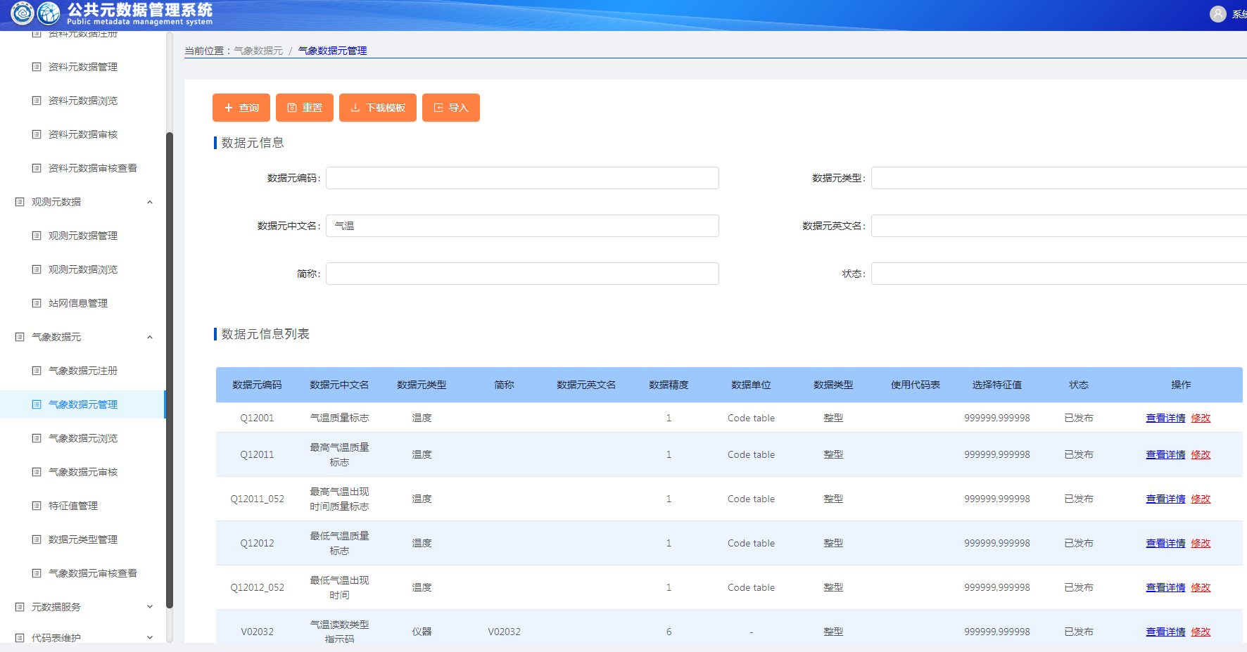
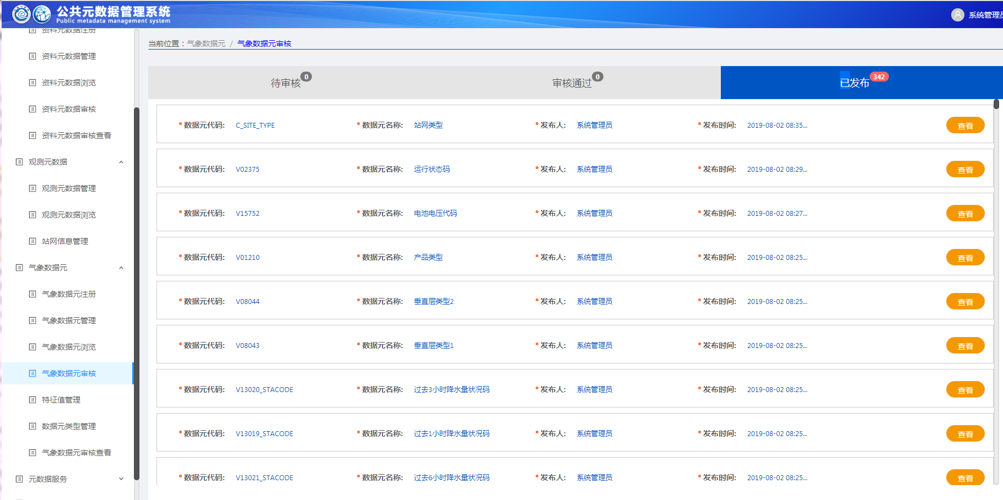
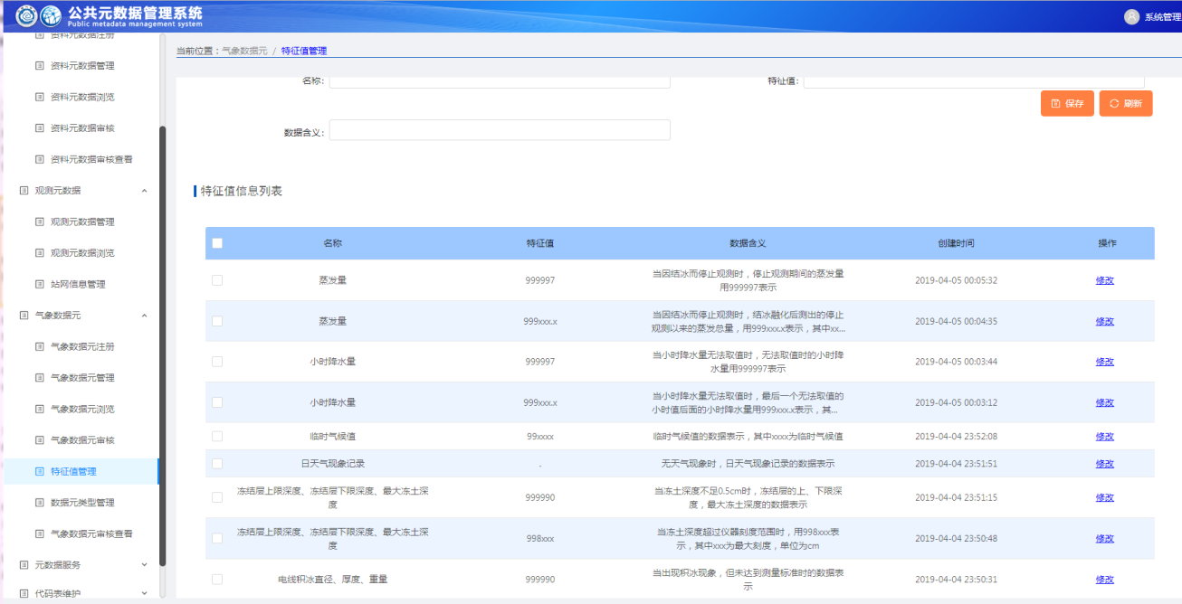
Data element specification in CMA
（2）Management of data elements for meteorology
CMA has developed a system to manage the data element standard, realize sharing in the whole process of meteorological business, and ensure the "global" consistency of data element definition.
Registration
Inquiry, Import, Amendment
Check
Monitoring

Slide 16
Summary and Recommentation
The netCDF format, formally stored data and productions, has been used in CMA. Among which, climate field application is well and widely, but few data and production follow CF standard.
CMA is working on “The data elements for meteorology” specification, which refers to BUFR and will be considered to refer to CF specification later.
We believe that the application of CF specification in satellite and radar data is a challenge and urgent. Suggest to enhance the applicability of CF specifications for satellite and radar data.

Slide 17
Thank you

