Slide 1
CF/NetCDF for Marine and Oceanographic data
David I. Berry¹, Kevin O’BRIEN²
National Oceanography centre
Pacific marine environmental laboratory, NOAA

Slide 2
”A primary aim for the workshop is to investigate a potential governance model for the netCDF-CF data representations to be used in WIS in a framework of collaboration with the CF community.”
Notes:
Tried to focus on this whilst putting slides together

Slide 3
Outline
Background
  Why NetCDF
  CF conventions
Observation sources and NetCDF layouts
Potential issue
Potential solutions / recommendations
Notes:
The aim of these slides is to give an outline of how NetCDF is used in the OBSERVATIONAL (emphasize not model) oceanographic community. This will include:
- a brief overview of why NetCDF is widely used
- some example NetCDF layouts and relationship to the CF conventions
- potential interoperability / governance issues
- any recommendations

Slide 4
Background – why NetCDF
Summarized nicely by the WOCE (World Ocean Circulation Experiment)
  “All of the WOCE Global Data is now in netCDF format. This format has many advantages, the most important of which is that it is self-describing, meaning that software packages can directly read the data and determine its structure, the variable names and essential metadata such as the units. This self-describing aspect of netCDF file format means that the information needed to ensure accurate work (reduce the incidence of errors) is available with the data itself. Secondly, it means that programs described below can examine a netCDF file and generate the code needed to read the file whether it be Fortran, C/C++, JAVA or PERL. Thirdly, plotting and analysis packages (e.g. Ferret, IDL, Matlab) can directly read the netCDF files for plotting or analysis.”
https://www.nodc.noaa.gov/woce/woce_v3/wocedata_1/cmdac/primer/why.htm
Notes:
I was going to try and phrase something around why NetCDF is widely used in the oceanographic community but someone has already done the work, with a nice summarty from WOCE

Slide 5
Background – why NetCDF
Self describing format
  Scale, offset, units
  Attributes (missing values, units, related variables etc)
APIs available for many programming languages, e.g.
  C / C++
  Fortran
  Python
Wide support in different analysis packages
  Matlab
  Ferret
  IDL
  R
Flexible
Notes:
Reiterating the main points from the previous slide

Slide 6
Background – why NetCDF
Self describing format
  Scale, offset, units
  Attributes (missing values, units, related variables etc)
APIs available for many programming languages, e.g.
  C / C++
  Fortran
  Python
Wide support in different analysis packages
  Matlab
  Ferret
  IDL
  R
Flexible
Notes:
Note flexibility can be an issue for interoperability, hence conventions developed.

Slide 7
CF Conventions
  “The purpose of the CF conventions is to require conforming datasets to contain sufficient metadata that they are self-describing in the sense that each variable in the file has an associated description of what it represents, including physical units if appropriate, and that each value can be located in space (relative to earth-based coordinates) and time.”
Source: http://cfconventions.org/Data/cf-conventions/cf-conventions-1.7/cf-conventions.html#_goals
  “Principles of CF include self-describing data (no external tables needed for understanding); metadata equally readable by humans and software; minimum redundancy and maximum simplicity; and a development process focusing on existing needs.”
Source: http://cfconventions.org/faq.html#principles

Slide 8
CF Conventions - comments
CF Conventions initially aimed at model data, i.e. gridded fields containing spatio-temporal means and related statistics.
Most oceanographic (and other) observational data point observations (including series of points), sometimes temporal averages.
Recent versions of CF conventions (since 2011, v1.6) contain Discrete Sampling Geometries, allowing these observations to conform to the CF conventions.

Slide 9
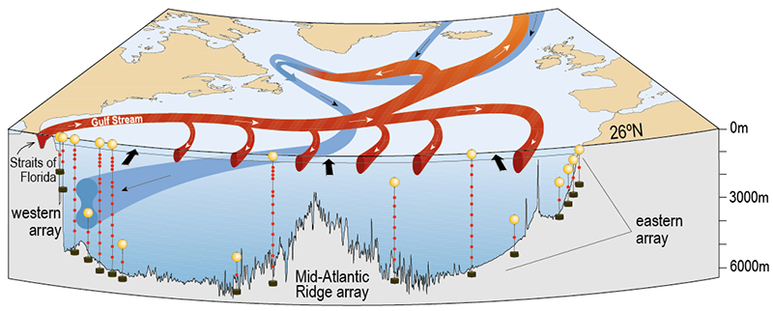
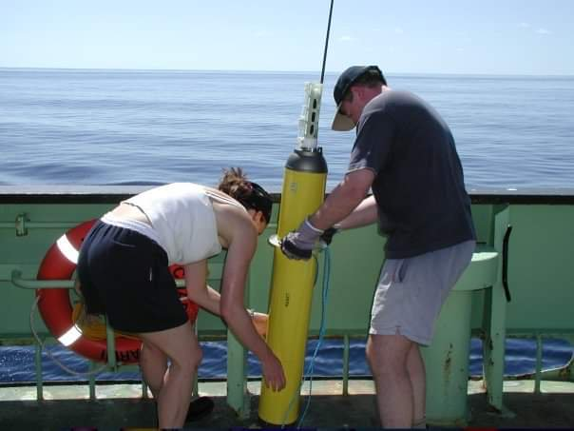
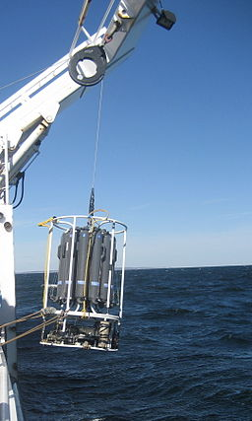
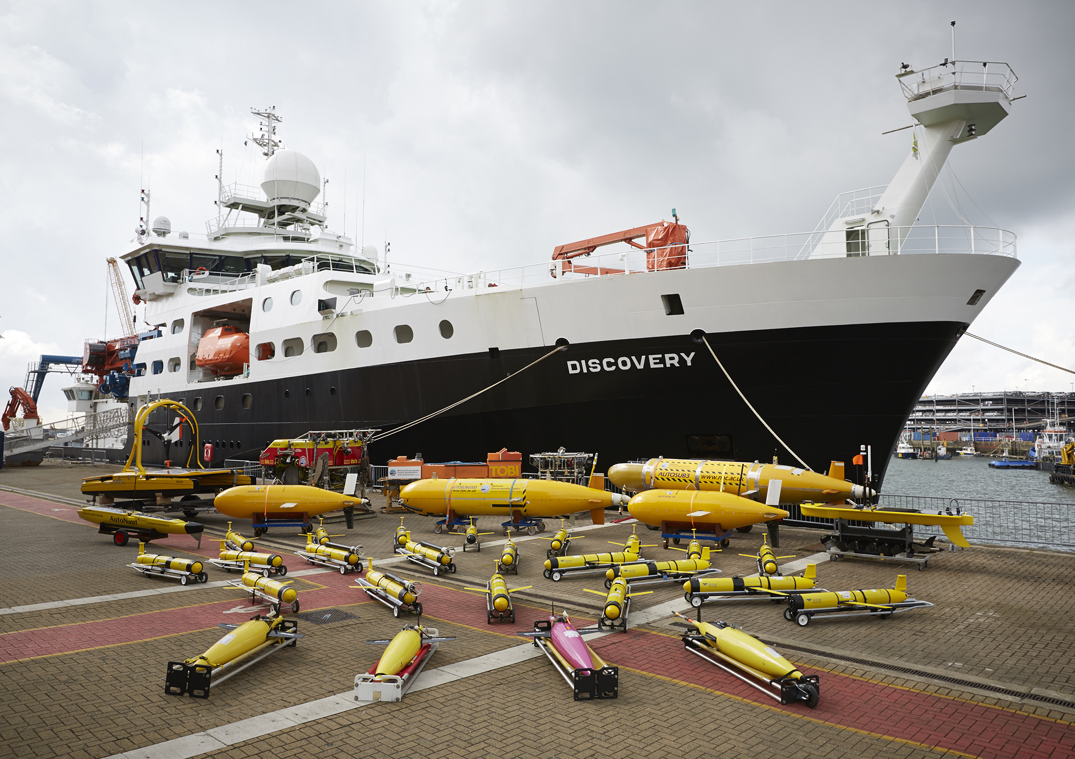
Observation types
Notes:
Example observing platforms, wide variety ranging from autonomous vehicles, mooring arrays to fully equipped scientific cruises

Slide 10
Observation (feature) types – discrete geometries
CF feature type | Examples | Parameters (not exhaustive)
point | Synoptic weather reports | Surface meteorology: Sea level pressure, SST, wind, weather, temperature and humidity
timeSeries | Tide gauge data, surface moorings | Water level, temperature, surface meteorology, waves
trajectory | TSG / underway data / surface gliders, gliders | SST, salinity, biogeochemical parameters, surface meteorology
profile | Profiling floats, CTD casts | Pressure, temperature, salinity, currents
timeSeriesProfile | Oceanographic moorings | Pressure, temperature, salinity, currents
trajectoryProfile | Gliders | Pressure, temperature, salinity, currents, biogeochemical
Notes:
Nearly all observations, if not all, fall into the discrete geometries categories. Examples on this slide

Slide 11
Example file – IMOS glider (truncated)
Trajectory data type
CF1.6 and IMOS 1.4 conventions
Single NetCDF dimension variable (time)
Coordinates for each instance given by separate longitude, latitude, depth and and time variables
Links between observations and coordinate variables given in ‘coordinates’ attribute
Notes:
To give a feel for the data over the next few slides example from one of the IMOS gliders shown

Slide 12
Example file – IMOS glider (truncated)
Trajectory data type
CF1.6 and IMOS 1.4 conventions
Single NetCDF dimension variable (time)
Coordinates for each instance given by separate longitude, latitude, depth and and time variables
Links between observations and coordinate variables given in ‘coordinates’ attribute
Notes:
Note that for most oceanographic applications / data the CF onventions are extended by additional conventions, in this case IMOS (Integrated Marine Observing Systerm).
Will address why this is later.

Slide 13
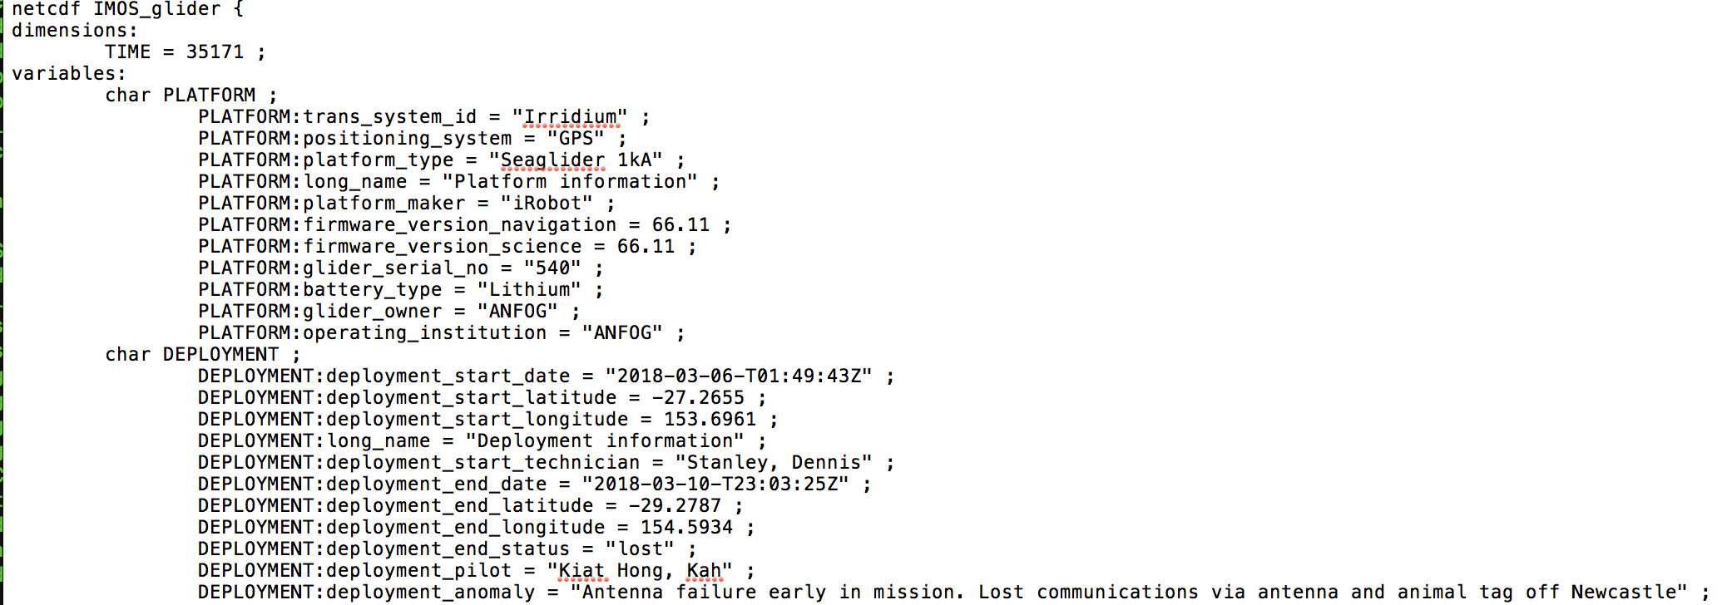
Notes:
This slide just shows the start of output from headers / ncdump for the file
Note single dimension variable
Able to include metadata, e.g. platform type, serial number etc
Fully self describing datasets

Slide 14
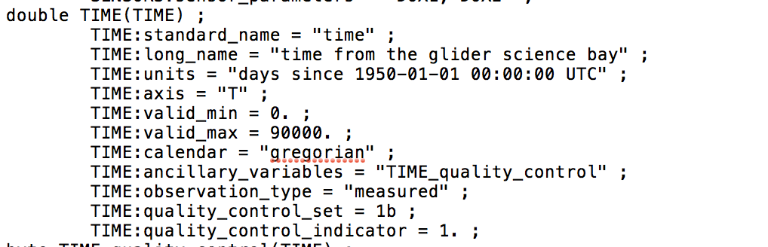
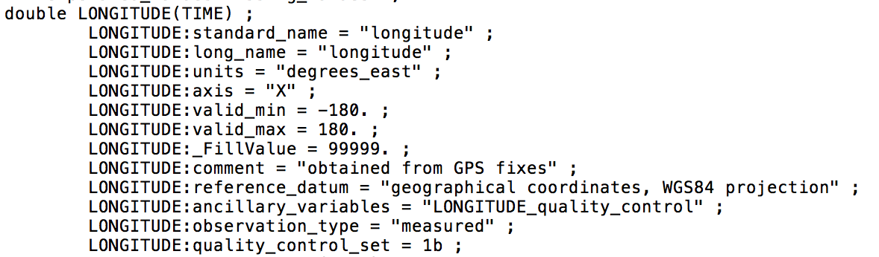
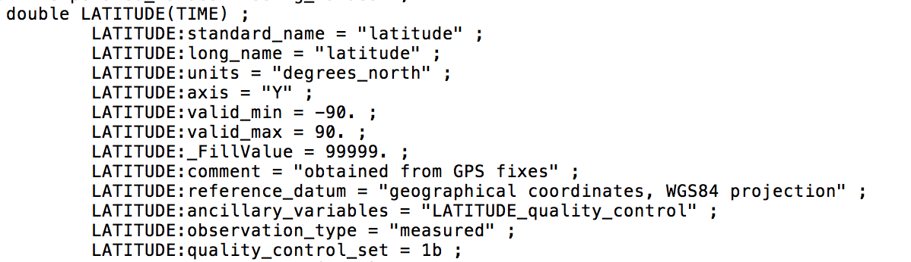
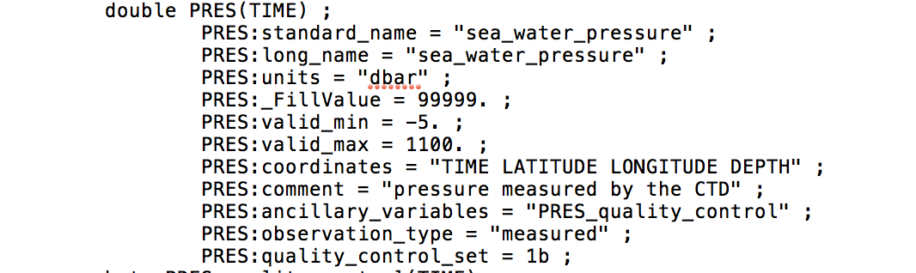
Notes:
3 or the 4 coordinate variables plus measured parameter.

Slide 15
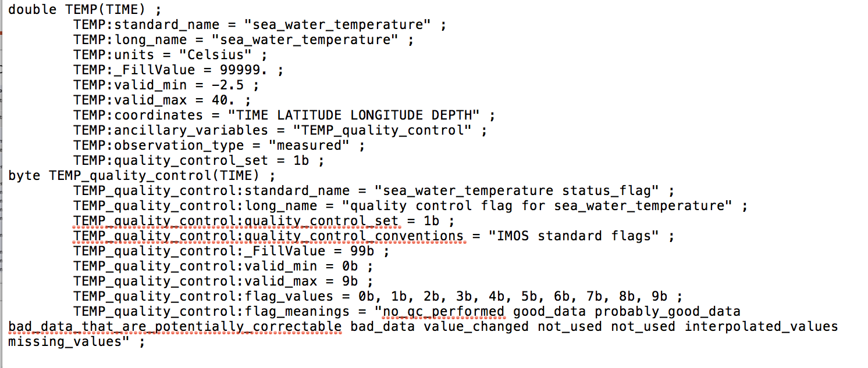
Notes:
Example of ancillary variable
Qualifier appended to variable name and standard name, in this case quality flag
Flag values and meanings embedded in variable attributes

Slide 16
Most oceanographic data follows a similar pattern (as expected if following CF conventions).
Typically single dimension variable with linked coordinate variables.
Additional metadata / flags given in ancillary variables.
Processing given by cell methods, e.g. standard deviation / variance.
However, even when nominally following the same convention(s) difference in coding can be found.
Notes:
Not going to show any more NetCDF structure – hopefully everyong familiar NetCDF.

Slide 17
sea_water_temperature example
Variable name | Long name | Units | Data source | Conventions
TEMP | Sea temperature in-situ ITS-90 scale | degree_Celsius | Argo | Argo-3.1 CF-1.6
TEMP_ADJUSTED | Sea temperature in-situ ITS-90 scale | degree_Celsius | Argo | Argo-3.1 CF-1.6
TEMP | sea water temperature | degree_Celsius | Bermuda Atlantic Timeseries | CF-1.4, OceanSITES 1.1
TEMP | sea_water_temperature | Celsius | IMOS Glider (AU) | CF-1.6,IMOS-1.4
temperature | Sea Water Temperature | Celsius | IOOS Glider (US) | Unidata Dataset Discovery v1.0, COARDS, CF-1.6
temperature | Sea Water Temperature | Celsius | Rutgers SLOCUM glider | Unidata Dataset Discovery v1.0, COARDS, CF-1.6
TEMP_SBE37_MEAN | Seawater temperature | degrees_c | Saildrone glider | CF-1.6, ACDD-1.3
TEMP_CTD_RBR_MEAN | Seawater temperature | degrees_c | Saildrone glider | CF-1.6, ACDD-1.3
TEMP_O2_AANDERAA_MEAN | Seawater temperature | degrees_c | Saildrone glider | CF-1.6, ACDD-1.3
TEMP_O2_RBR_MEAN | Seawater temperature | degrees_c | Saildrone glider | CF-1.6, ACDD-1.3
TEMP_SBE37_STDDEV | Seawater temperature SD | degrees_c | Saildrone glider | CF-1.6, ACDD-1.3
TEMP_CTD_RBR_STDDEV | Seawater temperature SD | degrees_c | Saildrone glider | CF-1.6, ACDD-1.3
TEMP_O2_AANDERAA_STDDEV | Seawater temperature SD | degrees_c | Saildrone glider | CF-1.6, ACDD-1.3
TEMP_O2_RBR_STDDEV | Seawater temperature SD | degrees_c | Saildrone glider | CF-1.6, ACDD-1.3
OTV | SST 2 | celsius | ICOADS | CF-1.6, ACDD-1.3
Notes:
List of variables from 6 different files where the standard name is sea_water_temperature
Majority following OceanSites parameter list, with variable name beginning TEMP_
Units all the same but different text representation (but all valid with udunits)
Mix of conventions used with different governance bodies
Note, major issue as some appear to be standard deviations rather than sea water temperature! More information should be given by cell_methods.

Slide 18
sea_water_temperature (cont.)
Some standardization of naming conventions (both variable name and long name).
Different representations for the units, but all valid according to udunits package (and hence CF conventions).
Standard name does not always indicate when the contents of the variable (e.g. standard deviations on previous slide).
Multiple standards used extending CF conventions, some of those extending each other (e.g. OceanSITES and Argo).
Most enforce use of standard_name but not always consistent in unit naming convention
Notes:
Moh (Argo) vs Sievert (IMOS) per m as example of units for conductivity.

Slide 19
Partial list of conventions extending CF conventions
Convention | Version | Date | URL
OceanSITES | 1.3 | January 2015 | http://www.oceansites.org/data/
Argo | 3.2 | September 2017 | https://archimer.ifremer.fr/doc/00187/29825/
IMOS | 1.4 | August 2015
SeaDataNet | 1.21 | September 2019 | https://archimer.ifremer.fr/doc/00454/56547/
EGO | 1.2 | May 2017 | https://archimer.ifremer.fr/doc/00239/34980/
NCEI NetCDF templates | 2.0 | December 2015 | https://www.nodc.noaa.gov/data/formats/netcdf/v2.0/index.html

Slide 20
”A primary aim for the workshop is to investigate a potential governance model for the netCDF-CF data representations to be used in WIS in a framework of collaboration with the CF community.”
Notes:
Tried to focus on this whilst putting slides together

Slide 21
Potential issues
standard_name not mandatory under CF conventions
standard_name English only (no internationalization)
specification of units too flexible, different conventions use different representations for the same quantity
mapping between code tables (e.g. QC flags) for different standards / conventions
Potential for collision between conventions or need for multiple versions of the same file

Slide 22
Potential solutions
Many of the issues addressed by SeaDataNet, e.g. use of URNs for linking to parameter and unit of measurement vocabularies
  “sdn_parameter_urn” and “sdn_uom_parameter” attributes for parameter and unit of measurement repectivley
  SDN:P01::TEMPST01 and SDN:P061::UPAA for sea_water_temperature and degree_Celsius respectively
Use similar approach for WMO controlled vocabularies / code tables
  E.g. mandatory “wmo_parameter_uri” attribute (value https://codes.wmo.int/bufr4/b/22/_042 for sea_water_temperature)

Slide 23
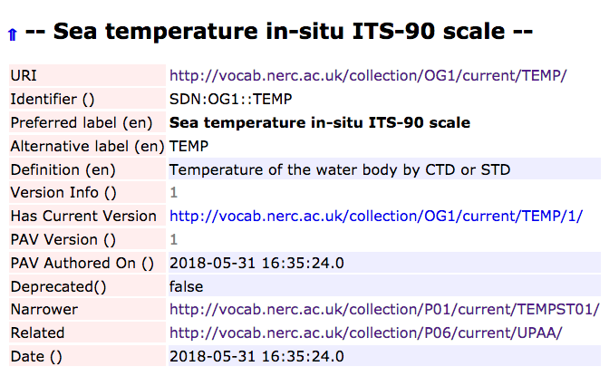
SeaDataNet entry

Slide 24
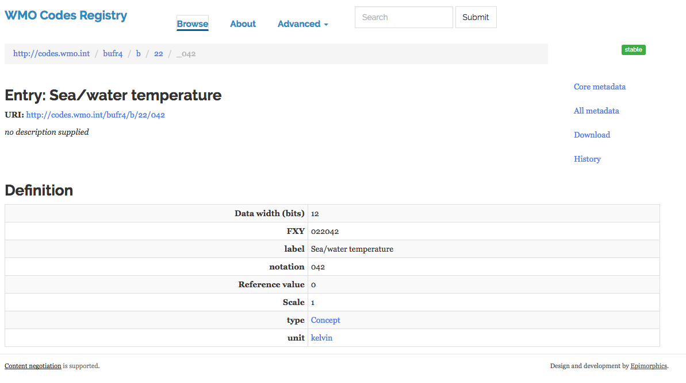

Slide 25
Media sources
CTD photo by Wikipedia user Frhop published under CC BY-SA 3.0 (available from https://commons.wikimedia.org/wiki/File:CTDdeploy.jpg)
Discovery photo from https://noc.ac.uk/files/images/story/NOC_008.jpg
Argo – photo taken of cruise CD135 (personal collection)
RAPID array from https://www.rapid.ac.uk/research/tenyearsofrapid.php

