Slide 1
Capacity Development
Sungsoo DO, KMA
Agenda item 4.5

Slide 2
Outline
Agenda
  Agenda Item 4.5 – Capacity Development
  Progress on the development of common training materials Training and capacity development

Slide 3
Agenda Item 4.5 | Training and capacity development
References | Decision 4, Final report of TT-GISC2018 - D4. The meeting agreed to the WP7 work plan and to develop common training materials to the proposed scopes as listed in Annex 7 of this report
Background | Ken Tsunoda, Chair TT-GISC, presented the issues, actions and decisions from TT-GISC2017 (presentation) [http://wis.wmo.int/tdoc=377]. Chair TT-GISC2017 noted the importance of capacity building by GISCs within their area of responsibility was highlighted. An ad-hoc team on capacity building was established. Decision: All GISCs were urged to list their training materials on the GISC-Ops WIS wiki pages. TT-GISC2017 added new work package, WP-7 Capacity Development into TT-GISC work packages(2017-2020) TT-GISC2018 reviewed the report on capacity development(doc) Sungsoo DO, WP7 team leader proposed two strategic approach, 1. Sharing training materials and 2. Establishing common training materials ET-WISC2019 reviewed the progress on the WP-7 Focused on sharing training materials on TrainingAids in wis-wiki
Rationale | Provision of training materials is required for capacity building of WIS.

Slide 4
WP-7 Capacity Development
WP-7 was added to TT-GISC Packages(2017-2020) in TT-GISC2017
Work Package |  | Member | Expected Deliverable/Outcome
ID | unit
WP-7 | Capacity Development by TT-GISC2017 | Sungsoo(lead, kr): ssdo@korea.kr SL.Singh(in): sl.singh@imd.gov.in LiXiang(cn): lixiang@cma.gov.cn Mark(uk): mark.francis@metoffice.gov.uk Talal(sa): talal.alowaibdi@gmail.com | # Develop a common training materials to know fundamentals of WIS

Slide 5
WP-7 Capacity Development
Objectives
  Each GISC has utilized its own materials according to the WIS training and learning guide.
  It is required to consolidate dispersed information and to share each GISC’s training materials

Slide 6
WP-7 Capacity Development
Target
  Members who having had little or no knowledge of WIS
    the gaps of national knowledge of WIS among members were identified as a result of the survey from WMO Mid-Term Performance Assessment Report 2016-2017
    The common training materials for WIS should be to fill these gaps

Slide 7
WP-7 Capacity Development
Proposed Scope
  Main purpose of training material is to raise the level of competencies for who has little knowledge of WIS.
  Key learning resources for seven WIS competencies are presented from Guide to the WIS but it is difficult for NCs and DCPCs to utilize those resources
  The training materials can provide summarized information from key learning resources as a baseline of training materials

Slide 8
WP-7 Capacity Development
Sharing training materials
  Each GISC has performed WIS training activities with its own training materials for lecture, presentation and brochure etc
  “WIS Training Material(provisional)”, shared repository for WIS training materials is created in wis-wiki and GISCs are collaborating in collecting its own materials not limited to any language
  Will be collected in the directories categorized by key learning resources as shown in the proposed scopes of common training materials.

Slide 9
WP-7 Capacity Development
Past Progress
  Discussed the categories for sharing materials in TT-GISC 2018(Cassablanca)
  Requested Secretariat to create new menu in wis-wiki, TrainingAids
    [https://wiswiki.wmo.int/tiki-index.php?page=TrainingAids]
  Secretariat created new menu in TrainingAids in June 2019. Thanks to Secretariat.

Slide 10
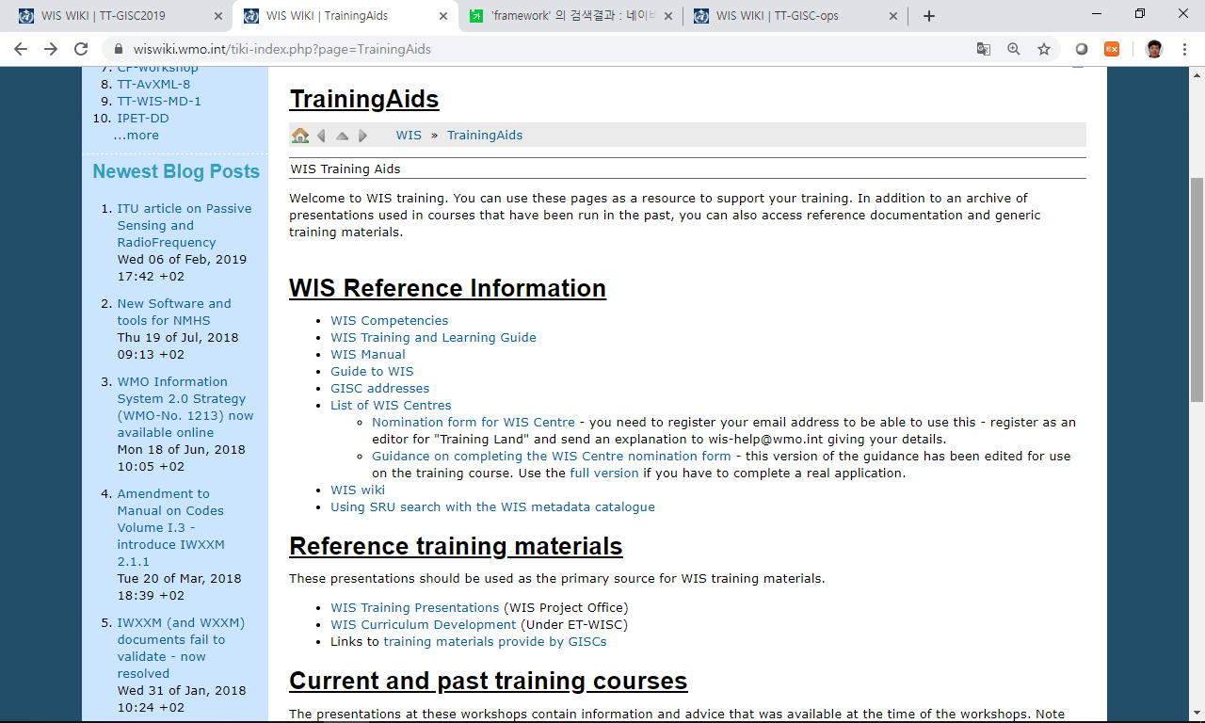
WP-7 Capacity Development
Sharing training materials; WIS > TrainingAids
    https://wiswiki.wmo.int/tiki-index.php?page=TrainingAids]
Training Materials provided by GISCs

Slide 11
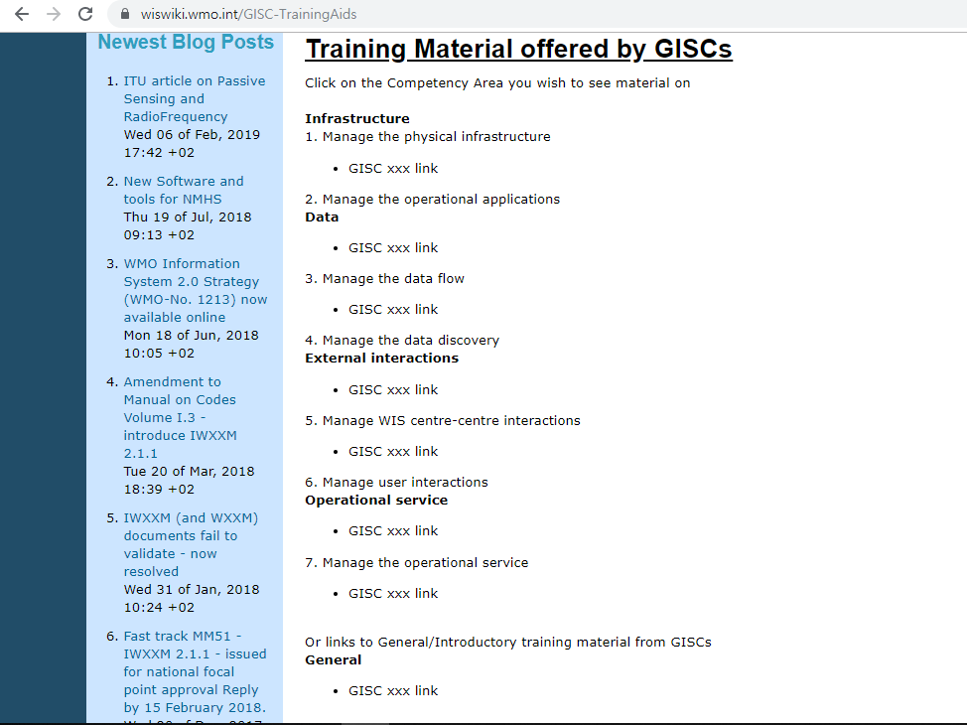

Slide 12
WP-7 Capacity Development
Future Progress(suggested)
  Re-organising the configurations in the “Training Materials provided by GISCs”
    Adding , changing or removing items
    Reflecting opinions with team members
  Requesting Secretariat to amend the configurations in the menu
  Encouraging GISCs to upload their own materials in accordance with each item

Slide 13
WP-7 Capacity Development
  Work Plan(proposed)
Section | Timeline |  | Work | Participants | Progress
Sharing training materials | 2019 | 3Q | Re-organising the configuration in the menu, “Training Materials provided by GISCs” | WP-7 team | -
 |  | 4Q | Amending the menu | WMO secretariat | -
 | 2020 |  | Collection of training materials from GISCs Reviewed by TT-GISC2020 | All GISCs | -

Slide 14
Summary (Text for report)
The meeting reviewed the progress of sharing training materials on TrainingAids in wis-wiki [https://wiswiki.wmo.int/tiki-index.php?page=TrainingAids]. The meeting confirmed and evaluated the categories in the new menu created by Secretariat.
WP-7 team of TT-GISC will consider the amendment of the configurations of the new menu and request Secretariat to finalise the categories on wis-wiki. It is also requested that all GISCs provide their training materials to be available on wis-wiki page in accordance with each item in the new menu.

