Slide 1
Status Report
GISC Seoul
Kwangjae LEE,KMA

Slide 2
Area of Responsibility
1 NC and 3 DCPCs are in the AoR of GISC Seoul
  NC Seoul : In Headquarter
  DCPC NMSC : 10Gbps of dedicated network
  DCPC LC/LRFMME : 1Gbps of internet
  DCPC WAMIS : In Headquarter
NMSC : National Meteorological Satellite Center
LC/LRFMME : Lead Center for Long-Range Forecast Multi-Model Ensemble
WAMIS: World Agro-Meteorological Information Service

Slide 3
Training – Capacity Building Activity
ICT training course in KMA includes WIS capacity development
Training materials cover WIS Overview, WIS functionality, WIS metadata, Operational guide and TDCF migration, WIS2.0 implementation plan
  (2019.4.17~18/KMA) ICT Training course for Meteorological Services, held by RTC-Korea
    Trainees: 19 staffs from 11 countries
    Specially 4 countries are invited (Sri Lanka, Bhutan, Bangladesh, Maldives / AoR of IMD) for GISC-GISC backup consultation.
  (2019.6.26~27/APCC) Training for operator of DCPC LC/LRFMME
    Trainees: 5 staffs of DCPC operators
    DCPC Operational guide, Metadata
  (2019.8.16/KMA) ICT and NWP training program for Viet Nam (VHMA)
    Trainees: 6 staffs from Viet Nam (VHMA)
    Regarding NWP, Global data exchange, WIS Overview, WIS functionality

Slide 4
Operational issues(ticket system)
Matadata
2019-07-18 (0000125) Seoul cannot connect to OAI server of Offenbach due to https.
  Acknowledged that GISC Seoul can't access OAI server of GISC Offenbach via https(TLS v1.2) and trying to resolve this issue.
2019-08-16 (0000007) No response (OAI-PMH), PORTAL and SRU for >= 4 days Seoul - Melbourne
  Network connectivity issue, still working on to resolve it.
2019-08-20 (0000079) Invalid BUFR upper air reports from Korea
  The following stations are not providing any BUFR upper air reports:
    47122 OSAN AB
    47158 GWANGJU AB
  Data producer(ROK Air Force) has a plan to migrate TAC into BUFR(high resolution) as early as this October.
Networking
BUFR issue

Slide 5
GISC Watch
GISC Seoul carried out GISC Watch duty during 16-31 March 2019.
Activities
  3 tickets were closed due to duplicated issues
  ==> 0000053: No response (OAI-PMH,Portal, SRU) for >= 4 days Jeddah to all centres
  Closed: 0000022: No response (OAI-PMH) Melbourne - Jeddah
  Closed: 0000051: No response from GISC Jeddah
  Closed: 0000032: List records and ListIdentifiers not working
  2 tickets were closed with fixation
  Closed: 0000030: No response (Portal) for >= 4 days Tokyo - Exeter
  Closed: 0000019: Distribution System status "Unknown" for GISC Tokyo
  1 ticket was open and closed
  Closed: 0000106: monitor.json file has not been updated for 3days

Slide 6
GISC Backup and activities
LOA for GISC Backup arrangement with GISC New-Delhi (2018.5)
Face to face meetings for backup line with 4NCs in AoR of GISC New-Delhi (2019.4)
  NC Colombo (Sri lanka)
  NC Male (Maldives)
  NC Thimphu (Bhutan)
  NC Dhaka (Bangladesh)
  Confirmed backup environment b/w the counties

Slide 7
Monitoring Activity & volume
GISC Seoul is providing metadata synchronization monitoring system [http://gischelp.kma.go.kr/wismon/].
Status of 1:1 GISC data exchange in GISC Seoul
  Files inbound to GISC Seoul (As daily value)
    Number of files : 20,733 , volume : 1,061 Mb
  Files outbound from GISC Seoul
    Number of files : 6,126 , volume : 104Mb

Slide 8
Metadata Status
At 23st August 2019
Number of MD records of AoR of GISC Seoul
  640 records
Core profile Version
  1.2: 347 records, 1.3: 293 records
OAI provider: https://gisc.kma.go.kr/openwis-user-portal/srv/en/oaipmh
Harvesting 1,148,675 records
  WIS cagegory : 114,985
  GEOSS cagegory : 1,033,690
    GISC Seoul provides WIS community with GEOSS metadata harvested from GEO-DAB on basis of ISO19139.
    GEOSS SRU server pointer :http://gisc.kma.go.kr/openwis-user-portal/srv/en/main.home/portal.sru?

Slide 9
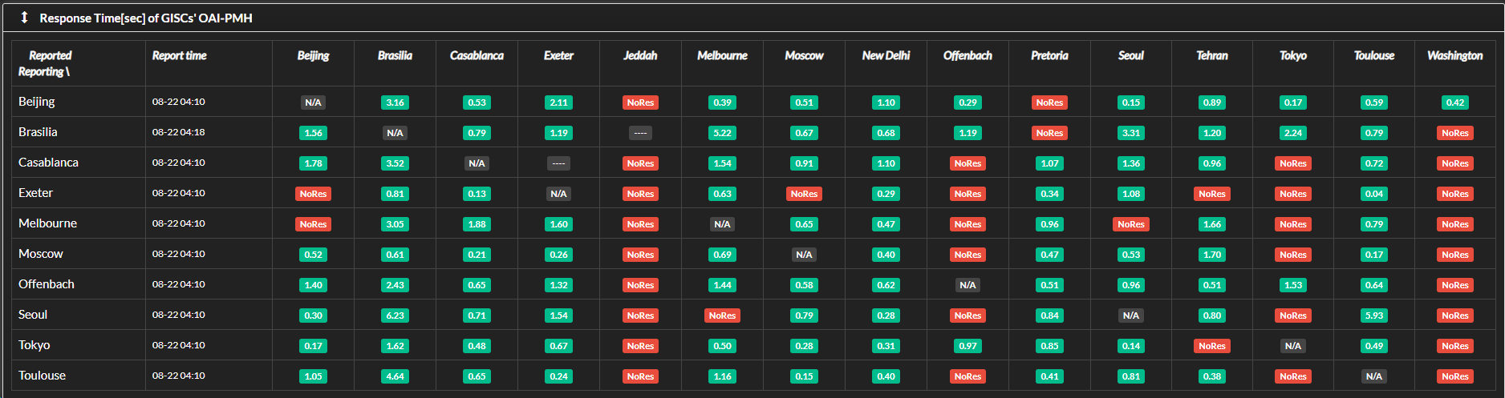
OAI PMH server connectivity
Response : 9 GISC’s OAI server
No response : 5 GISC’s OAI server
At 23th August
internet network connection failure
https connection failure

Slide 10
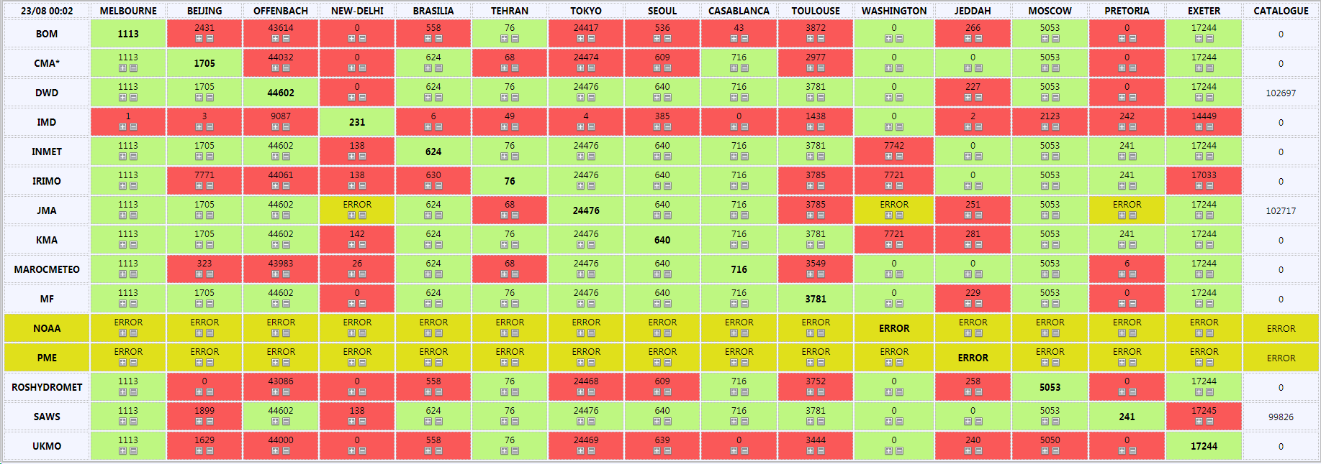
Metadata syncronization
Perfect matched : 11
Partial matched : 1
No connection: 2
Harvested from GISC Toulouse
Harvested from GISC Tokyo,
since https connection failed
No MD records changed,
since https connection failed
At 23th August
Assumed that number of MD in GISC New-Delhi is duplicatedly counted

Slide 11
Metadata syncronization
Perfect matched : 7
Partial matched : 5
No connection : 2
Beijing, Moscow
Melbourne
New-Delhi
MDs currently added are not harvested
Network connection problem
Network connection problem
Exeter
One MD with normal
coexist with deleted flag

Slide 12
Changes in GISC
OpenWIS version upgrade(v3.14.8) (2017.12)
GISC Seoul improved the portal service(2018.12)
  BUFR decoding service
  Statistics of MD and Caches in GISC Seoul
  User guide of GISC Seoul data Catalog
Remote backup GISC as role DR is on operational (2018.12)
  Located in Supercomputer center 100km away from Seoul
Revised operational manual for GISC and DCPC operators (2019.7)
  Including changes above

Slide 13
Recommended Text
GISC backup activity in GISC Seoul works in progress with having face to face meeting with 4NCs of GISC New Delhi’s AoR. GISC Seoul has performed WIS capacity building activity in annul ICT training course for WMO members in RTC-Korea. As WIS and GCI interoperability activities, GISC Seoul provides GEOSS metadata sets and GEOSS SRU server for other GISCs to harvest WIS compliant discovery metadata from GEO-DAB.

