Slide 1
Status report of GISC Beijing
GISC Beijing/CMA

Slide 2
Area of responsibility
NCs (7):
China
Democratic People’s Republic of Korea. (new in Nov. 2015)
Hong Kong, China
Macao, China
Mongolia
Nepal
Pakistan
DCPCs (6):
WWIS ( Hong Kong, China )
5 CMA’s internal DCPCs
International roles of CMA in WIS:
NC China
GISC Beijing
RTH Beijing (DCPC)
RCC Beijing (DCPC)
RSMC Beijing – Geographical (DCPC)
RSMC Beijing – Activity – ATM (DCPC)
National Satellite Meteorological Center (DCPC)

Slide 3
Connectivity
GISC Moscow
GISC
New Delhi
GISC
Offenbach
GISC
Seoul
GISC Tokyo
GISC Toulouse
0
RMDCN
MPLS VPN
16Mbps
GISC Beijing
1 Gbps
4Mbps
64Kbps
64Kbps
64Kbps
64Kbps
Internet
Thailand
Vietnam
DRPK
Mongolia
4Mbps
2Mbps
GISC Melbourne
Hong Kong
Macao
Pakistan
Nepal

Slide 4
Training - Capacity building activities
On-site training on CMACast and WIS services
  August 2018, hold in Mongolia
  April, 2019, hold in Maldives
  May 2019, hold in Tajikistan
  July 2019, hold in Vietnam
  Invited training on CMACast and WIS services
  May 2018, invited Bangladesh experts to visit Beijing and hosted CMACast training for them.

Slide 5
Operational Issues in last period
System outage occurred during June 21-25, 2018 due to a database server failure
Network outage occurred during July, 2019 due to upgrading local network system

Slide 6
GISC backup activities
Two partner GISCs
  GISC Tokyo: the backup service is established and in operation
  GISC Melbourne: the backup service is agreed and under developing

Slide 7
Monitoring activities
GISC Watch
  Two WCDs have been developed and are operated by GISC Tokyo and GISC Beijing. They are being used as the tools for GISC Watch.
  GISC Beijing has taken the duty of GISC Watch during the following periods
    16th ~ 31st May 2018
    16th ~ 31st Jan. 2019
    16th ~ 31st Aug. 2019
Assigned | 10
Closed (solved) | 8
Solving | 2 ( No response * 1, WCD issues * 1 )

Slide 8
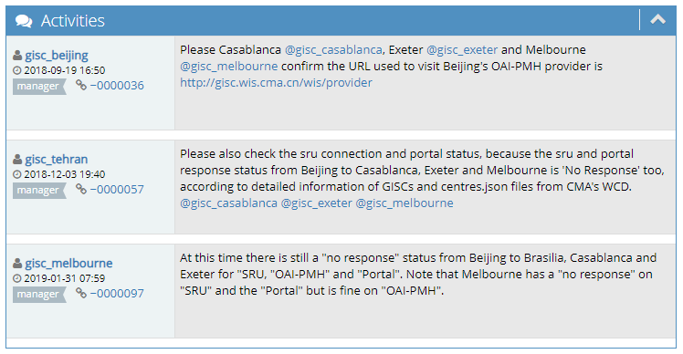
Monitoring activities
Ticket #0000031: "no response" to the OAI-PMH from Casablanca, Melbourne and Exeter to Beijing for at least 4 days
  Please Brasilia, Casablanca, Exeter and Melbourne confirm the URLs used to visit Beijing's OAI-PMH provider, Portal, SRU are correct.
  It seems that this issue may caused by Internet-related causes
  Beijing hope involved GISCs can manually test access and cooperation

Slide 9
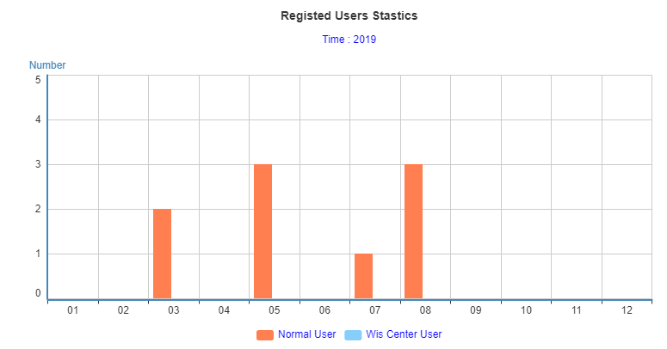
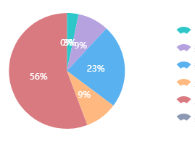
Traffic size
As of 23rd Aug. 2019, there are 156 users from 37 WMO Members registered in GISC Beijing. The daily data volume of distribution via CMACast and Internet is over 600GB.
Daily volume
Synoptic & AWS
Upper air
NWP
Weather Radar
Satellites, including FY-3, FY-4 data
Others

Slide 10
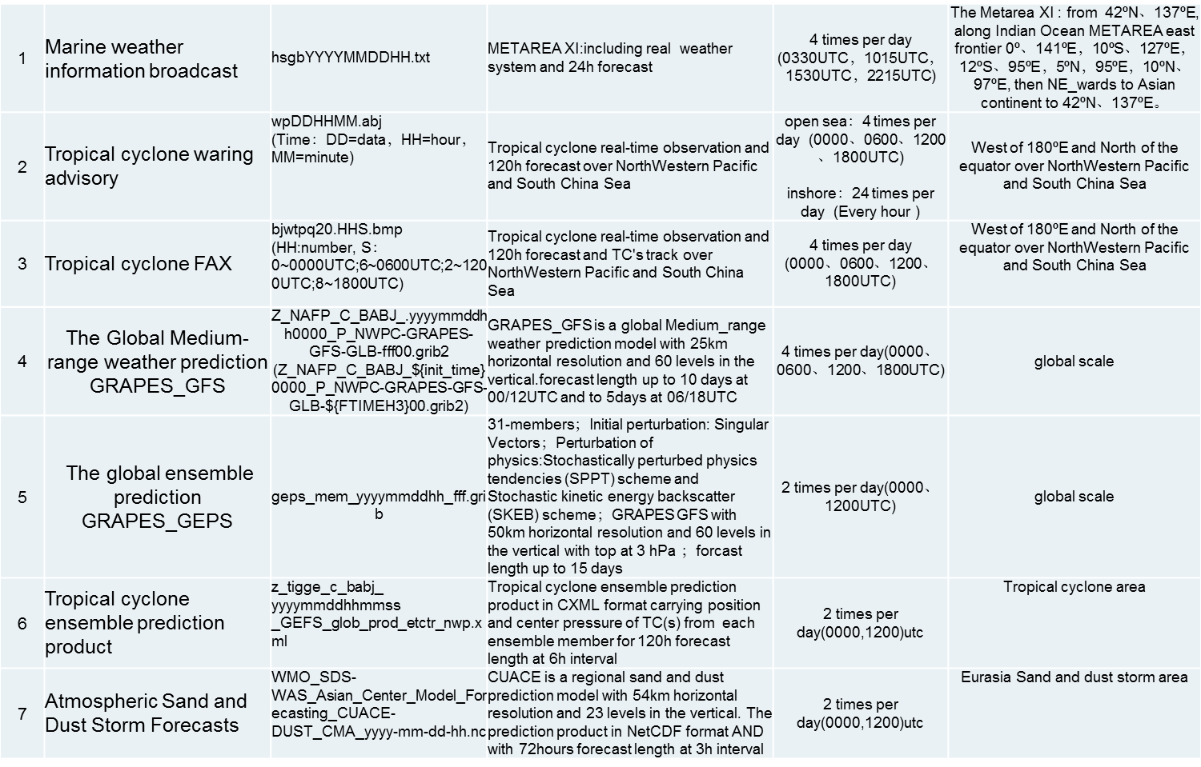
Changes – WMC Beijing products available in WIS
WMC Beijing published the metadata records for its products in GISC Beijing’s DAR catalog in June 2019. Meanwhile, their real-time products files are available online.

