Slide 1
Time Critical Data Delivery
Kenji Tsunoda

Slide 2
Extract from the report of IOTWS communication test on 12 Dec 2018
5.2.1 GTS
  The GTS reception rate was 75%, just above the 72% in the previous test and similar to most tests in the previous 4 years which were generally around 70-80%. However this was a lower rate than recorded in the IOWave18 exercise prior to this test.
  Seventeen of the 22 NTWCs received GTS messages, including Comoros and Thailand which had not received any in the previous test. Bangladesh, Iran, Madagascar, Timor Leste and Yemen did not receive any GTS.
  TSP Australia's and Indonesia's GTS messages were received by 17 NTWCs each, and India's by 16 NTWCs.
  GTS message delay times continued to be low in this test, with most messages received within 1-3 minutes and the longest delay being 6 minutes

Slide 3
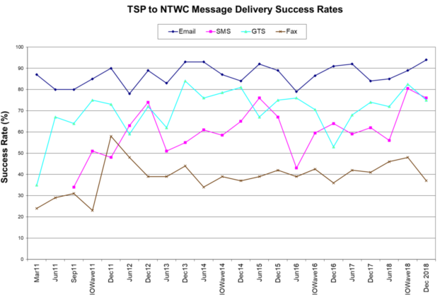

Slide 4
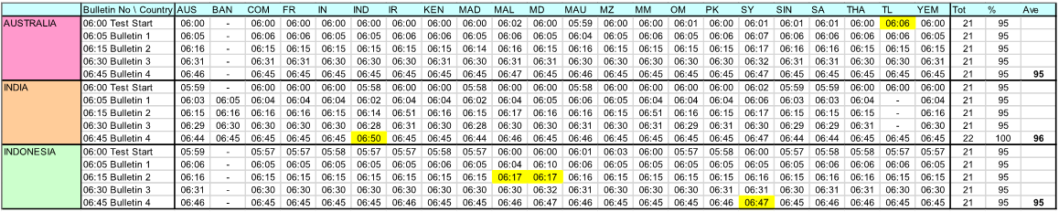
GTS: most messages received within 1-3 minutes and the longest delay was 6 minutes.
Email: almost all messages received within 2 minutes and the longest delay was 6 minutes.
AUS=Australia, BAN=Bangladesh, COM=Comoros, FR=France (Indian Ocean Territories), IN=India, IND=Indonesia, IR=Iran, KEN=Kenya, MAD=Madagascar, MAL=Malaysia, MD=Maldives, MAU=Mauritius, MZ=Mozambique, MM=Myanmar, OM=Oman, PK=Pakistan, SY=Seychelles, SIN=Singapore, SA=South Africa, THA=Thailand, TL=Timor Leste, YEM=Yemen

Slide 5
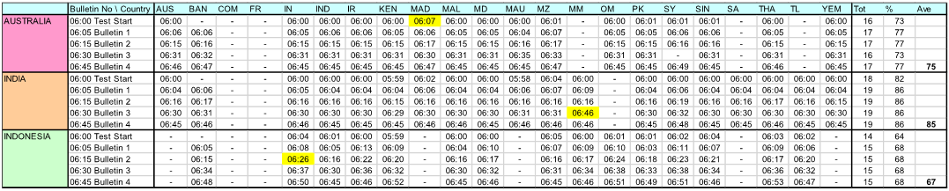
SMS: typically within 1 to 5 minutes. The longest delay was 16 minutes
Reception rate
  GTS: 75% (5/22 countries did not receive any test messages. Other 17 countries received more than 11/15 messages)
  Email: 95% (all countries received 4 or more messages. Messages from Australia and Indonesia were not delivered to Bangladesh)
  SMS: 76% (two out of 22 countries did not receive any test messages, and several messages were not
Delay
  GTS: within 1-3 minutes (longest: 6 minutes)
  Email: within 2 minutes (longest: 6 minutes)
  SMS: within 1-5 minutes (longest: 16 minutes)

Slide 6
Summary
Delivery rate and delay
  GTS delivery rate was lower than email, but similar as SMS.
  GTS delay was similar as email, and faster than SMS
Characteristics
  Once the link is established and maintained accordingly, almost of all messages over the GTS are delivered without significant delay
What should we do;
  Take action, establishing a link and operating reliably
Request:
  Relevant principal GISCs of Bangladesh, Iran, Madagascar, Timor Leste and Yemen to take above actions

Slide 7
Draft text
Participants reviewed the summary of the result of IOTWS communication test on 12 Dec. 2018. TT-GISC recognized there are different characteristics between their commination tools, GTS, email and SMS, and noted there are some rooms to improve GTS delivery.
TT-GISC agreed to continue supporting Tsunami warning message delivery and requested relevant GISCs to take actions, also all GISCs to re-check their routing table to deliver AATT=WEIO to right countries.
Secretariat informed, the next IOTWS communication test will be on 11th Dec 2019.

