Slide 1
GISC Tokyo Cloud Pilot Project
Shuichi Ikeda
ICT division, JMA

Slide 2
WIS 2.0 things
Pub/sub message protocols
Internet connection
Cloud technology
Visualization tools for reducing data volume
No routing table
New data catalog (WIS metadata)

Slide 3
The aims of this project
WIS 2.0
AMDCN of GISC Tokyo
utilizing results of assessment
Pub/Sub technology
Exchange data in our AoR by new protocols
Cloud technology
The internet connection
Touch WIS 2.0 technology
Capacity Building
Ready to migrate WIS 2.0

Slide 4
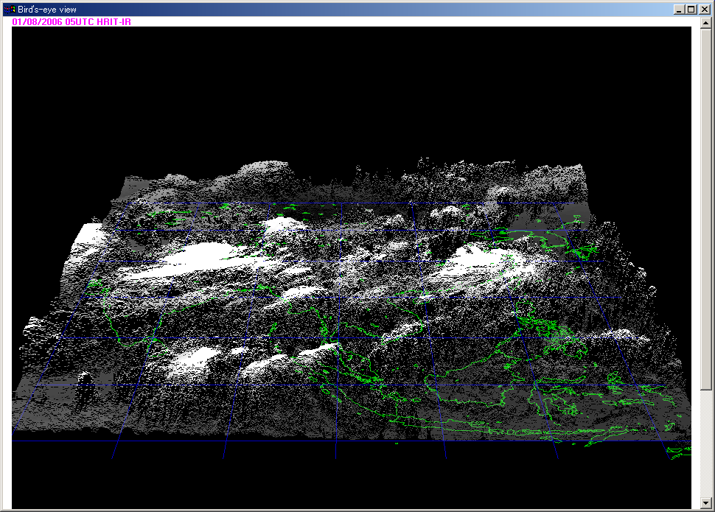
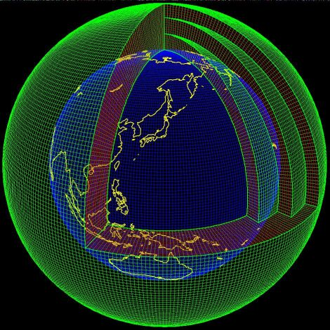

The brief image of the pilot project
The internet
GISC Tokyo Cloud
Exchanging data in the AoR
by current style
Offering
Visualization tool
Exchanging data in the AoR
by WIS 2.0 style

Slide 5


The plan for evaluation of WIS 2.0
- evaluation of pub/sub -
GISC Tokyo Cloud Pilot Project
Data producer
Data producer
Publish json message
Put data
Publish json message
Put data
Broker (AMQP/MQTT)
HTTP server
JSON
DATA
Subscribe json message
Download data by HTTPS
Data consumers (NCs)

Slide 6

The plan for evaluation of WIS 2.0
- converter from old style to pub/sub -
NCs
GISC Tokyo Cloud Pilot Project
Data producers (NCs)
GISC Tokyo MSS
Convertor
Publish json message
Put data
bulletin
Broker (AMQP/MQTT)
HTTP server
JSON
DATA
Subscribe json message
Download data by HTTPS
Data consumers (NCs)

Slide 7
Future plan - Visualization tools -
GISC Tokyo Cloud Pilot Project
Data producers
Put data
NWP
Satellite
Get data by web browser
Users

Slide 8
Draft timeline of the pilot project
 | 2019 | 2020 | 2021 | 2022 | 2023 | 2024 | - | 2026 | - | 2030
WIS 2.0 Implementation approach |  | Technical architecture Tech sepcs Communication plan | Technical regulation (experimental) |  | Technical regulation (operational)
 |  |  | Real time data exchange with new protocols (experimental) |  |  | GISCs implement new protocols, ready to support migration in their AoR |  | GISCs provide service to support discovery of real-time data from WIS Centres in their AoR that are yet to migrate to new protocols |  | Migration to use of new message protocols complete
 |  |  | Begin publishing recommended practices and details of exemplar implementations relating to WIS 2.0 technologies |  |  | Inter-GISC communications use new message protocols
GISC Tokyo Pilot Project
Set up cloud service (plan)
Pilot (experimental) stage
preparing

Slide 9
Summary
Install cloud service on the internet for evaluating WIS 2.0 things and supporting GISC Tokyo AoR
Collect Tokyo’s AoR opinions and needs for capacity building through this project
Plan to ask GISCs to join this project it’s when ready (if you are interested in this project)

