Slide 1
GISC Toulouse status
Benjamin Saclier

Slide 2
Area of Responsability - NC
National Met Centres:
  Algeria, Belgium, Luxembourg, Monaco, Spain, Portugal
  Backup: Iceland, Ireland, Netherlands, Armenia, Georgia, Ukraine, Tunisia

Slide 3
Area of Responsability - DCPC
Numerical Weather Prediction
EUMETNET Opera Data Centre Radar
Long-Range Forecasting
MEDARE, Spain Opera Data Centre
Volcanic Ash Advisory Centre (Toulouse)
Cyclone Data Centre (South West Indian Ocean)
Environmental Emergency Response Data Centre
Copernicus Regional Air Quality Data Centre

Slide 4
Harvesting sets
WIS-GISC-BEIJING
WIS-GISC-BRASILIA
WIS-GISC-CASABLANCA
WIS-GISC-EXETER
WIS-GISC-JEDDAH
WIS-GISC-MELBOURNE
WIS-GISC-MOSCOW
WIS-GISC-OFFENBACH
WIS-GISC-SEOUL
WIS-GISC-TEHRAN
WIS-GISC-TOKYO

Slide 5
Operational issues
Metadata synchronization : slowness with large sets. Did a full harvesting.
Monitoring of HTTPS site : in investigation

Slide 6
GISC Backup activities
GISC Exeter
  Regular exchange with Met Office
GISC Moscow
  Regular exchange with Roshydromet
GISC Casablanca
  In progress
  Meeting plan last quarter 2019

Slide 7
Monitoring activity & Volume
GISC Watch from : 01/03/2019-15/03/2019
Echange with AoR for BUFR issues

Slide 8
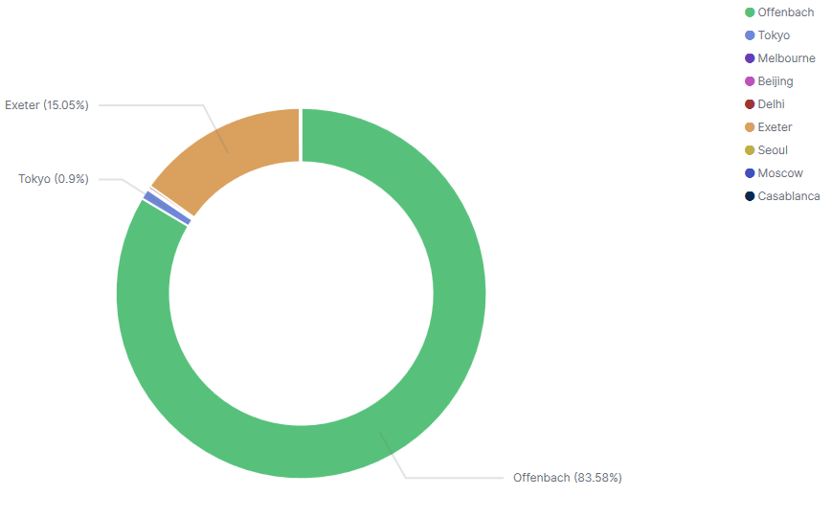
Monitoring activity & Volume
WIS volume reception
Site | Daily size
Casablanca | 84.9KB
Brasilia | 56.4MB
Seoul | 5.8MB
Tehran | 0B
Pretoria | 86.3KB
Exeter | 3.4GB
New Delhi | 51.5MB
Moscow | 19.7MB
Offenbach | 19.2GB
Melbourne | 31.6MB
Beijing | 2MB
Tokyo | 212.2MB

Slide 9
Monitoring activity & Volume
WIS 24h cache : 7.9 GB
WIS GISC Toulouse 24 cache : 320 MB

Slide 10
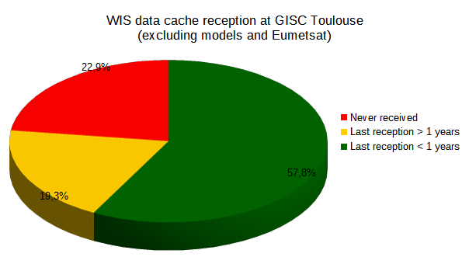
Monitoring activity & Volume
Year 2019
Year 2016

Slide 11
Monitoring activity & Volume
Main activity on DCPCs (~ 7000 clients), few clients on GISC

Slide 12
Outlook
Main activities on WIS 2.0 and pub/sub solutions.
Action on Openwis middleware upgrade

