Slide 1
TT-GISC 2019
Messaging (AMQP/ MQTT)

Slide 2
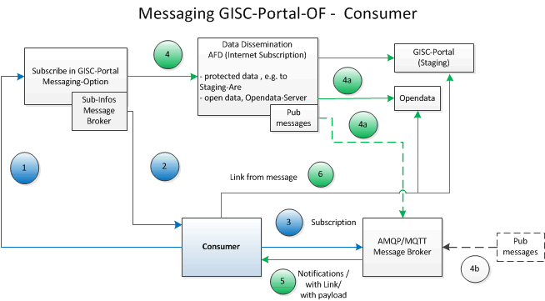
Idea for Operational Architecture

Slide 3
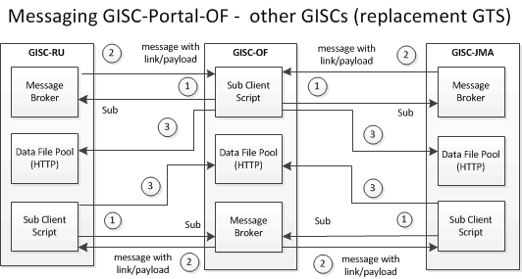
WMO Mesh - GISCs

Slide 4
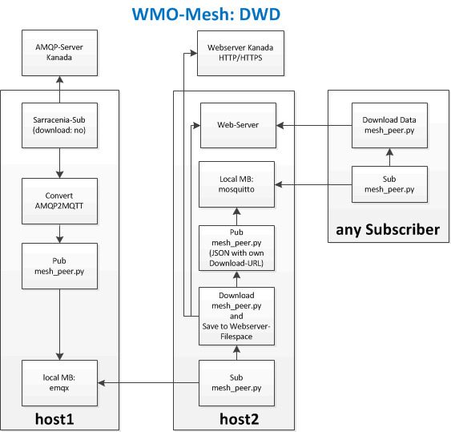
Architecture for Testing (DWD)

Slide 5
Next Steps
There are different next steps that could be done in parallel:
Make own meteorological data available.
Subscribe to other test systems (subscription information should be exchanged).
Conception and execution of load tests.

Slide 6
Open Tasks
The message format should be standardized. Things would be much easier if the message format will be the same over the WMO community. Nevertheless there might be two types:
  payload includes the data (e.g. warnings) and
  payload only includes a link to get the data
Specify a protocol: AMQP or MQTT (and if necessary for exchange: the version of the protocol). There are big differences between AMQP version 0.9 and AMQP version 1.0 or greater. So we should make a decision whether we want to support AMQP version 1.0 or greater or not.

