Slide 1
  Guidance on Good Metadata
  Hermann Asensio (DWD) , Guillaume Aubert (Eumetsat)

Slide 2

Agenda
why we need good quality metadata
example metadata
Guidance on Metadata in WMO 1061 Guide on WIS
title and abstract in the Metadata
Granularity of metadata

Slide 3

Supermarket without metadata
Source: WMO Core Metadata Profile v1-2 Guidance Documentation v0.1
Notes:
3
3
Data Bulletins without knowing exactly whats inside

Slide 4
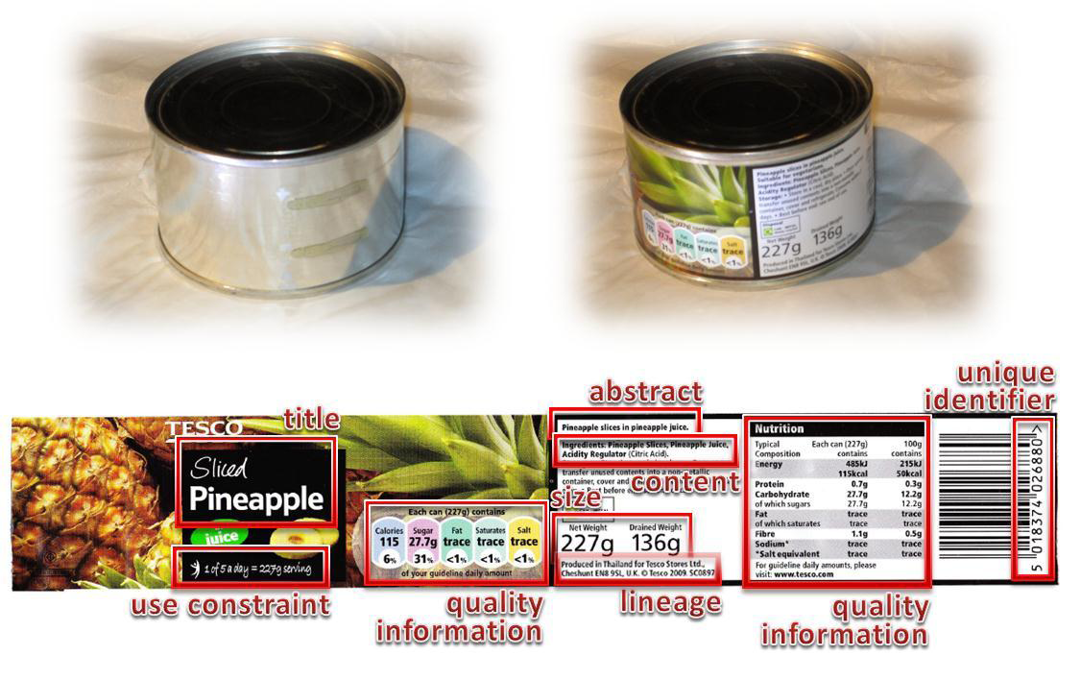
Supermarket with metadata
Source: WMO Core Metadata Profile v1-2 Guidance Documentation v0.1
Notes:
4
4
Major Benefit: Description of the Data
Originator
Content
Searchable

Slide 5
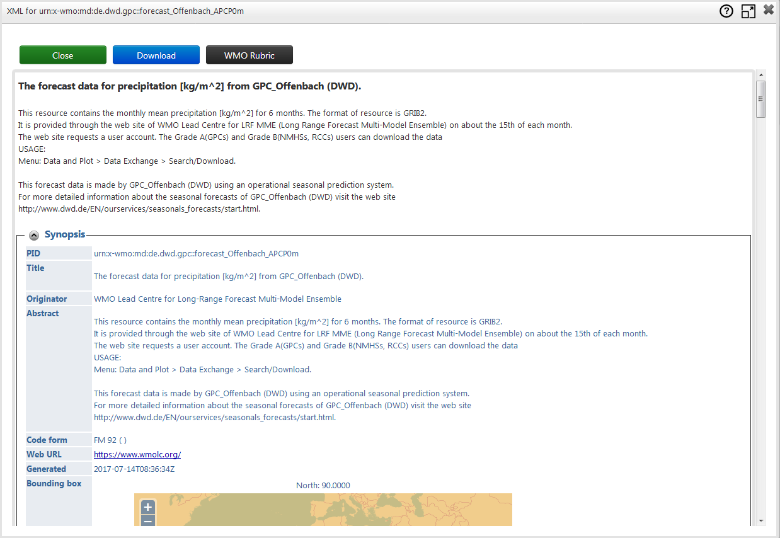
example metadata: Long Range Forecast DWD
GISC Offenbach – 05/2019
5

Slide 6
Reasons for having good metadata quality
To advertise your datasets and attract more users using the WIS
Your datasets should be discovered when users enter relevant search terms
  “Cloud satellite Europe” should match some EUMETSAT products

Slide 7
Reasons for good Metadata
WHAT you describe is in WIS. Data can only be found with Metadata
Advertise your Data
HOW you describe is defining how easy your Data can be found
Ensure good user experience
IMPORTANT
COMPLETE, GOOD, ACCURATE, Up-To-Date
Whenever you change or publish something, think about the Metadata

Slide 8
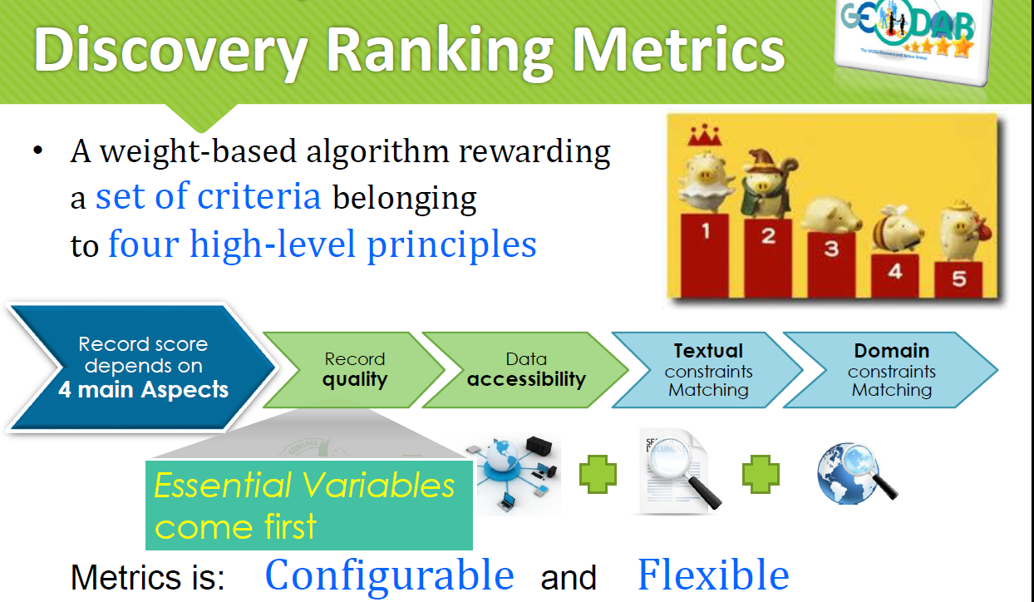
GeoPortal – ranking search results
Source: Stefano Nativi

Slide 9
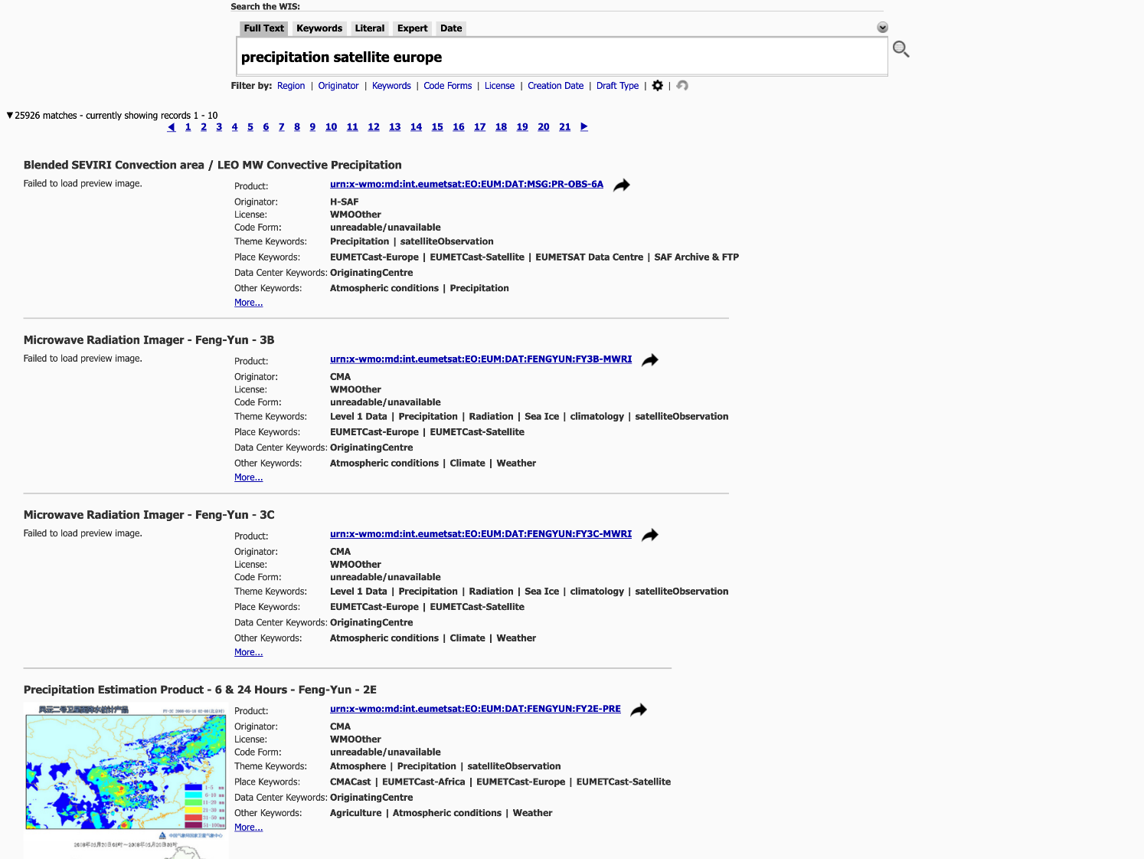
Why creating good quality metadata ?
To allow having your datasets being discovered when users enter relevant search terms
And avoid this

Slide 10
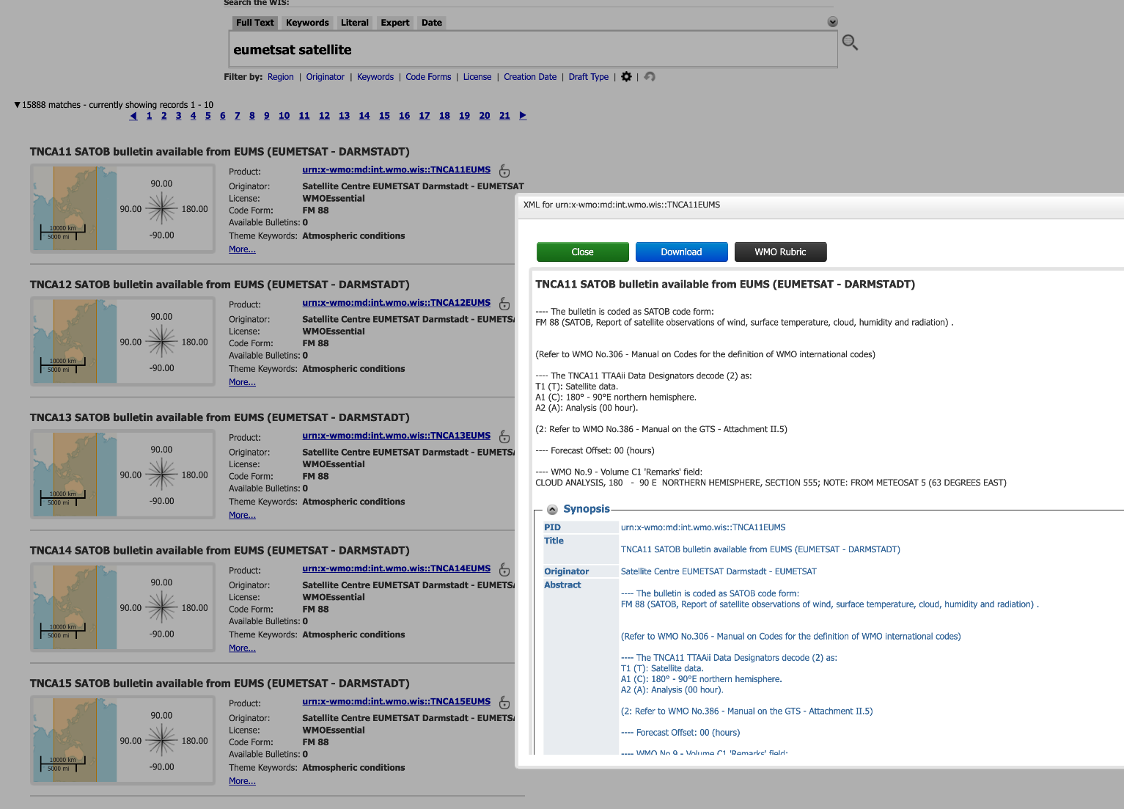
Why creating good quality metadata ?
To allow users understanding the purpose of the discovered datasets
Don’t understand ???

Slide 11
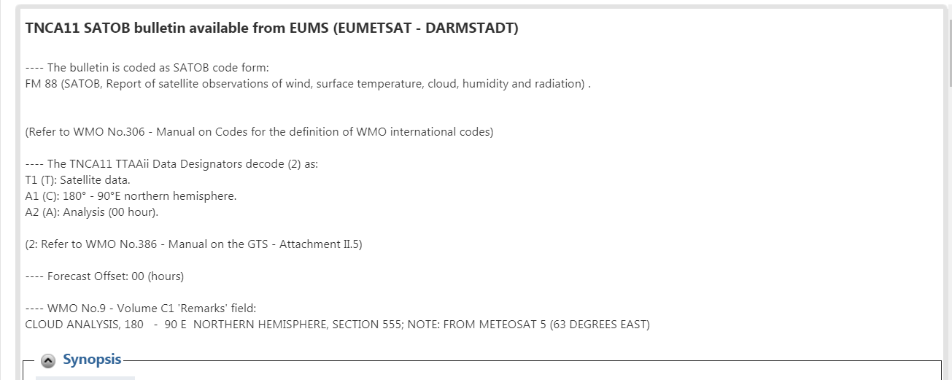
Why creating good quality metadata ?
Don’t understand ???

Slide 12
What makes good quality metadata ?
The metadata is the fuel for having a performing search
  As a metadata provider you should understand how you want each of your datasets to be discovered
  Typical search: “Cloud Satellite Europe” should match EUMETSAT products
Good quality metadata allows the user understanding what is the dataset, its purpose and potential usage
  An accurate and clear and comprehensive product description should be provided (in the abstract)
  Link all reference documentation to allow user finding it
An abstract should define the following information in a human readable way
  What is the product,
  its purpose and domain of application,
  its distribution format(s), distribution frequency and if necessary a summary of the product generation (created from source A & B).
  It should be created by a product specialist.

Slide 13
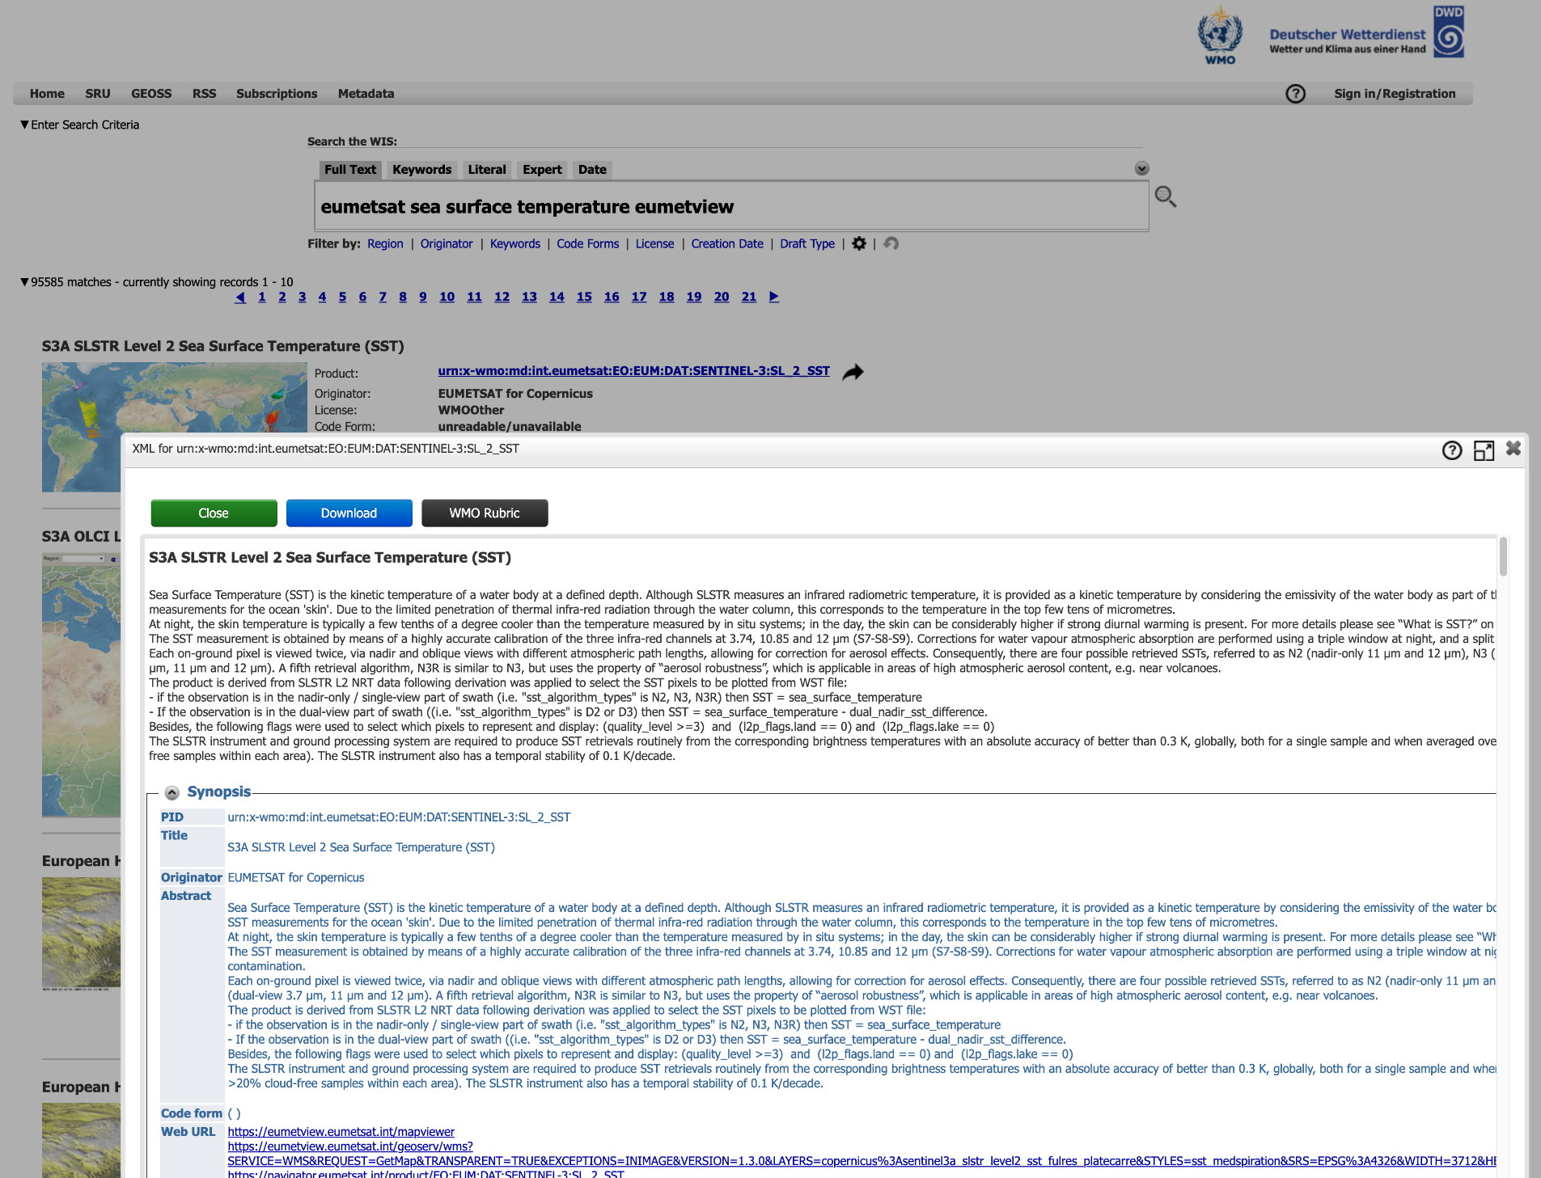

Slide 14
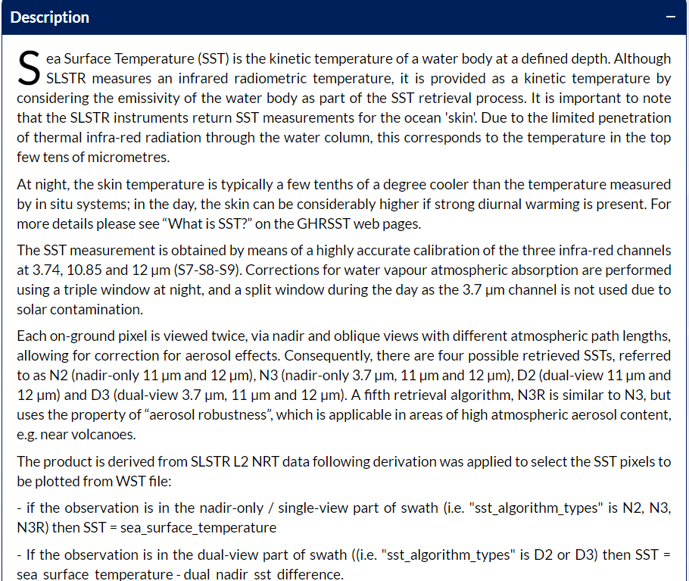

Slide 15
What makes good quality metadata ?
Create a taxonomy/categorization for your products
  Use of keywords (relatively high weight in GISC DWD)
  Allow the creation of a “Browse by category discovery”
Define a geographic and temportal extent
  GeographicElement to indicate the closest bounding box
  TemporalElement to indicate the time period, ie 2009-05-15 til now
Which organization is in charge of creating/generating the product
  pointOfContact
Is the product open/restricted/licensed ?
  Data Policy: is it an open dataset, can I redistribute it ?
  How do I access it: Link to the data delivery service or the data

Slide 16
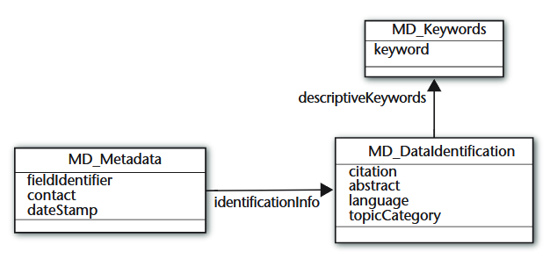
Mandatory contents of a WIS discovery metadata record
Source: WMO Core Metadata Profile version 1.3

Slide 17
Prepare your metadata for GISC DWD
The following metadata elements are the most important for the indexing of information:
  Abstract, (100 kg)
  Title, (50 kg)
  Keywords (20 kg)
  and the rest of the metadata (5 kg)
A Preview Image makes the dataset more attractive
Link to access the online resource (the data or the service allowing to download the data)
Update your metadata to avoid dead links especially for online resource (transferOptions) that is present in the

Slide 18
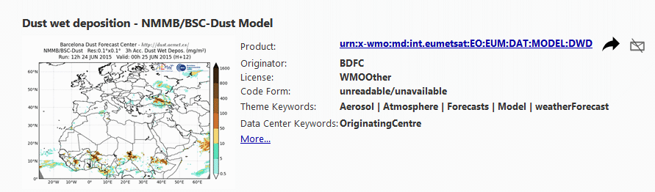
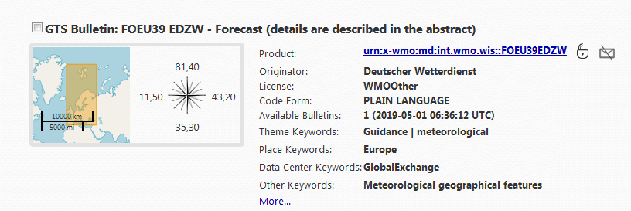
Metadata - Preview Icon
Preview Icons are very useful for a better overview within the search result list
bounding box is used if preview is empty

Slide 19
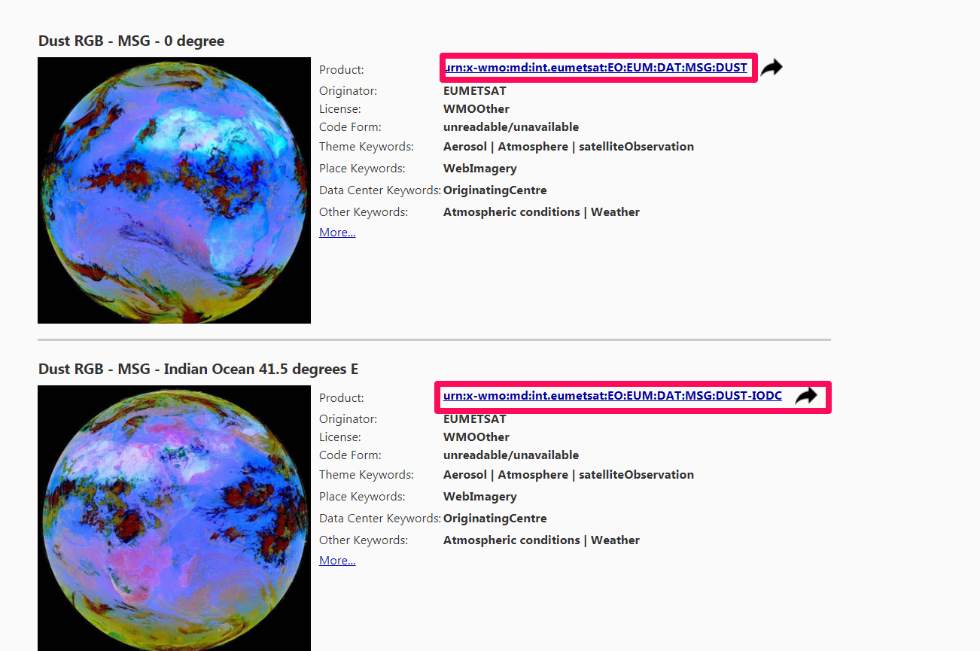
Important links

Slide 20
Granularity of metadata
size of dataset instance
full numerical model output in one metadataset vs.
very fine granularity for each element, level, ensemble member etc.
temporal characteristics
e.g. “French WMO Resolution 40 Essential SYNOP” as time series and not for each temporal instance
spatial extent
synoptic observations from the French Overseas Departments of Guyana, Martinique, Reunion and Guadeloupe are dispatched in different datasets
Try to describe very coarse datasets to avoid this

Slide 21
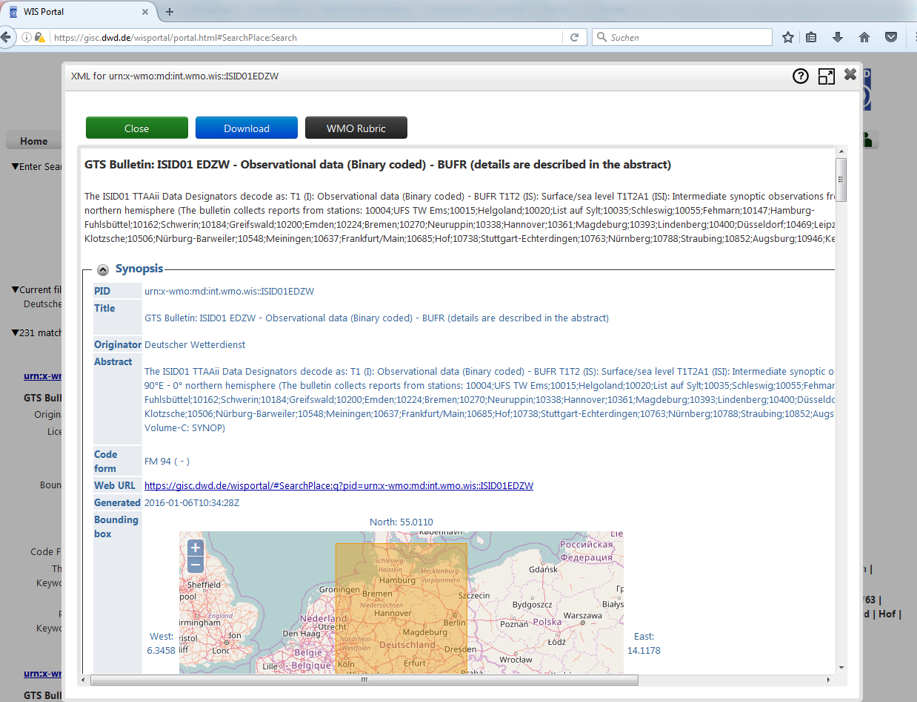
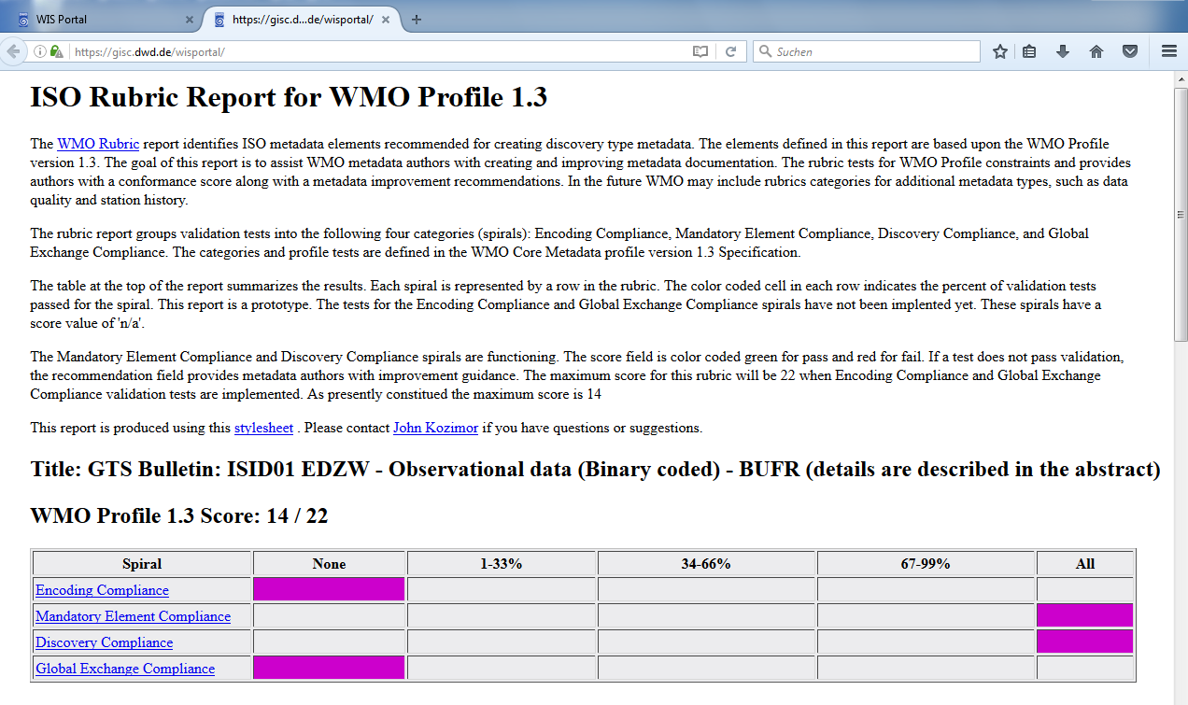
Metadata Quality in WMO Information System
NOAA provides a “WMO Rubric Report” (xslt transformation) http://www.ngdc.noaa.gov/metadata/published/xsl/wmoRubricReport.xsl
Useful tool to monitor metadata quality, build into Web-Frontend GISC Offenbach (https://gisc.dwd.de, single metadata set, button „WMO Rubric“)

Slide 22
WMO Expert team working on metadata quality
The quality of the metadata is a recognized problem at WMO
The Inter Program Expert Team on Data Representation Development (IPET-DD) is looking at the problem
Task Team on Metadata Guidance and Search improvement (TT-MDGS) has started to work on the issue
Create Key Performance Indicators to highlight and make more visible the problems for the WIS users
  Check presence of information in addition to WMO Core Profile already mandatory information: station identifier, parameter keyword,
  Check for “bad” automatically generated content and provide a replacement
  Study if the Title and Abstract structure can be automatically assessed.
Integrate the defined KPIs in the WIS monitoring dashboard
All discussions are open and available from Github
  https://github.com/wmo-im/wmcp-docs & https://github.com/wmo-im/wmcp

Slide 23
Guidance on Metadata
WMO 1061 Guide on WIS, Part V https://library.wmo.int/doc_num.php?explnum_id=4004
WMO Core Profile of the ISO 19115: Geographic Information - Metadata standard
Current Version: 1.3
WMO Wiki contains a lot of information: WMO WIS Wiki Guidance
  Examples per type of products that can be used as templates
  Data policy

Slide 24
Resources and further information
WMO
WMO Core Metadata Profile version 1.3:
http://wis.wmo.int/2012/metadata/WMO_Core_Metadata_Profile_v1.3_Part_1.pdf
Manual on the WMO Information System, 2015 edition (WMO-No. 1060)
https://www.wmo.int/pages/prog/www/WIS/documents/Manual-on-WIS-en.pdf
Guide on WIS (updated in 2017), with Guidance on Metadata (WMO–No. 1061)
https://library.wmo.int/doc_num.php?explnum_id=4004
Python metadata validator made by the Canadian Met Service
  It verifies the presence of the mandatory elements (part 2 of the WMO Core Profile 1.3
  https://github.com/OGCMetOceanDWG/wmo-cmp-ts
Wiswiki, github repository wmo-im
https://github.com/wmo-im

Slide 25

Contact:
GISC-OF Team
Referat TI14
Frankfurter Straße 135
63067 Offenbach
E-Mail: wis@dwd.de

