Slide 1

World Meteorological Organization
WIS Future Technologies - 2019
Network 2030 overview
Geneva, 20 March 2019

Slide 2

ITU-T Focus Group on
Technologies for Network 2030 (FG NET-2030)
Objectives
  To study, review and survey existing technologies, platforms, and standards for identifying the gaps and challenges towards networks for the year 2030 and beyond
  To formulate all aspects of Network 2030, including its vision, requirements, novel and forward-looking use cases, and so on and so forth
  To establish liaisons and relationships with other SDOs
  Asses architecture, evaluation methodology
Established in July 2018
"Network 2030: A pointer to the new horizon for the future digital society and networks in the year 2030 and thereafter." – Dr Richard Li, FG NET-2030 chairman
Chairman: Richard Li (Huawei)
Vice-Chairmen: Mehmet Toy (Verizon),
Alexey Borodin (Rostelecom),
Yuan Zhang (China Telecom),
Yutaka Miyake (KDDI)

Slide 3
Focus Group on Network 2030 – deliverables per ToR
To identify the gaps and challenges which are not supported by existing and near future technologies like 5G/IMT-2020, including new network layer or new network architecture.
To identify performance targets of Network 2030 that is beyond the limitation of existing and near future networks including 5G/IMT-2020.
To make a report on the definitions, terminologies and taxonomy for Network 2030 and the relevant eco-system.
To describe the potential architecture and framework of Network 2030.
To analyse the backward compatibility and steps towards Network 2030, based on existing and near future networks including 5G/IMT-2020.
To study the future scenarios and use cases.
To draft a report on describing the standardization gaps for ITU-T study groups.
To organise thematic workshops and forums on Network 2030, which will bring together all stakeholders, and promote the FG activities and encourage both ITU members and non-ITU members to jointly contribute on this work.
To make liaison with other SDOs, such as ETSI specific ISGs, IETF, IRTF.

Slide 4
Looking at the future
Astronomical amount of connections beyond the limitation of current and near future networks including 5G/IMT-2020
Very-high throughput to support explosive bandwidth-intensive future applications beyond the limitation of current and near future networks including 5G/IMT-2020
Super-ultra-low latency networking, with deterministic guarantee beyond the limitation of current and near future networks including 5G/IMT-2020
Trustable network infrastructure
Human safety and privacy centric reliable networking mechanism

Slide 5
Vector of research
New Media
  Holograms
  Holosenses
  Qualitative digitalization
New Services
  Latency-Guaranteed Services (in-time and on-time)
  Throughput Guaranteed Services
  Holographic Teleport
New Architectures/Infrastructures
  Convergence of Terrestrial and Space Networks
  Trustable Infrastructure
  Federated network architecture

Slide 6
Focus Group Structure
FG-NET-2030
Sub-G-1
Use Cases and Requirements
Sub-G2
Network Services and Technologies
Sub-G3
Architecture and Infrastructure
New (Network) Services
Technical Gap
Terminology
New Technology Roadmap
Terrestrial and Satellite
Trustability
Use Cases
Requirements
Trends Analysis
Concepts and Principles
Architectural Gaps
Layering and Interfaces

Slide 7
Generic deliverables plan
GAP: Gap analysis (gaps and challenges), towards a Standardization Gap Report for ITU-T Study Groups
UC: Use Cases and Future Scenarios (including requirements)
PDT: Performance and design targets 2030
AF: Architecture and Framework, including backward compatibility
TERM: Report on Terminologies, Taxonomy and Definitions

Slide 8
Meetings of ITU-T FG NET-2030 and Workshops
First Workshop on Network 2030, October 2018, New York City, United States
Inaugural meeting FG NET-2030, New York, October 2018
2nd meeting and WS, Hong Kong, China, December 2018
3rd meeting and WS, London, UK, February 2019
4th meeting and WS, St Petersburg, Russia, May 2019
5th meeting and WS, Geneva, October 2019
6th meeting (if groups continues), Portugal
More info on FG NET-2030 at its webpage
https://www.itu.int/en/ITU-T/focusgroups/net2030/Pages/default.aspx

Slide 9
Internet: Past, Present, Future
New Media
(e.g. Hologram)
eMBB
Web
New Services
(e.g. Teleport)
New Infrastructure
(e.g. Trust)
mMTC
uRLLC
Multimedia
APPs
2000 - 2020
2020 - 2030
2030 +
Present Digital Era
Near Future
(5G Era)
Far Future
Notes:
The coming decade will see swift changes in technologies pertaining to novel types of devices, systems and functions they perform.

Slide 10
Current Internet Capabilities

Slide 11
5G Network capability requirements
Recommendation ITU-R M.2083 (09/2015): IMT Vision - "Framework and overall objectives of the future development of IMT for 2020 and beyond"
https://www.itu.int/rec/R-REC-M.2083-0-201509-I/en

Slide 12
Capabilities for the Future applications

Slide 13
Future Internet Technologies
Support future applications
Interoperate with current Internet technologies
Expect to keep IPv6 addressing
Simplified devices such as Ethernet Switches
Simplified routing Protocols that are combined with ML/AI techniques. To reduce complexity and improve efficiency
Support secure and intelligent Internet
Seamless data transfer across borders

Slide 14
A New Horizon in Sight
2D
3D
New Media
(e.g. Holograms)
Gbps
Tbps
2-Sense
5-Sense
ms
Sub-ms
Do
we need a new IP?
New
Services
New
Infrastructure
Holographic Teleport
Best-Guaranteed Services
High-Precision Communications
Trustable Infrastructure
Federated Network Architecture
Integrated Terrestrial and Space

Slide 15
Future apps
Holographic multimedia
Remote surgery
Humanoid robots
Instantaneous data delivery and movement
Intelligence-enabled tiny IoT terminals
Fully autonomous transportation system
Everything connected
Equipped with intelligence
Notes:
The intelligence is no longer only in the end devices, but distributed among end devices, data-centers, edge and core devices in the network. As a result, the complexity is increased. On the other hand, automation of operational processes for inter and intra networks is being worked in the industry. Management of network elements and applications on-demand is becoming a common trend. The level of intelligence in each component is increased with the proliferation of machine learning (ML) and artificial intelligence (AI) techniques. By 2030, we expect to see self-managed networks with substantial user controls (combine with the previous paragraph and tie intelligence and automation).

Slide 16
Future use cases
These ICT use cases will span new media such as hologrammes, a new generation of augmented and virtual reality applications, and high-precision communications for 'tactile' and 'haptic' applications in need of processing a very high volume of data in near real-time – extremely high throughput and low latency.

Slide 17
Directions for study
The Focus Group FG-NET2030 intends to study the capabilities of future networks roughly in the period of 2025-2035, when it is expected to support future-oriented new scenarios
holographic telepresence
industrial avatars
extremely fast response in critical situations
The study aims to answer specific questions on what kinds of network architecture and the enabling mechanisms are suitable for such novel scenarios.

Slide 18
New Services for the Future Digital Society
Best Effort
Web, APP
DiffServ
Voice/video
Traffic Engineering
VPN
Leased Line
Guaranteed
AR/VR
Autonomous Driving
High Precision
Remote Surgery
Industrial Internet
Holographic
Teleport
Holographic Type Communications
Industrial Humanoids

Slide 19


New Media: Hologram
Bandwidth requirement will grow up to terabits for
holographic telepresence applications
Effective Pixel Count | Approx. Bandwidth Requirement
31.5 M | 1 Gbps
157 M | 10 Gbps
755 M | ~75 Gbps
1.19G | ~90 Gbps
5.10 G | 300 Gbps
19.1G | 1Tbps
4”
20” wide
4”
6’4” tall
 | Dimensions | Bandwidth
Tile | 4 x 4 inches | 30 Gbps
Human | 77 x 20 inch | 4.62 Tbps
color, FP (full parallax), 30 fps
(reference: N. Peyghambarian, University of Arizona)
Source: 20th Century Fox
Terabytes 10¹² bytes

Slide 20





New User Experience:
Senses, Throughput and Latency
User experience goes from single sense to five senses
Throughput goes up higher and higher
Multimedia Evolution
4K/8K HD
VR/AR
Hologram
Completed image
Visual trick
Hologram
Extreme experience requires superior network capabilities
35Mbps~140Mbps
25Mbps~5Gbps
4 Tbps ~ 10 Tbps
Band
width
Band
width
VR/AR
In addition to bandwidth, more requirements are put forward for network latency
Video
Multidimensional information consumes multiple bandwidth
Latency falls down lower and lower
Voice
Image
Experiences on a single dimension are enhanced and consumed more bandwidth
4K/8K HD
VR/AR
Hologram
Text
Human
Senses
15 ms ~ 35 ms
Delay
5 ms ~ 7 ms
Delay
Submillisecond
Vision
Hearing
Touch
Taste
Smell

Slide 21

New Digitization: from Quantitative to Qualitative
Quantitative
Qualitative
Goldman Sachs have been busy playing with their AI system, which has predicted victory for Brazil in the FIFA World Cup 2018 final. The AI system reportedly ran simulations of 1 million possibilities and variations, before reaching its conclusion.
Each and every byte has the same significance
the whole packet is retransmitted if a byte is lost
Reliability is often a concern
Example:
  Texts, voices
Traditional applications
Each byte has different significance than other
No retransmission is required if the lost byte is not significant
Latency is often a concern
Example: Images, videos, holograms
High-throughput holographic applications

Slide 22
Federated Networks – Terrestrial and Space Networks

Slide 23
New Concepts for Future Communications
Today’s Communications
Future Communications
Applications
HTML App Data
Transport
Network
App-logic
Applications
HTML, App Data
Transport
Network
Applications
Holographic 5-sense Matrix
Teleport
New IP
App-logic
Applications
Holographic 5-sense Matrix
Teleport
New IP
App-data
Multi-Sense
Connection
Qualitative and Quantitative connection
QoS
Forwarding
Hi-precision
Forwarding
Datagram | A self-contained routable entity with destination address in packet switched networks
Transport | A one-dimensional information carrier over network. Behavior captured E2E.
Hologram | New attributes for different senses
Teleport | Transmits at near-real-time (sub-ms) latency, b/w, metadata, behavior etc.)
New IP | Network enabler of high precision service attributes
https://gigaom.com/2010/09/13/sensor-networks-top-social-networks-for-big-data-2/
Notes:
Current Internet is a best effort network
NET2030 is a guaranteed delivery network

Slide 24
From IMT 2020 to Network 2030
ITU-T IMT-2020
ITU-T Network 2030
Enables an Era of Mobile Connected Society
Enables a New Internet
Low Latency (1 ms)
Super Ultra-Low Latency (<1ms)
Guaranteed Latency (in-time)
High-Precision Latency (on-time)
Data Rate (10 Gbps)
Data Rate (1 Tbps)
Network Technologies: Slicing, SDN, NFV, SON
  New IP, Rail-Switching, Preferred Path Routing
Internet of Things
  CPS and Digital/Physical Twins
Enhanced Privacy and Security
  Trustable Network Infrastructure
  2-Sense 3D Media
  5-Sense 3D Holograms
  Holographic Teleport
  Holistic Protocol Efficiency

Slide 25
Fundamental Questions for Study
New Media
  Holograms
  Holosenses
  Qualitative digitalization
New Services
  Latency-Guaranteed Services (in-time and on-time)
  Throughput Guaranteed Services
  Holographic Teleport
New Architectures/Infrastructures
  Convergence of Terrestrial and Space Networks
  Trustable Infrastructure
  Federated Infrastructure
FG Network 2030 is a just starting point and will be instrumental initiating the work in ITU-T that will eventually bring Network 2030 into reality.

Slide 26
Fundamental Questions for Study
New Media
  3D Light Field Display
New Services
  Autonomous driving (latency for processing traffic conditions 100 ms compared to human drivers (600 ms)
  VR/AR with ability to view three-dimensional images
  - leisure, personal navigation
  - pain treatment, Neuropathy and telesurgery, telehealth (administering medicine, closely monitoring a patient remotely)
  Remote industrial management, network intelligent operation
  Smart agriculture
New Architectures/Infrastructures
  Convergence of Terrestrial and Space Networks
  Trustable Infrastructure
  Federated Infrastructure

Slide 27
More about future services

Slide 28

Coming FG-NET2030 activities
4th ITU-T Focus Group NET2030 meeting and workshop
Saint Petersburg, Russia
21-23 May 2019
Open events
No fees
Please contribute to the work!

Slide 29

Your presenter of today
Thank you for your attention!
Tatiana Kurakova, PhD
Counsellor for ITU-T Study Group 13 “Future networks, with focus on IMT-2020, cloud computing and trusted network infrastructures” and Focus Group “Technologies for Network 2030”
https://www.itu.int/en/ITU-T/focusgroups/net2030/Pages/default.aspx
https://www.itu.int/en/ITU-T/studygroups/2017-2020/13/Pages/default.aspx
+41 22 730 51 26
tatiana.kurakova@itu.int
International Telecommunication Union
- Committed to Connecting the World
Notes:
Tatiana KURAKOVA, PhD
Counsellor, ITU-T Study Group 13
“Future networks, with focus on IMT-2020, cloud computing and trusted network infrastructures”
International Telecommunication Union
Places des Nations
Geneva 20, Switzerland
Office M426
Tel : +41 22 730 51 26 | Mobile : +41 79 249 48 34

Slide 30
Supplementary material

Slide 31
Introducing ITU-T
The ITU Telecommunication Standardization Sector (ITU-T) is a platform for governments and the private sector to coordinate development of the telecommunication networks and services that connect the world.
ITU-T complements ITU’s Radiocommunication Sector (ITU-R), Development Sector (ITU-D) and General Secretariat in fulfilling ITU’s strategic goals.
Notes:
ITU homepage: www.itu.int
ITU-T homepage: www.itu.int/ITU-T

Slide 32

ITU-T: The Standardization Sector
Vision: Committed to Connecting the World
ITU-T is driven to remain the pre-eminent worldwide telecommunication standards body:
Developing interoperable,
non-discriminatory international standards
Bridging the Standardization Gap
Extending international cooperation
Plays a crucial role in defining the operation and interoperability of technologies that underpin global communications network
200 - 300 new global standards approved every year, with over 4,000 in use today
Standards enable global communications by ensuring ICT networks and devices speak the same language globally

Slide 33
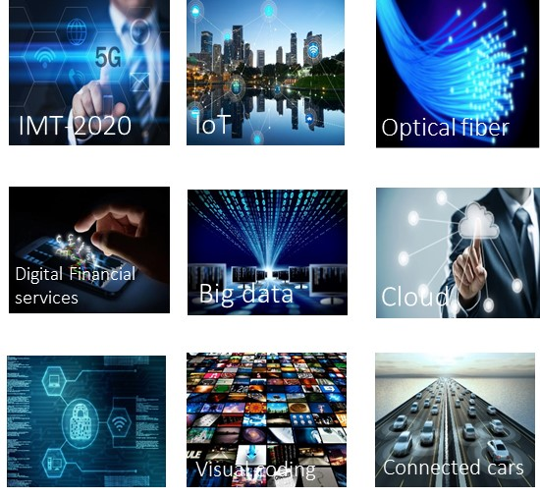
Standardization in ITU-T
Currently ITU-T has 11 Study Groups

Slide 34

ITU-T Study Groups
ITU-T standardization work is carried out by the technical Study Groups (SGs) in which representatives of the ITU-T membership develop consensus based Recommendations (standards) for the various fields of international telecommunications.
SG2 - Operational aspects
SG3 - Economic and policy issues
SG5 – Environment, climate change and circular economy
SG9 - Broadband cable and TV
SG11 - Protocols and test specifications​
SG12 - Performance, QoS and QoE
SG13 - Future networks with a focus on IMT-2020, Cloud & Big Data
SG15​ - Transport, Access and Home
SG16 - Multimedia
SG17 – Security
SG 20 – IoT, smart cities & communities

Slide 35
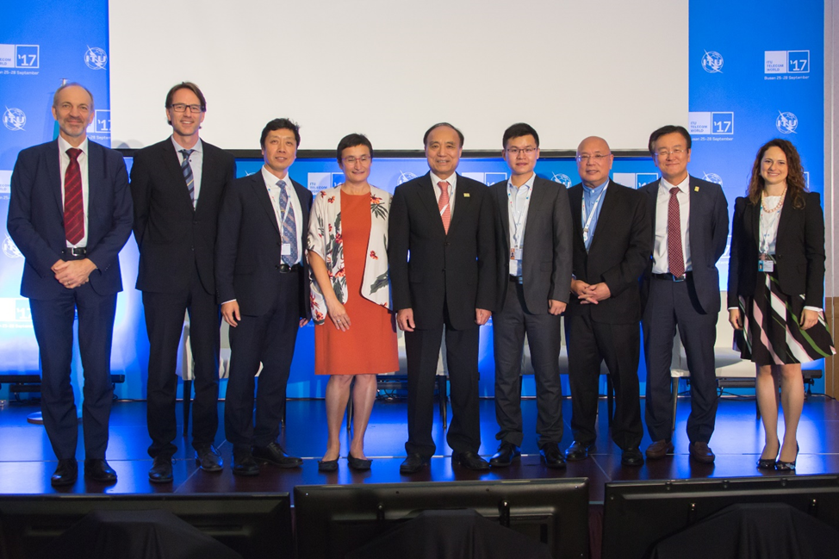


Two special issues in 2018
Launch Ceremony at ITU Telecom World Busan, Rep. of Korea, 25 September 2017
International Editorial Board
Editor-in-Chief
Associate Editors-in-Chief
Outreach Chairman
Guest Editors
Reviewers
https://www.itu.int/en/journal/Pages/default.aspx

Slide 36


Call for Papers
Deadlines
Submission of full paper proposals: 17 June 2019
Notification of paper acceptance: 23 September 2019
Submission of camera-ready accepted papers: 14 October 2019
http://itu.int/go/K-2019
Kaleidoscope 2019 calls for original academic papers addressing ICTs’ contribution to innovation in healthcare delivery and medicine.
The conference encourages submissions highlighting the role to be played by communication networks and international standards in achieving affordable access to healthcare for everyone, everywhere, in line with the United Nations Sustainable Development Goals.

