Slide 1





Future Technology Workshop for WMO Information Systems
Building Trust in the Connected World
Root of Trust
Secure Identity
Secure IoT
Artificial Intelligence
Blockchain
March 2019

Slide 2
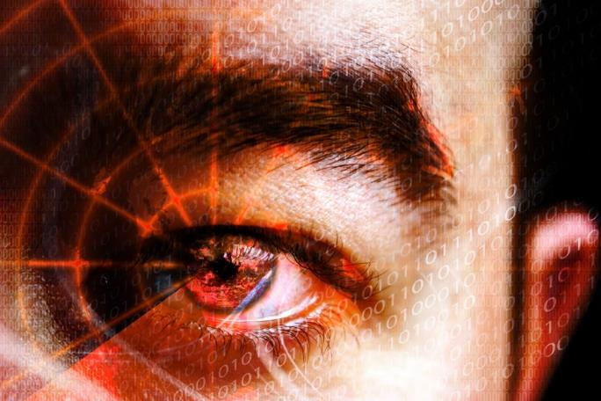
Company snapshot
WISeKey is a global leader in the delivery of integrated security products for the Internet of Things (“IoT”) and digital identity ecosystems
Founded 1999
Employees 165 worldwide
Headquarters Geneva, Switzerland
Stock Exchange* SIX Swiss (SWX: WIHN)
*Announced ADR listing in U.S.
Core Expertise
Over two decades of experience developing innovative digital security solutions that use cryptographic chips and trust services to protect users, devices, data and transactions in the connected world.
Markets Served
Trust Services - mPKI, eID, e-Signatures
Brand Protection / Anti-Counterfeiting
Secure IoT
Root of Trust
Blockchain
Artificial Intelligence

Slide 3


















































CUSTOMER VALUE
3,500+ CLIENTS WORLDWIDE
WISeKey enables secure connections and transactions, creating new avenues of business efficiencies and revenue growth for our customers in a wide range of market verticals
FINANCIAL SERVICES
PUBLIC SECTOR
CONSUMER / HEALTH
INDUSTRIAL / IT

Slide 4

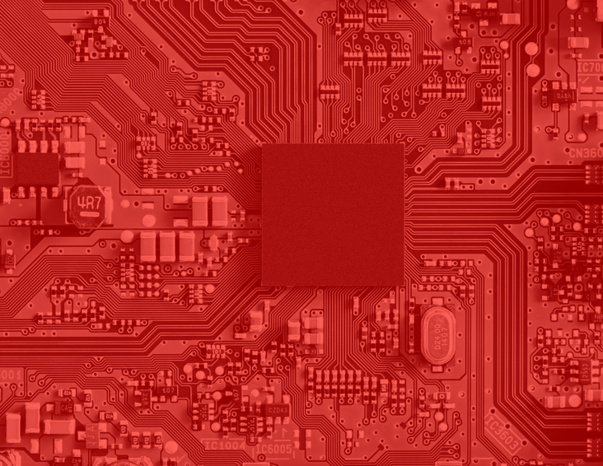

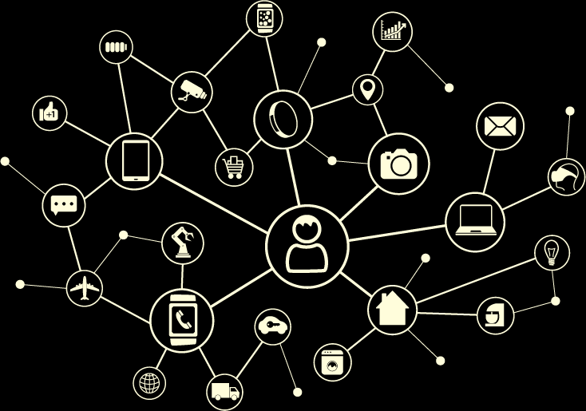

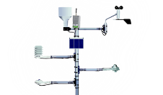

THE INTEGRATED IOT PLATFORM BASED ON A WMO CRYPTOGRAPHIC ROOT OF TRUST
IoT & Semiconductor
mPKI & Digital Signing
Secure software-enabled tamper resistant microchips
Trust Service Provider platforms for digital certificates and e-Signatures

Slide 5
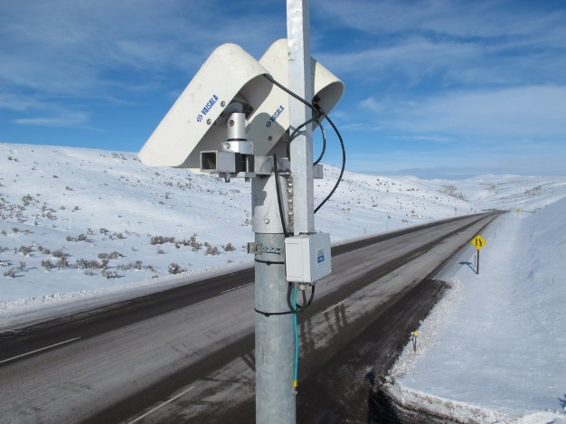

The problem
What cyber related risk is being tacitly accepted by the insecure by design nature of sensors and actuators?
What reliability and safety requirements can be impacted by lack of cyber security of process sensors, actuators, and drives. If you can’t trust the measurements, we are in trouble!
The development of sensor networks, particularly in the last years, has extended their applicability in various domains, such as heritage preservation, environmental motoring and human activity recognition. Sensor based systems are known as being highly application dependent.
This also includes the top layer, which should handle the data in an efficient and useful manner. Furthermore, the size of collected data is rapidly increasing with the number and scale of deployed sensor networks and specialized methods able to deal with such scale and still satisfy application requirements are needed

Slide 6





















OISTE WISEKEY ECOYSTEM
3.6 Billion
1.6 Billion
250 Million
1 Billion
Browsers/OS (total) Root of Trust installed
Mobile OS (total) Root of Trust installed
Digitally signed emails per year
WISeKey VaultIC IoT chips since 2010
WISeKey has more accreditations than any other Certificate Authority (CA), and is the only EU TSP eIDAS “qualified” in multiple countries with local operational support

Slide 7
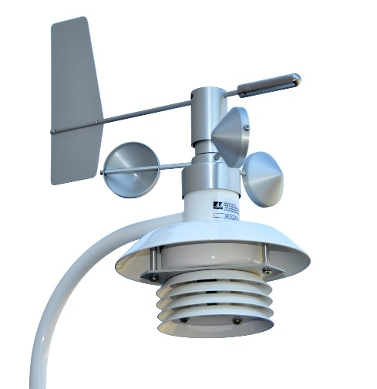
Rapidly Growing Market of Connected IoT devices
50B
42B
CAGR ‘10-’20: 15%
35B
28B
23B
18B
14B
11B
9B
2009 - IoT Inception
1992 - 1,000,000 Devices
2003 - 0.5 Billion Devices
Source: NCTA.

Slide 8
security AND DATA INTEGRITY is one of the top concerns for iot DEVICES
Security Headlines in the News
($ in billions)
CAGR ‘16-21: 14%
Mirai Botnet Infecting Routers & IP Cameras
“Spectre” and “Meltdown” Exploited Microchips and Processors
Cybercriminals Shut Down Heating of Two Residential Buildings In Finland
Undisclosed University Saw 5,000+ IoT Devices Attacked via a Botnet
Source: IDC.

Slide 9

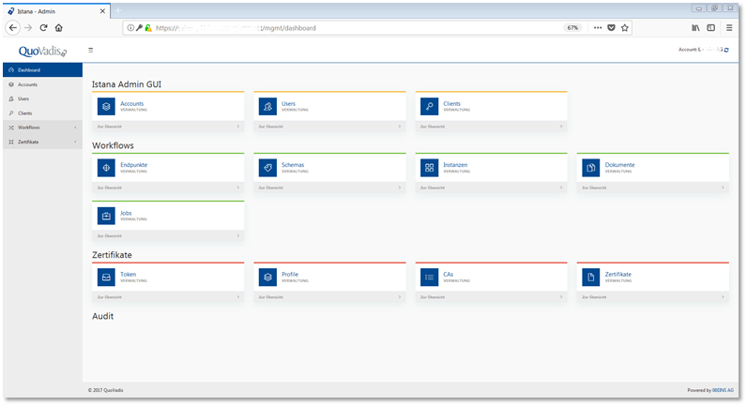



PKI for IoT
Designed with special needs of IoT in mind
  On-premise, managed PKI, hybrid operation
  Decentralized microservice architecture:
    Built-in High-Availability
    Load-Balancing
    Failover
  Resource-efficient and high performance; designed for large amount of certificates
  Able to manage complex PKI hierarchies
  Customisable workflows to handle different client provisioning/lifecycle needs
  Extensible by plug-in approach to accommodate special IoT needs
Flexible for “all partner” needs
SECIAL LEVERAGE
WISeKey Semiconductor and VaultIC
  Security Broker/Gateway
  End-to-End protection
  Lifecycle management
SECURE CHIPS
SECURITY BROKER
TRUST SERVICES
+
+

Slide 10




















TWO DIFFERENT PATHS TO IOT SECURITY
SECURE CHIPS
SECURITY BROKER
TRUST SERVICES
CYBERSECURITY TRUST PLATFORM
2
Unified security platform with all components from a single vendor
Seamless integration and the option to interoperate w/ 3rd party components
Security certified by the highest industry standards and accreditations
CONNECTED DEVICE
SECURE APPLICATION
HARDWARE
MICROCHIPS
SECURE
PROVISIONING
SECURE
COMMUNICATION
CERTIFICATE
AUTHORITY
ROOT OF
TRUST
LEGACY IoT ECOSYSTEM
1
Multi-vendor approach built from individual security components
Integration steps add time and money to development costs
Increased opportunities for flaws in overall security architecture

Slide 11









IoT Devices
IoT Platform*
Applications
Artificial Intelligence
Data
Analytics
IoT Edge Gateway
Device Connectivity
Predictive Analytics
Infrastructure Connectivity
Decision
Making
SECURE CHIPS
PKI & Security Broker
TRUST SERVICES
SECURITY BROKER
Device authentication
Digital certificate provisioning
Managed PKI vs. on-premises
Secure key storage
Remote (OTA) firmware updates
Tailored to IoT ecosystem standards
Digital certificate storage
Threat analysis and reporting
Trust options: private vs public
1
2
3
Authentication extends all the way from the device through to the application, providing device and message integrity
Life-Cycle control of identities, ownership changes, and device decommissioning all inside a single, secure platform
Device and data security, confidentiality, and non-repudiation are anchored through the Trust Services
*Integrated w/ IBM Watson, ready for integration w/ AWS, Azure, and others

Slide 12





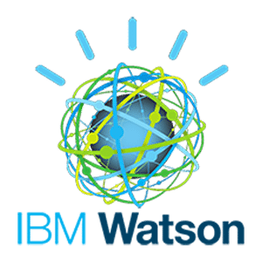






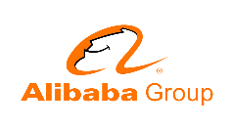








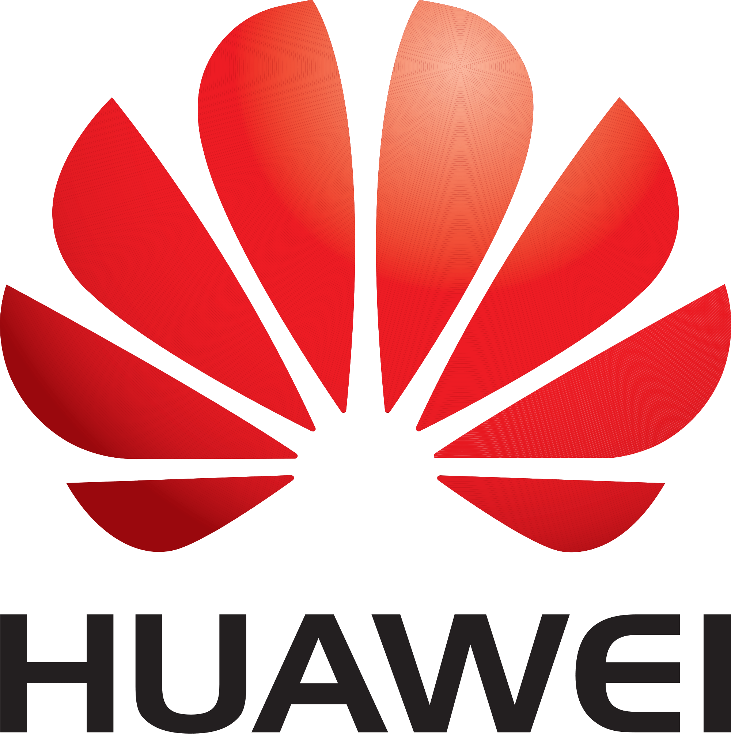


Iot ecosystem
COLLECT DATA
TRANSPORT & AGGREGRATE
ANALYZE / ACT / REPORT
CHIPS
IoT DEVICES
CONNECTIVITY
NETWORK
IoT PLATFORM
APPLICATIONS
Microcontrollers
Sensors
Connectivity
Things that capture data
Telecom
Local network
Gateways & Hubs
Flow management
Cloud storage
Data integration
Cloud providers
Data analytics
Big Data
Access control
Authentication
Reporting
Partners
Types of Customers
Ecosystem Partners

Slide 13




Case studies
SMART INDUSTRY
SMART HOME
BRAND PROTECTION
MEDICAL
CUSTOMERS
World’s #1 Air Conditioning Supplier
Leading Provider of Sensors Appliances
World-leader in IoT
Global Healthcare Solutions Provider
Smart buildings have a huge attack surface
Unique ID used for device authentication
Certificates for roles and permissions
Secure provisioning during manufacturing
Next gen (smart) appliances require security
Secure storage of private credentials
Private certs for remote firmware updates
Public certs for secure web-based applications
Desire to move from passive protection to interactive (connected) solutions
Washable (encapsulated) secure chips
Certificates for fan participation
Connected medical devices create a safety concern for users
Industry standards demand certified hardware-based security
Privacy concerns require certificates
NEEDS
WISEKEY SOLUTIONS
Secure Chips
Device-unique private ID
Tamper-resistance and low-cost
Temp. & environmental qualifications
Industrial certifications
Trust Services
Based on industrial standards
Multi-use certificates
High-volume provisioning
Global accreditations
IoT Platform
Personalization during chip mfg.
Provisioning & lifecycle mgmt.
Meets volume expectations
Secure supply channel

Slide 14



WISEKEY SEMICONDUCTORS
APPLICATIONS
1
MICROXSAFE
Networking equipment
Industrial metering
Mobile applications
Secure Controller delivered with SDK for OS development
VAULT-IC
Security cameras
Building access/control
Brand protection
2
Secure Controller with Embedded Firmware designed for IoT
SECURE CHIPS
Semiconductors used for the protection of digital identities on devices
3
MICROPASS
Credit/Debit cards
Luxury wearables
NFC enabled devices
VISA and MASTERCARD certified Secure Chips for payment cards
SMARTCARD
POS terminals
Portable readers
NFC enabled devices
4
Smart card reader chips

Slide 15



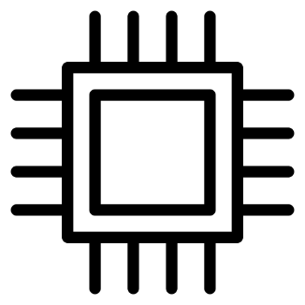
WISECOIN UTILITY TOKEN | SOLUTION COMPONENTS
HARDWARE LAYER
SOFTWARE LAYER
COMPONENTS
VaultIC chips
Wallets
Identities
WISe Utility Token
PURPOSE
Secure storage of wallets
Holds WISe Utility Tokens
Gives unique
identities to objects
Triggers the mechanism that allows the
verification process

Slide 16


WISECOIN UTILITY TOKEN | USE CASE: CARS AND CHARGING STATIONS
A car wantS to safely make a payment to the charging station (fiat or cryptocurrency)
?
The car would need to verify the charging station’s identity before a payment could be made
Car
Charging
Station

Slide 17
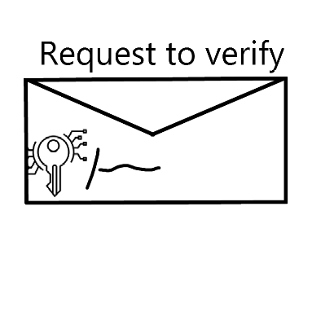




WISECOIN UTILITY TOKEN | STEPS
1
MAKING THE REQUEST
The car creates a request and signs it with a private key (which comes with the car’s certificate)
2
RECIEVING THE REQUEST
The request is sent to the Route Key via internet/API
3
ACCEPTING THE REQUEST
Route Key checks that enough unused tokens are in the car’s wallet
Route Key Verification
4
VERIFICATION
A. Route Key accepts the request and registers tokens as used
B. Route Key verifies that the wallet address provided by the charging station has the right to interact
C. Route Key passes on the verification result to the car. The latter can proceed to make a payment to the charging station if the results are valid.
3
4
A
2
4
C
4
B
1
Charging
Station
Car

