Slide 1


Inmarsat Capability Briefing to WMO
Inmarsat Capability Brief - WMO
Technology and Service Roadmap to 2030 onwards
Geneva, March 2019
Ben Colton

Slide 2


Global leader in mobile satellite communications
No. 1 government satcom operator globally in 2017 by revenues
20% of government satcom services market in 2016 (NSR)
Fully-funded
Financially strong FTSE 250 status
Global
Seamless coverage and in-orbit redundancy
Reach
Global Distribution network
Multi-band
L, S, Ka, Mil-Ka band capabilities
Breadth
Unrivalled product and service range
99.9%
Reliability over secure satellite and ground network
Security
Highly secure networks
Mobile
A network specifically built for mobility

Slide 3
Inmarsat’s Past and Future
Inmarsat has become frequency agnostic – it designs networks to meet customer requirements
Era of L-band
Era of multi-frequency services
5 x I-3
Satellites
2 x I-4
Satellites
1 x I-4
Satellites
Alphasat & 1 x GX Satellite
2 x GX Satellite
1 x GX & S-band satellite
GX 5
Launch
2 x I-6 Launch
1998 2005 2008 2013 2015 2017 2019 2022
Strategic Focus still global coverage and mobile services for land, air and sea operations
Inmarsat the only commercial L-band and HTS provider offering global services
Provides flexibility and agility to offer bespoke managed services to government customers

Slide 4
Constellation development path 2016 - 2029
?
?
?
Future Ka
?
?
?
By 2022 the Inmarsat network will have:
6 high capacity L-Band satellites
>7 Ka Band satellites
Notes:
DINNER

Slide 5
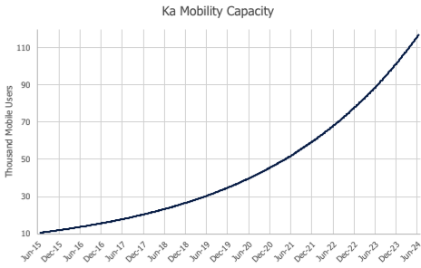
Our Strategy:
Start global, infill with on-going cost-effective capacity as demand grows
Grow global capacity 10-fold
Drop cost/bit >10-fold
>5X the hotspot capacity
System dedicated to mobility
(Not dependent on
consumer broadband)
Notes:
Idea around refining this story with a better visual. We can improve the visual – do you have a view about the story?
“what is really critical here is the peak capacity in a single hot spot – that could be a stepped line against a second axis to the right that grows pretty rapidly with time and is really where we shine vice the “terabit” crowd. Today we can put over a gigabit anyplace on earth (4xHCC+1xGSB=432MHz=800Mbps forward and 600Mbps return). Adding 5F4 means we can double that in much of EMEAAsia, adding GX5 means we can take that to 4X in EMEA, adding I-6 takes it to 4X from SA through Asia and 6X in EMEA, adding Flex takes it to 10X (assuming 2 Flex in hot area) and Flex 2 to 12X. These are VERY crude figures and later satellites have more forward capacity than return but in general these are probably proportionally representative. We can go back and do some maths to make it more accurate if this is something you want.”

Slide 6
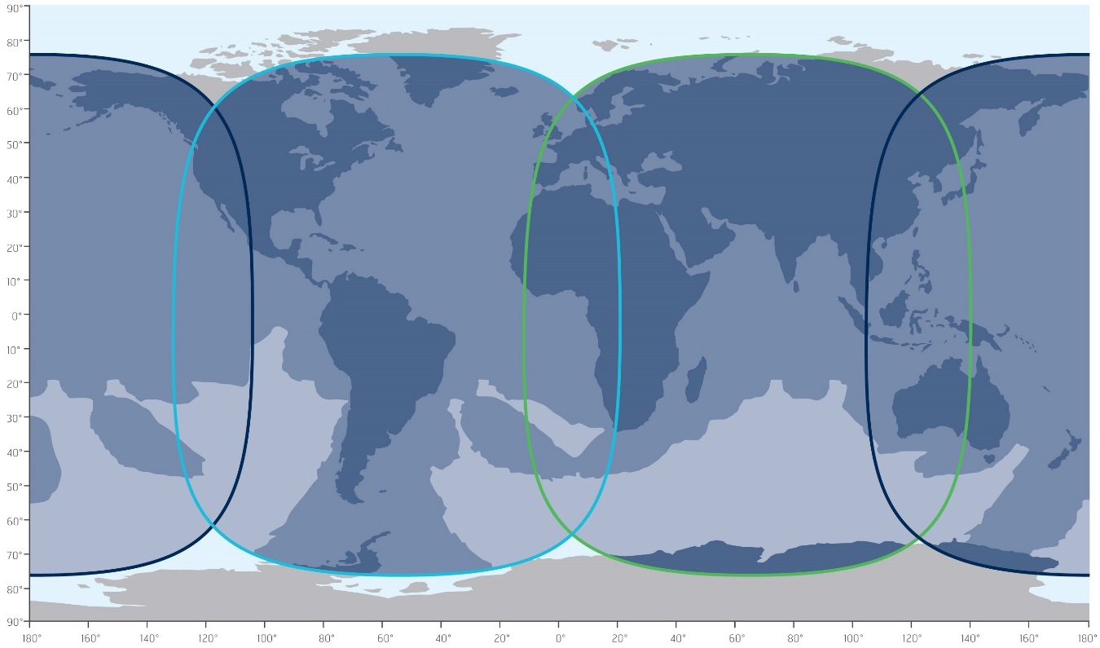
Deployment plan emphasizes Flexibility
Capacity constraints will no longer define customer requirements
I-5 Atlantic Ocean Region
I-5 Indian Ocean Region
I-5 Pacific Ocean Region
I-5 F4 coverage area.
Possible GX5 coverage area.
GX network available over at least 99% of this area.
Extendable GX coverage via steerable beams
I-6 F1 steerable beam examples
I-6 F2 steerable beam examples
Flexible capacity from Thor 7
I-5 Steerable HCP beams
(locations shown as example)
Note: I-6 satellite locations are still to be confirmed.
The I-6 beams are steerable clusters that can be located at any point in the satellite footprint. The locations here are just shown as an example.
Notes:
But in the animation, include an operational example which the animation follows in closer view on the next slide (more natural progression and recolouration to match)

Slide 7
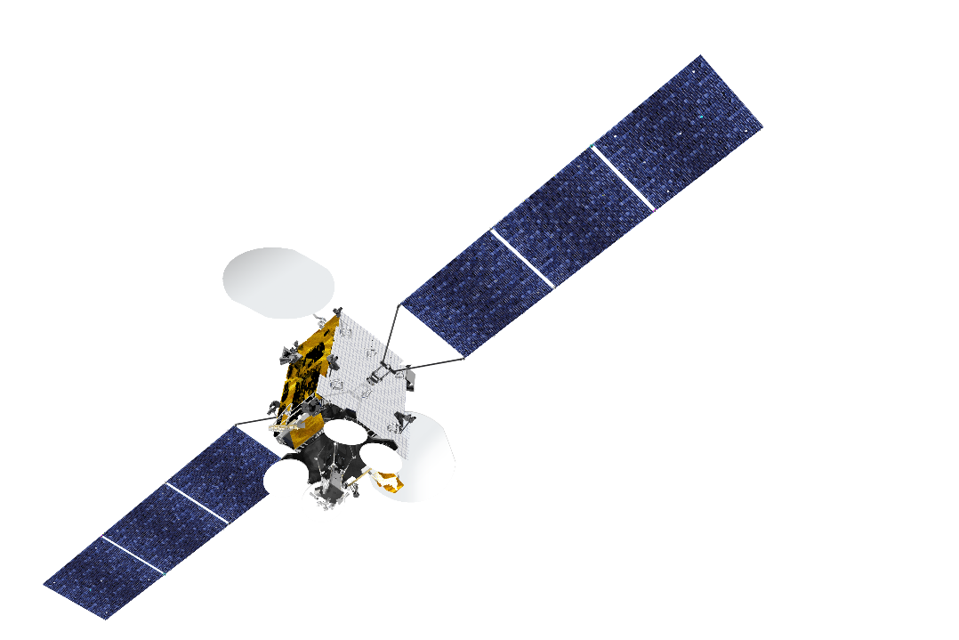
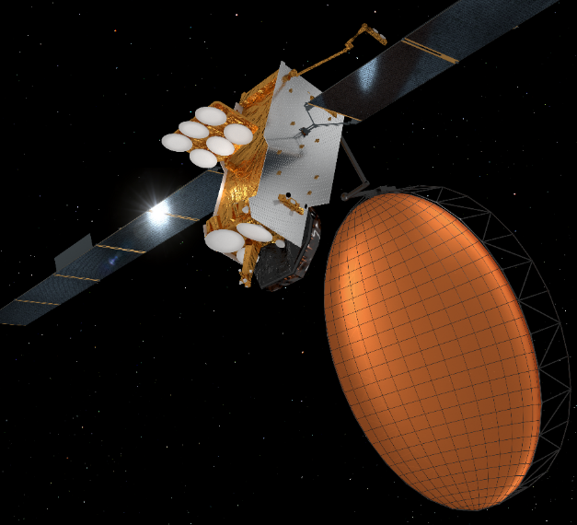
New Satellites
Remaining on the cutting edge of mobility communications
Image © Thales Alenia Space
GX5 F5 : A new VHTS Platform (2019)
Overlays high fill capacity for Europe and Middle East
Frees up existing spot beams for new coverage
Additional steerable Commercial / Mil-Ka beams
I6 F1/F2: New high capacity L/Ka Band (2021/22)
Introduces higher throughput L-Band with greater flexibility
Adds powerful and flexible Ka Cluster Beams
Continues Mil-Ka support

Slide 8

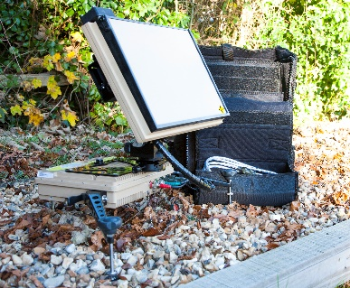


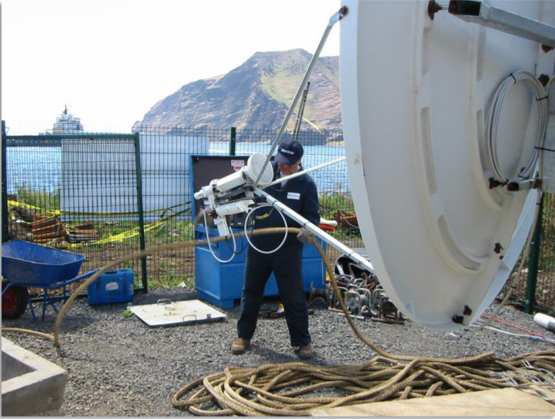

Terminal Transformation
Remaining on the cutting edge of mobility communications
Smaller terminals offering high throughput global services
Easier to ship and install in remote locations
Higher throughput….even in L-band
L-Band backup
Low cost terminals
New electronically steered flat antennas

Slide 9

New managed services
Inmarsat Capability Brief - WMO
Examples of Inmarsat adopting new services in new markets

Slide 10

Group Service
Plans
Mobile capacity for fixed global networks
A GSP enables a pool of bandwidth in multiple beams to be shared across a number of terminals globally dispersed
Customers can support global networks with a fraction of dedicated capacity allowing for increased cost effectiveness.
A capacity limit is set for each beam and for the total of all the beams.

Slide 11
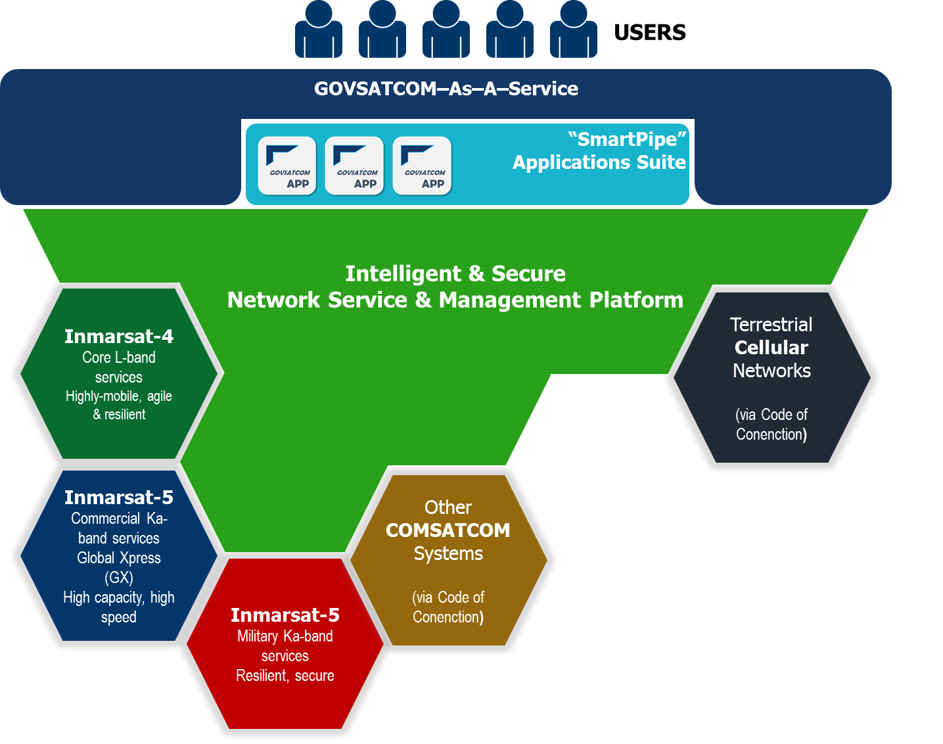
INVISON
Providing customers with their own virtual satellite
Smart, integrated service delivery front-end providing access to mission-specific SATCOM services, products and applications
Intelligent, secure service & network management platform enabling dynamic SATCOM procurement & provisioning and the cross-connection of networks on a global scale
A federated, “system of systems” to provide pooling and sharing of commercial and sovereign national SATCOM assets, providing global coverage and multi-frequency capacity
Notes:
Inmarsat’s vision of GOVSATCOM is an integrated service management platform managing a system of systems, a network of networks, to enable pooling and sharing of SATCOM resources.
An innovative new service provision approach – the Managed Services Framework – a combination of technology platform(s), processes and resources;
Dynamic pooling and sharing of resources and a common infrastructure with certified built-in security;
An innovative access point-of-presence intended to be located at one or more sites in each EU member state to provide autonomy and secure access to the system and network;
SATCOM terminal solution to connect remote sites and users to the GOVSATCOM network;
Provision of secure applications to support end user operations;
Private “smart” networks capable of cross connecting between different global commercial and national space assets, terrestrial networks and different user communities across national boundaries;
Global SATCOM coverage with options of services and hardware in a variety of satellite communications frequency bands;
Future proofing to include new networks and satellites via standardised common interfaces

Slide 12








Inmarsat Managed IoT Service
A reusable bridge between the real world and your business applications
Data consumers
Customer’s choice of cloud vendor / business applications
To anything
Industrial IoT Enablement Platform
Security
Inmarsat
Managed IoT Service
Skills
Connectivity (Satellite, Cellular, WAN)
SLA
Software Defined Gateways
Partners
Edge Connectivity (Wired – Wi-Fi – BLE – LoRaWAN)
Data producers
Sensors
Assets
Machines
Connect anything
Notes:
This would be even better if we could bullet

Slide 13


European Aviation Network (EAN)
S-band satellite & LTE ground network
The development of a highly innovative S-band satellite integrated with an LTE ground network (in partnership with Deutsche Telecom) to deliver a high-speed broadband service to the European aviation community.

Slide 14
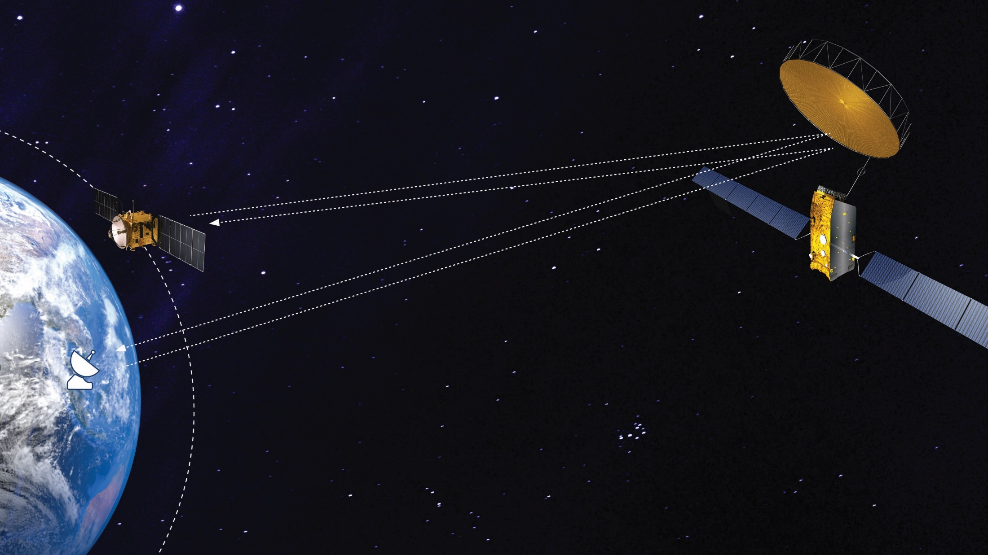
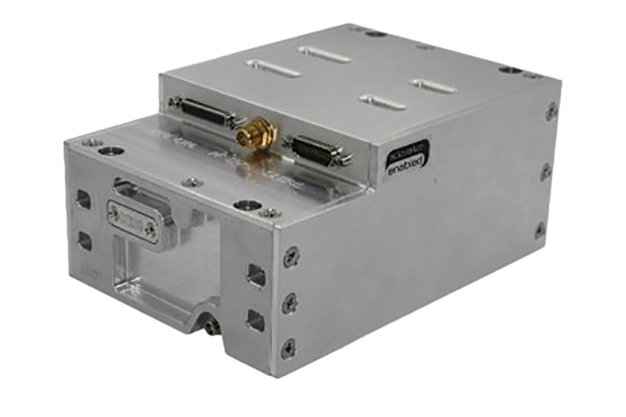
IDRS
Notes:
Inter Satellite Data Relay System

Slide 15
Inter-Satellite Data Relay Service (IDRS)
IDRS Concept Explained
Without IDRS
With IDRS
Customer LEO Satellite
Communicating with ground for a short window (~4% of the orbit)
I4 GEO Satellite
Earth
Customer LEO SAS
Customer LEO Satellite
Relaying certain traffic over I4 network for the majority of its orbit
I4 SAS
Earth
I4 SAS
I4 SAS
Out of contact with ground for majority of orbit
Out of contact with ground for majority of orbit
I4
I4

Slide 16

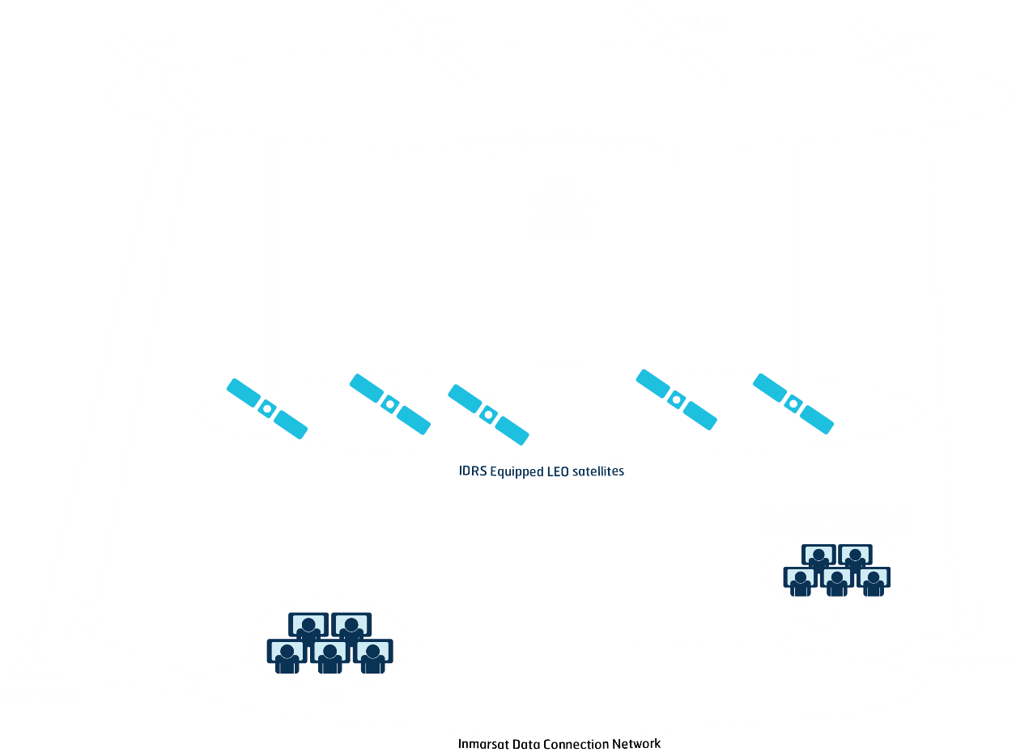
IDRS

Slide 17
Ben Colton
Inmarsat Global Government
Email: Benjamin.colton@Inmarsat.com
Tel: +44 (0) 7730488489
Inmarsat Capability Brief - WMO
Thank You. Questions?

