Slide 1

S2S data collection, processing and service at CMA
WIS 2.0
National Meteorological Information Center, CMA
Hu Xing
huxing@cma.gov.cn
Notes:
WMO信息系统全球通信系统中心和数据收集或产品中心专家组(ET-WISC)会议-WIS2.0
My name is Hu xing, I’m from National Meteorological Information Center of CMA, It's very pleasure indeed for me to be able to attend this meeting. The topic of my presentation is “S2S data collection, processing and service at CMA”.

Slide 2
Contents
Background
The progress of CMA S2S data center
Future plan
Notes:
My presentation includes these three parts:
First. The Background
Second。 The progress of CMA S2S data center（archiving ['ɑ:kaɪvɪŋ] center）
Third。The plan of future

Slide 3
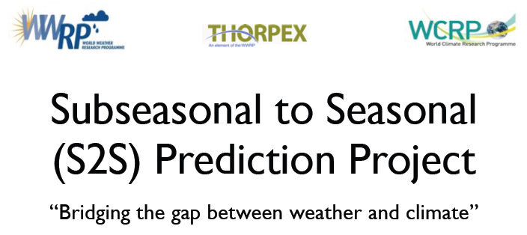
About S2S
Background
Notes:
The Subseasonal to Seasonal Prediction Project (abbreviation S2S) is a proposed WWRP/THORPEX/ WCRP joint research project.
The main goal of the S2S project is to improve forecast skill and understanding on the subseasonal to seasonal timescale.

Slide 4
Background
S2S data providers
  Collected data from 11 centers
  mutual backup of two WMO S2S archive centres by ECMWF and CMA respectively
UKMO
ECMWF
HMCR
ECCC
CMA
NECP
Meteo-France
JMA
ISAC
KMA
BOM
S2S members
Notes:
As shown in the map, there are 11 S2S members , including : BoM Australia, CMA China, ECCC Canada, ECMWF Europe Center, CNR-ISAC Italy, HMCR Russia, JMA Japan, KMA Korea, CNRM France, NCEP United States, UKMO United Kingdom.
ECMWF and CMA are two respectively mutual [ˈmjutʃuəl] backup centres。

Slide 5
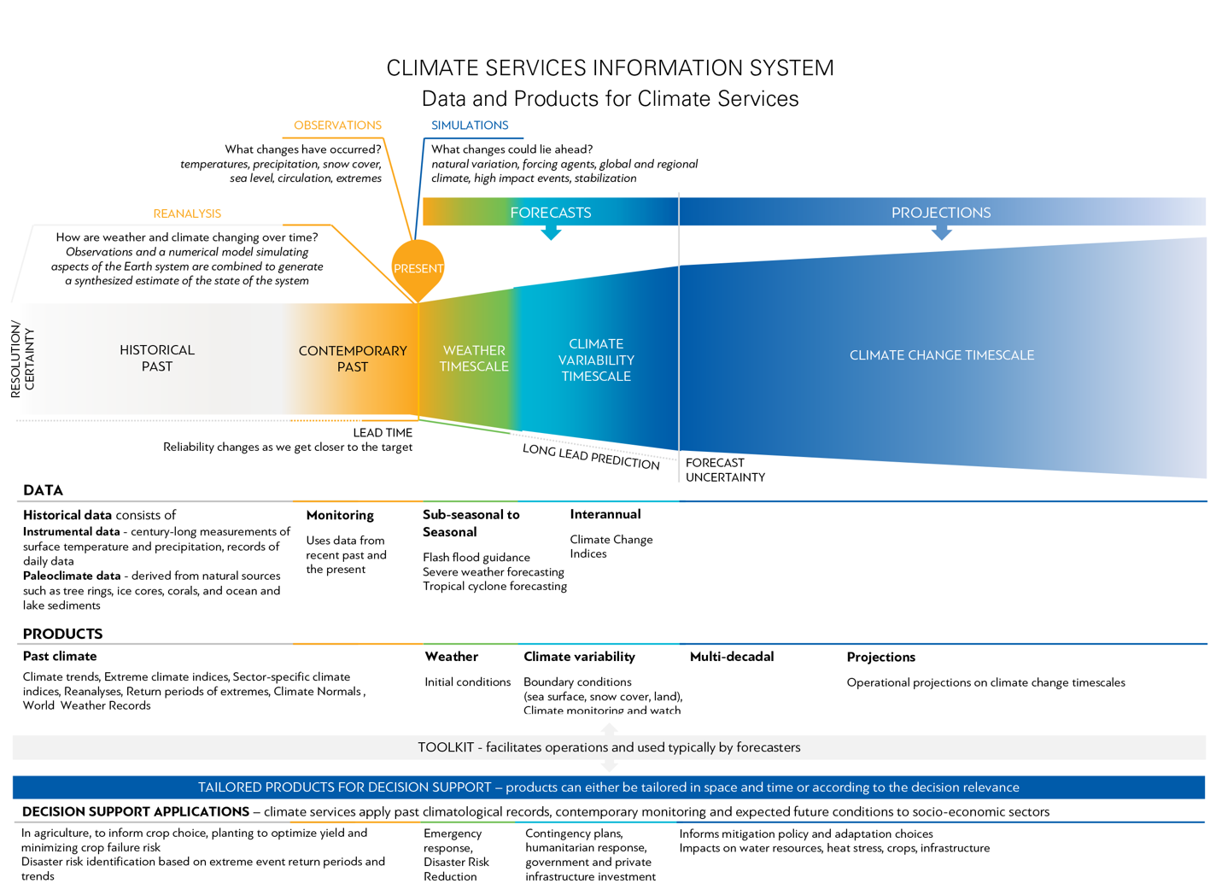
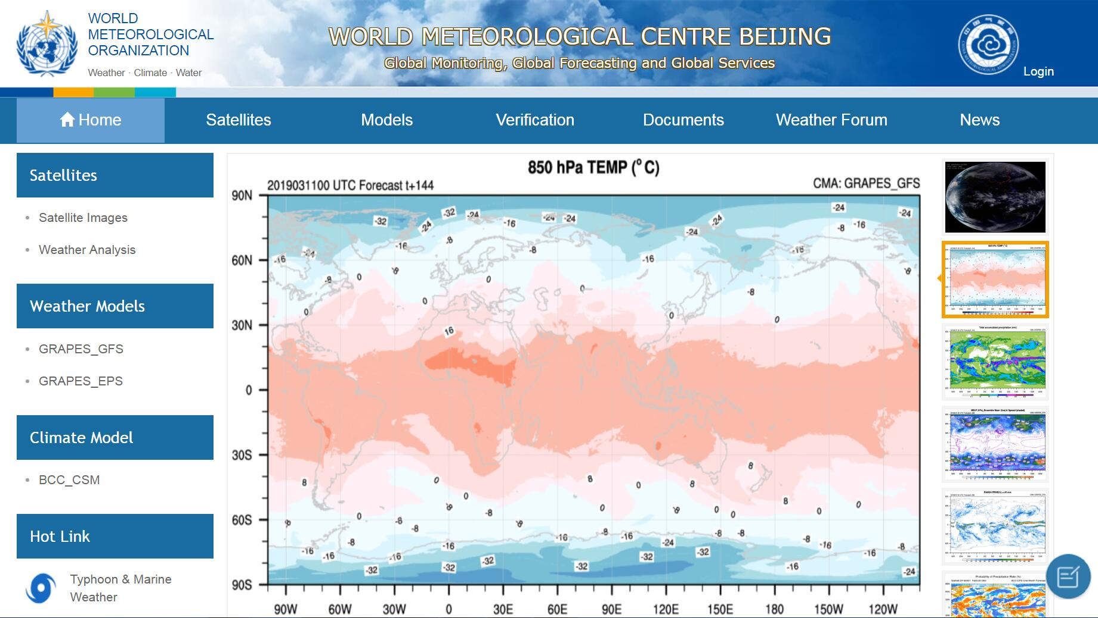
World Meteorological Centre BeiJing (WMC-bj)
Background
CMA S2S is global climate model data service sub-system of WMC-bj.
Forecast time scale is between sub-seasonal and seasonal.
Sub-seasonal to
Seasonal forecasts
Notes:
As we know, there is a World Meteorological Centre in Bei Jing.
CMA‘s S2S is sub system of global climate model data service in WMC-bj.
And it provides forecast which time scale is between sub-seasonal and seasonal.

Slide 6
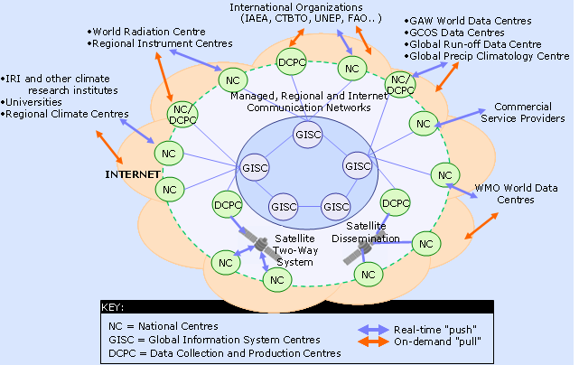
In WIS(WMO Information System)
Background
CMA collects S2S data, processing and provides online services
CMA S2S like GISC and DCPC in WIS
Current centres | WIS Centres
NMHS | NC
RSMC | DCPC
WMC | DCPC and/or GISC
RTH | DCPC
RTH on MTN | DCPC and/or GISC
Others | NC and/or DCPC
Notes:
And In WIS, there are Global Information System Centers and data collection and production centers.
CMA collects, processing and provides S2S data service online. It’s just like GISC and DCPC do in WIS.

Slide 7
Contents
Background
The progress of CMA S2S data center
Future plan
Notes:
My presentation includes these four parts:
First. Background
Second。 The progress of CMA S2S data center（archiving ['ɑ:kaɪvɪŋ] center）
Third。The plan of future

Slide 8
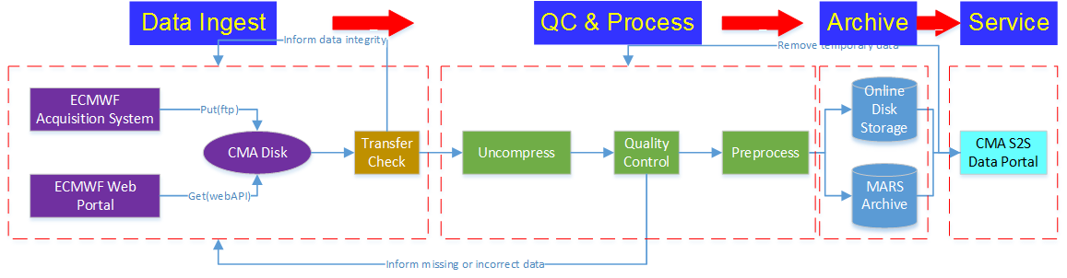
Construction of CMA S2S archiving center
CMA S2S Data Archiving Center
  Collection, check, preprocessing, archiving, data services
  Collection server ：1 server
  Data processing server：2 servers
  Data storage server ：1 server
  Data service portal ：1 servers
Notes:
CMA S2S Archiving Center‘s process is as follows：
Data collection， processing， storage，and service
----------------------------
Storage：
NAS（Network Attached Storage)

Slide 9
Data Collection
S2S data collection
  ECMWF collects all S2S center products
  CMA obtains all data except CMA from ECMWF Archive Center
  ECMWF pushes directly to the CMA FTP site
Notes:
Collection
…
…
…

Slide 10
Data check
Check items
  Number of files
  Data size
  file format（tar.gz/tar/GRIB）
  Make sure data timeliness and accuracy synchronize with ECMWF
Notes:
Check items include:
Number of files
Data size
file format（tar.gz/tar/GRIB）
Make sure data timeliness ['taɪmlɪnəs] and accuracy [ˈækjərəsi] synchronize [ˈsɪŋkrəˌnaɪz, ] with ECMWF

Slide 11
Data preprocessing
Receive data each time → Merge into a big GRIB file
Big GRIB file→Split into multiple files
  Rule：s2s_[centre]_{yearOfCycle}_[dataDate]_{shortName}.grib
Transfer to an online disk
      $DIR/[centre]/{yearOfCycle}/[year]/[month]/[day]
Notes:
Preprocess:
Receive data each time Merge into a big GRIB file.
Big GRIB file Split into multiple [ˈmʌltəpəl] files as follow rule.
Transfer files to an online disk.

Slide 12
Data storage management
Online disk storage
  Metadata: Index
  Data: Large capacity disk(200TB)
  Directory Structure←→File name mapping
    Catalog：$DIR/[centre]/{yearOfCycle}/[year]/[month]/[day]
    File name: (s2s_[centre]_{yearOfCycle}_[dataDate]_{shortName}.grib)
      Realtime forecasts：{yearOfCyle} = [year]
      Hindcasts：
        Fixed model： {yearOfCycle} = 2015 or 2016
        Fly model： {yearOfCycle} = The year of the model version
Other storage methods
  Tape archiving
Notes:
Data storage:
Online disk storage
Metadata put into Index.
Data put into large capacity [kəˈpæsɪti] disk.
Directory [dɪˈrɛktəri,] Structure is used to File name mapping. Details as follow:
Other storage methods is Tape archiving. Use tape archives when online storage is insufficient. [ˌɪnsəˈfɪʃənt]

Slide 13
S2S data visualize
S2S Visualization components
Contour-> surface
Vector diagram, high quality
Slow, suitable for small files
Contour trace method
Grib/NC/..
files
Latitude and longitude grid data
Color pattern method
Same value of same color
Fast, suitable for large files
File preprocessing
Grid drawing
Notes:
S2S Visualization components framework:
Step1 File preprocessing
Step2 Grid drawing

Slide 14
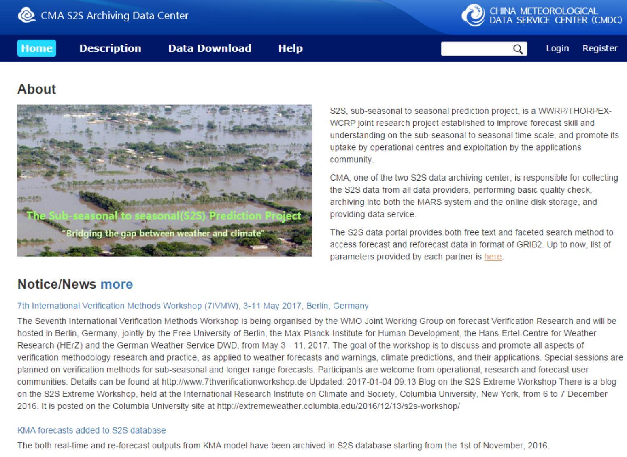
CMA S2S data service
CMA S2S portal launched on November 16, 2015.
http://s2s.cma.cn
Notes:
The CMA’s S2S data portal, developed by CMA, was officially launched on November 16, 2015 (Twenty fifteen) and is accessible at our website freely.
It provides the S2S weather forecast data to the researchers worldwide for studying the predictability [prɪˌdɪktə'bɪlətɪ] on time-scales of up to 60 days.

Slide 15
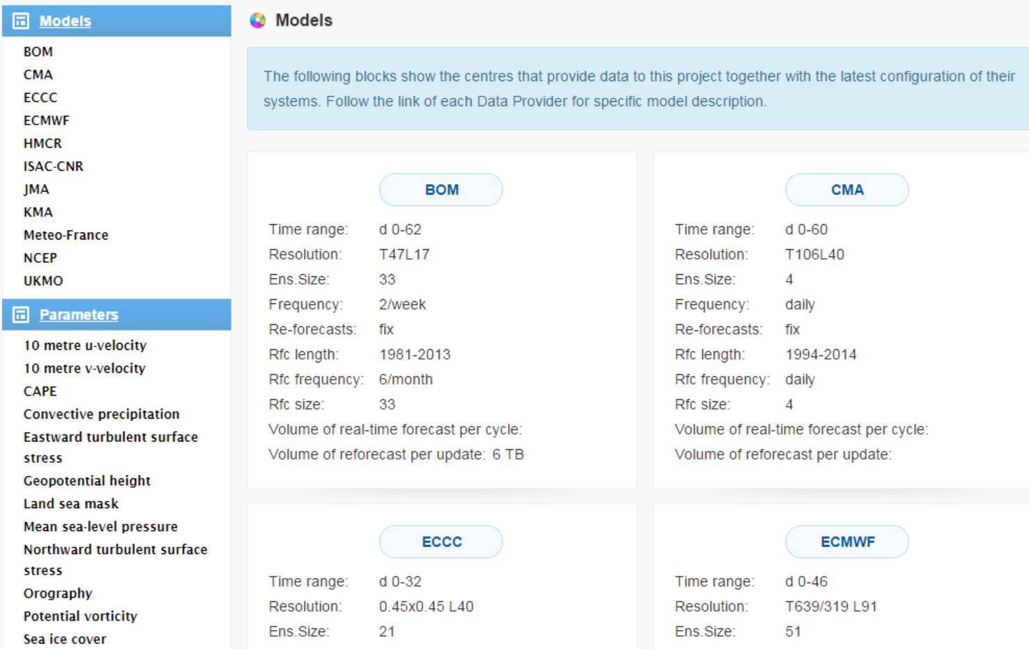
Data description
models
parameters
Notes:
Data description
includes parameters [pəˈræmɪtɚ] introduction and models [ˈmɑdl] introduction。

Slide 16
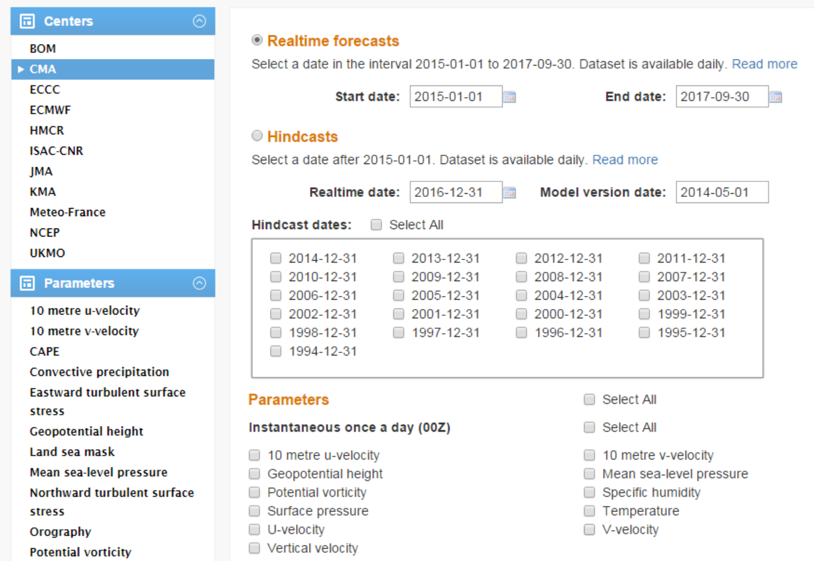
Data Access and download
Subset
• parameter
• time
• center
Notes:
Two ways of searching and accessing the data are supported: free text search and faceted ['fæsɪtɪd] search.
Users can choose center , time , parameter [pəˈræmɪtɚ] , and Realtime forecasts or Hindcasts.
The method of downloading data is similar to the e-commerce "shopping- cart".
Get data in user Account [əˈkaʊnt]

Slide 17
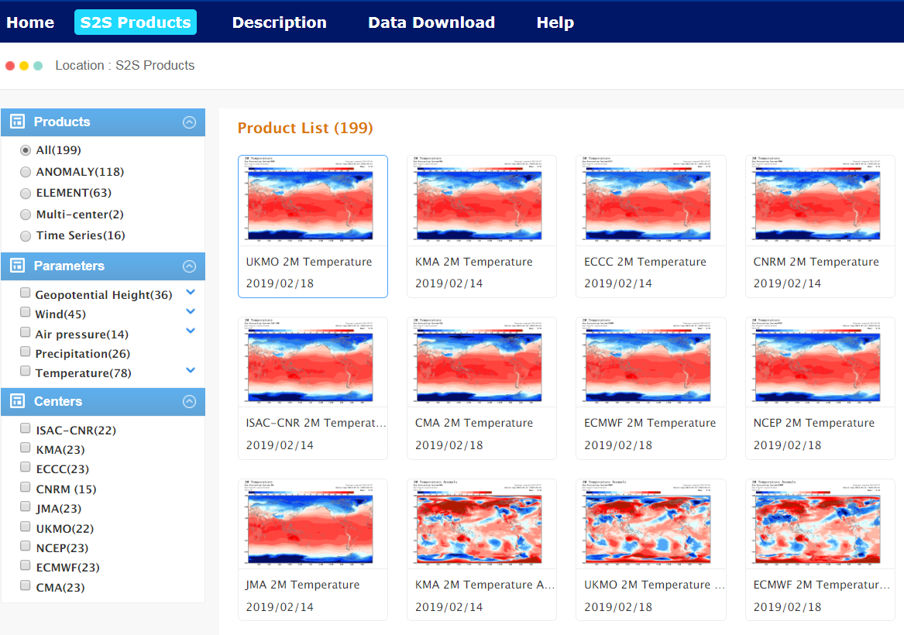
S2S data view
Notes:
Through S2S Visualization components，we make graphics products for different centers and meteorological elements.
The product views are 5days，weekly, 10days average.

Slide 18
S2S data list
 | Time range | Resolution | Ens.Size | Frequency | Re-forecasts | Rfc length | Rfc frequency | Rfc size
BoM(ammc) | d 0-62 | T47L17 | 33 | 2/week | fix | 1981-2013 | 6/month | 33
CMA(babj) | d 0-60 | T106L40 | 4 | daily | fix | 1994-2014 | daily | 4
EC(cwao) | d 0-32 | 0.6x0.6 L40 | 21 | weekly | on the fly | 1995-2014 | weekly | 4
ECMWF (ecmf) | d 0-46 | T639/319 L91 | 51 | 2/week | on the fly | past 20y | 2/week | 11
CNR-ISAC(isac) | d 0-31 | 0.75x0.56 L54 | 41 | weekly | fix | 1981-2010 | every 5d | 1
HMCR (rums) | d 0-61 | 1.1x1.4 L28 | 20 | weekly | on the fly | 1985-2010 | weekly | 10
JMA(rjtd) | d 0-33 | T319L60 | 25 | 2/week | fix | 1981-2010 | 3/month | 5
KMA(rksl) | d 0-60 | N216L85 | 4 | daily | on the fly | 1996-2009 | 4/month | 3
CNRM(lfpw) | d 0-61 | T255L91 | 51 | monthly | fix | 1993-2014 | 2/month | 15
NCEP(kwbc) | d 0-44 | T126L64 | 16 | daily | fix | 1999-2010 | daily | 4
UKMO(egrr) | d 0-60 | N216L85 | 4 | daily | on the fly | 1996-2009 | 4/month | 3
Notes:
S2S data list, include 11 centers.

Slide 19
CMA S2S data service
Visited increased(ten thousands)
Registered user distribution
Data download（TB）
year | amount of data
2016 | 1.9
2017 | 3.1
2018 | 3.2
download top five centers
ECMWF, JMA, NCEP, CMA, UKMO
download top five parameters
t, 2t, tp, mx2t6, mn2t6
Notes:
By now, the total visits is more than two millions and three hundred thousand. (2,303,285.)
337 users have registered to the CMA’s S2S data portal, registers originate from more than 40 countries .
The data download of 2016 (Twenty sixteen) is 1.9 TB, 2017 (Twenty seventeen) is 3.1TB. And 2018 (Twenty eighteen) is 3.2TB.
Data download top five centers are ECMWF, JMA, NCEP, CMA, UKMO,
Data download top five parameters are Temperature, Surface air temperature, Total precipitation [prɪˌsɪpɪˈteɪʃn] , Surface air maximum temperature, Surface air minimum temperature.

Slide 20
Contents
Background
The progress of CMA S2S data center
Future plan
Notes:
My presentation includes these four parts:
First. Background
Second。 The progress of CMA S2S data center（archiving ['ɑ:kaɪvɪŋ] center）
Third。The plan of future

Slide 21
S2S on cloud computing
Future Plan
CMA will satisfy S2S business functions by using cloud computing.
CMA’s Meteorological Big Data Cloud Platform manage huge data.
Collection, processing, and service sub systems can be deployed on public cloud.
Notes:
In the future, maybe this year in 2019, we will put S2S on cloud.
CMA will satisfy S2S business functions by using cloud computing.
The brief plan is:
CMA’s Meteorological Big Data Cloud Platform manage huge data.
And Collection, processing, and service sub systems can be deployed on our public cloud in China.

Slide 22
S2S connect with WIS
Future Plan
S2S will contribute metadata information to WIS.
S2S Metadata supplement will follow WIS standards..
Notes:
And we will try to connect S2S with WIS.
S2S will contribute metadata information to WIS.
S2S Metadata supplement will follow WIS standards.

Slide 23
WIS 2.0
Thank You!
http://s2s.cma.cn
Notes:
That's all my talk.
Thank you very much for your attention.

