Slide 1
Status report of GISC CASABLANCA
Submitted by: HADDOUCH Hassan, NMS of MOROCCO
Joint meeting of the Expert Team on WIS Centres (ET-WISC) and Task Team on Data Centres (TT-DC) Beijing, China (12-15 Mar 2019)

Slide 2
Status report of GISC CASABLANCA
GISC Casablanca is connected to the internet via two ISPs with an overall bandwidth of 200MB/s.
GISC Casablanca is also connected to the RMDCN.
GISC Casablanca harvests the following metadata sets:
GISC | Metadata set
Tokyo | WIS-GISC-TOKYO
Offenbach | WIS-GISC-OFFENBACH
Beijing | WIS-GISC-BEIJING
Melbourne | WIS-GISC-MELBOURNE
Brasilia | WIS-GISC-BRASILIA via Tokyo
Tehran | WIS-GISC-TEHRAN
Seoul | WIS-GISC-SEOUL
Toulouse | WIS-GISC-TOULOUSE
Moscow | WIS-GISC-MOSCOW
Exeter | WIS-GISC-EXETER
ET-WISC 2019 pp2

Slide 3
Area of responsability connectivity
ET-WISC2019pp3

Slide 4
Capacity building
Casablanca is a Center of Excellence (CoE) for training in Satellite Meteorology:
Online training course (01-22 October 2018)
face-to-face course (10-14 December 2018)
An other training course is planed for September 2019
We hope also to organize a Workshop in 2019 (Metadata Management + Usage of GISC Casablanca Portal + connectivity).
ET-WISC2019pp4

Slide 5
GISC Backup
GISC CASABLANCA is backed up by GISC TOULOUSE
A first meeting was held in Casablanca from 12 to 13 December 2017 between GISC Toulouse and GISC Casablanca and a work plan has been established.
ET-WISC2019pp5

Slide 6
Monitoring Activity & volume
GISC Casablanca has carried out the GISC Watch duty during the the second part of August 2018.
GISC Casablanca will be responsible for GISC watch duty for the period from the 1st to the 16th of April 2019.
ET-WISC2019 pp6

Slide 7
Traffic size and volumes, uptime, user registration
76 users are registered on GISC CASABLANCA and a daily cache of around 260 Mb.
GISC Casablanca’s total metadata records is around 98 689.
GISC Casablanca manages 716 metadata records from its AoR.
ET-WISC2019pp7

Slide 8
Changes in GISC
ET-WISC2019pp8
GISC CASABLANCA worked with GISC TOKYO on the migration of its AoR’s metadata from WIS-UNASSOCIATED.
GISC Casablanca is now managing all metadata from its Area of Responsibility, the other GISCs were able to reach and harvest metadata from our OAIPMH providers without any problems.
GISC Casablanca established direct connections to GISC Offenbach

Slide 9
Survey results
a survey aiming to understand center’s capacities as well as connectivity.
16 answers /37 only

Slide 10
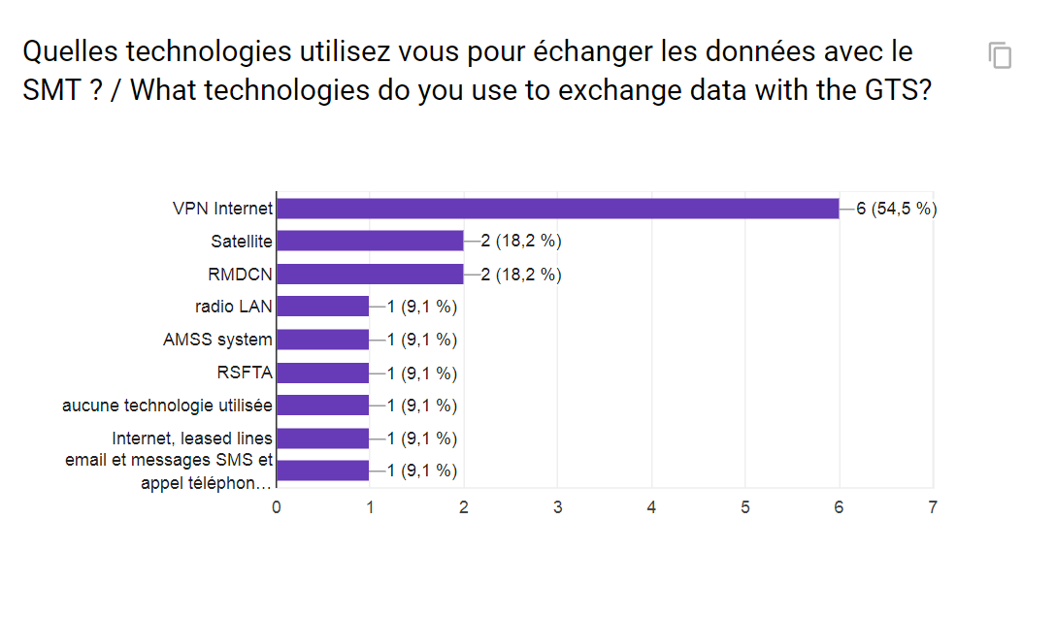
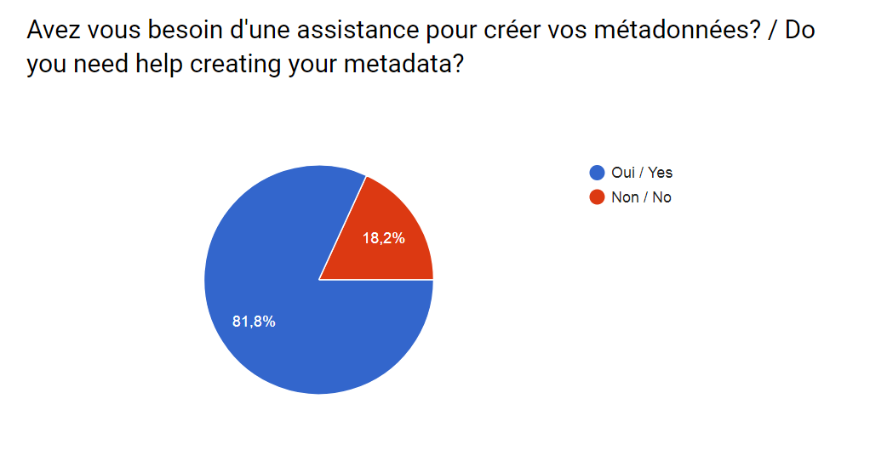

Slide 11
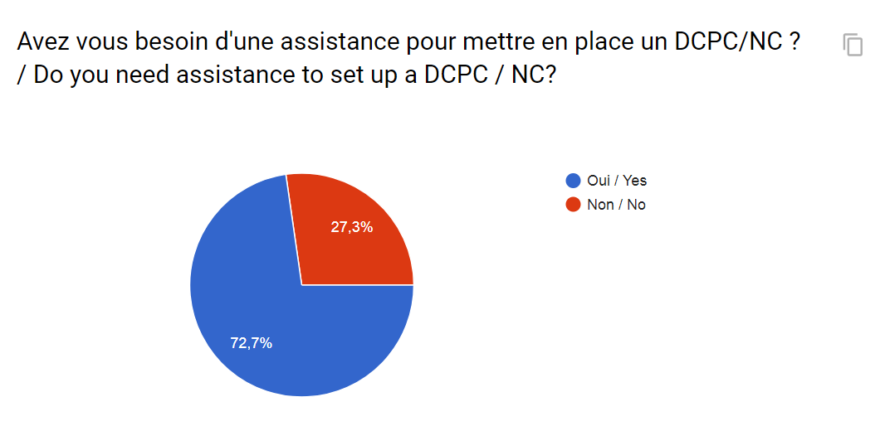
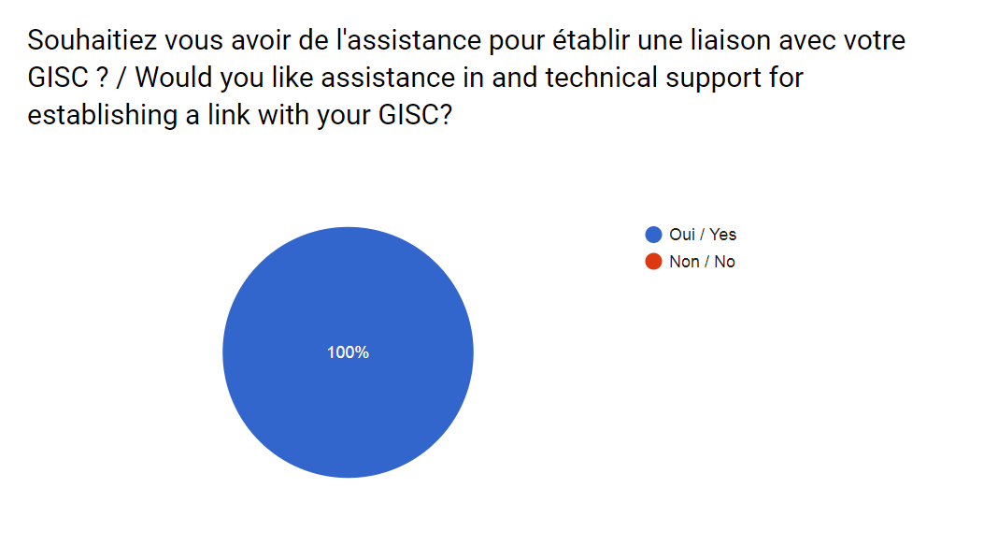

Slide 12
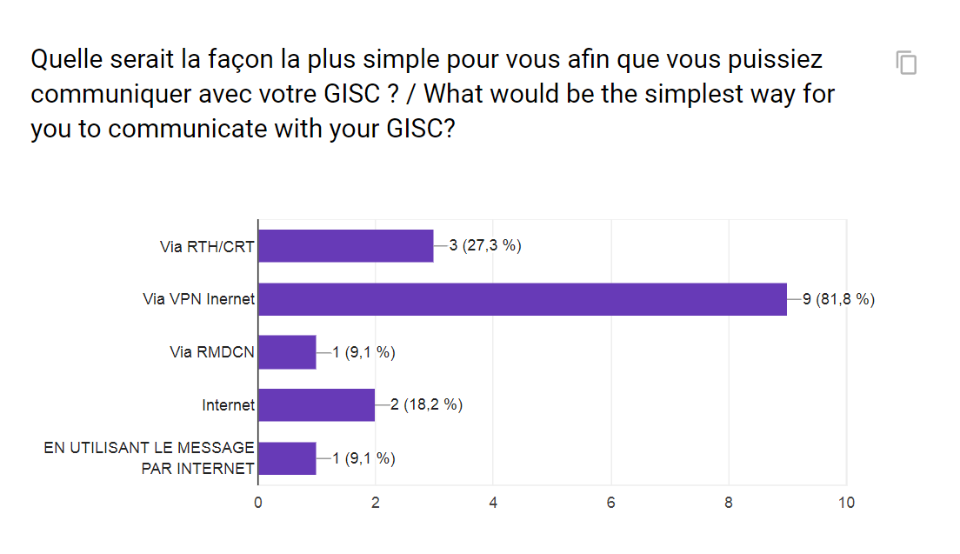
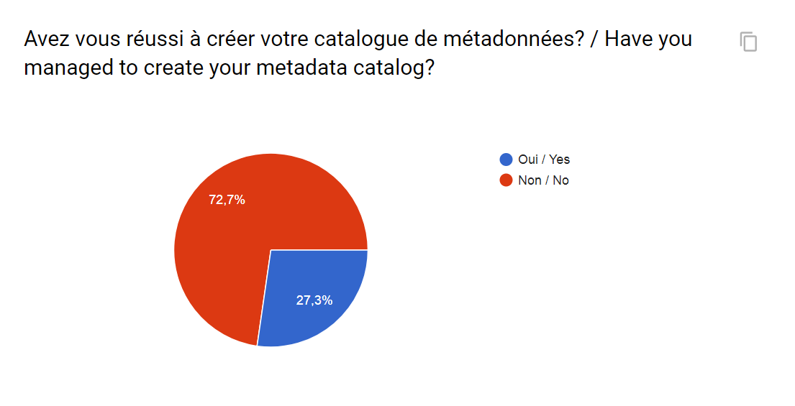

Slide 13
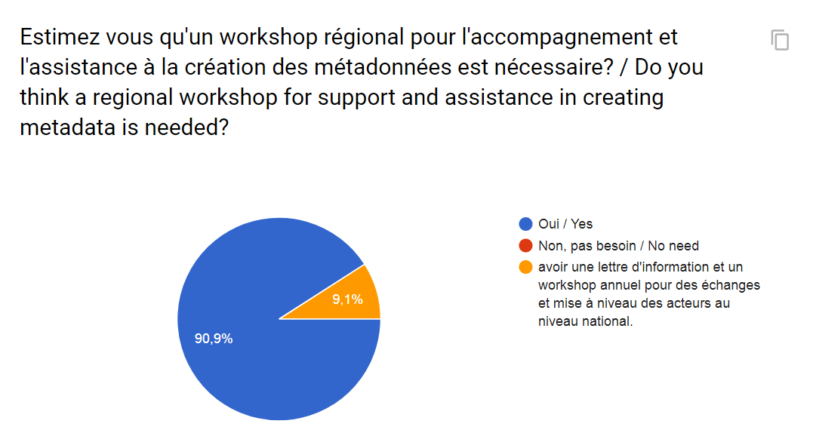

Slide 14

Thank you
Merci

