Slide 1
Development of common training materials
Sungsoo DO, KMA
Agenda item 11
TT-GISC WP-7
ET-WISC-DC2019
12-15 March 2019, Beijing

Slide 2
Outline
Agenda
  Agenda Item 11 – Training and capacity development
  Progress on the development of common training materials Training and capacity development(D4, TT-GISC2018)

Slide 3
Agenda Item 11 | Training and capacity development
References | Decision 4, Final report of TT-GISC2018 - D4. The meeting agreed to the WP7 work plan and to develop common training materials to the proposed scopes as listed in Annex 7 of this report
Background | Ken Tsunoda, Chair TT-GISC, presented the issues, actions and decisions from TT-GISC2017 (presentation) [http://wis.wmo.int/tdoc=377]. Chair TT-GISC2017 noted the importance of capacity building by GISCs within their area of responsibility was highlighted. An ad-hoc team on capacity building was established. Decision: All GISCs were urged to list their training materials on the GISC-Ops WIS wiki pages. TT-GISC2017 added new work package, WP-7 Capacity Development into TT-GISC work packages(2017-2020) TT-GISC2018 reviewed the report on capacity development(doc) Sungsoo DO, WP7 team leader proposed two strategic approach, 1. Sharing training materials and 2. Establishing common training materials
Rationale | Provision of training materials is required for capacity building of WIS.

Slide 4
Introduction
According to the WMO Mid-Term Performance Assessment Report 2016-2017, more than 43 percent of members had little or no knowledge of WIS and have not implemented WIS functionality.

Slide 5
Introduction
In the WIS training and learning guide there are seven competencies across four basic functional areas have been identified (Guide to the WIS, WMO-No.1061 Appendix A)
  Infrastructure
    1. Manage the physical infrastructure
    2. Manage the operational applications
  Data
    3. Manage the data flow
    4. Manage data discovery
  External Interactions
    5. Manage interaction among WIS centres
    6. Manage external user interactions
  Overall service
    7. Manage the operational service

Slide 6
WP-7 Capacity Development
WP-7 was added to TT-GISC Packages(2017-2020) in TT-GISC2017
Work Package |  | Member | Expected Deliverable/Outcome
ID | unit
WP-7 | Capacity Development by TT-GISC2017 | Sungsoo(lead, kr): ssdo@korea.kr SL.Singh(in): sl.singh@imd.gov.in LiXiang(cn): lixiang@cma.gov.cn Mark(uk): mark.francis@metoffice.gov.uk Talal(sa): talal.alowaibdi@gmail.com | # Develop a common training materials to know fundamentals of WIS

Slide 7
WP-7 Capacity Development
Objectives
  Each GISC has utilized its own materials according to the WIS training and learning guide.
  It is required to consolidate dispersed information and to share each GISC’s training materials
  Common capacity development material of WIS will be used as basic reference to encourage WIS competencies

Slide 8
WP-7 Capacity Development
Target
  Members who having had little or no knowledge of WIS
    the gaps of national knowledge of WIS among members were identified as a result of the survey from WMO Mid-Term Performance Assessment Report 2016-2017
    The common training materials for WIS should be to fill these gaps

Slide 9
WP-7 Capacity Development
Proposed Scope
  Main purpose of training material is to raise the level of competencies for who has little knowledge of WIS.
  Key learning resources for seven WIS competencies are presented from Guide to the WIS but it is difficult for NCs and DCPCs to utilize those resources
  The training materials can provide summarized information from key learning resources as a baseline of training materials

Slide 10
WP-7 Capacity Development
Proposed Scope
  Training materials focus on data management with avoiding infrastructure and operational functions
    Due to different IT environment on each site, different service level and various software of WIS centres
Functional Area | Competency | Key learning resources
Data | Manage the data flow | Data policies GTS data exchange Data representation WIS discovery, access and retrieval Managing GTS data exchange security of data exchange network management
 | Manage data discovery | WIS metadata guidance Metadata entry and management tools Samples of how to complete typical metadata record Metadata policies and WIS metadata guidelines ISO 19100 series: ISO standards on geographic information

Slide 11
WP-7 Capacity Development
Proposed Approach
  Sharing training materials
  Establishing common training materials

Slide 12
WP-7 Capacity Development
Sharing training materials
  Each GISC has performed WIS training activities with its own training materials for lecture, presentation and brochure etc
  “WIS Training Material(provisional)”, shared repository for WIS training materials is created in wis-wiki and GISCs are collaborating in collecting its own materials not limited to any language
  Will be collected in the directories categorized by key learning resources as shown in the proposed scopes of common training materials.

Slide 13
WP-7 Capacity Development
Sharing training materials
  Work Plan(proposed)
Section | Timeline |  | Work | Participants | Progress
Sharing training materials | 2019 | 1Q | Creation of shared repository | WP-7 leader WMO secretariat | Planning
 | 2019 | 2Q | Collection of training materials from GISCs | All GISCs | -
 |  | 3Q | Review by TT-GISC2019 |  | -

Slide 14
WP-7 Capacity Development
Sharing training materials
  Future progress
    Define the categories for sharing materials under consideration with team members
    Request Secretariat to create new menu in wis-wiki, TrainingAids
    [https://wiswiki.wmo.int/tiki-index.php?page=TrainingAids]
    Upload each GISC’s training materials on the relevant categories by GISCs

Slide 15
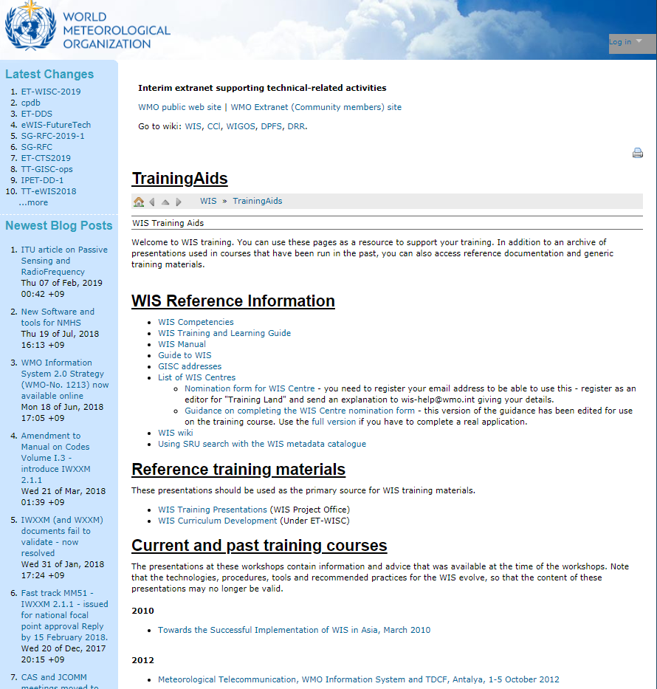
WP-7 Capacity Development
Sharing training materials
  WIS > TrainingAids
    https://wiswiki.wmo.int/tiki-index.php?page=TrainingAids]
WIS Training Materials(GISCs)

Slide 16
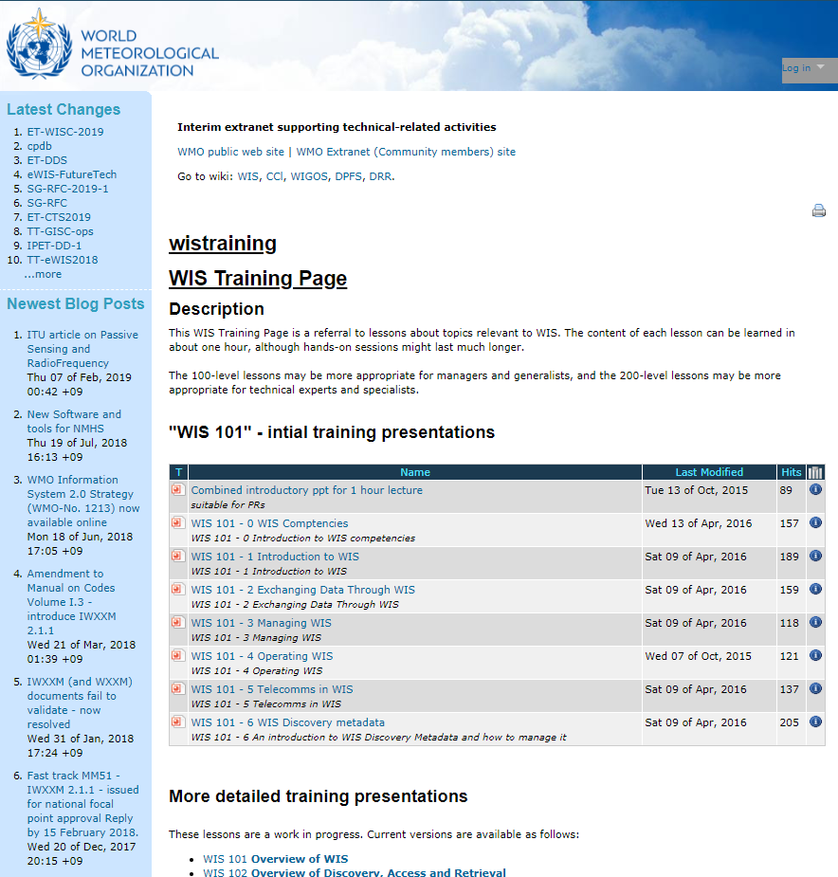
WP-7 Capacity Development
Sharing training materials
  WIS > TrainingAids > WIS Training Materials(GISCs)
    https://wiswiki.wmo.int/tiki-index.php?page=TrainingAids]

Slide 17
WP-7 Capacity Development
Establishing common training materials
  Detailed list of contents should be consulted with the members of work package
  Each member should establish assigned common training materials in English
  The baseline of the materials is suggested by key learning resources from Guide to the WIS
    The existing training materials provided WIS Project Office in wis-wiki is good reference to make common training materials

Slide 18
WP-7 Capacity Development
  Establishing common training materials
  Work Plan(proposed)
Section | Timeline |  | Work | Participants | Progress
Common training materials | 2018 | 4Q | Sorting the range of materials from the scopes Assigning materials for each member | WP-7 members | Planning
 | 2019 | 1Q | Outlining the assigned training materials |  | Planning
 |  | 2Q | Draft of the common training materials |  | -
 |  | 3Q | Reviewed by TT-GISC2019 |  | -
 | 2020 | 1Q | Final version of training materials |  | -

Slide 19
WP-7 Capacity Development
Establishing common training materials
Consideration prior to initiating the work (discussion)
  Duplicity & Differentiations
    Comparing to the existing training materials on wis-wiki
    In the TrainingAds in wis-wiki, various materials are provided in spite of 2013-2016 versions
  Persistency & Efficiency
    Expectation of the advent of WIS2.0 in a few years
    Most of technical specifications in the current WIS will be phased out
    Considering expected effectiveness from new common training materials in terms of ROI; return on investment
Is the lack of WIS knowledge still attributed to the lack of training materials?

Slide 20
Summary (Text for report)
Mr. Sungsoo DO introduced the report of the WP-7 capacity development presented in TT-GISC2018. He mentioned two approach for training materials, one is sharing training materials, the other is establishing common training materials.
The meeting reviewed the progress of sharing training materials. WP-7 team of TT-GISC will define the categories for sharing materials under consideration with team members and request Secretariat to create new menu in wis-wiki, TrainingAids [https://wiswiki.wmo.int/tiki-index.php?page=TrainingAids]. It is also requested that all GISCs provide their training materials to be available on wis-wiki page.
For establishing common training materials, the meeting reviewed the progress of work plan and discussed ….

Slide 21

Thank you
Merci

