Slide 1
Report from Task Team on GISC (TT-GISC)
Ken Tsunoda, Chair, TT-GISC
Agenda item 8.1
Joint ET-WISC/TT-DC meeting
12-15 March 2019, Beijing, China

Slide 2
General Information
ICT-ISS re-established TT-GISC under the ET-WISC in 2016
TT-GISC took over the Terms of Reference and Work Plan from its last period (2012-2016)
TT-GISC member is consist of ET-WISC members and representative of GISCs
  http://www.wmo.int/pages/prog/www/CBS/Lists_WorkGroups/CBS/ICT-ISS/ET-WISC-TT-GISC/members
Members are sharing experience to improve all GISC’s service level

Slide 3

Face to face meeting
TT-GISC meetings have been held annually since 2014. GISCs are providing their status report based on agreed template every year.
List of previous meetings
  2014: Toulouse
  2015: Brasilia
  2016: Melbourne
  2017: Geneva : all GISCs attended (incld. WebEx)
  2018: Casablanca
  2019: GISC Offenbach offered hosting the meeting

Slide 4
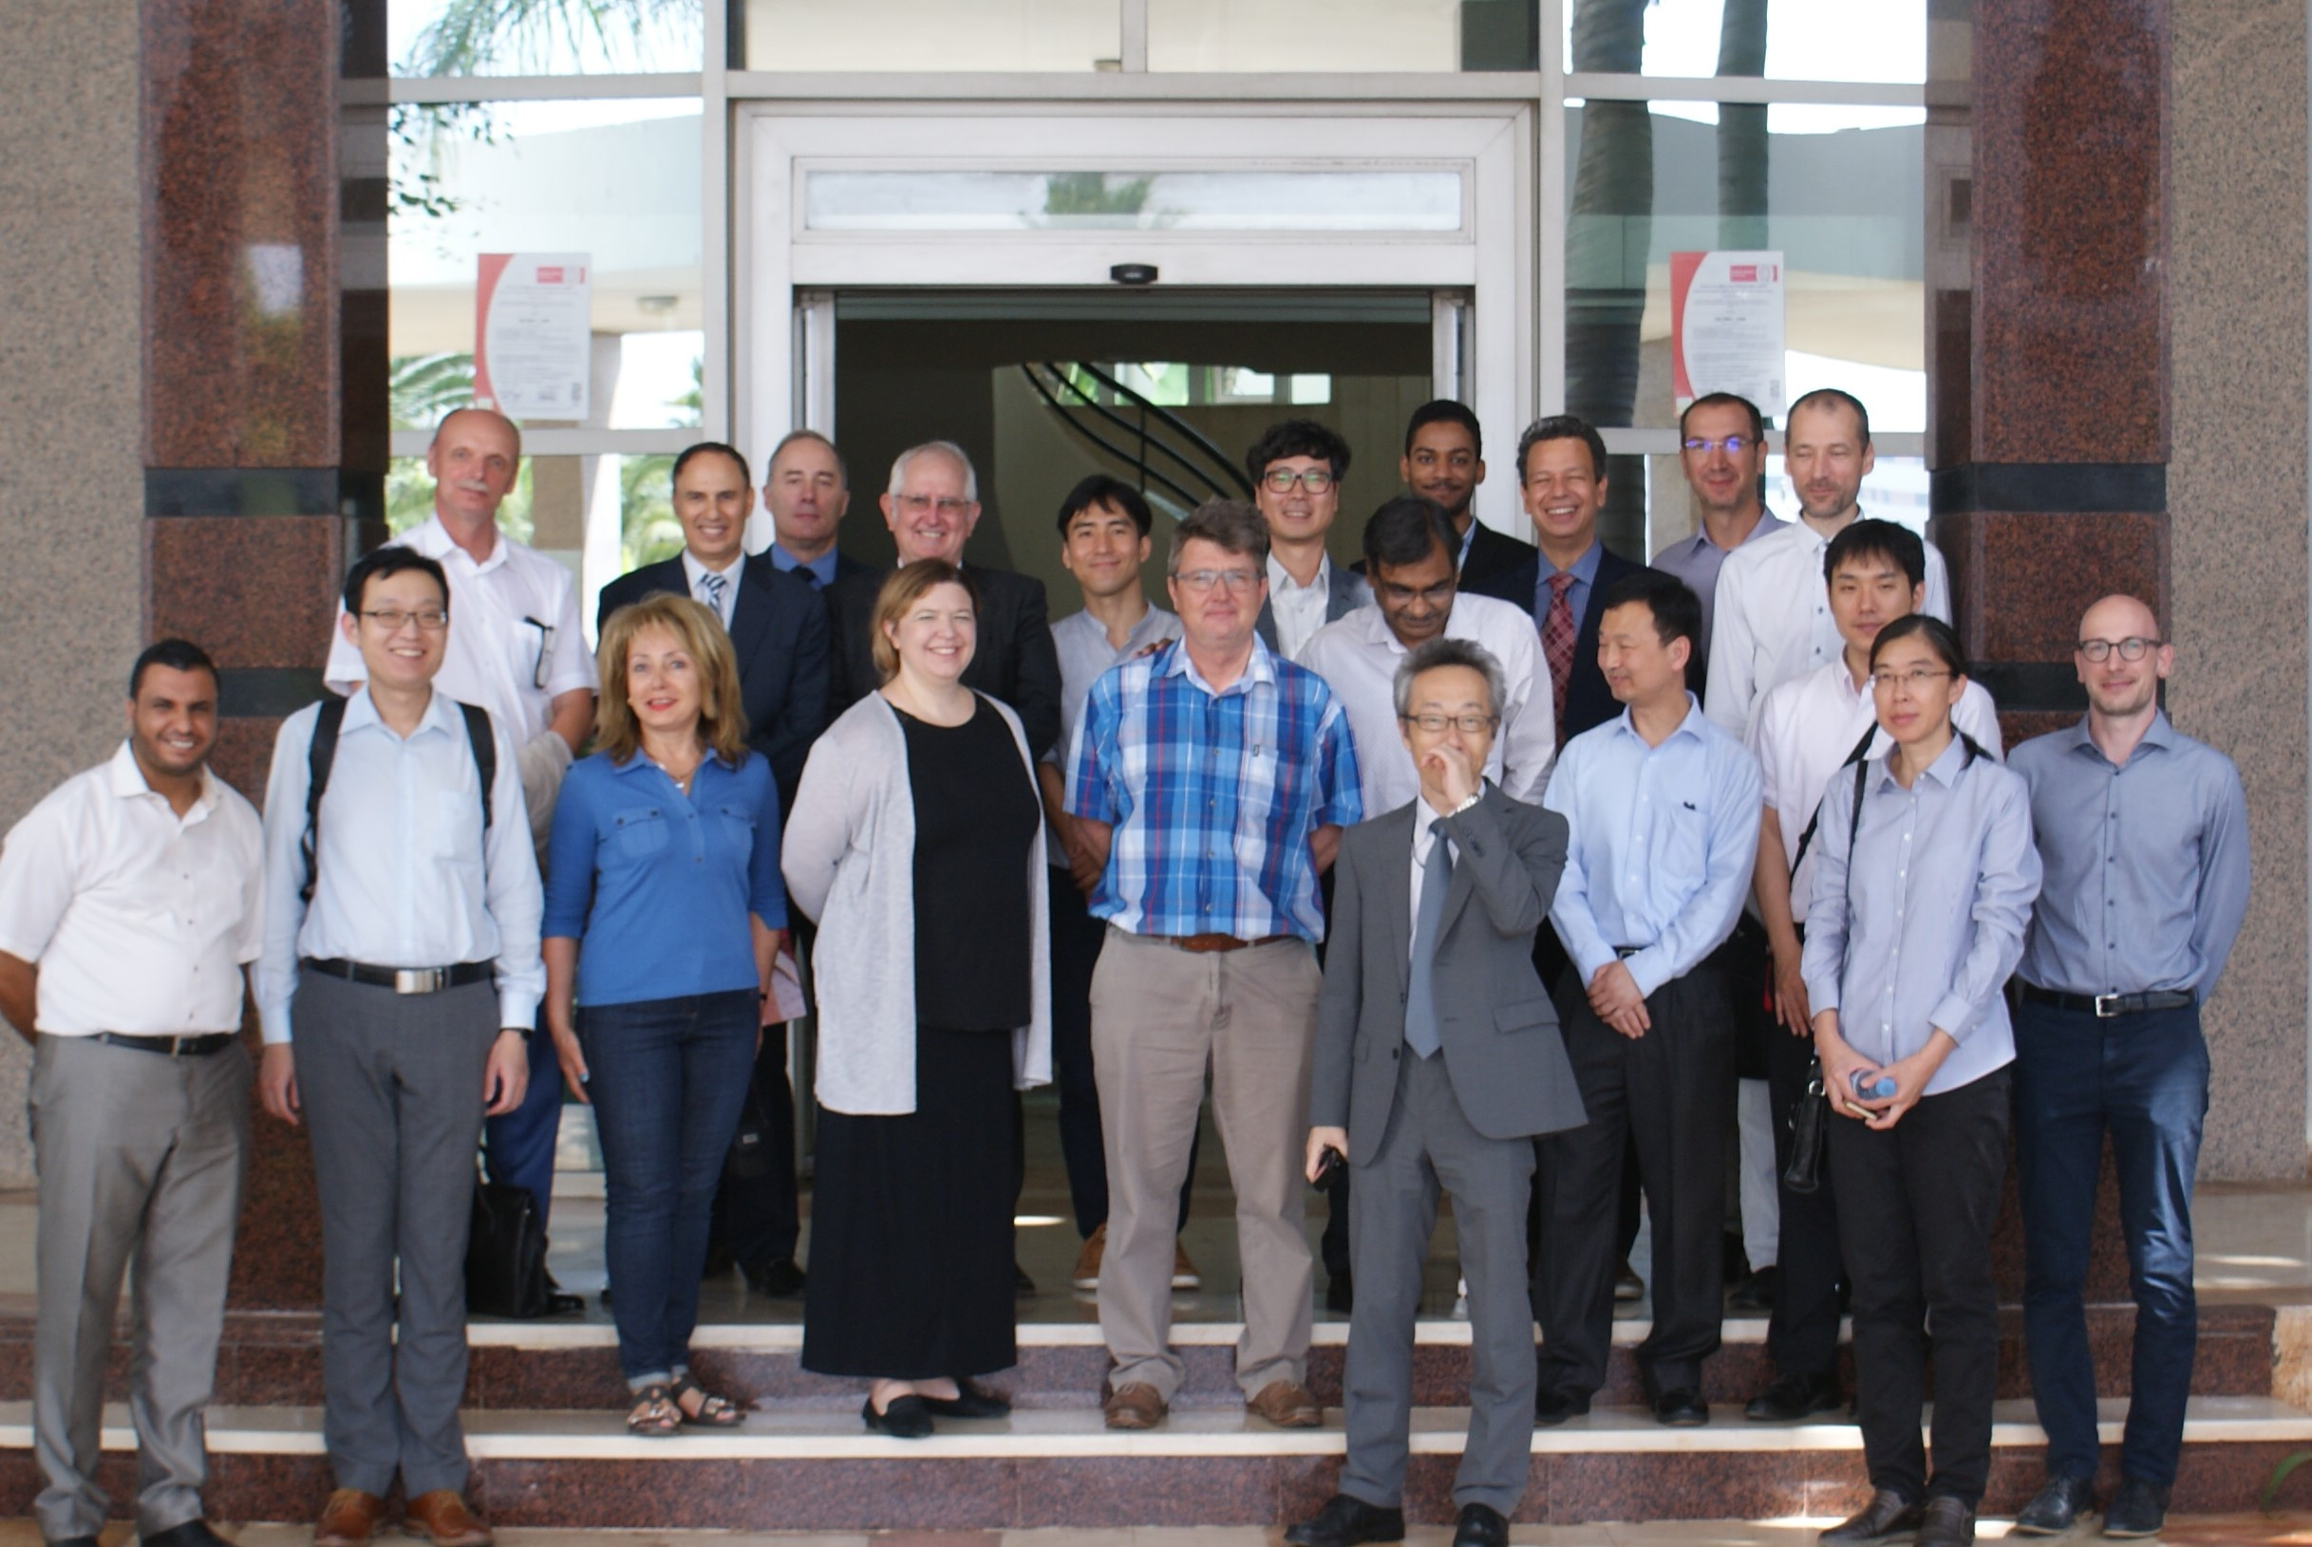
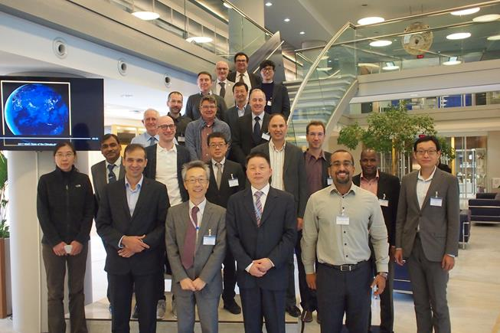
TT-GISC 2017 & 2018
TT-GISC-2018, Casablanca
TT-GISC-2017, Geneva

Slide 5
Work packages
TT-GISC-2017 took over the sub groups from ex-TT-GISC to address specific issues, and re-named the sub-groups with work packages (WP).
All the WPs are expected to consider/propose solutions and to submit progress report to TT-GISC meeting.
TT-GISC 2018 establish a new WP-8, Tech-Reg-updating.

Slide 6
Work packages
WP-1 Part C, established by TT-GISC2015 (not started)
WP-2 User Interface, led by Jan (HMEI)
WP-3 User Federation, led by JoseMauro (br)
WP-4 GISC Committee, all GISCs
WP-5 Metadata Consistency, led by Benjamin (fr)
WP-6 Next Step WIS Monitoring, led by Weiqing (au)
WP-7 Capacity Development, led by Sungsoo (kr)
WP-8 Technical Regulation updating, led by Weiqing (au)
  Each WP has 5 to 10 members.
  http://wiswiki.wmo.int/tiki-download_file.php?fileId=4488

Slide 7
Action Items
2016: Took over 37 action items
2018: Closed 24 action items, and then 13 action items are “Open”

Slide 8
Connection and backup Status

Slide 9
GISC - GISC connectivity
All GISCs are required to connect other GISCs to share the same dataset in accordance with the Manual on WIS (No. 1060)
TT-GISC meeting 2017 and 2018 collected connectivity status between GISCs to GISC.
As of September 2018
  one GISC, Offenbach completed establishing link to all other 14 GISCs.
  Seven GISCs connected to more than 50% (8-13)
  Other seven GISCs connected to less than 50% (2-7)

Slide 10
GISC status
Official status
All GISCs had demonstrated its capability to be a GISC and been successfully audited by CBS OPAG-ISS audit team.
All the GISCs were moved to “Operational” by the end of 2015.
  http://www.wmo.int/pages/prog/www/WIS/GISCs_en.html

Slide 11
Connectivity matrix
http://wiswiki.wmo.int/tiki-download_file.php?fileId=4432
 | Beijing | Brasilia | Casablanca | Exeter | Jeddah | Melbourne | Moscow | New Delhi | Offenbach | Pretoria | Seoul | Teheran | Tokyo | Toulouse | Washington
Beijing (BABJ) |  |  |  |  |  | 750M, FTP 100% for WMO | 16M, FTP | 16M, FTP | 16M, FTP |  | 16M, FTP |  | 16M, FTP | 16M, FTP
Brasilia (SBBR) |  |  |  | 2x200Mbps, FTP |  |  |  |  | 2x200Mbps, FTP |  |  |  | 2x200Mbps, FTP | 2x200Mbps, FTP | 2x200Mbps, FTP
Casablanca (GMMC) | via LFPW |  |  | via LFPW |  | via LFPW | via LFPW | via LFPW | via LFPW |  | via LFPW |  | via LFPW | 2Mbps, FTP
Exeter (EGRR) |  | 100M, FTP No-Alloc. |  |  |  | 100M, FTP | 100M, FTP | 100M, FTP | 100M, FTP | 100M, FTP | 100M, FTP |  | 100M, FTP | 100M, FTP | 100M, FTP No-Alloc.
Jeddah (OEJD) |  |  |  |  |  |  | 2Mbps, FTP |  |  |  |  |  | via DEMS
Melbourne (AMMC) | 250M, FTP |  |  | 4M, FTP |  |  | 250M, FTP | 250M, Socket | 4M, FTP |  |  |  | 4M, FTP | 4M, FTP | 250M, FTP, Soc
Moscow (RUMS) | 10M, FTP |  |  | 10M, FTP |  | 100M, FTP No-Alloc. |  | 10M, FTP | 10M, FTP |  | 10M, FTP | 100M, FTP No-Alloc. |  | 10M, FTP
New Delhi (DEMS) | 6M, FTP | 150M, http 100% for WMO |  | 6M, FTP | 150M, FTP 100% for WMO | 150M, http&soc 100%forWMO | 6M, FTP |  | 6M, FTP | 150M, http 100% for WMO | 150M, http 100% for WMO | 150M, FTP 100% for WMO | 6M, FTP & sock | 6M, FTP
Offenbach (EDZW) | 50M, FTP | 7.5G, FTP No-Alloc. | 50M, FTP | 50M, FTP | 7.5G, FTP No-Alloc. | 50M, FTP | 50M, FTP | 50M, FTP |  | 7.5G, FTP No-Alloc. | 50M, FTP | 7.5G, FTP No-Alloc. | 50M, FTP | 50M, FTP | 7.5G, FTP No-Alloc.
Pretoria (FAPR) | via EGRR | via EGRR | via EGRR | 4Mbps, FTP | via EGRR | via EGRR | via EGRR | via EGRR | via EGRR |  | via EGRR | via EGRR |  | via EGRR | via EGRR
Seoul (RKSL) | 6M, FTP |  |  | 6M, FTP |  |  | 6M, FTP |  | 6M, FTP |  |  |  | 6M, FTP | 6M, FTP
Teheran (OIII) | 250M, FTP 160MforWMO | 250M, FTP 160MforWMO |  |  |  |  | 250M, FTP 160MforWMO |  | 250M, FTP 160MforWMO |  |  |  |  |  | 250M, FTP 160MforWMO
Tokyo (RJTD) | 10M, FTP | 100M,https 100% for WMO |  | 10M, FTP | under-d. | 10M, FTP |  | 10M, FTP & sock | 10M, FTP |  | 10M, FTP |  |  | 10M, FTP | under-c. by end Sep '18
Toulouse (LFPW) | 100M, FTP | 1G, FTP No-Alloc. | 100M, FTP | 100M, FTP |  | 100M, FTP | 100M, FTP | 100M, FTP | 100M, FTP | 1G, FTP No-Alloc. | 100M, FTP |  | 100M, FTP |  | under-d.
Washington (KWBC) |  |  |  |  |  |  |  |  |  |  |  |  | via EGRR

Slide 12
Backup arrangement
Each GISC has to maintain arrangements with back-up GISC(s) the collection and dissemination of information to/from its AMDCN in accordance with the Manual on WIS.
TT-GISC2018 collected GISC back-up status and updated the back-up matrix.
As of September 2018, six GISCs have started GISC-GISC back-up operation, and other nine GISCs are under discussion with partner GISCs.

Slide 13
GISC backup matrix
Operational
Planned (under developing)
Negotiating
To be confirmed(one-side info.)
As of TT-GISC 2018
GISC (2?)
Exeter
GISC (2)
Moscow
GISC (2)
Beijing
GISC (3)
Tokyo
GISC (3?)
Offenbach
GISC (2?)
Seoul
GISC (3)
Toulouse
GISC (1?)
Jeddah
GISC (1)
Casablanca
GISC (1?)
Tehran
GISC(2?)
Pretoria
GISC (?)
New Delhi
GISC (1)
Washington
GISC (2)
Brasilia
GISC (3)
Melbourne

Slide 14
TT-GISC activities

Slide 15
Metadata Synchronization
12 GISCs provide its AoR metadata though OAI provider. Others are provided by WIMMS.
Sync. between all GISCs needs more improvement
TT-GISC WP-5 is reviewing the Synchronization Procedure and finding solutions to complete full sync.

Slide 16
Capacity development
Majority of GISCs held training workshops and/or onsite training for their AoR. Some GISCs plan to hold a workshop.
TT-GISC noted the baseline materials will help GISC with training plan
TT-GISC WP-7 is developing the materials

Slide 17
WIS Monitoring
Started GISC Watch as from 1st May 2018 using WIS Common Dashboard (WCD)
Draft amendment of regulatory materials will be submitted to Cg18 as a CBS rec.
ET-WISC WP-6 considers next step of WIS monitoring

Slide 18
Time critical data delivery
WIS delivers time critical data (e.g. warnings) from end to end within 2 minutes
TT-GISC noted that most messages through the GTS were delivered within 1-3 minutes
TT-GISC 2018 agreed to continue supporting the Tsunami warnings and related information delivery across all tsunami warning areas as well as the IOTWS.
It is requested to develop Service monitoring

Slide 19
GISC Operations page https://wiswiki.wmo.int/tiki-index.php?page=TT-GISC-opspage
TT-GISC 2014 agreed that recommended practices from GISC should be recorded an easily maintained Operations Guide to GISCs
TT-GISC2017 re-established a web page for made available
TT-GISC2018 updated the page with some new items

Slide 20
GISC Operations page
Portal site: operation guidance, best practices ….
GISC Status reports
GISC connectivity
GISC Backup
Metadata harvesting: Para.4.10 Manual on WIS (No. 1060)
GISC Cache
TT-GISC Email Groups (TT-GISC2018)
GISC communications: agreed by TT-GISC-2015
Metadata Guidance
Metadata Migration Procedure GISC A to GISC B
WIS Monitoring
GISC Watch
Fast Track Changes
Other miscellaneous reference material for GISCs

Slide 21

Thank you
Merci

