Slide 1
Status report of GISC Beijing
GISC Beijing/CMA
TT-GISC, Mar. 2019, Beijing
Notes:
I would like to introduce the status report of GISC Beijing.

Slide 2
WIS implementation of GISC Beijing
GISC Beijing’s responsible area:
NCs (7):
China
Democratic People’s Republic of Korea. (new in Nov. 2015)
Hong Kong, China
Macao, China
Mongolia
Nepal
Pakistan
DCPCs (6):
WWIS ( Hong Kong, China )
5 CMA’s internal DCPCs
International roles of CMA in WIS:
NC China
GISC Beijing
RTH Beijing (DCPC)
RCC Beijing (DCPC)
RSMC Beijing – Geographical (DCPC)
RSMC Beijing – Activity – ATM (DCPC)
National Satellite Meteorological Center (DCPC)
Notes:
GISC Beijing’s responsible area includes 7 NCs and 6 DCPCS.CMA fulfills the following international roles, each designated as GlSC or DCPC duties within the framework of WIS:

Slide 3
Data Communication Network
EUMETSAT
Offenbach
Tokyo
Osaka
Moscow
New Delhi
Toulouse
Seoul
0
RMDCN
MPLS VPN
16Mbps
16Mbps
Beijing (main site)
Beijing (DR site)
600Mbps
4Mbps
64Kbps
64Kbps
64Kbps
64Kbps
Internet
Thailand
Vietnam
DRPK
Mongolia
IP Multicast
4Mbps
2Mbps
Hong Kong
Macao
Australia
Pakistan
Nepal
USA
EUMETCast
Terrestrial
Notes:
This is the data communication network of GISC Beijing, which connects to EUMETSAT, Offenbach, Tokyo etc. by RMDCN, connects to Hong Kong, Macao, Mongolia etc. by special line and connects to USA, Pakistan etc. by internet.

Slide 4
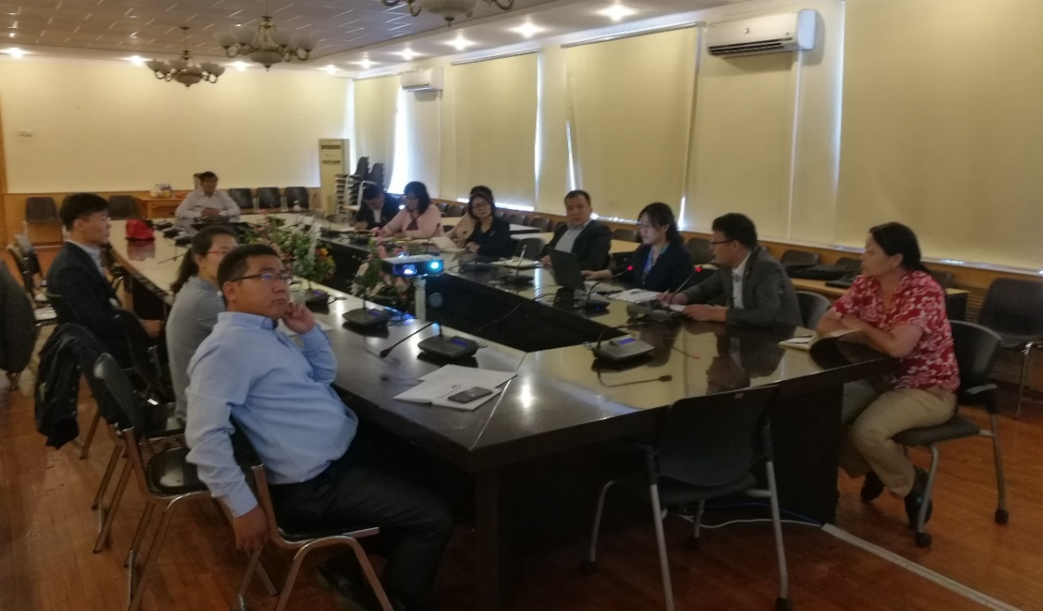
Training - Capacity building
On-site training on CMACast & WIS to WIS AoR users.
20th – 21st August 2018, to Mongolia
Notes:
We went to Mongolia to provide on-site training on CMACast & WIS during 20th – 21st August 2018.

Slide 5
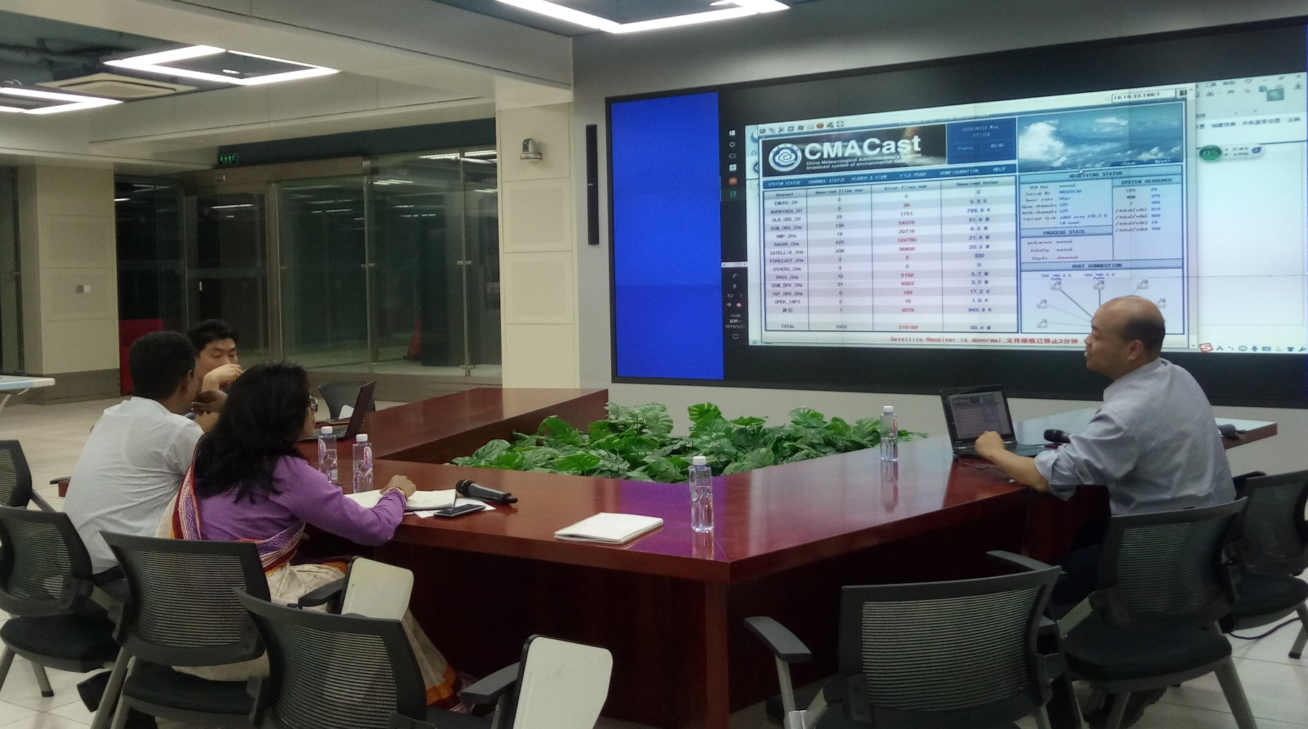
Training - Capacity building
Invited training on CMACast & WIS to WIS AoR users.
21st – 25th May 2018, to Bangladesh (in CMA, Beijing)
Notes:
We provided invited training on CMACast & WIS to WIS AoR users during 21st – 25th May 2018 in CMA, Beijing.

Slide 6
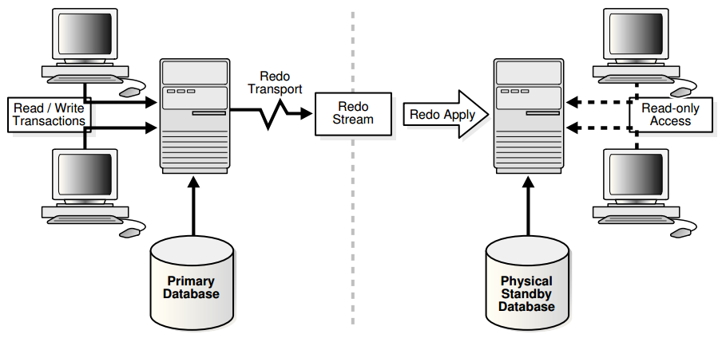
Operational Issues in last period
GISC Beijing encounters database server malfunction during 21st ~ 25th June, 2018
The cause is due to the incompatibility of “hardware – Oracle Linux – Oracle 12 database”
The issue SOLVED by changing OS to RHEL – Oracle 12 database
Now the database service is composed of a primary database server and a backup one, which keep real-time data synchronization by oracle dataguard architecture, as show in the following figure.
In this way, the database service can emergently switch or fail over to the backup server when the primary needs maintenance or breaks down.

Slide 7
Operational Issues in last period
Invalid BUFR upper air reports from China
Issue ID: 0000055
Reported By: efucile
Assigned To: gisc_beijing
Project: GISC ISSUE TICKETS
Category: BUFR upper air
Reproducibility: always
Priority: high
Status: assigned
Date Submitted: 2019-02-26 11:11 CET
Last Modified: 2019-02-26 11:11 CET
Problem1: Some stations are not providing any BUFR upper air reports.
Answer: The stations for global data exchange are scheduled to generate bufr reports before 15th Mar..
Problem2: The reports have no information on the radiosonde position during the ascent and
sometimes parts of the profile are missing.
Answer: The problem is scheduled to be solved in 2020 year after radiosounding system in the stations are upgraded.

Slide 8
Monitoring activity
Participating in GISC Watch
16th ~ 31st May 2018
16th ~ 31st Jan. 2019
Summary of issue tickets assigned to GISC Beijing
Assigned | 6
Closed (solved) | 3
Solving | 3 ( No response * 1, invalid BUFR * 2 )

Slide 9
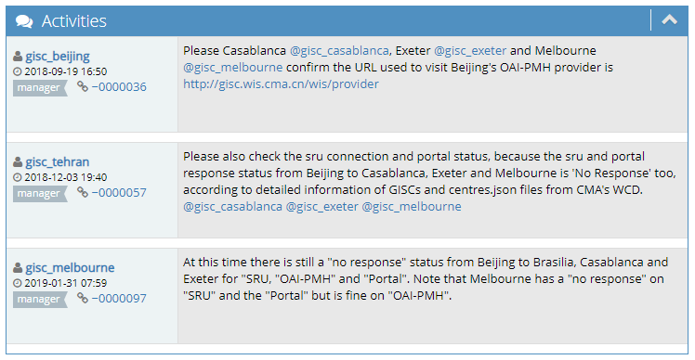
Monitoring activity
Ticket #0000031: "no response" to the OAI-PMH from Casablanca, Melbourne and Exeter to Beijing for at least 4 days
  Please Brasilia, Casablanca, Exeter and Melbourne confirm the URLs used to visit Beijing's OAI-PMH provider, Portal, SRU are correct.
  It seems that this issue may caused by Internet-related causes
  Beijing hope involved GISCs can manually test access and cooperation

Slide 10
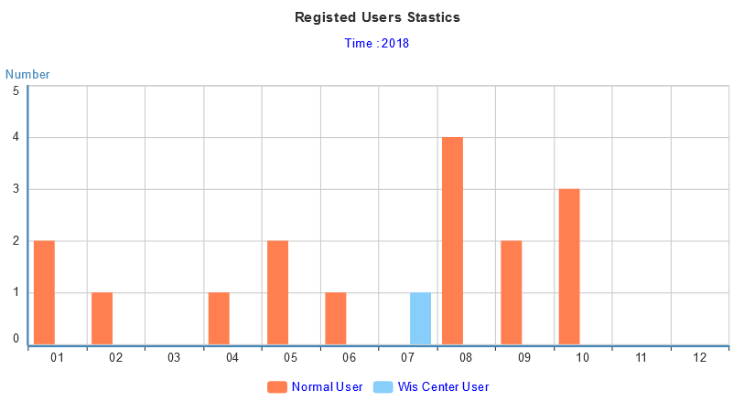
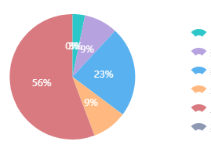
Traffic Status of GISC Beijing
As of 7th Mar. 2019, there are 148 users from 36 WMO Members registered in GISC Beijing. The daily data volume of distribution via CMACast and Internet is over 600GB.
Daily volume
Synoptic & AWS
Upper air
NWP
Weather Radar
Satellites
Others

Slide 11
Uzbekistan metadata harvested from GISC Moscow
Mid August, 2018, after published by GISC Moscow
(7 records)
CSUZ10 UTTW
FCUZ31 UTTW
FTUZ31 UTTW
ISID20 UTTW
SAUZ31 UTTW
SIUZ20 UTTW
SMUZ10 UTTW
Notes:
7 Uzbekistan metadata were harvested from GISC Moscow in Mid August, 2018.

Slide 12
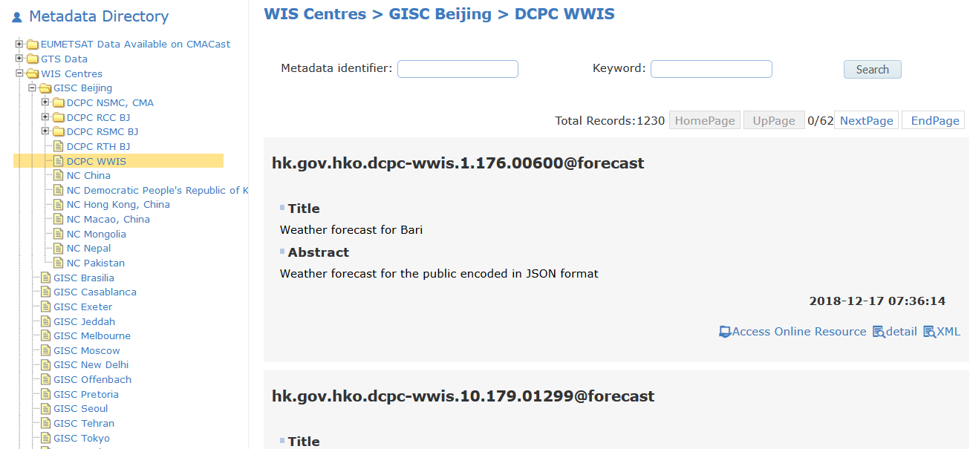
Metadata replacement from DCPC WWIS(Hong Kong, China)
Dec. 18, 2018
Delete 1230 old metadata like hko.gov.hk.VHHH.* which are replaced by 1230 new metadata like hk.gov.hko.dcpc-wwis.* harvested from DCPC WWIS.
Notes:
We deleted 1230 old metadata like hko.gov.hk.VHHH.* which are replaced by 1230 new metadata like hk.gov.hko.dcpc-wwis.* harvested from DCPC WWIS on Dec. 18, 2018
.

Slide 13
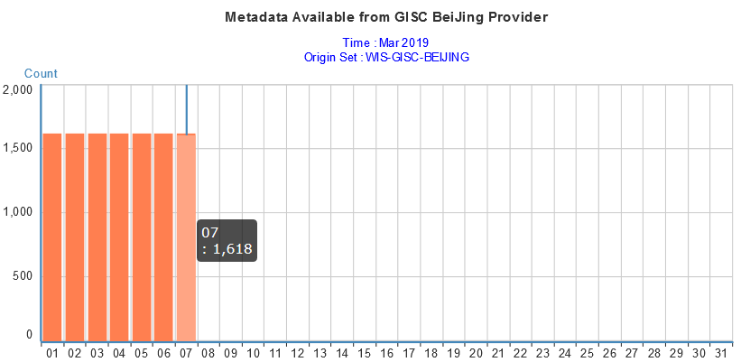
DAR Metadata of GISC Beijing
As of 7th Mar. 2019, there are 1,618 DAR metadata records provided in GISC Beijing, including 280 records of global exchange data.

Slide 14
Changes – Publish new data
YOPP includes Special Observing Periods (SOP)
  February 1st to March 31st, 2018 in the Arctic,
  July 1st to September 30th, 2018 in the Arctic, and
  November 16th, 2018 to February 15th, 2019 in the Antarctic.
China participates in the last two SOPs.
IUSN59 BABJ, IUSS19 BABJ
http://gisc.wis.cma.cn/wis/provider?verb=GetRecord&identifier=urn:x-wmo:md:int.wmo.wis::IUSN59BABJ&metadataPrefix=iso19139
http://gisc.wis.cma.cn/wis/provider?verb=GetRecord&identifier=urn:x-wmo:md:int.wmo.wis::IUSS19BABJ&metadataPrefix=iso19139
Notes:
YOPP includes three Special Observing Periods (SOP). China participates in the last two SOPs. The metadata of the upper air data in Arctic is IUSN59 BABJ, while the metadata of the Antarctic data is IUSS19 BABJ

Slide 15
Changes – Publish new data
NC Hong Kong, China published Daily Climate Observation message to GISC Beijing monthly since Feb. 4, 2019.
ISCC60 VHHH
http://gisc.wis.cma.cn/wis/provider?verb=GetRecord&identifier=urn:x-wmo:md:int.wmo.wis::ISCC60VHHH&metadataPrefix=iso19139

Slide 16
Summary
The meeting noted the report from GISC Beijing. It reported that during 2018 GISC Beijing provided onsite training in neighbouring NMHS, including guidance for WIS implementation. GISC Beijing planned to continue capacity building activities for their AoR in 2019. It reported that GISC Beijing published upper air sounding data for YOPP, also on both GTS and WIS in 2018.

Slide 17
Thanks for your attention!

