Slide 1
SG RFC 19
4.4 Issues related to weather radars and wind-profiler
Mike Banks
Spectrum Policy Manager

Slide 2
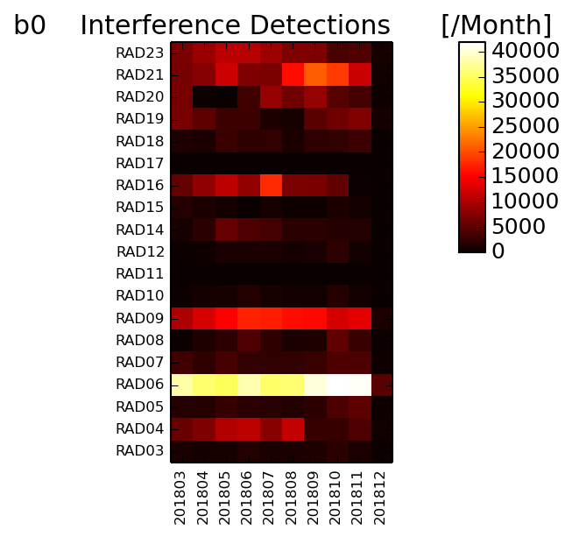
Weather Radar 2018
38 cases of interference logged
All 15 radars experienced interference
Reduction on 2017 due to staff resources
11 sites now have Rx filters
4 Rx filters fitted in 2018

Slide 3
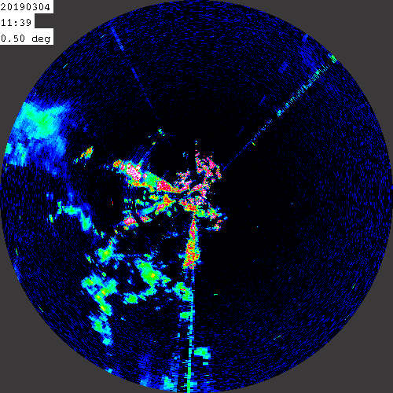
Weather Radar 2018
15 cases reported to NRA (Ofcom)
  12 Resolved
  2 Cancelled
  1 Out of band
Ofcom request Impact Statement in relation to interference at Castor Bay (Northern Ireland)

Slide 4
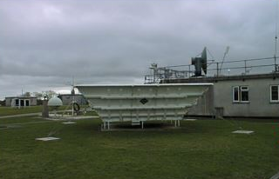
Wind Profilers 2018
All Boundary Layer profilers turned off
1st Oct 2018
Reaching end of life, decision taken not to renew
Hoping spares can be gifted to European Community
Wind data will now be sourced from aircraft Mode-S transmissions

