Slide 1
GitHub @TT-WMD
Nina Horat MeteoSwiss
https://github.com/wmo-im/wmds
https://github.com/wmo-im/wmds/wiki

Slide 2
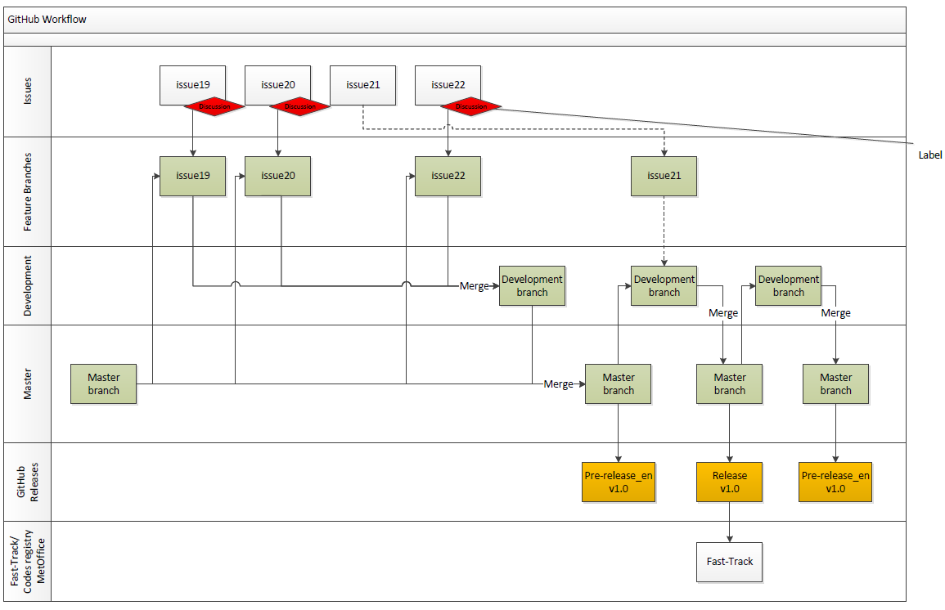

Slide 3
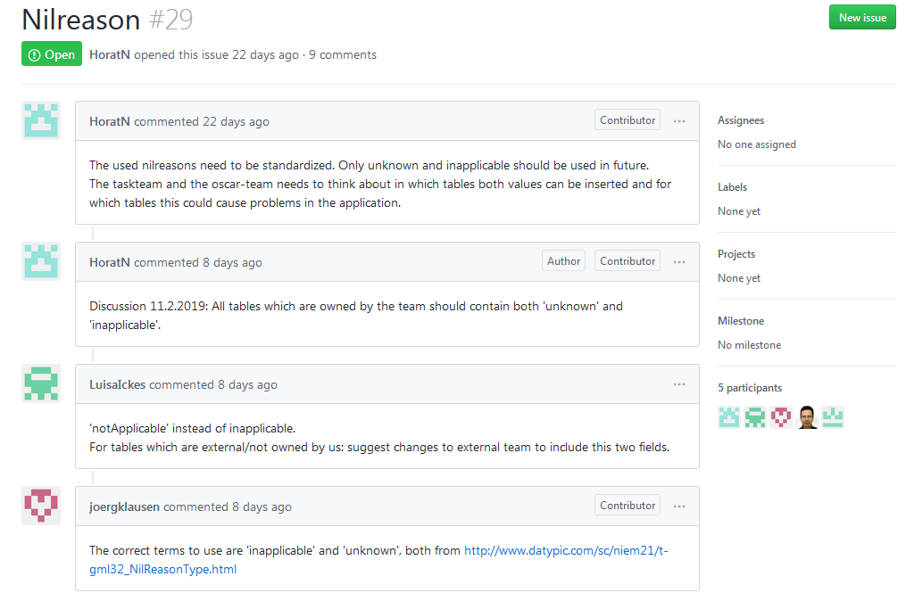
Issues

Slide 4
Feature Branch
Development
Master

Slide 5
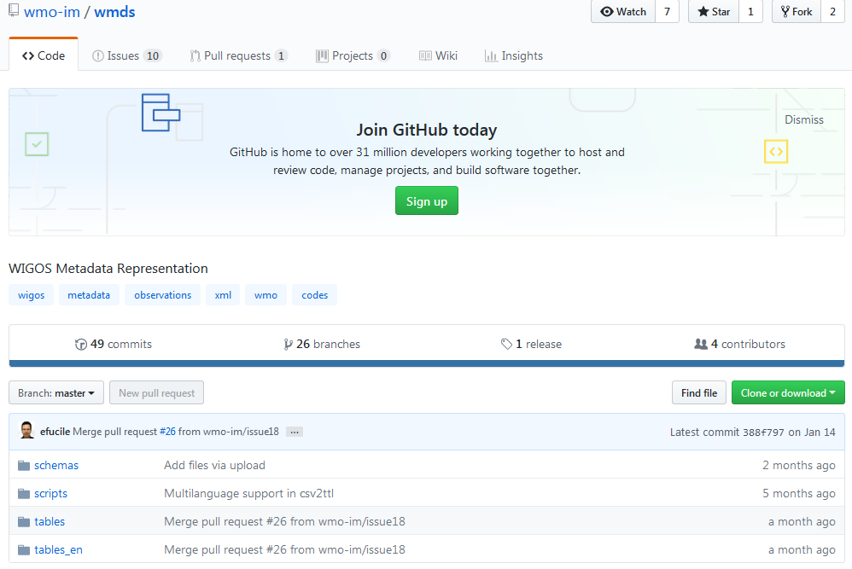
Organisation of repository
Multilingual tables
english tables

