Slide 1
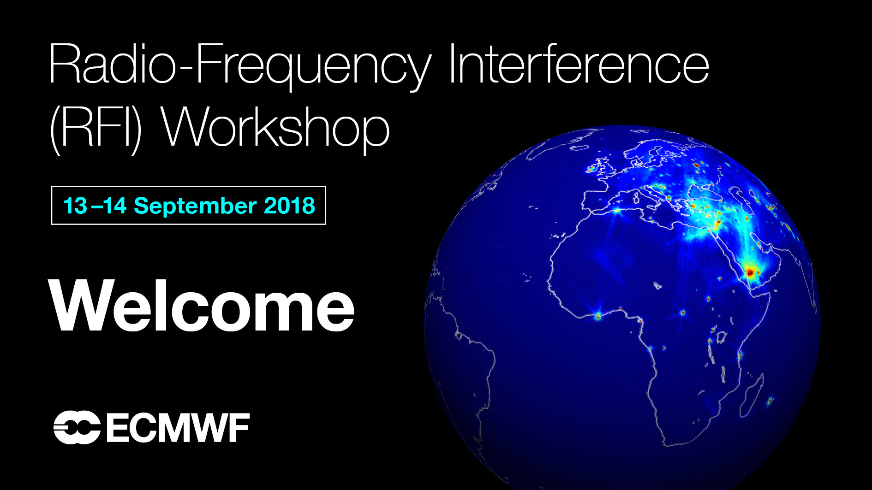
Goal
To better quantify value of MW spectrum to Numerical Weather Prediction and to bring NWP experts and frequency managers together
Organisers
NWP: Stephen English (ECMWF)
Frequency Management: Rich Kelley (NOAA)

Slide 2
Participants
Frequency managers
ITU: Vadim Nozdrin; NOAA: Richard Kelley; EUMETSAT: Markus Dreis; ESA: Elena Daganzo-Eusebio; Met Office: Mike Banks
NWP centres by WMO regions
Region | Participants
Region I Africa | Nil
Region II Asia | CMA, China: Wei Han; KIAPS, South Korea: In-Hyuk Kwon; JMA, Japan: Masahiro Kazumori.
Region III South America | Nil (but Stephen English ex-CPTEC, Brazil)
Region IV North America | NRL, USA: Ben Ruston and Steve Swadley; NOAA, USA Andrew Collard; ECCC, Canada: Mark Buehner
Region V South West Pacific | BoM, Australia: Chris Tingwell and Fiona Smith
Region VI Europe | ECMWF: Niels Bormann, Stephen English; Met Office, UK: Chawn Harlow, John Eyre; Meteo-France Jean-Francois Mahfouf; DWD, Germany: Christina Kopken-Watts; HIRLAM regional consortium (Met Norway): Roger Randriamampianina.

Slide 3
Bands being actively used or prepared for by NWP centres
Frequency GHz | Instruments | Application area
1.4-1.427P | SMOS (ESA), SMAP (NASA), Aquarius (NASA) , CIMR (ESA) | Soil moisture, salinity, thin sea ice
6.425-7.25 | AMSR-2 (JAXA) , CIMR (ESA) | SST
10.6-10.68p 10.68-10.7P | AMSR-2 (JAXA), GMI (NASA), MWRI (CMA) , CIMR (ESA) | Heavy Precipitation
18.6-18.8p | AMSR-2 (JAXA), GMI (NASA), AMR (NOAA), MWRI (CMA) , CIMR (ESA) , MWI (EUMETSAT) | Ocean near surface wind,
23.6-24P | AMSU-A (NOAA/EUMETSAT), ATMS (NOAA), SSMIS (DOD), GMI (NASA), AMR (NOAA), MTVZA-GY (Roscosmos), MWRI (CMA), MWS+I (EUMETSAT), AMSR-2 (JAXA) | Total column water vapour
31.3-31.5P 31.5-31.8p | AMSU-A (NOAA/EUMETSAT), ATMS (NOAA), GMI (NASA), MTVZA-GY (Roscosmos), MWS+I (EUMETSAT) | Total column cloud liquid
37 GHz | SSMIS (DOD), GMI (NASA), AMSR-2 (JAXA), MWRI (CMA), CIMR (ESA) | Liquid water path and cloud detection on GMI
50.2-50.4P 52.6-54.25P 54.25-59.3p 59.3-59.5 60.40- 61.15 63-63.5 | AMSU-A (NOAA/EUMETSAT), ATMS (NOAA), SSMIS (DOD), MWTS-2 (CMA), MTVZA-GY (Roscosmos), MWS (EUMETSAT) | Temperature profile
86-92P | AMSU-A (NOAA/EUMETSAT), ATMS (NOAA), SSMIS (DOD), MWHS-2 (CMA), MTVZA-GY (Roscosmos), MWRI (CMA), MWS (EUMETSAT), AMSR-2 (JAXA) | Precipitation
100-102P 109.5-111.8P 114.25-116P 116-122.25p | MWHS-2 (CMA), TROPICS (NASA), MWI (EUMETSAT) | Temperature profile, cloud
148.5-151.5P 155.5-158.5p 164-167P | ATMS (NOAA), GMI (NASA), MHS (EUMETSAT), MWHS-2 (CMA), MTVZA-GY (Roscosmos), SSMIS (DOD) , MWS+I (EUMETSAT) | Precipitation, water vapour
174.8-182.0p 182.0-185.0P 185.0-190.0p 190.0- 191.8P | AMSU-B (NOAA), MHS (EUMETSAT), ATMS (NOAA), SSMIS (DOD), MWHS-2 (CMA), GMI (NASA), SAPHIR (CNES-ISRO), TROPICS (NASA), MTVZA-GY (Roscosmos), MWS+I (EUMETSAT) | Water vapour
200-209P 226-231.5P | TROPICS (NASA), MWS (EUMETSAT) | Ice cloud

Slide 4
Key areas benefiting from EESS bands via NWP application
Daily weather forecast
Flood and storm damage warning and mitigation, public safety
Severe storm forecasts (including tornados, hurricane), public safety
Transport and logistics by road and rail, shipping and particularly aviation
Energy, including the large and increasing renewable energy contribution
Agriculture
Tourism
Public health, including air quality monitoring and forecasts
Climate change monitoring
Diverse business applications (including e.g. building industry)
Defense services and military operations, training and planning
Providing early warning signs for famine over large scales
Private households

Slide 5
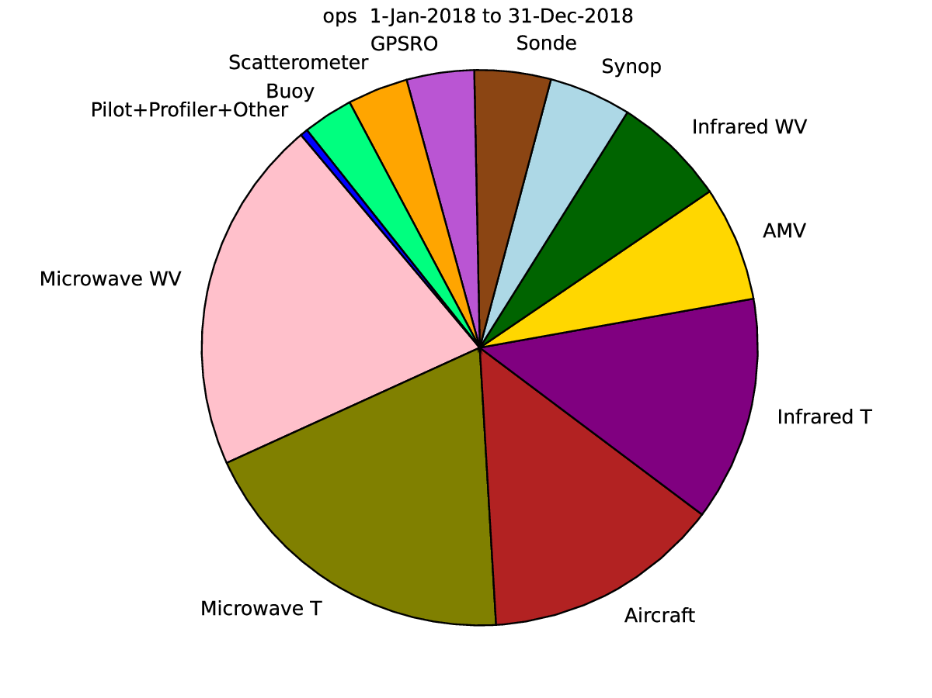
Key conclusions
Microwave observations are critical to NWP
NWP is critical to WMO Member State National Warning Systems and many socio-economic sectors (previous slide)
Passive microwave observations contribute around 40% of the overall improvement of short-range forecast skill, plus a further 10% from active microwave.
  50-60 GHz and 176-190 GHz remain the two most critical spectral bands (176-190 much more than 10y ago).
  18.7, 23.8, 31.4, 89, 166 also important
  1.4, 6.8, 10.7, 209, 229 important for emerging applications
Many countries have detailed financial assessments of the value of their weather and environment services
  https://www.metoffice.gov.uk/about-us/what/pws/value UK $2.0B per year
  USA $11.4B per year
Harder to quantify benefits in military sector in $

Slide 6
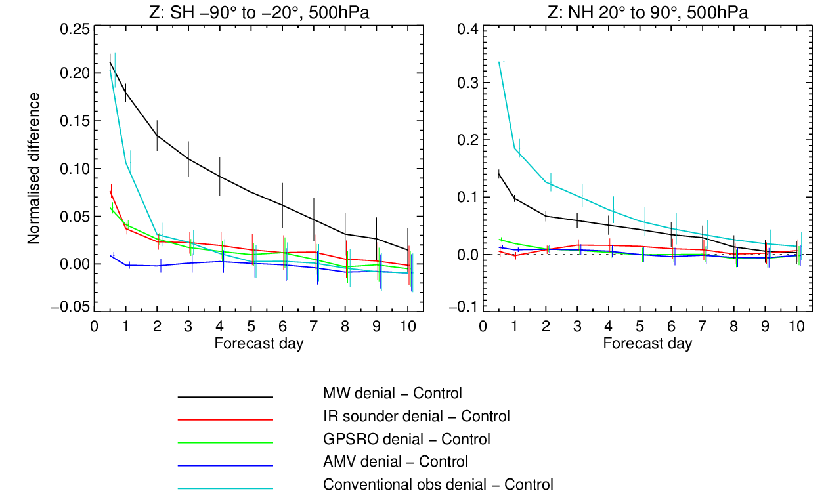
Current impact of various observing systems: Z 500 hPa
Southern Hemisphere
Northern Hemisphere
Normalised difference in stdev of error
MW radiances are the leading satellite observing system.
(verified against operational analyses, both seasons combined)

Slide 7
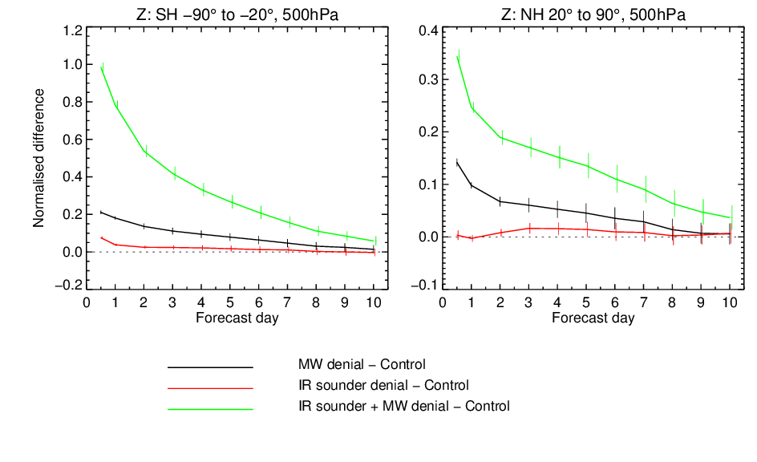
Loss of robustness of observing system:
Larger impact of losing IR sounder data in absence of MW data

Slide 8
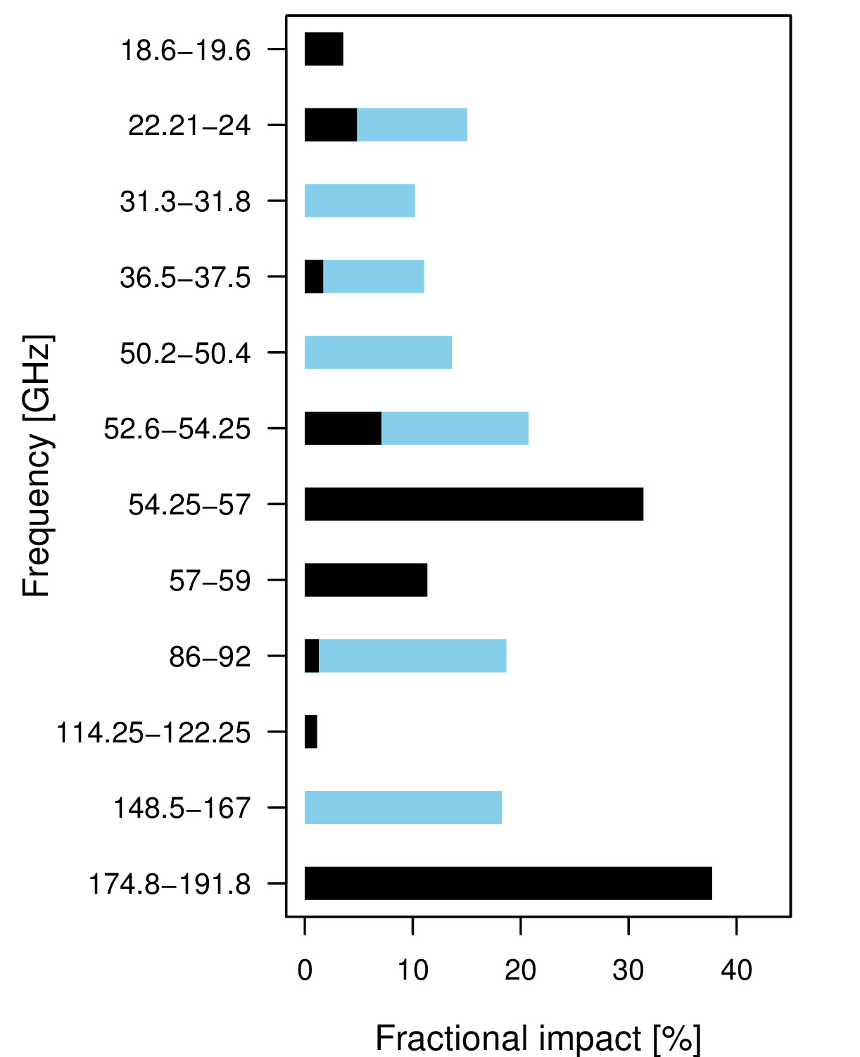
What contribution would we lose if we lost a single given band?
FSOI contribution [%]
TCWV, clouds, precip, ocean winds
Surface emission, clouds
Lowest T-sounding, clouds
Mid/upper tropospheric T-sounding
Stratospheric T-sounding
TCWV, clouds, precip, surface emission
T-sounding, clouds
TCVW, clouds, precip, surface emission
Q-sounding, clouds, precip
Direct loss from assimilation
Indirect loss from supported channels
Note L, C and X band are very important for soil moisture, salinity, sea ice and sea surface temperature, this plot reflects impact on atmospheric analysis only.
N Bormann

Slide 9
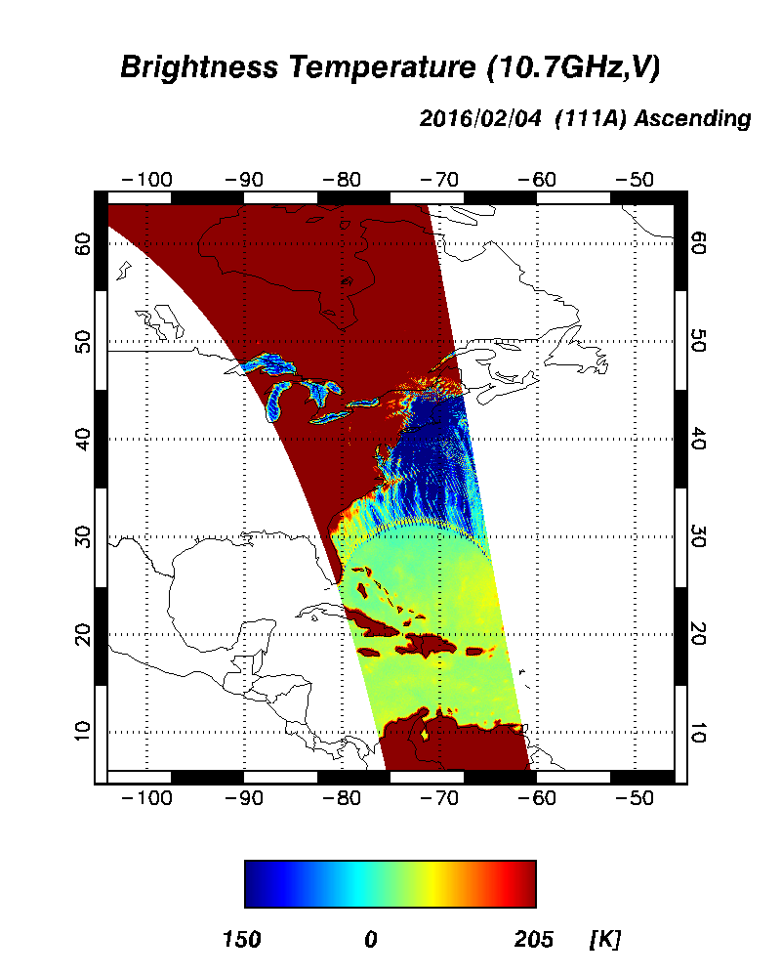
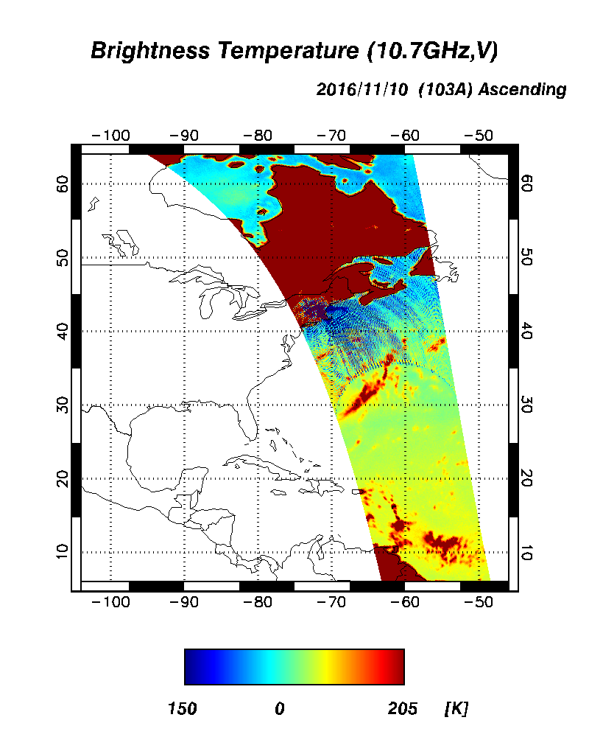
Examples of current RFI shown by JMA (Japan) in C, X and K band
A. Shibata

Slide 10
Workshop report
ECMWF Radio-Frequency Interference (RFI) Workshop: Final Report
Role and importance of microwave space based measurements in weather forecast/predictions and climate monitoring and their socio-economic benefits
Workshop report will be available very soon from ECMWF (final checking amongst participants).
https://www.ecmwf.int/en/learning/workshops/radio-frequency-interference-rfi-workshop
An article stimulated by the workshop also appeared in the ITU news magazine edition “Monitoring our Changing Plant”:
https://www.itu.int/en/itunews/Documents/2019/2019-01/2019_ITUNews01-en.pdf

