Slide 1
WMO Codes Registry: http://codes.wmo.int
Task Team on Aviation XML
Montreal, Canada, 7-9 October 2013
Submitted by: Jeremy Tandy, Met Office
TT-AvXML-3/Doc(15)
Agenda Item 5.7
02 October 2013
WMO; Name of Department (ND)

Slide 2
Overview of WMO Codes Registry
WMO Codes Registry provides web-based publication of authoritative vocabulary for new data exchange standard WMO AvXML enabling transmission of XML-encoded operational meteorological data for international air navigation (OPMET) as specified in ICAO Annex 3 Amd 76 (Nov 2013)
Implemented with UKgovLD Registry software using RDF and Linked-Data principles – open source (Apache 2 license) on GitHub
Definitive source of terms is WMO No. 306 Manual on Codes and other WMO Technical Regulation
Current coverage of WMO No. 306 is sparse as initial objective is support for WMO AvXML; commitment from WMO to expand coverage
Service operated on behalf of WMO by Met Office for initial 2-years from September 2013
For further information, please refer to User Guide, FAQ and technical documentation

Slide 3
Overview of Registry concepts
Register: a single controlled collection (e.g. a list) maintained on behalf of some owner organization which provides the authority & governance regime for the collection
Entity: a member of the controlled collection – the Entity type is completely open but may be constrained by the Register’s governance policy
Sub-register: a Register may contain other Registers, enabling creation of arbitrarily complex sub-register hierarchies
Register Item: a metadata record describing the relationship of an Entity to a given Register – the Register Item includes a graph of information properties that describe the Entity as determined by the Register manager enabling a local description of the Entity to be maintained within the Registry
Data model is derived from ISO 19135 ‘Geographic information – Procedures for item registration’ – please refer to technical documentation for full details of the data model

Slide 4
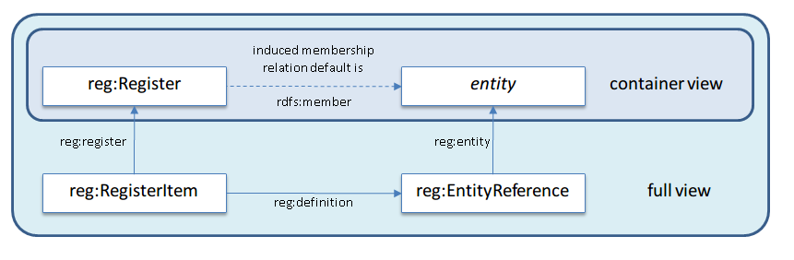
Registry information views
The Registry design assumes that the majority of users simply want to access the list of member entities for a given Register; a “Container view” is provided for this purpose
A “full view” provides expert users with detailed item-level metadata …
Relationship between Register, Entity and Register Item

Slide 5
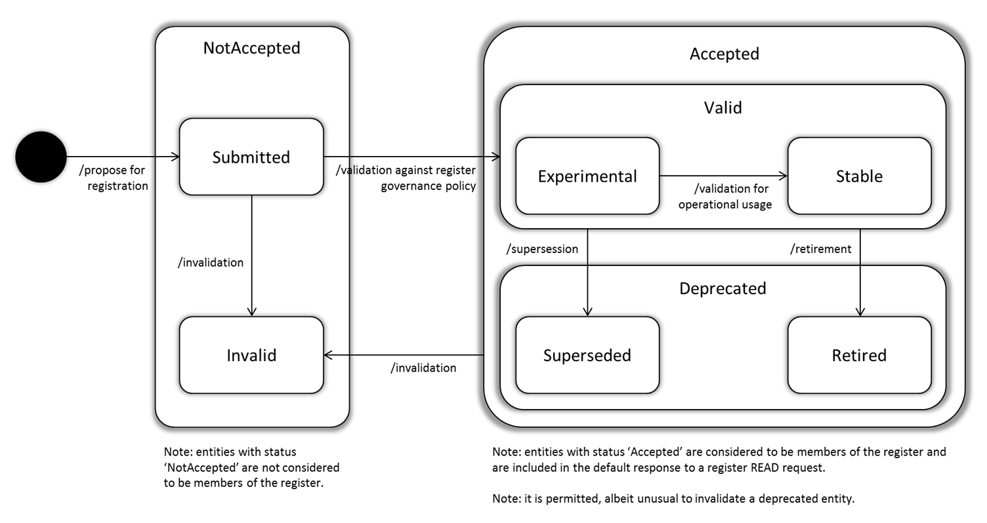
Register Item status and lifecycle
A Register Item has status within its associated Register
Status is not intrinsic to the Entity but rather a statement of how the Entity is regarded by the Register’s authority
Lifecycle is derived from ISO 19135 ‘Geographic information – Procedures for item registration’
Note that only Entities whose Register Item has status “Accepted” (& subtypes thereof) are regarded as members of the Register

Slide 6
History and versioning
The Registry service maintains an accessible history of changes to Registers and Register Items – including changes to the graph of information properties used to describe the Entity
Concept management 101: it is essential that changes to the description of an Entity do not change its semantics; once allocated, the Entity’s identifier should always refer to the same concept – else data “in the wild” referring to that concept (e.g. using the identifier) may be rendered incorrect. Instead, deprecate the concept and introduce a replacement that supersedes it. Likewise, don’t delete concepts; mark them as retired
For more information regarding history and versioning please refer to technical documentation

Slide 7
WMO Codes Registry web application & API
The WMO Codes Registry provides two forms of read and modify access:
  Programmatic access via an API
  Human readable access via a web application
Details of the programmatic API can be found here, including a summary of the API operations
Modification of Registry content requires authorization – external Identity Providers are used to authenticate via the OpenID protocol (currently only Google is validated as a working Identity Provider, but other OpenID providers may also work)
By default, HTML content is provided; this may be overridden using the _format={format} query parameter; content negotiation is also supported
  HTML: text/html
  Turtle: text/turtle ?_format=ttl
  RDF/XML: application/rdf+xml ?_format=rdf
  JSON-LD: application/ld+json ?_format=jsonld

Slide 8
Overview of web application navigation (i)
The figure below provides a generic overview of navigation within the web application; please refer to the User Guide (pg: 19-30) for a more detailed review …

Slide 9
Overview of web application navigation (ii)
Link to root Register; provides quick access to top-level Registers
Links to Registry functions
Search facility to find resources within the WMO Codes Registry; based on textual properties of resources (e.g. label, description)
Link to user authentication page
“Breadcrumb” specifying the path to current Register; provides hyperlinks to parent Registers for quick access
Register or Entity label
Register or Entity description
Register or Entity status
Links providing data-download access for the current Register or Entity
Tabs providing information about the current Register or Entity
Sidebar providing quick access to supplemental information for the current Register or Entity
Information section; content varies depending on which tab is selected

Slide 10
Top-level Registers
Top-level Registers in the WMO Codes Registry are aligned with WMO publications
Currently, this includes:
  WMO No. 306 – Manual on Codes
  WMO No. 49 Volume II – Meteorological Services for Air Navigation
Due to their frequency of use, top-level registers are also provided for terms drawn from WMO No. 306 – Manual on Codes – International Codes, Volume I.2; FM 92 GRIB (edition 2), FM 94 BUFR (edition 4) and Common features
Each top-level register is assigned a unique URI within the wmo.int domain:
  WMO No. 306 http://codes.wmo.int/306
  WMO No. 49-2 http://codes.wmo.int/49-2
  FM 94 BUFR (edition 4) http://codes.wmo.int/bufr4
  FM 92 GRIB (edition 2) http://codes.wmo.int/grib2
  Common Features http://codes.wmo.int/common

Slide 11
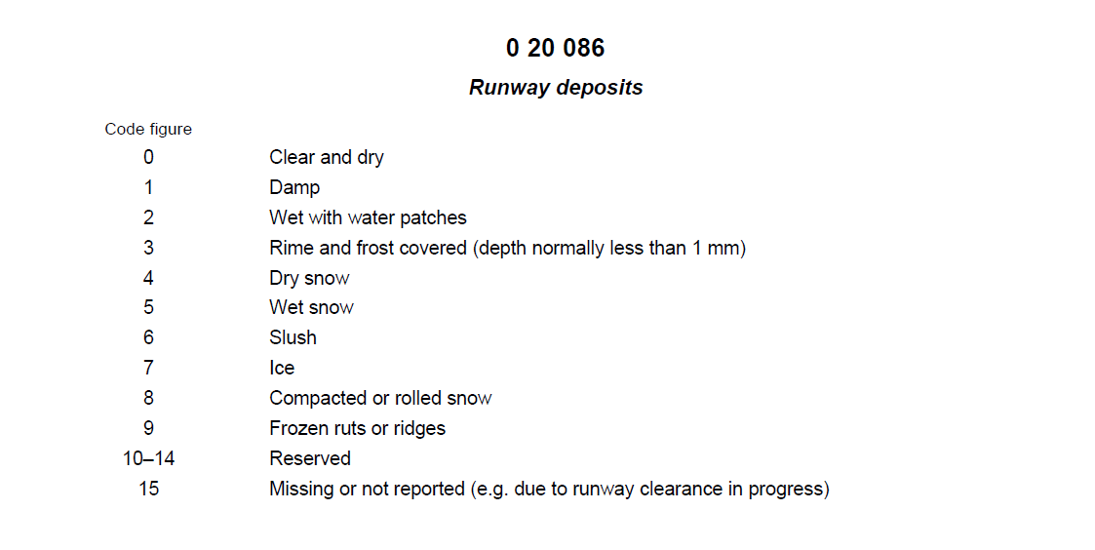
Leaf Registers
The WMO Codes Registry is organized into Sub-registers; where possible this is aligned with the organization of the WMO publications
Each Sub-Register is assigned a unique URI – adding a further segment to the URI of the parent Register
Leaf Registers represent the code-tables themselves; for example, table 0 20 086 “Runway deposits” from FM 94 BUFR (edition 4) Code- and Flag-tables has identifier http://codes.wmo.int/bufr4/codeflag/0-20-086

Slide 12
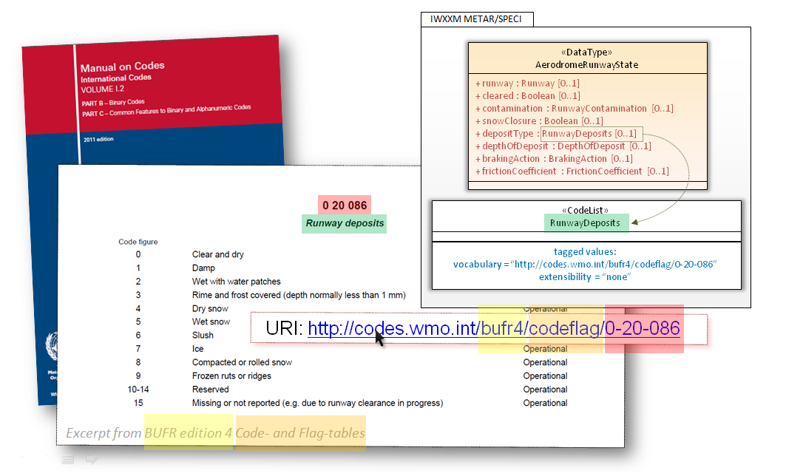
«CodeList» classes within AvXML
The leaf Registers are bound to «CodeList» classes in the AvXML Application Schema enabling the controlled vocabulary for AvXML to managed outside the model ...

Slide 13
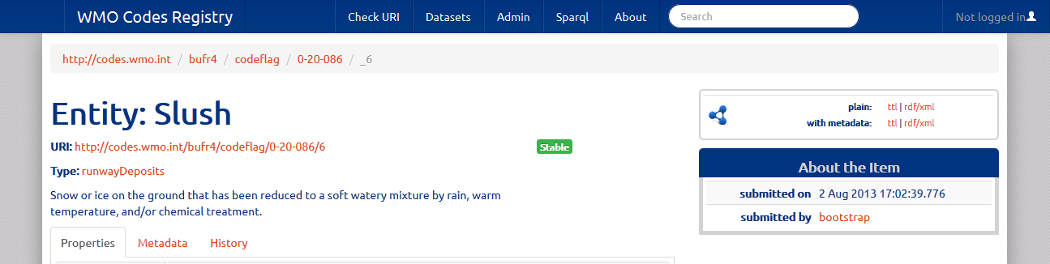
Codes and associated concepts
The Entities within these leaf Registers are the concepts represented by the codes, whilst the codes themselves are implemented as the Register Items
Where available, the numeric identifiers from the WMO code-tables are used as the Register Item ‘notation’
In the majority of cases, the unique URI for an Entity is assigned by appending the ‘notation’ to the identifier of the containing Register – thus ensuring clash-free allocation of identifiers; the Register Item identifier is distinguished from the Entity identifier by use of the underscore “_” syntax
Register Item URI
Entity URI

Slide 14
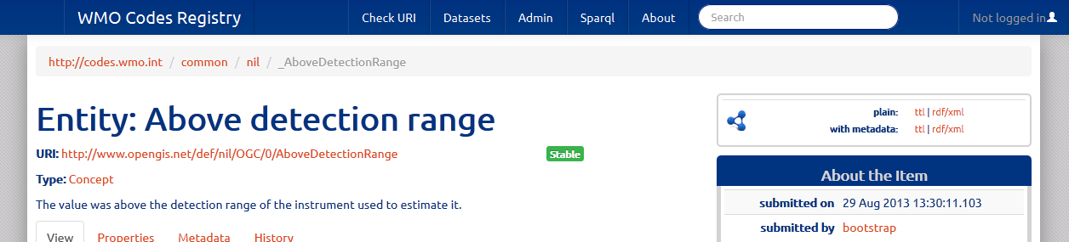
Externally managed Entities
In some cases, the Entity that is registered is defined elsewhere in the Registry – or perhaps defined by some external authoritative source
In such cases the Register Item identifier is still allocated by appending the ‘notation’, prefixed with an underscore “_” character, to the identifier of the containing Register. However, the identifier of the Entity shall refer to the external definition
For example, see the /common/nil Register that curates nil-reason codes:
  Register Item: http://codes.wmo.int/common/nil/_AboveDetectionRange
  Entity: http://www.opengis.net/def/nil/OGC/0/AboveDetectionRange

Slide 15
WMO TDCF encoding details (i)
The Register Item provides metadata about how an Entity is used in the context of a specific Register.
In the WMO Codes Registry, the Register Item represents the code rather than the concept represented by that code;
For example, in FM 94 BUFR (edition 4) table B, the concept “dew-point temperature” is referenced three times – each with different units of measurement and precision implied by the combination of ‘data-width’, ‘reference value’ and ‘scale’.
  Concept: http://codes.wmo.int/common/c-15/me/dewPointTemperature
  Code: http://codes.wmo.int/bufr4/b/12/_003
  Code: http://codes.wmo.int/bufr4/b/12/_024
  Code: http://codes.wmo.int/bufr4/b/12/_103
Note the underscore “_” syntax designating them as Register Items.

Slide 16
WMO TDCF encoding details (ii)
Each of these Register Items are configured with details about how the concept “dew-point temperature” is used in each context; e.g. the specific encoding information associated with each code. That is:
  BUFR_DataWidth_Bits
  BUFR_ReferenceValue
  BUFR_Scale
  BUFR_Unit
These properties are defined in the FM 94 BUFR ‘schema’ Sub-register:
  http://codes.wmo.int/bufr4/schema/core/BUFR_DataWidth_Bits
  http://codes.wmo.int/bufr4/schema/core/BUFR_ReferenceValue
  http://codes.wmo.int/bufr4/schema/code/BUFR_Scale
  http://codes.wmo.int/bufr4/schema/code/BUFR_Unit
A similar mechanism is provided for capturing WMO-specific metadata for codes within FM 92 GRIB (edition 2) and Common Features.

Slide 17
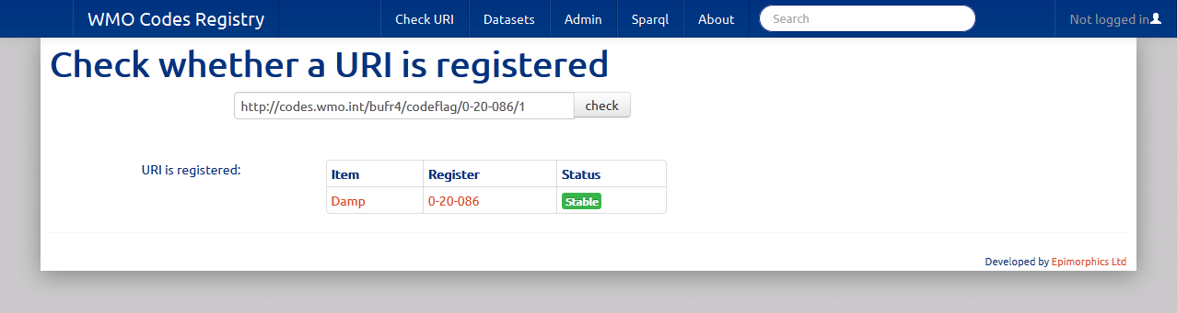
Register membership validation mechanisms
The WMO Codes Registry provides validation via both web application and programmatic API
In the case of the web application, one simply enters the URI of the term to be validated in the form-field and selects “check” …
Alternatively, the programmatic API may be used to achieve the same result by way of a HTTP POST request; e.g.
  [POST] http://codes.wmo.int/bufr4?
  validate=http://codes.wmo.int/bufr4/codeflag/0-20-086/1
  [HTTP 200 OK] http://codes.wmo.int/bufr4/codeflag/0-20-086/1 is http://codes.wmo.int/bufr4/codeflag/0-20-086/_1

Slide 18
Thank you for your attention
For further information please refer to the User Guide, FAQ and technical documentation

