Slide 1
Review of the current status of implementation of TCP/IP procedures and applications at GISC Beijing
ET-CTS 2019, SMN, Buenos Aires, 11-15 Feb 2019

Slide 2
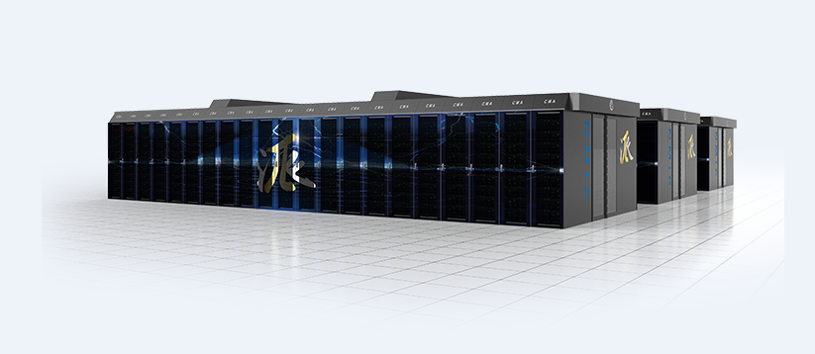
New HPC installed in CMA
  Draw (ShuGuang) HPC system, install in 2018, and put into operation in January, 2019
    Peak Computing Capacity: 8,189.5 TFLOPS
    Storage Capacity: 23,088 TB
    Based on Intel Xeon Gold 6142 processor, 2.6GHz
    Interconnected Network：IB(EDR)，100Gb/s

Slide 3
New National Communication System
  National communication system upgraded in January, 2019
  Supporting the transmission of:
    BURF format observing data from 2400+ national observation stations to provincial center and then to CMA, per minute.
    Frame (several degree per angle of elevation) data from 190 radar stations to provincial center and to CMA, and produce base data of whole radar scan in provincial center and CMA based on frame data.

Slide 4
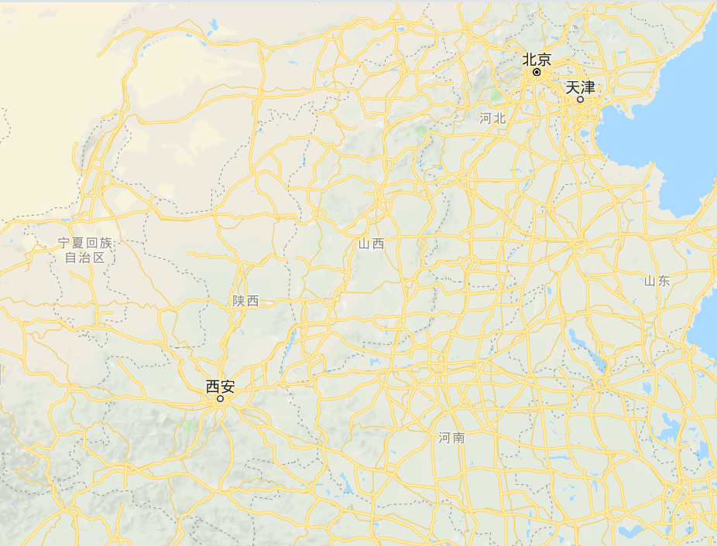

CMA’S DR Centers
Beijing
Internal and International network and communication systems
Data Management Systems
Data and Products
NWP and Forecasting Applications
CMA
20km
CMA
Communication DR
Internal network and communication system
International network system and GISC Beijing/DCPSs
Master station of CMACast system
Xi’an
The Building will be finished in 2019, and the backup
systems are under construction

Slide 5
International Telecommunication Network of GISC Beijing
EUMETSAT
Offenbach
Tokyo
Moscow
New Delhi
Toulouse
Seoul
Melbourne
Islamabad
Washington
…
0
Internet
RMDCN-NG
MPLS VPN
16 Mbps+16Mbps(DR)
450Mbps+150Mbps(DR)
GISC Beijing
64
Kbps
64
Kbps
64
Kbps
64
Kbps
20
Mbps
20
Mbps
Bangkok
Hanoi
Pyongyang
Ulan Bator
Hong Kong
Macao

Slide 6
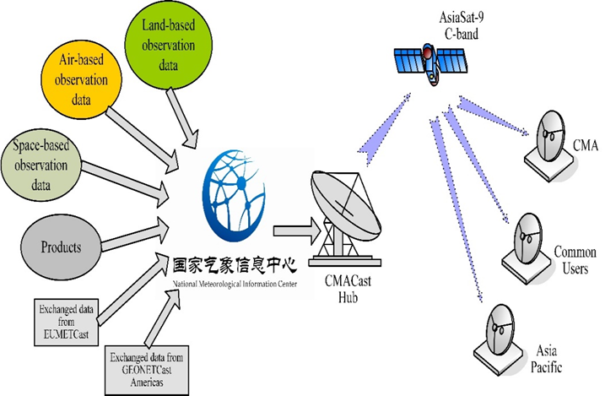
Data Sharing System: CMACast + CMACloud
For CMACast Users:
  Using CMACast receive data and work locally (traditional method)
  Using CMACloud Client download data from CMACloud and work locally
  Using MICAPS4 Client directly access the data from CMACloud
  Using Browser access WebMicaps and work on CMACloud
Data and application of process (WebMicaps)

