Slide 1
Met Office 2019 Update
Submitted by: United Kingdom
ET-CTS 2019
Buenos Aires, Argentina
Date: 11-15 February 2019
WMO. ET-CTS 2019

Slide 2
Met Office Update 2019
Supercomputer
Cloud
Message Switching
Telecomms
Networks
Future

Slide 3
Supercomputer
Cray XP40 - Largest international contract in Cray’s history at that time (2015)
Phases 1&2 total 40% of our capability and was installed into existing IT Halls 2015 & 2016.
Phase 3 - September 2016 60% of our total capability Installed in new IT Hall
Total: Compute nodes: 12932, Cores: 460672
Peak TFLOPS 15600

Slide 4
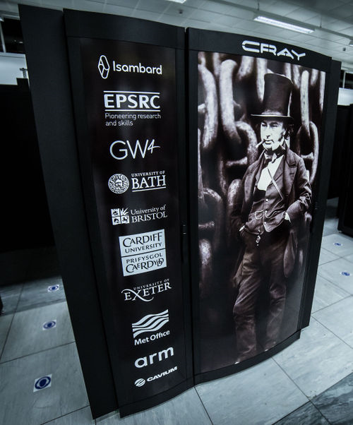
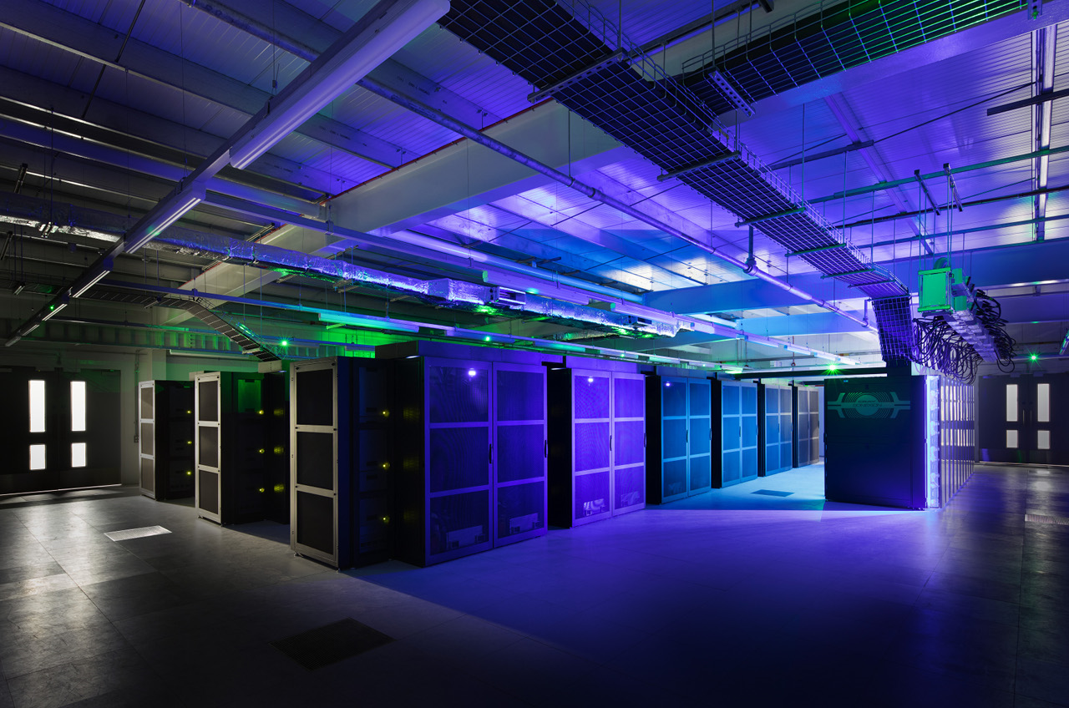
Supercomputer

Slide 5
Cloud
The internet is now considered “good enough” (even without an SLA)
Requires applications “architected for failure”.
Green-field – opportunity to code and operate differently.
Deliberately take advantage of SaaS/PaaS
Adopting cloud services for new requirements.
“Cloud first” for commodity software.

Slide 6
Cloud - Exploitation
Cloud Operations Team (FinOps, SecOps + templates and good practice).
Cloud data platform “ServiceHub” as a source of all our production data.
This is in place, and some services are already available from it.
Will eventually replace all our existing on-premises web services (WAVE)

Slide 7
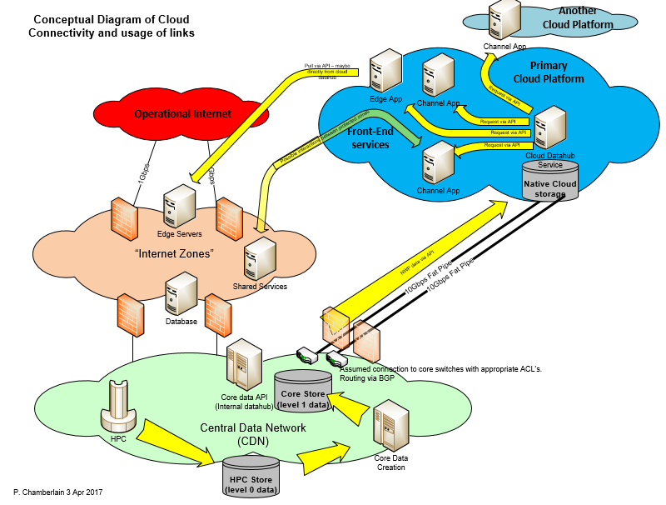
Cloud – Conceptual Data Flows

Slide 8
Message Switching
Message Switch - IBL Moving Weather
GISC – OpenWIS application
File Switching – AFD on mainframe
USA now on Internet. UK “bridge” between USA & Japan.
Only Oslo & De Bilt remain as WMO socket connections.
Successful multi-Gbps transfers to cloud.

Slide 9
Message Switching
Daily traffic since 2006

Slide 10
Telecommunications
2 x 1Gbps to Internet (commercial, resilient)
to be upgraded to 2 x 10Gbps in March 2019 (IP service initially 3Gbps)
10Gbps to JANET (NREN, resilient) (2018) includes BADC traffic
1Gbps to ECMWF (upgraded from 100Mbps 2017)
Upgrade to 100Mbps RMDCN (from 20Mbps in 2018 to help with migration)
2 x 10Gbps Direct Connect to AWS (2017)

Slide 11
Telecommunications
WAN Replacement in progress
    New provider. Over halfway there.
Replacement of PABX –
  New dial-up PABX for observations.
  Skype for users.
  Contact Centre for 24/7 weatherdesk

Slide 12
Networks
Spine and Leaf CLOS network
160Gbps spine-core.
Network Core (x 6)
Network Spine (x 10)
2 x 100Gbps Connectivity to IT Halls 3
Upgraded external connectivity environment – replaced all firewalls (2018)

Slide 13
Future
Next HPC. This will not be on our premises.
MASS storage may not be either.
Campus Access switch replacement, merge with Wi-Fi.
Connection to other cloud providers.
What if there was no Exeter?
Multiple ISP.
Keeping infrastructure relevant (i.e. make sure we are helping cloud teams with Network design)!

Slide 14
Thank you for your attention
Phil.chamberlain@metoffice.gov.uk

