Slide 1
Current Status at ECMWF
ET-CTS 2019, SMN, Buenos Aires, Argentina
Oliver Gorwits
Head of Platforms and Services

Slide 2

Hello from ECMWF!

Slide 3
Real-time Data Volumes Growth Projections
Real time data produced in ECMWF forecast system
Real time data disseminated by ECMWF
Notes:
2021: factor = 2**2, 2025: 1.8**2~3.25
produced
the ECMWF Strategy 2016-2025: global ensemble forecast at 5 kilometres resolution
the volume of the real-time data produced by the ECMWF integrated forecasting system may increase by a factor of 12 by the year 2025
disseminated
gap between data produced and disseminated is large
projected increase taking into account the projected increases in ensemble resolution
neglected: increase in demand but broader use of ensemble data in future expected, example: number of maximum charge customers rose by 54%

Slide 4
Local area and Internet Networks
Today, 4x 10GE with 15 Gbps IP bandwidth
  Peak at 12.5 Gbps
Preparing for a move to Bologna, Italy
  2x 100GE at each site
    100 Gbps IP b/w for two years to synchronise parallel HPCs
    2x 40 Gbps IP bandwidth thereafter
  Re-procure all infrastructure (green-field site) in 2019
IPv6? WAN-only today, perhaps more in Bologna

Slide 5
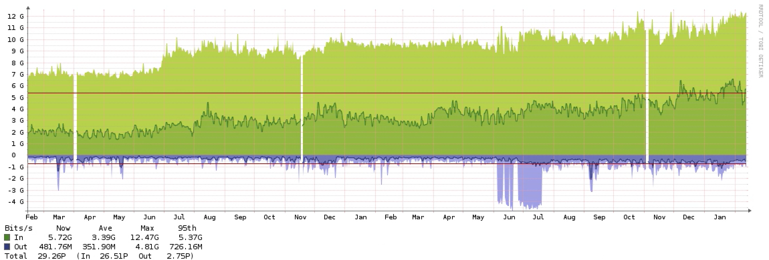
Internet Connection

Slide 6
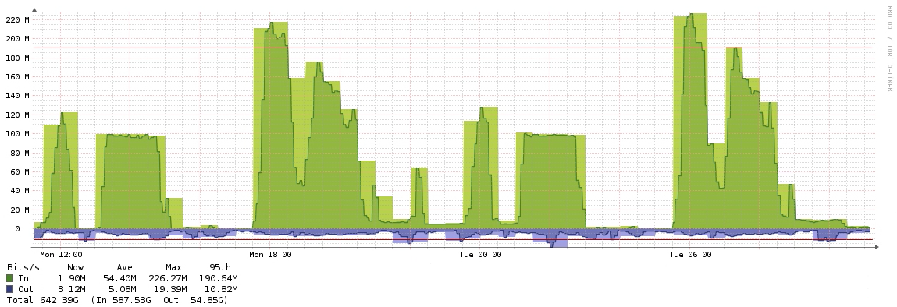
RMDCN Connection
500 Mbps
Comfortably within this at ~220 Mbps daily peak
Unlikely to upgrade following TCR2 and before Bologna
Likely to be 1 Gbps in Bologna (simply easier)

Slide 7
Acquisition, Dissemination, and Data Portal
Single infrastructure/platform for all services
  Internet: 23 servers
  RMDCN: 4 servers, LAN: 8 servers
Data transfer volumes are [always] increasing
  Internet: 23 TB / day (6.4 in 2016, 4.1 in 2015, 2.9 in 2014)
  RMDCN: 738 GB / day (165 in 2016, 107 GB 2015)
Internet sources and destinations: 792 (488 in 2016, 254 in 2014)
RMDCN destination hosts: 79

Slide 8
Observation Volumes per Network
Monthly volume of data acquisition: 2.6 TB (~105 GB/day)
Key in-situ observations are all available via RMDCN only
Notes:
key insitu obs: SYNOP, SHIP, BUOY,TEMP, DROPSONDES, PROFILER. PILOT, AIRCRAFT

Slide 9
Dissemination volumes per network
Monthly volume of data transmission: 857 TB (~28.6 TB/day)
Member and cooperating states use RMDCN as backup for most important products
Notes:
Increasing Exponential Trend for Internet
Why are users using the Internet, and not just RMDCN?
WMO Information System (WIS) dissemination:
GTS
EUMETCast dissemination route for RA VI and ACMAD
Data Collection or Production Centres (DCPC)
- dissemination via ecCharts.

Slide 10
Climate Data Store and WEkEO
“CDS provides access to a wide range of climate datasets via a searchable catalogue. An online toolbox is available that allows users to build workflows and applications suited to their needs.”
“WEkEO is the EU Copernicus DIAS reference service for environmental data, virtual processing environments and skilled user support.”
Virtual infrastructure IT hosted in ECMWF’s data centre
OpenStack, 1800 CPUs, 6TB RAM, 100TB SSD + 900TB
Procured by ECMWF (Copernicus), managed by contractor
Hosting external (alien) users’ workload

Slide 11
Stress Points and Future Development
One ECPDS (acq/diss/portal) infrastructure is problematic
  Single failure can affect three services
Third party systems in the data centre
  We will make this (multi tenancy) easier in Bologna
Lots of Access Management work: Keycloak users?
Growing data volumes
  “European Weather Cloud”
  with EUMETSAT and other Member States
Oh, and moving our data centre from UK to Italy!
  Design, purchase, and deploy everything again in 2019-2020

Slide 12
Thank You
Any questions?

