Slide 1
Status Report of GISC Tokyo
Yoritsugi YUGE (OHNO)
ICT division
Japan Meteorological Agency (JMA)
(Doc 2.x)
ET-CTS 2019, SMN, Buenos Aires, Argentina
Date: 11-15 February 2019

Slide 2
Communication circuit (1)
Topics:
  Establishment of a new link (Internet VPN)
    with Nay Pyi Taw in November 2016
    with Dhaka in May 2017
    with Ulaanbaatar in October 2017
  Migration from TCP socket to FTP connection
    with Exeter and Melbourne in March 2017
    with Khabarovsk in January 2018
  Establishment of a new link (IP-VPN) with Hanoi; September 2018
  Upgrading the bandwidth of MPLS access link (NTT-COM) from 2 Mbps to 6 Mbps; December 2018
Plans:
  Migration of the link with New Delhi, Bangkok, Hong Kong and Manila from the TCP socket to FTP connection in 2019-2020
  Establishment of a new link (RMDCN) with GISC Jeddah in 2019

Slide 3
Communication circuit (2)
GISC/RTH Tokyo
Dedicated
DCPC/RTH Khabarovsk
64Kbps
2Mbps
IP-VPN
IP-VPN
DCPC Doha
10Mbps
10Mbps
100Mbps
6Mbps
2Mbps
NC Hanoi
MPLS Network
Regional Meteorological Data Communication Network (RMDCN)
(GTT communications)
MPLS Network
(NTT Communications)
NC Phnom Penh
NC Vientiane
GISC Melbourne
4Mbps
128Kbps
DCPC/RTH Bangkok
GISC Beijing
16Mbps
1Mbps
DCPC Hong Kong
Internet
GISC Offenbach
50Mbps
64Kbps
NC Manila
GISC Toulouse
100Mbps
GISC Washington
GISC Exeter
20Mbps
GISC New Delhi
6Mbps
NC Ulaanbaatar
GISC Seoul
6Mbps
NC Nay Pyi Taw
GISC Brasilia
NC Dhaka
Notes:
This slide shows “Configuration of communication circuit (GTS) of GISC Tokyo”.

Slide 4
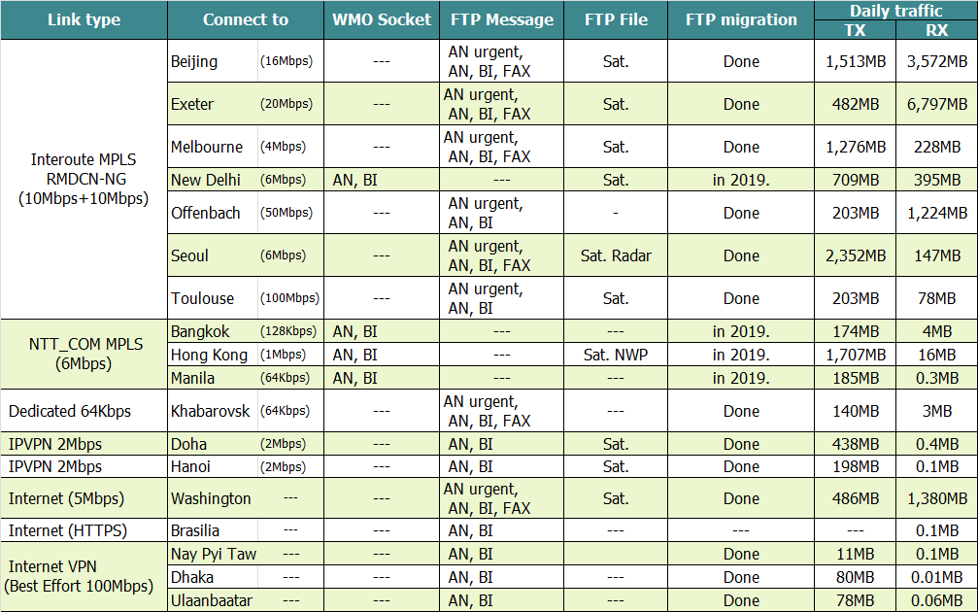
Communication Circuit (3)
Implementation status
15th January 2019
Notes:
This slide shows “Implementation status of communication circuit (GTS) connected to GISC Tokyo”.

Slide 5
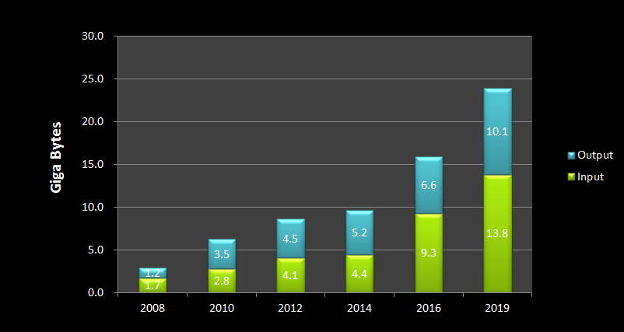
Daily Volume (1)
Text, Binary, FAX message and File
Notes:
This slide shows “Daily volume on GTS circuit”. It is excluding Internet connection.

Slide 6
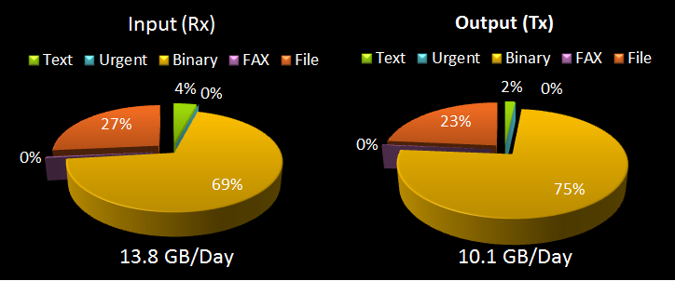
Daily Volume (2)
Occupancy rate (each channel)
Notes:
This slide shows occupancy rate on daily volume.
As you can see, 97-98% is binary & file (bufr & grib) data.

Slide 7
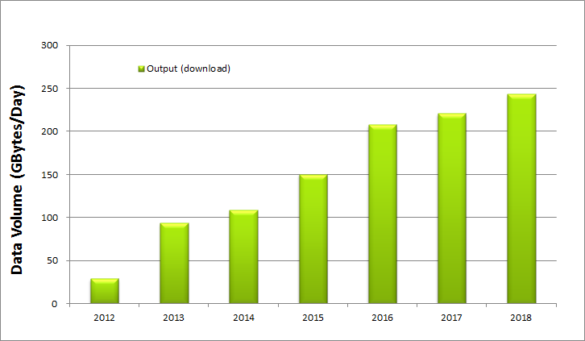
Average Daily Download Volume on the Internet
Downloading data
240 GB/Day
WIS part-B Internet Traffic
Bandwidth 100Mbps
Notes:
This slide shows average daily download volume on Internet service.
In our Internet service, we are providing Himawari-satellite data and High resolution GSM data in addition to routing data.

Slide 8
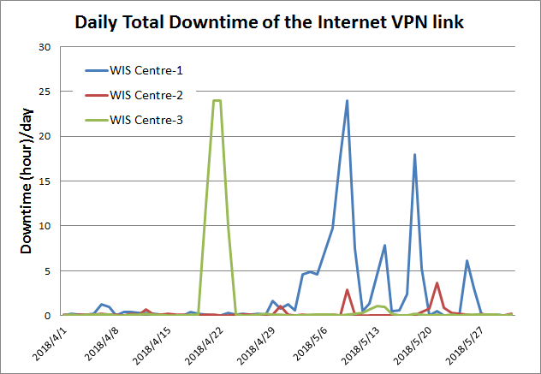
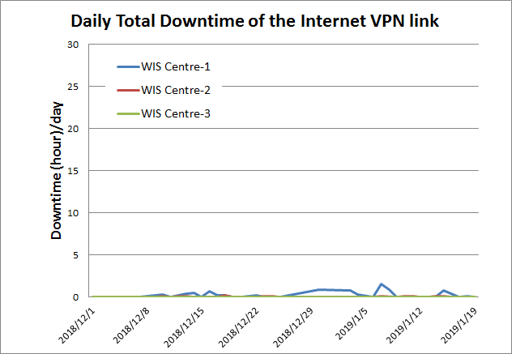
Internet VPN connection on AMDCN of GISC Tokyo
Before (in Apr – May 2018)
Currently (in Dec 2018 – Jan 2019)
2 days
1 day
90 min
GISC Tokyo has connected with three NC centers through Internet VPN link.
Almost NCs have two or more data connections with their neighbouring WIS centres.
Internet connection is gradually stable operation in Asia region.
Before sometimes, NC's Internet connection had traffic jam due to their Internet was sharing to get product data. And also NC’s ISP was to be in down due to electric power problem for a few days.
Notes:
This slide shows daily total downtime of Internet VPN connection.
GISC Tokyo has connected with three NC centers through Internet VPN link.
Almost NCs have two or more data connections with their neighbouring WIS centres.
Internet connection is gradually stable operation in Asia region.
Before sometimes, NC's Internet connection had traffic jam due to their Internet was sharing to get product data. And also NC’s ISP was to be in down due to electric power problem for a few days.
I think recently, their Internet connection is stable operation.

Slide 9
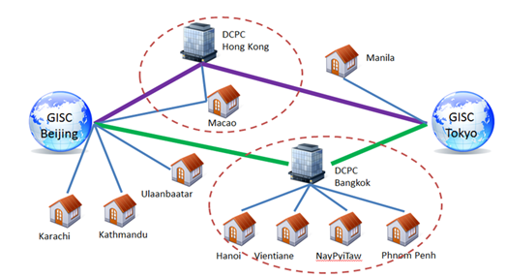
GISC Backup (1)
GISC Beijing
GISC Backup between Beijing and Tokyo is in operational by using GTS and Internet DAR service.
GISC Melbourne
  Tokyo has two options for AoR of Melbourne;
  option 1: Existing GTS based backup
  option 2: Internet based backup
  Both options are already running in backup with Beijing and Offenbach.
Notes:
GISC Tokyo has bilateral agreements on GISC backup with GISC Offenbach, GISC Beijing and GISC Melbourne.
GISC Backup between Beijing and Tokyo is in operational by using GTS and Internet DAR service.
GISC Melbourne and Tokyo, GISC Tokyo has two options for the Centre of AoR of Melbourne.
Option 1 is to use existing GTS based backup and option 2 is to use Internet based backup.

Slide 10
GISC Backup (2)
GISC Offenbach
  GISC Backup between Offenbach and Tokyo is in operational by using Internet.
    To Offenbach: using FTP put
    To Tokyo : using HTTPS file upload
GISC Tokyo
GISC Offenbach
HTTPS file upload
FTP put
Internet
cache
cache
DCPC
NC
DCPC
NC
NC
NC
NC
NC
GISC Tokyo AMDCN
GISC Offenbach AMDCN
Notes:
Between GISC Offenbach and Tokyo is in operational by using Internet. The centres of the Area of Responsibilities send data to Offenbach by using FTP_PUT and to Tokyo by using HTTPS file upload function. GISC Tokyo shows their received data on the Internet.

Slide 11
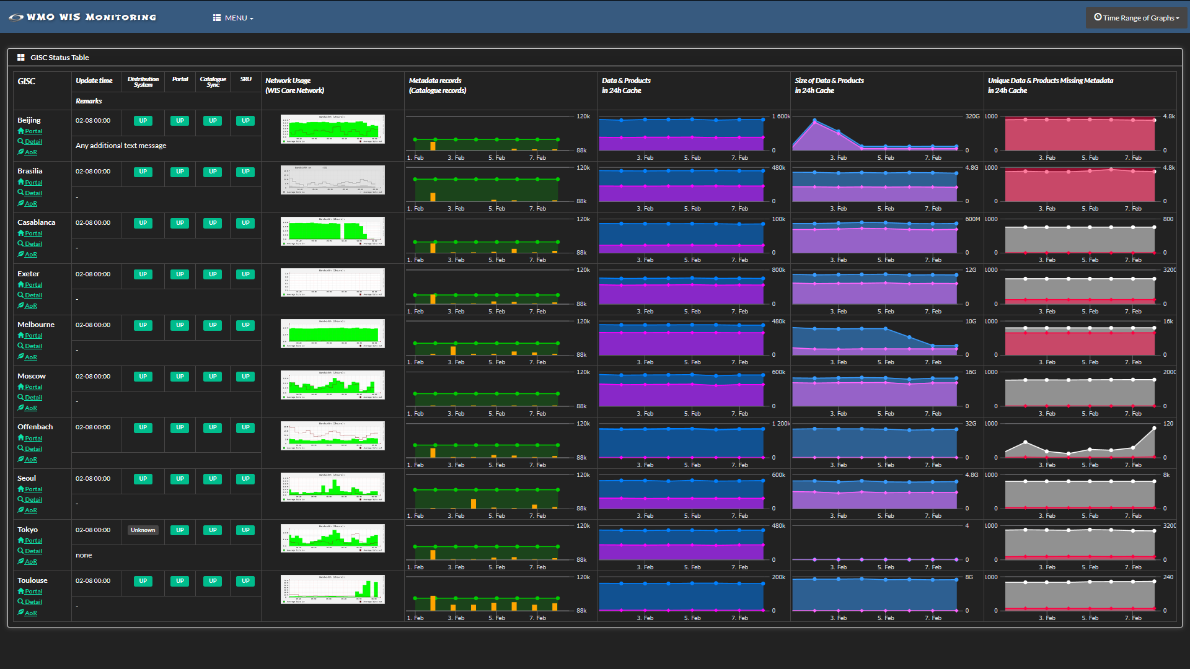
WIS monitoring
https://www.wis-jma.go.jp/wcd/v1/top.html
Notes:
GISC Tokyo has been operating WIS Monitoring Dashboard.
And the WIS Monitoring is a collective effort of all WIS Centres to provide comprehensive and up-to-date information that enable reports on system status including availability, stability, integrity.

Slide 12
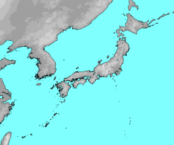
Disaster Recovery Site (DRS)
JMA's Disaster Recovery Site (DRS) on west side of Japan (Osaka city, 500km far from Tokyo) has been in operation since March 2015.
If the Tokyo system has a failure, JMA will switch over to Message Switching System (MSS) of Osaka DRS to continue data exchange.
The MSS of DRS has the same architecture of Tokyo's MSS and access lines of MPLS networks. Several centres finished a connectivity test and started backup operation.
RMDCN-NG
Tokyo
500Km
Osaka
AMDCN
Notes:
This slide shows our Disaster Recovery Site.

Slide 13
Recommended Text
GISC Tokyo has a high availability connection to RMDCN-NG (10Mbps+10Mbps, Platinum Service), MPLS of the NTT-Communications (6Mbps) and Internet access (100Mbps Guaranteed bandwidth).
And also GISC Tokyo has a Disaster Recovery Site (DRS) in Osaka city which is located in 500 km far west side of Tokyo.
GISC Tokyo has bilateral agreements on GISC backup with GISC Offenbach, GISC Beijing and GISC Melbourne. Its backup procedures have been in operation.
GISC Tokyo has a plan to migrate from TCP socket to FTP connection in 2019-2020.
GISC Tokyo has a plan to hold WIS Workshop in JMA HQ in 11th-12th March 2019.

Slide 14


Thank you
Gracias
GISC Tokyo Web portal: https://www.wis-jma.go.jp/
JMA HP: https://www.jma.go.jp/jma/indexe.html

Slide 15
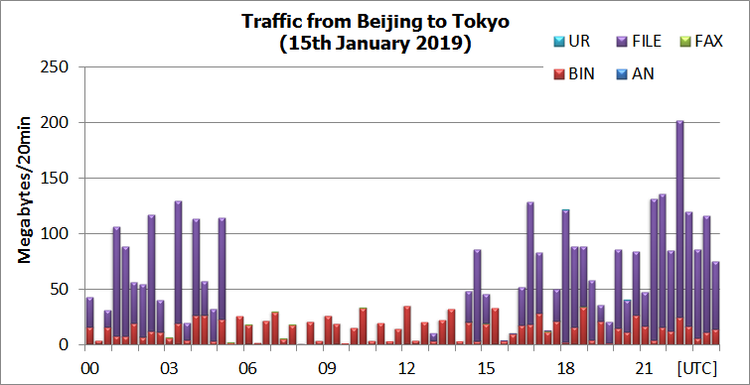
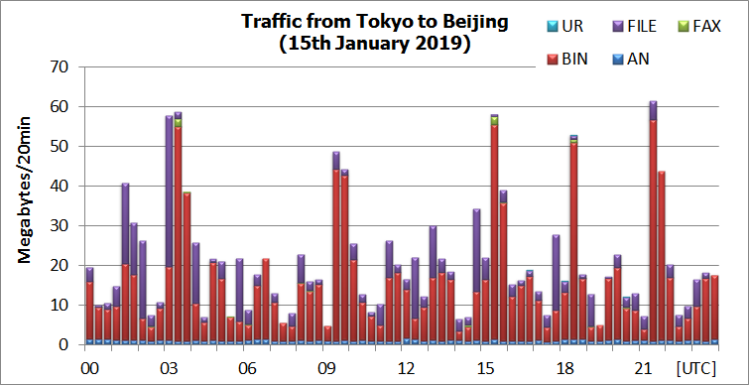
Beijing (16Mbps) – Tokyo (10Mbps)
3.6GB/Day
1.5GB/Day

Slide 16
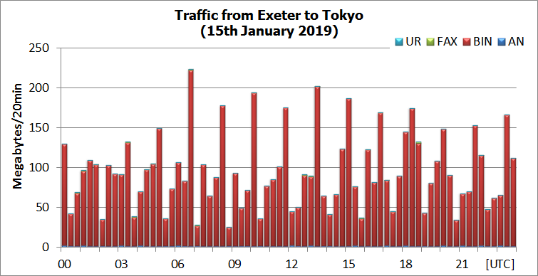
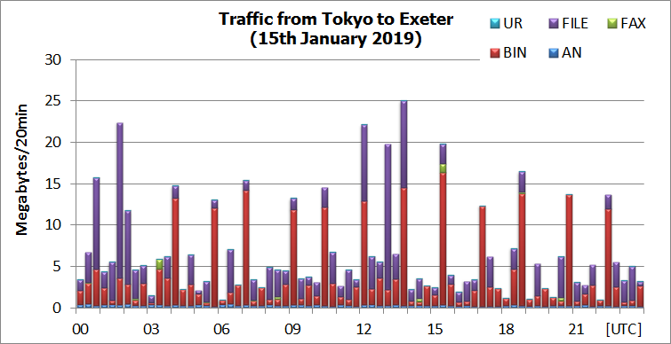
Exeter (20Mbps) – Tokyo (10Mbps)
6.8GB/Day
482MB/Day

Slide 17
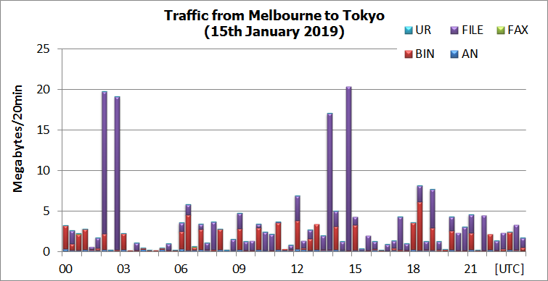
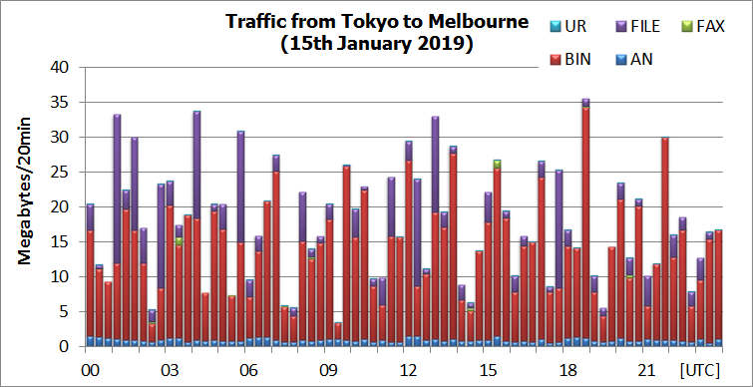
Melbourne (4Mbps) – Tokyo (10Mbps)
228MB/Day
1.3GB/Day

Slide 18
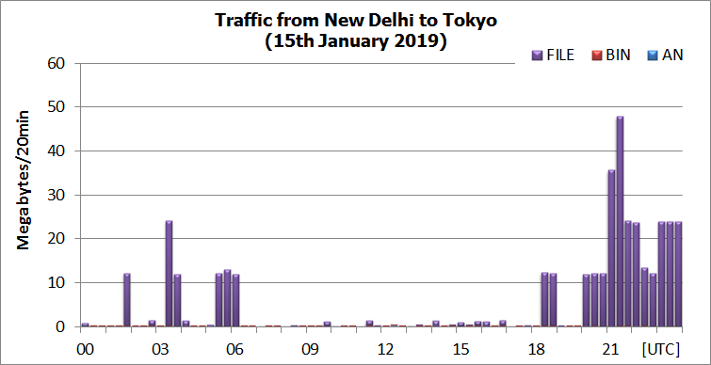
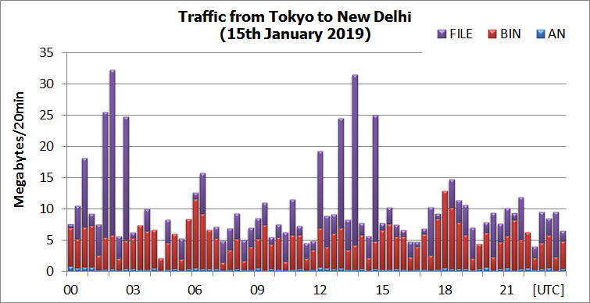
New Delhi (4Mbps) – Tokyo (10Mbps)
395MB/Day
709MB/Day

Slide 19
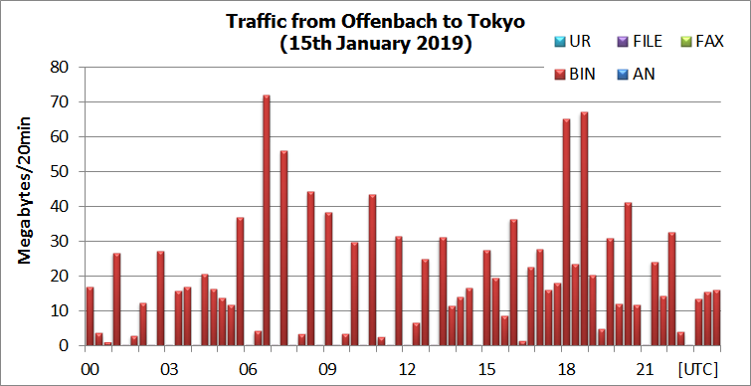
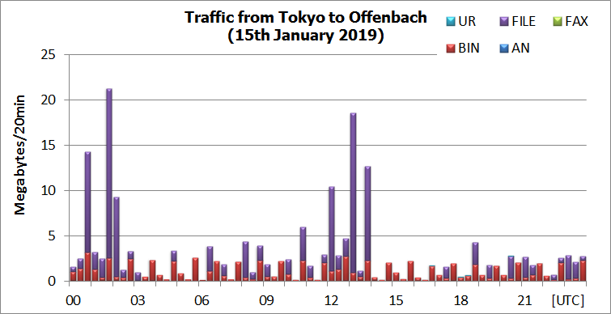
Offenbach (50Mbps) – Tokyo (10Mbps)
1.2GB/Day
203MB/Day

Slide 20
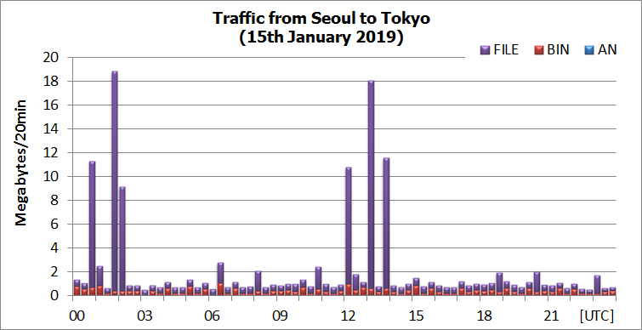
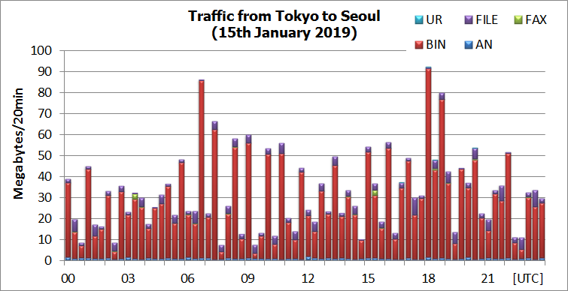
Seoul (4Mbps) – Tokyo (10Mbps)
147MB/Day
2.4GB/Day

Slide 21
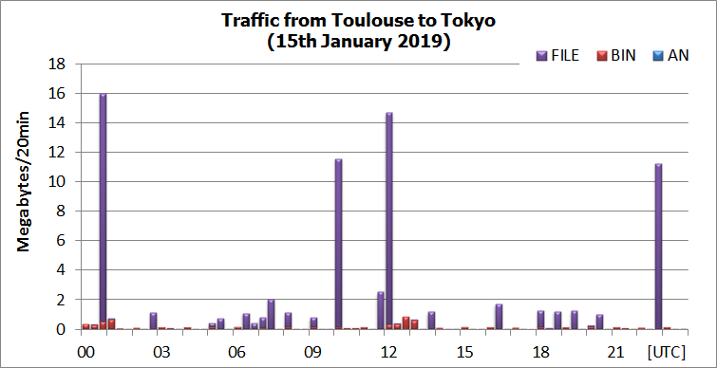
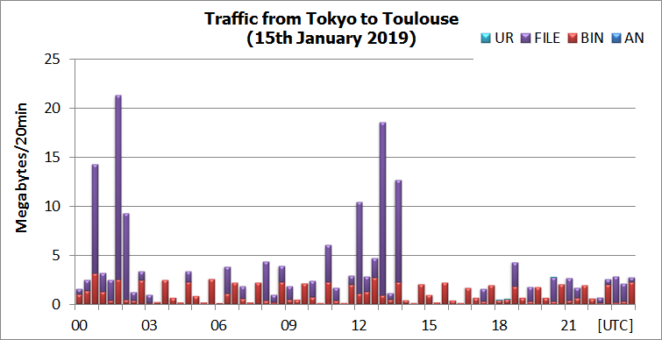
Toulouse (50Mbps) – Tokyo (10Mbps)
78MB/Day
203MB/Day

Slide 22
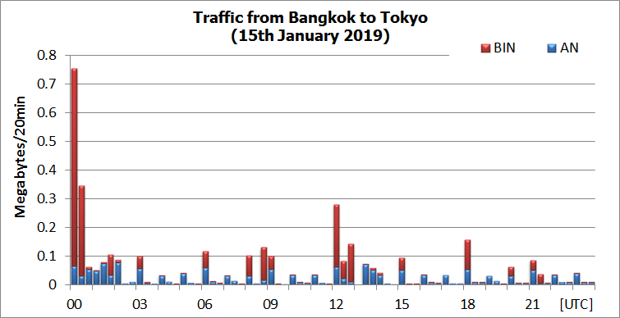
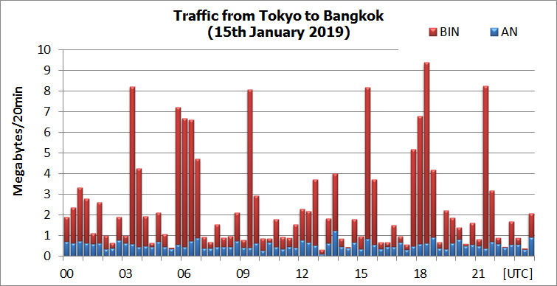
Bangkok (128Kbps) – Tokyo (2Mbps)
4MB/Day
174MB/Day

Slide 23
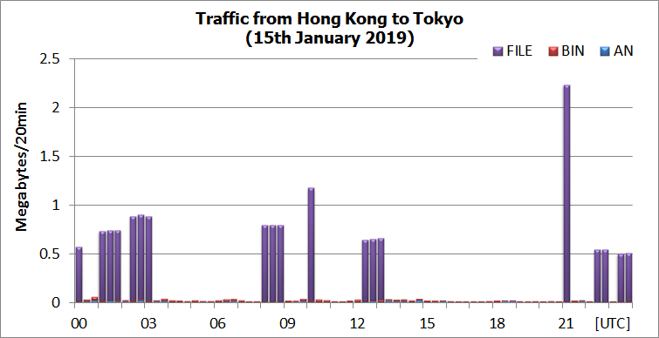
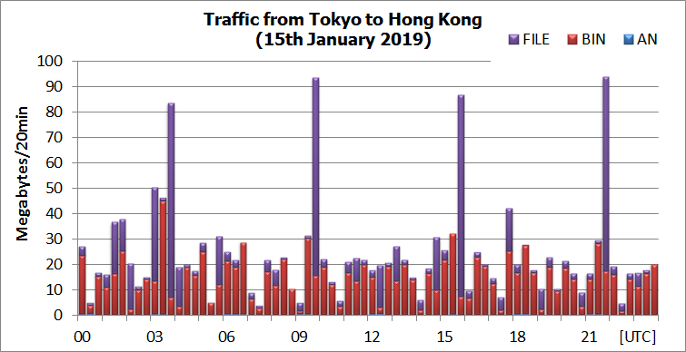
Hong Kong (1Mbps) – Tokyo (2Mbps)
16MB/Day
1.7GB/Day

Slide 24
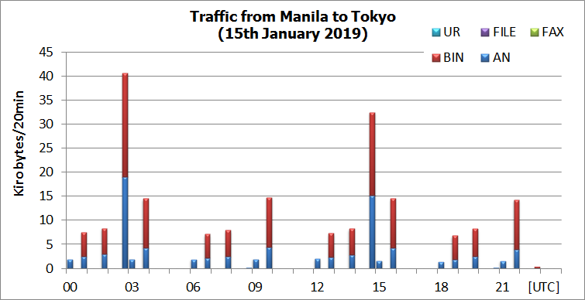
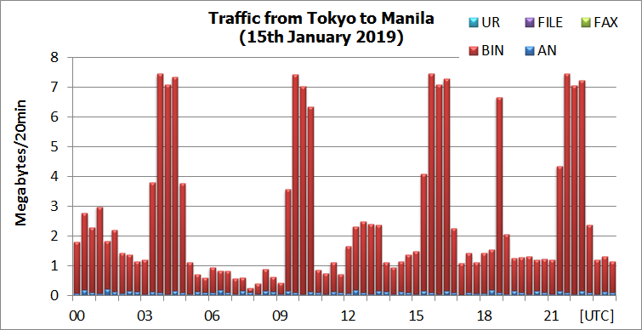
Manila (64Kbps) – Tokyo (2Mbps)
0.3MB/Day
185MB/Day

Slide 25
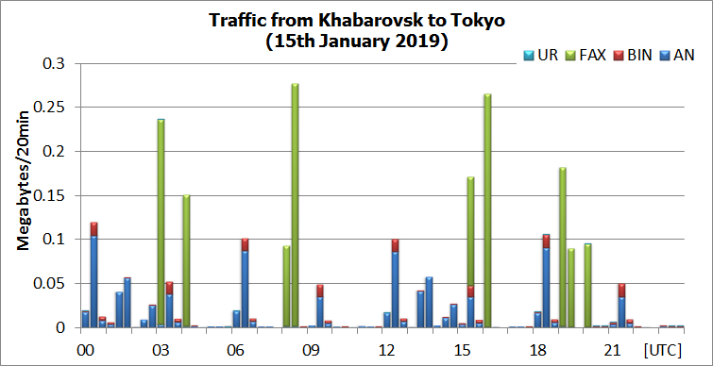
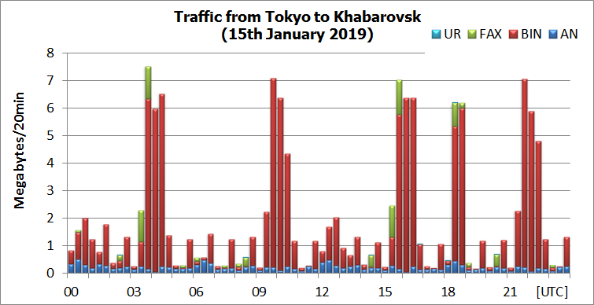
Khabarovsk (dedicated 64Kbps) – Tokyo
3MB/Day
140MB/Day

Slide 26
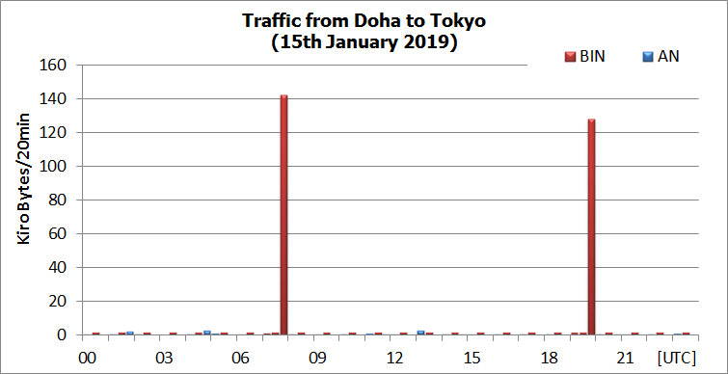
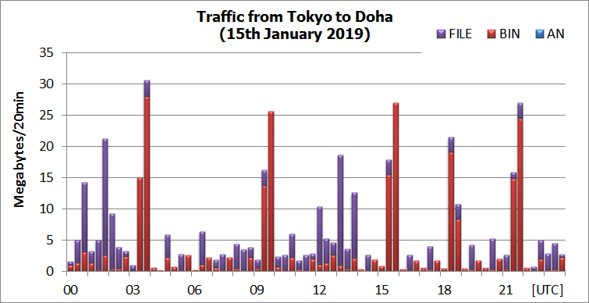
Doha (IPVPN 2Mbps)– Tokyo
0.4MB/Day
438MB/Day

Slide 27
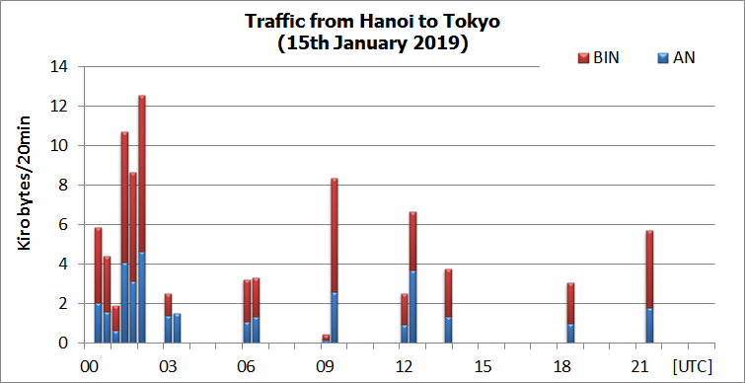
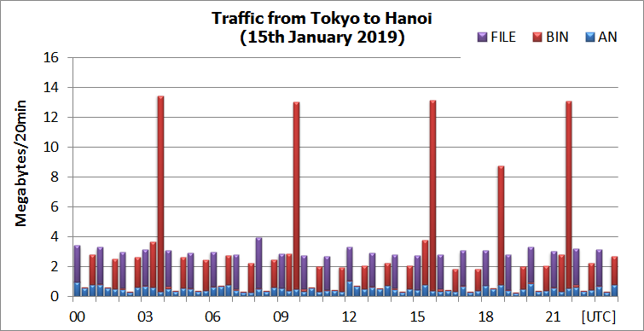
Hanoi (IPVPN 2Mbps)– Tokyo
0.1MB/Day
198MB/Day

Slide 28
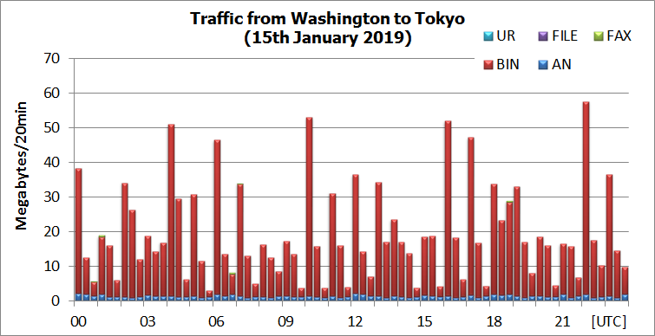
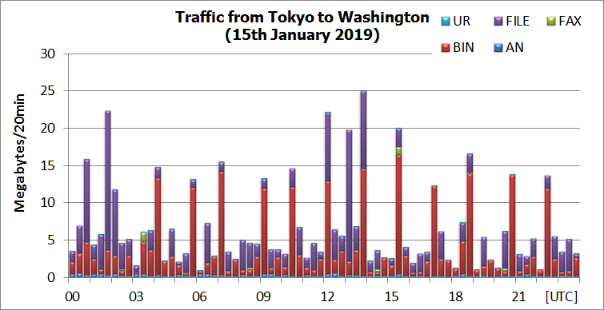
Washington (Internet) – Tokyo (Internet)
1.4GB/Day
490MB/Day

