Slide 1
RMDCN Service
Oliver Gorwits
ECMWF
oliver.gorwits@ecmwf.int

Slide 2
Overview
The Regional Meteorological Data and Communication Network (RMDCN) currently provides connections to 55 sites.
  Changes during 2017-2018
    Connection with USA was terminated
    New sites: New Caledonia, Algeria, Azerbaijan
  Soon 58 (Tunisia, Israel-DR, Kazakhstan)
2017
  completion of the implementation of first Technical and Commercial Refresh
    Half of sites opted for bandwidth upgrade; other half chose reduction in MRC
  ECWMF met with Interoute Senior Management to discuss delays (notably Ireland, France)
2018
  May 2018: GTT Communications Inc. completed the acquisition of Interoute Communications Ltd.
  Received offer second Technical and Commercial refresh (31/12/2018)
  ECMWF TAC subgroup to investigate the future requirements of the RMDCN beyond its current contract term which ends in June 2022

Slide 3
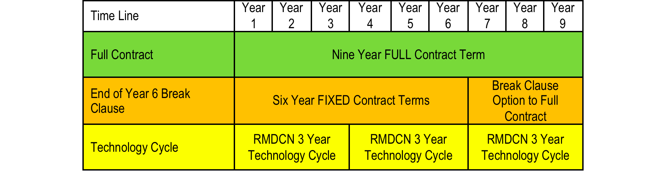
RMDCN Contract
30 June 2013
Feb 2019
30 June 2022

Slide 4
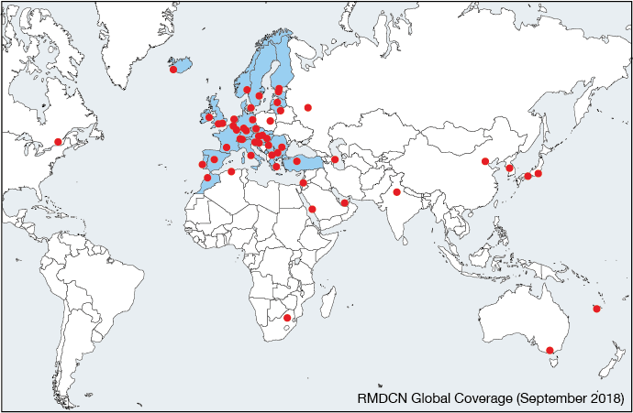

Slide 5
Service Performance
The performance of the RMDCN service is monitored on the basis of contractually agreed service levels with the service provider GTT.
The main performance indicator is the RMDCN service availability for all connected sites; other service level elements include, for example, circuit downtimes and guaranteed time‐to‐repair.
The performance of the RMDCN service over the reporting period has been very good, with Global Service Availability at 100% for most of the period.
  July 2017 two separate incidents in Interoute’s core network affected the availability for some sites for a very short time
  March 2018: A local LAN issue impacted the service in Latvia for about 3.5 hours.
  There was one month (May 2018) where the global service availability was below 100%. Canada was affected by a 5‐day circuit downtime. Unfortunately, Canada is a single connected site without a backup connection so this had a significant impact on their service.
non service‐impacting issues:
  Notably delays in fixing the primary connection for Luxembourg and backup connection in Portugal in December 2017, CRC errors on one connection in Latvia (April 2018), and unavailability of the backup service in France for seven days (June 2018).

Slide 7
Future
Second Technical and Commercial Refresh
TAC Subgroup
  to assist ECMWF with the Technical and Commercial Refresh (TCR) process of the current RMDCN service contract with GTT in 2019;
  to assist ECMWF in its preparation of a strategy for the future development of a potential newly oriented service beyond 2022;
  to assist ECMWF with the definition of requirements for the future service, including the current requirements for WMO RA VI GTS and WIS and the emerging requirements and usage scenarios that are being developed within the European Weather Cloud initiative;
  to involve WMO/RA VI, WMO Secretariat and EUMETSAT as observers in the Subgroup, as appropriate.
Connection to new ECMWF Data Centre in Bologna (1Q 2020)

Slide 8
TAC Subgroup 2019 Mini Update
Subgroup met at ECMWF 11-12 February 2019
Action Plan
  Survey user sites to gather status and requirements for the future
  Contact EUMETSAT who were not able to attend the meeting ✅
  Clarify existing termination clauses for acceding parties (Tier 3 sites)
  Review TCR and discuss with the Subgroup
    Get a better deal for Tier 3 sites
    Meet online in April, hopefully to endorse the negotiated offer
  Three options:
    Re-procure the RMDCN
    Extend the current contract (another TCR term)
    End the RMDCN service
  Deliver report and proposal to ECMWF TAC September 2019

Slide 9
Thank You!
Any questions?

Slide 10
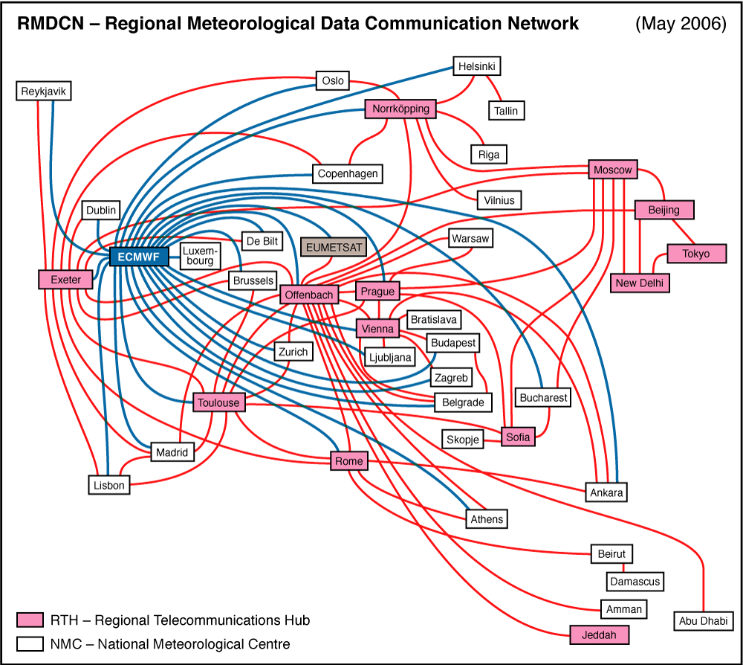
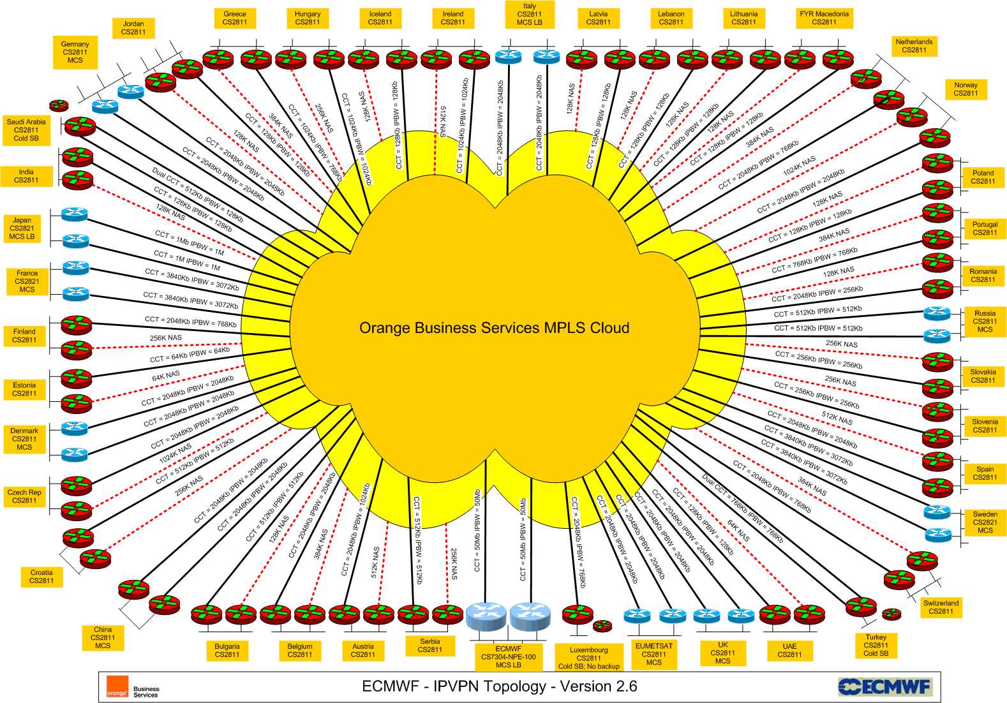
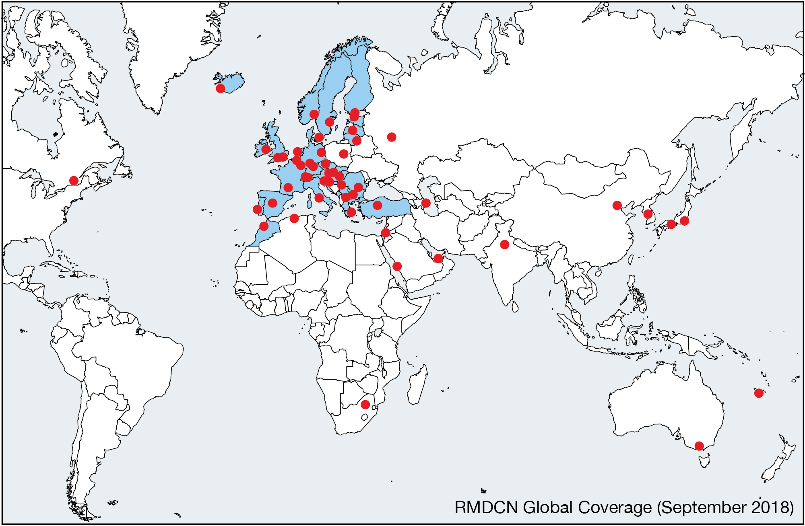
Evolution of the RMDCN Service
Initial Technology Frame Relay
2007 migrated to MPLS IP VPN
  Any to any connectivity
Several contract amendments during contract with Equant /
Orange Business Services
  Change technology + Controlled growth beyond WMO RA VI (GISCs)
2007 TAC Subgroup – discuss the (then) future of the RMDCN beyond 2010
2010 ITT for RMDCN-NG
  9-year contract with Interoute Communications Ltd – operational service 30 June 2013
    Break clause after year 6; Technical and Commercial Refresh (TCR) every three years.
2015 TAC Subgroup – assess TCR-1
WMO assisted ECWMF in all the TAC Subgroups on RMDCN
Grown from 30 sites in 2000 to 55 sites in 2019 (soon 57)

