Slide 1
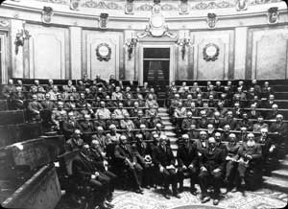

CONSTITUENT BODY REFORM (CBR)
ET-CTS 2019 Update
1873
2050
WMO for the 21st Century

Slide 2
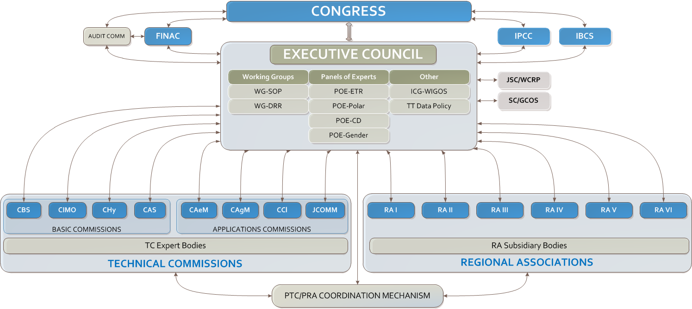
Current WMO Constituent Bodies
OPAG-ISS
ET-CTS
WE ARE HERE

Slide 3
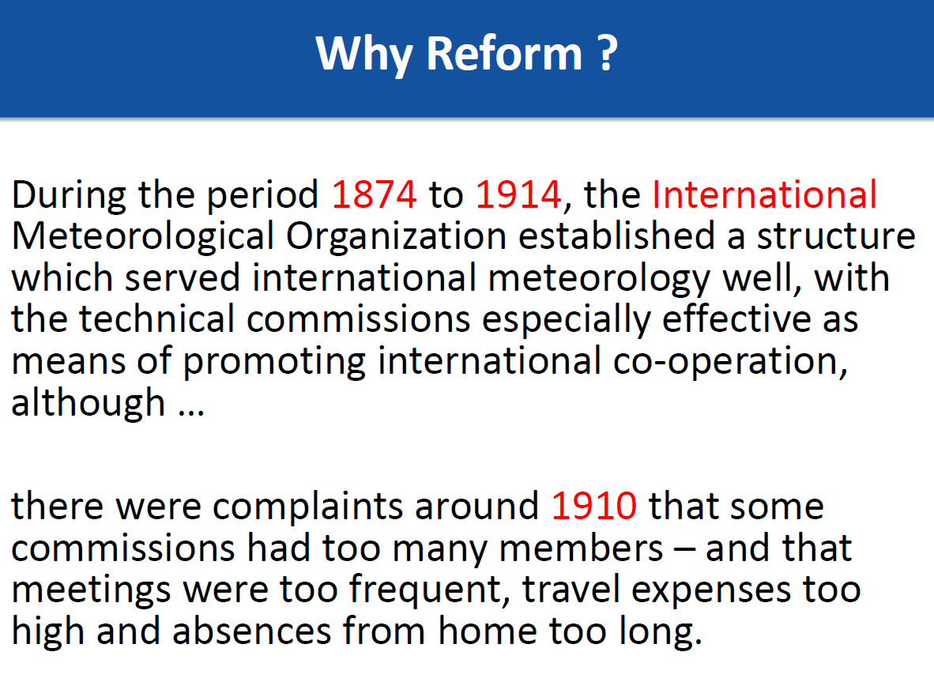

Slide 4
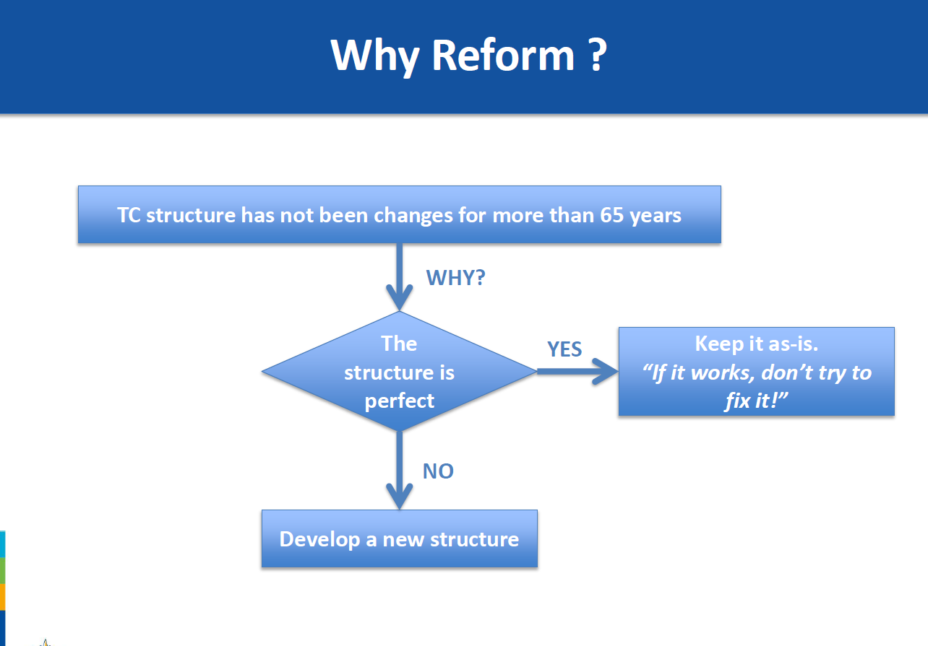

Slide 5
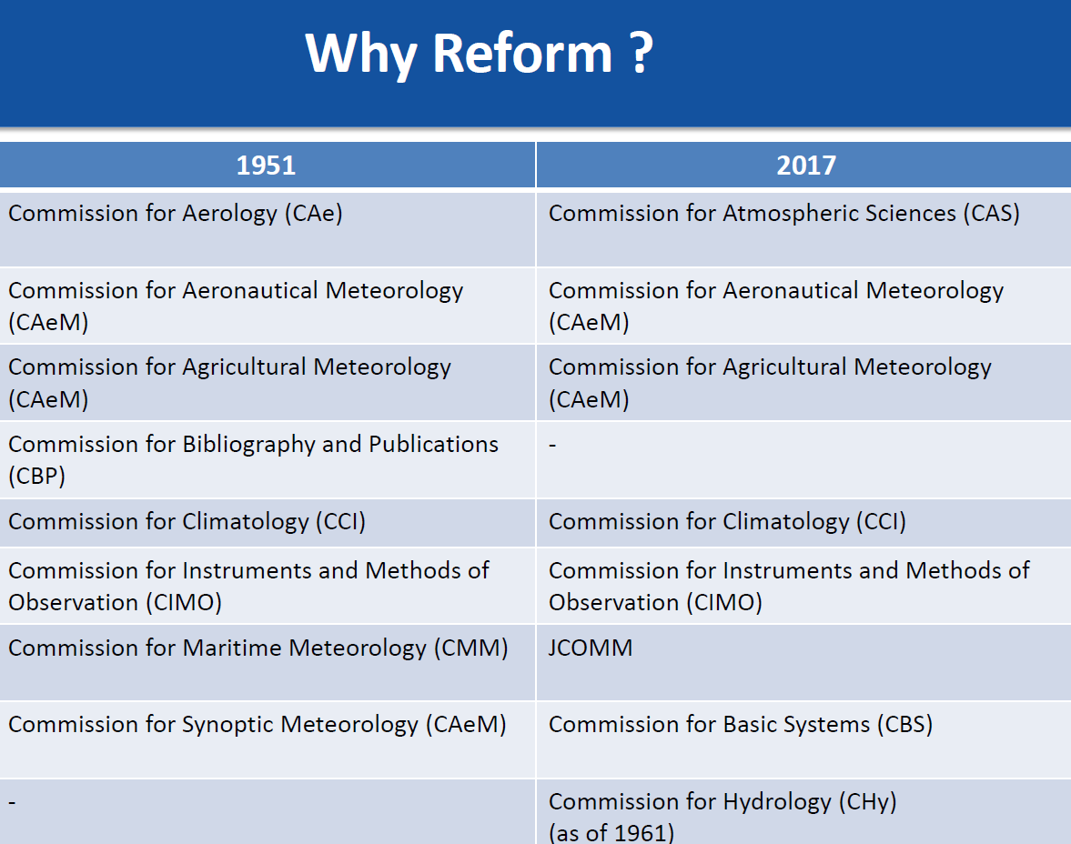

Slide 6
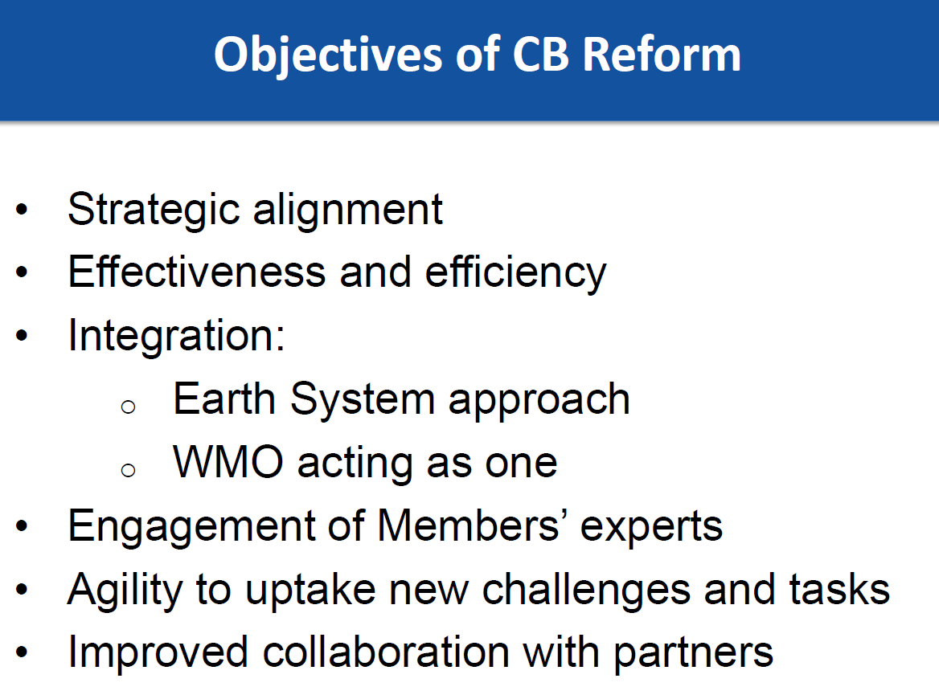

Slide 7
EC 70 (June 2018 ) Recommendation 25
Recalls
  That the Seventeenth Congress (May-June 2015) has requested EC to provide recommendations to the Eighteenth Congress (May –June 2019 ) on constituent body constructs
  Decision 84 (EC-68 June 2016 ) – Governance Review
    To continue to review WMO governance and make further recommendations to the next session of the Council;
    To consider the number and distribution of seats of the Executive Council with the aim of maintaining efficiency and effectiveness;
    To consider also, within the context of the holistic review of the Organization, the effectiveness of the current and possible future composition and structure of the regional associations;
  Decision 68 (EC-69 May 2017 ) WMO Constituent body reform
    to proceed with the development of separate recommendations, for consideration of EC-70 and ultimately the Congress, for restructuring of the Executive Council, the technical commissions and the regional associations with associated terms of references, implementation schedules and other relevant details;

Slide 8
EC 70 Recommendation 25 cont
Recommends
  Draft Resolution XX/1 (Cg-18) – Establishment of WMO technical commissions and other bodies for the nineteenth financial period
Recognizes
  That the Congress had classified the technical commissions into two groups
  Basic commissions dealing with basic operations and facilities, and research in atmospheric sciences,
  Application commissions dealing with applications to economic and social activities,
  That the technical commissions have played a major role in engaging the collective expertise of Members
Decides
  To establish, in accordance with Article 8 (g) of the Convention, the following 2 technical commissions for the nineteenth financial period:
  Commission for Observation, Infrastructure and Information Systems (COIIS), with terms of reference provided in Annex A; and
  Commission for Weather, Climate, Water and Related Environmental Services and Applications (CSA), with terms of reference provided in Annex B;

Slide 9
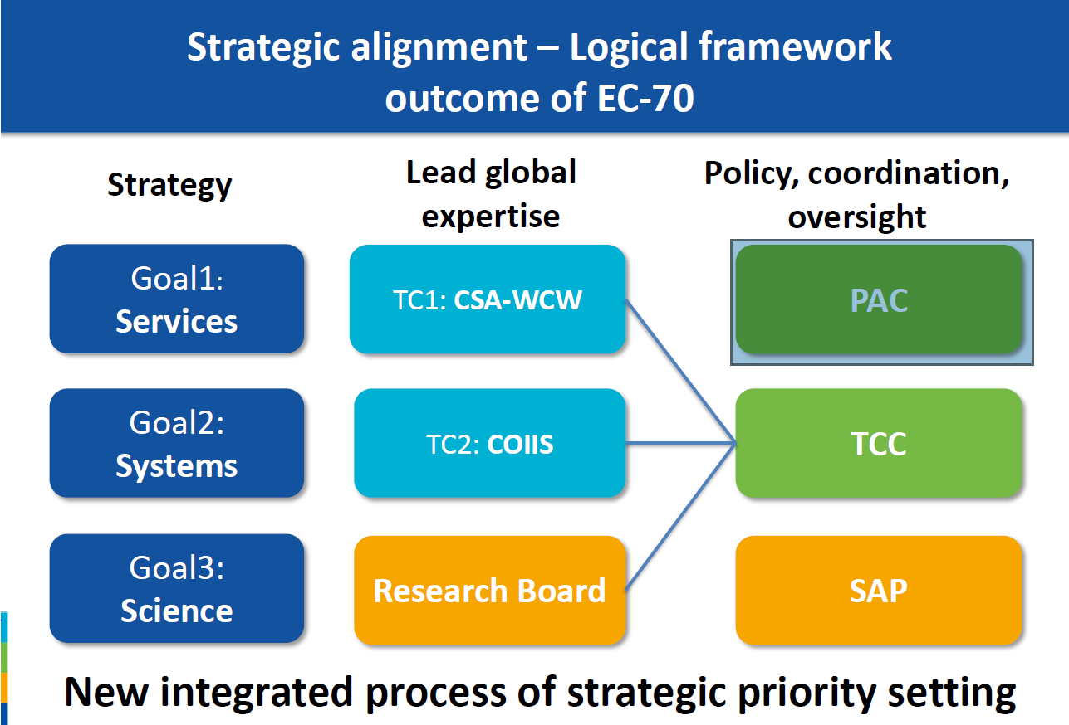

Slide 10








ALIGNMENT OF WMO STRUCTURES
Strategic Plan Long-term Goals | Global Lead/Regional Expertise | Executive Council Policy, Coordination, Integration, Foresight
1
Agile, responsive Secretariat
Services
Services
Commission
Policy Advisory Committee
2
Systems
Infrastructure
Commission
Technical Coordination
Committee
3
Science
Research
Board
Scientific
Advisory Panel
4
Support to Members
Regional
Associations
5
Smart Organization
■ EC-70 Recommendations to Congress
■ Established by EC-70

Slide 11
TECHNICAL COMMISSION STRUCTURES
Management Team
Normative Work
Exploratory Work
Standing Committee
Standing Committee
Standing Committee
Study Group
Study Group
Expert Team
Expert Team
Expert Team
Expert Team
Expert Team
Expert Team
Expert Network

Slide 12



STANDING COMMITTEES
Earth observing systems and measurement networks
Methods of observations, measurements
and instrumentation
Data, products and information exchange
and life cycle management
Data processing for applied Earth system
modelling and prediction
Infrastructure Commission


Slide 13
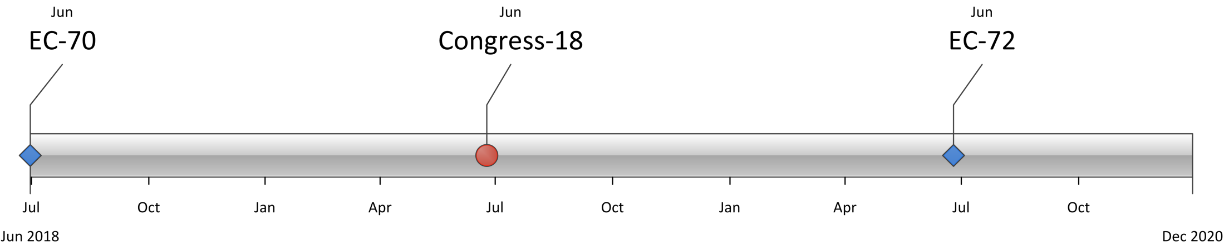
WHAT’S NEXT?
Finalization of proposals, work on details, mapping,
communication, formation of Communities of Practice (CoP)
Establishing of structures, work programmes, preparation of
first session
Kick-off of new TCs
APPROVAL of CBR
2018
2019
2020

Slide 14
Timelines Details
Milestone A: | EC WG-SOP (April 2018)
 | Agree in principle on proposals for restructuring (EC bodies, TCs, Research Board, other bodies reporting to EC and Congress) and submit recommendation for consideration by EC-70;
 | Agree on the need for establishment by the EC of a Constituent Bodies Reform Task Force (CBR-TF);
 | Endorse a draft (outline) of the Transition Plan.
Milestone B: | EC-70 (June 2018)
 | Endorse final draft proposal for WMO Governance Review, including the establishment of technical commissions and Research Board for the next financial period with respective recommendations for consideration of Cg-18;
 | Establish a new EC structure with main bodies: Policy Advisory Committee (PAC), Scientific Advisory Panel (SAP)1 and Technical Coordination Committee(TCC);
 | Endorse the Transition Plan and the Communication Strategy;
 | Decide on any other planning and implementation needs including performance evaluation (of the reform process), etc., identified by EC.
Milestone C: | Cg-18 (June 2019) and EC-71 (June 2019) ← We are here
 | Adopt WMO Strategic Plan and the Operating Plan;
 | Adopt WMO Governance Review document package, including the establishment of new technical commissions and Research Board;
 | Endorse new EC structure (PAC, SAP, TCC) and provide further advice
 | Adopt necessary amendments to the General Regulations;
 | EC-71 to complete the new composition of EC (PAC, SAP, TCC fully established with respective governance and work programmes).
Milestone D: | EC-72 (June 2020)
 | New EC structures (PAC, SAP, TCC) to meet in spring 2020 to elaborate decisions for the EC-72;
 | The new technical commissions and the Research Board report on their major outcome of their first sessions, including fully established new working structure, working programmes and plans with milestones
 | Final Report of CBR-TF on the completion of the transition phase;
 | Plan performance evaluation and follow up.

Slide 15
What does this mean for ET-C TS ?
Function most likely to reside under the COIIS Commission and remain unaltered
OPAG Structures to be reviewed
Commission Presidents structure will all be revised and re elected as 8 commissions are rationalized into
  Commission for Observation, Infrastructure and Information Systems (Infrastructure Commission COIIS)
  Commission for Weather, Climate, Water and Related Environmental Services and Applications (Applications Commission)
  Research Board on Weather, Climate, Water and the Environment
  Joint WMO-IOC Committee for Oceanography and Meteorology (JCOM)
  Scientific Advisory Panel

Slide 16
To disband after transition
Commission for Basic Systems (CBS)
Commission for Instruments and Methods of Observation (CIMO)
Commission for Hydrology (CHy) (pending CHy-Ext recommendations)
Commission for Atmospheric Sciences (CAS)
Commission for Aeronautical Meteorology (CAeM)
Commission for Agricultural Meteorology (CAgM)
Joint WMO-IOC Technical Commission for Oceanography and Marine Meteorology (JCOMM)
Commission for Climatology (CCl)

Slide 17
Thank You
Slides used from:
WMO Constituent Body Reform – Lisk and Brock Nov 2018
WMO Townhall – Tallas December 2018

Slide 18


