Slide 1
WIS center Offenbach
Ilona Glaser
ET-CTS
11.15.2 2019, Buenos Aires

Slide 2
Connectivity
AoR of 29 countries
GISC Offenbach directly connected to all other GISCs
Internet Access 18Gbps via two ISPs and direct peering at DE-CIX Frankfurt
Backup Internet Access 10Gbps in Berlin
RMDCN Connection 50Mbps

Slide 3
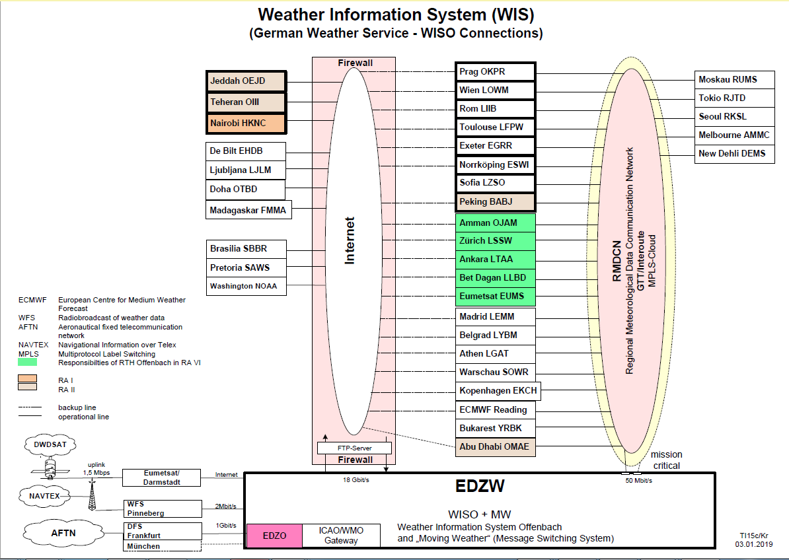

Slide 4
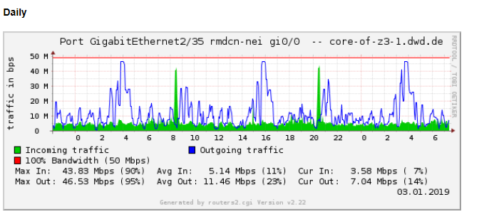

Slide 5
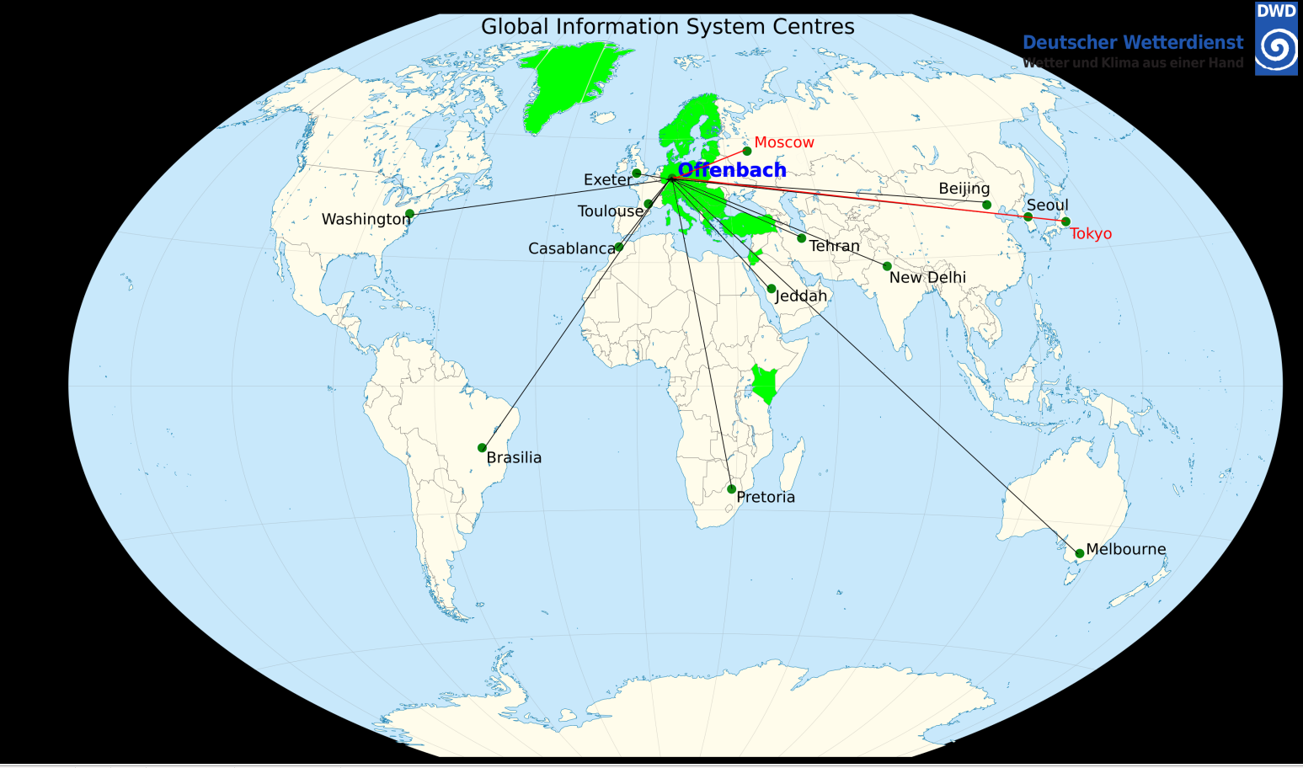

Slide 6
Backup
GISC Tokyo and GISC Moscow
Quarterly Backup Tests
  Very valuable

Slide 7
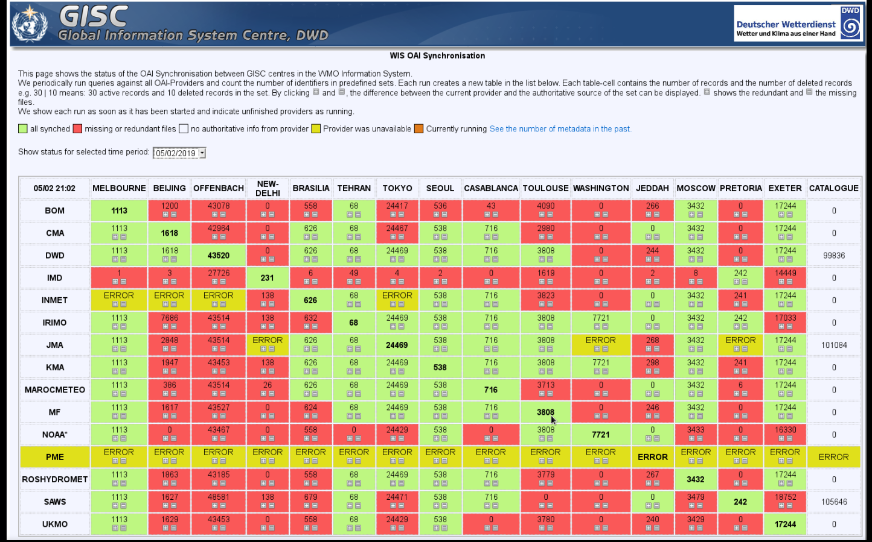
Monitoring

Slide 8
Upcoming
Participation in the AMQP/MQTT pilot

Slide 9
Recommended Text
The awareness of WIS in GISC Offenbach’s Area of Responsibility is good. Workshops to improve the usage of GISC Subscriptions over GTS message switching are planned. GISC Offenbach established direct connections with GISC Washington and GISC Casablanca.

Slide 10

Thank you
Merci

