Slide 1
Toward a new version of the “Guide on IT Security”
Ilona Glaser
4.2
Expert Team on Communication Techniques and Systems
ET-CTS2017
13-17 November 2017, Geneva

Slide 2
Current situation
WMO document 1115 is official but
  Open points from last ET-CTS meeting:
    Not all comments have been included, postponed to next revision
    Document to be read in the third person
    Review should keep in line with the evolving WIS
  Plan for a “major” review instead of iteration patches
  Aim at having the new version by the end of 2019 for endorsement by constituent bodies in their 2020 session

Slide 3
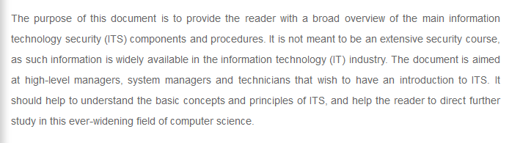
Aim of Document

Slide 4
Assumptions
Document should
  Provide valuable guidance to all WIS centers (good business practice)
  Provide a definition of IT security
  Mention/cover all areas of IT security
  Outline minimum requirements (must be implemented)
  Be modular (maybe not all sections will be required)
  Be a self-contained guide refering to external material when useful
  Be strongly aligned with the new WIS part C document

Slide 5
Suggestion: new structure
Executive Summary
Definitions of IT Security
Motivation
  Threats
  Impact analysis
  Chapter 3 and 4 of the old 1115
Organizational Aspects / Procedures
  Training
  Cyber security maturity model
  Chapter 5 and 6 of the old 1115
Technical Aspects
  Infrastructure
  Networks
  IT Systems
  Applications
  Cloud Services

Slide 6

Thank you
Merci

